Slide 1


AI-POWERED COMPANY-SPECIFIC INTERVIEW & ASSESSMENT
Simulator
BATCH NUMBER : 11
J. KISHORE NANDHAN (22761A0588)
SD. YASEEN ALI (22761A05B4)
M. SREENIVASULU REDDY (22761A0598)
PROJECT GUIDE
MS. T. VINEETHA
ASSISTANT PROFESSOR

Slide 2


Table of Contents
Abstract
1
Introduction
2
Literature Survey
3
Existing Systems
4
Proposed Solution
5
Features
6
Architecture
7

Slide 3
Abstract
Traditional recruitment methods face challenges like subjectivity, time constraints, and limited scalability. To address these, we propose a Company-Specific AI Assessment Simulator that integrates NLP, speech analysis and coding evaluation for unbiased, scalable candidate assessment. It supports coding challenges, MCQs, and skill tests through listening and speaking rounds. The system analyzes responses for grammar, fluency, pronunciation and reasoning while ensuring authenticity with AI-based proctoring. It also provides profile-based tracking, multilingual support, and exportable reports (PDF/Word), thereby enhancing recruitment efficiency, ensuring fairness, and offering candidates personalized feedback for improvement.

Slide 4
Introduction
Recruitment is evolving with AI and automation.
Companies need efficient, unbiased, and scalable assessments.
Our project bridges the gap using AI-driven analytics.
Candidates need personalized feedback to improve skills.

Slide 5
Literature Survey
S.No | Title Of Paper | Author Name | Journal Name | Year of Publications | Description | Limitations
1 | AI-Powered Interview Assistant Chatbot | Ayush Singh, Gaurav Gaikwad, Rahul Ranjavan | International Journal of Scientific Research and Engineering Development (IJSRED) | May–June 2025 | Presents an AI tool combining resume analysis, HR simulation, and technical Q&A. Uses NLP, speech recognition, and emotion detection to evaluate candidates and generate performance reports. | Too focused on resume parsing No coding/aptitude tests Lacks proctoring & multilingual support Acts as a prep tool, not a full simulator
2 | AI-Powered Interview Preparation System: Integrating Resume Analysis, HR Simulation, and Technical Skill Assessment | Harsh Koshti, Prathamesh Gosavi, Roshan Pagar, Prathamesh Khairnar, Sopan Talekar | Journal of Engineering Research and Reports | 2025 | Introduces a chatbot for mock interviews using voice-to-text, text-to-speech, and NLP. Evaluates grammar, keywords, and sentiment, offering basic feedback across different job domains. | No coding/aptitude assessments No proctoring Feedback is basic (not detailed reports) Only chatbot-based

Slide 6
S.No | Title Of Paper | Author Name | Journal Name | Year of Publications | Description | Limitations
3 | AI-enhanced interview simulation in the metaverse: Transforming professional skills training through VR and generative conversational AI | Abdullah Bin Nofal, Hassan Ali, Muhammad Hadi, and Team | Computers and Education: Artificial Intelligence (Elsevier) | 2025 (Available online Dec 2024) | Uses Generative AI (ChatGPT, Dolly v2, Flan-T5) for dynamic questions & feedback. Includes speech-to-text (Whisper), text-to-speech (Wit.AI), automated scoring (RoBERTa), bias analysis, and tested with 83 students. | • Requires VR setup, less feasible for recruiters • Limited coverage of coding/aptitude/gamified tests • Small sample (83 students) • Bias risks (5–10% variation by background) • No PDF/Word report export • Focused on training, not enterprise recruitment
4 | Empowering Interview Success: An AI-Driven Approach | Dr. Suvarna Pawar, Gaurav Misal, Vedant Sanap, Vaibhav Nanaware, Nikhil Berwal | International Journal of Creative Research Thoughts (IJCRT) | 2024 | AI-powered web app for interview preparation and assessment. Uses NLP & BERT for question generation and answer evaluation. Includes voice interaction, 3D avatar engagement, proctoring, and personalized feedback. | • General prep tool, not company-specific • No coding evaluation • 3D/VR may not scale for enterprises • Basic proctoring only • No report export (PDF/Word) or enterprise integration

Slide 7
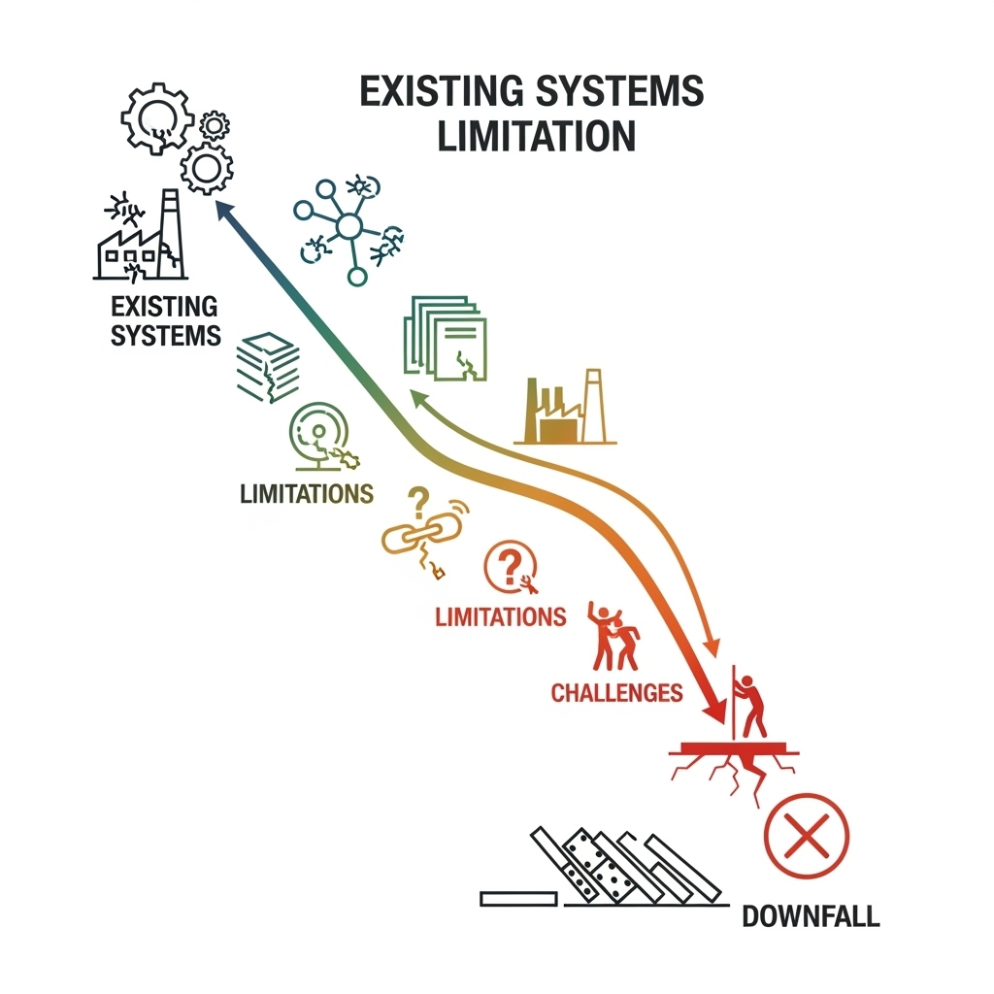
Existing Systems
Manual HR Interviews
→ Biased, inconsistent, subjective.
Online Tests & MCQs
→ Focus only on technical/aptitude, miss
communication skills.
Video Conferencing
→ Time-intensive, costly, not scalable.
General Issues
→ Limited scalability, no personalized
feedback.

Slide 8
Proposed Solution
1. AI-driven and Adaptive Platform
Our system leverages Artificial Intelligence to evaluate multiple skills – communication, coding,
problem-solving, and reasoning – ensuring deeper insights compared to traditional methods.
2. Addressing Limitations of Existing Systems
Unlike current platforms that are either manual or narrowly focused, this solution provides
automation, multi-skill coverage, and personalized analysis, reducing bias and saving evaluation
time.
3. Fair, Scalable, and Holistic Evaluation
The system ensures authenticity through AI-based proctoring, scalability for large candidate
pools, and fairness by relying on standardized AI metrics rather than subjective judgments.
4. Dual-Mode Functionality: Practice & Exam
It supports a flexible environment where candidates can use AI hints and review tools in practice
mode, while strict evaluation is maintained during official exams through admin-controlled features.

Slide 9

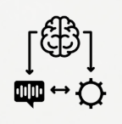




Features
Grammar & communication scoring with transformers.
Fluency & pronunciation via ASR, phoneme checks, WER/PER.
Multi-language coding, adaptive test cases, optional AI hints.
MCQ error analysis with weakness review in practice mode.
Admin-controlled proctoring:
Light / Strict / Off.
Exportable Reports (PDF/Word) with candidate insights.

Slide 10
Architecture
Candidate Profile in User Interface
Choosing Topic from the various courses
AI Mock Monitoring
Speech and Text Module
AI Engine
NLP Preprocessing Module
AI Model Evaluation (Analyzing Answers, Speech and Code Evaluation)
Scoring & Feedback (Final Score, Detailed Insights and Recommendations)

Slide 11
Thank You

