Slide 1
DocuMind
AI-Powered Document Intelligence Platform using RAG Architecture
Nilofar Sayyad (MCA II)
Pirens IBMA, Loni

Slide 2
The Challenge
Information Overload
Managing thousands of documents manually is impossible and prone to error.
Slow Retrieval
Finding specific information in deeply nested PDFs takes hours of manual searching.
Context Blindness
Traditional search fails to understand the actual meaning and context of queries.

Slide 3
The Solution: DocuMind
Leveraging Retrieval-Augmented Generation (RAG) to bridge the gap between static documents and AI.
Step 1: Ingestion
Smart processing of PDFs and text files.
Step 2: Vectorization
Encoding content into mathematical representations.
Step 3: Retrieval
Context-aware search using pgvector.
Step 4: Generation
Ultra-fast response generation via Groq Llama 3.

Slide 4
RAG 101: Core Concepts
1. Chunks
Breaking long documents into small, manageable pieces for the AI.
2. Embeddings
Converting text into numerical vectors that represent concepts and meaning.
3. Retrieval
Finding the exact chunks needed to answer a specific query.
4. Augmentation
Giving the AI factual 'Notes' so it doesn't have to hallucinate.

Slide 5
Project Scope
Target Audience
Researchers, Academics, Legal Compliance Teams, and Corporate Knowledge Labs.
Semantic Intelligence
Moving beyond keyword search to deep conceptual understanding of documents.
Scalability
Architected to handle massive PDF libraries with near-instant retrieval speed.

Slide 6
Real-World Industry Applications
Legal Tech
Automated contract auditing and fast retrieval of legal precedents.
Healthcare
Scanning medical journals and patient records for fast diagnosis assistance.
Corporate HR
Answering employee policy questions based on company handbooks.
Academic Research
Analyzing thousands of research papers for literature reviews.

Slide 7
System Architecture
Frontend Layer
React Client (Vite + Tailwind) for a responsive UI.
API Layer
FastAPI Asynchronous Gateway for high-concurrency routing.
Logic Layer
Celery & Redis for reliable background task processing.
Storage Layer
PostgreSQL 16 + pgvector for high-speed similarity search.
AI Layer
Groq LPU hardware for real-time Llama 3 inference.

Slide 8
Technical Stack
• Python 3.12: Core Backend Engine
• PostgreSQL 16: Robust Database with pgvector extension
• Docker: Containerized Service Orchestration
• React.js: Premium Interactive Frontend
• Groq API: Ultra-fast AI inference engine for source code analysis
• HuggingFace: MiniLM-L6 embeddings
• Redis: High-speed Message Broker
• Prometheus: Real-time System Monitoring

Slide 9
Platform Capabilities
Universal Code Intelligence
Native support for C, C++, Java, Python, JS, & more.
Unified Viewer
Preview PDFs, text, and code with live syntax highlighting.
Semantic Citations
Every answer is backed by direct quotes and page references.
Vectorized Search
Meaning-based retrieval beyond simple keywords.
Async OCR
Handles batches of complex documents in the background.
Modern Security
Built-in rate limiting and protected API endpoints.

Slide 10
User Management Module
Secure Authentication
JWT-based sessions with password hashing (BCrypt).
Ownership Isolation
Secure multi-tenancy where users only access their own data.
Member Profiles
Personalized settings, theme management, and account dashboard.
Role-Based Flow
Structured interactions for different user tiers (Member/Admin).

Slide 11
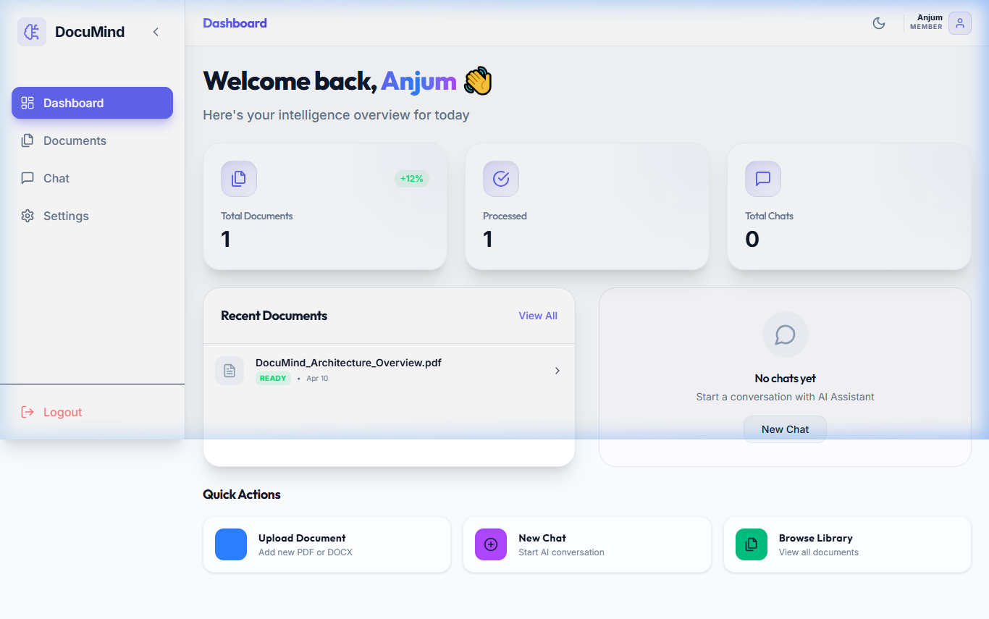
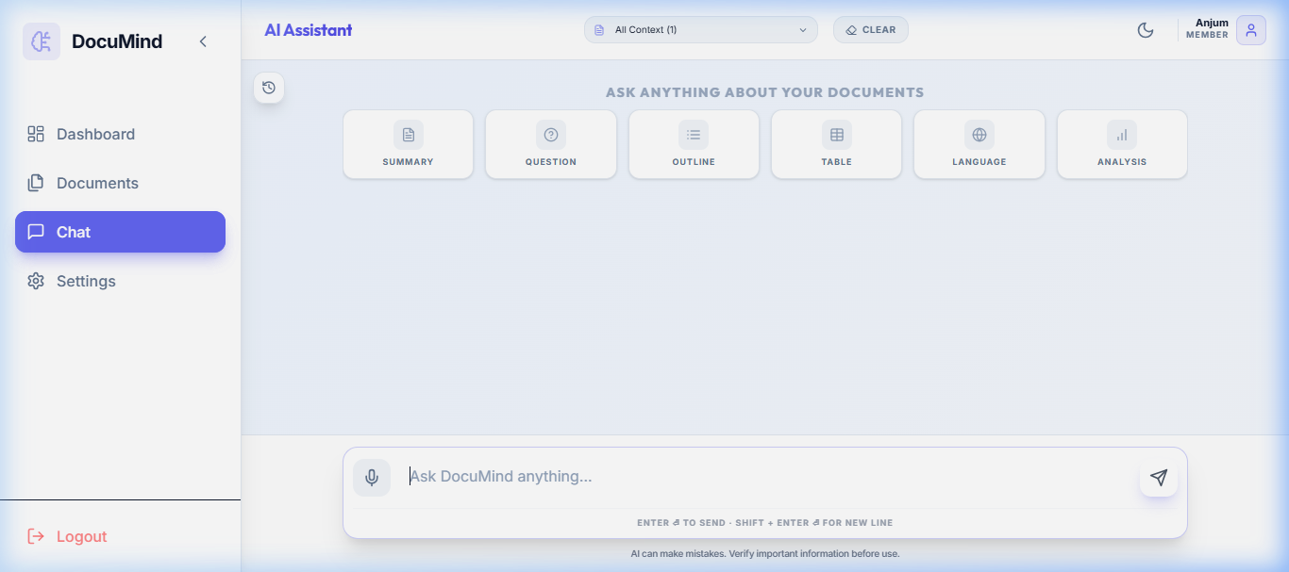
Project Walkthrough

Slide 12
Future Roadmap
Phase 1: Core RAG
Database integration and async pipeline (Completed).
Phase 2: Advanced Intelligence
Multi-modal OCR support and vision-based interpretation.
Phase 3: Enterprise Auth
Fine-grained ACL and role-based access control.
Phase 4: Collaboration
Shared vector spaces and organization-level document pools.

Slide 13
Roadmap: Technical Implementation
🖼️ Multi-modal OCR
Using Tesseract/EasyOCR for scanning and Llama 3.2 Vision for diagrams.
🔐 Advanced Auth
Expanding our JWT foundation to include OAuth2 and Multi-Factor Auth (MFA).
👥 Team Collaboration
Implementing Organisation-level Document Pools and Shared Vector Indexes.
🚀 Scalability
Shifting to dedicated vector engines like Pinecone for billion-scale document handling.

Slide 14
Conclusion & Impact
Technical Achievement
Distributed RAG pipeline with sub-second retrieval and generation.
Practical Utility
Reduces document research time by up to 90%.
Platform Stability
Scalable containerized architecture ready for production.

Slide 15
Thank You!
Any Questions?
DocuMind Project 2026
Presented to Science & Tech Seminar

