Slide 1

INTERACTIVE PRICE SEGMENTATION
ON JEWELLERY DATA

Slide 2
Agenda:
Problem Statement
Data Extraction/Collection
Data Cleaning
Data Analysis and Data Visualization
Conclusion

Slide 3
PROBLEM STATEMENT:
To analyze how changes in jewellery attributes such as material, design/model, plating, and brand influence the final price of neck jewellery. The objective is to identify which features have the most impact on pricing and use this insight to create a segmented pricing strategy

Slide 4
Libraries Required For Cleaning / Extraction
Requests :
The Purpose of Using REQUESTS Library in Python is to send HTTP/HTTPS requests and interact with web resources (APIs, websites, servers).
BeautifulSoup:
BeautifulSoup helps you extract specific content from it — like product names, prices, reviews, etc
RegEX:
Regex is used to search, match, extract, and clean patterns in text — especially useful when the text is unstructured or inconsistent.

Slide 5
HOW WE GET THE DATA: Data Collection or Extraction:
We collected this data from Flipkart, one of India’s leading e-commerce platforms.
The data includes various jewellery products with details such as material, plating, brand, gender, discount, and target price.
It was gathered to analyze product insights, pricing strategies, and customer preferences in the online jewellery market.
https://www.flipkart.com/search?q=chains&otracker=search&otracker1=search&marketplace=FLIPKART&as-show=onff

Slide 6
Problems Faced While Collecting The Data
This project includes web scrapping so I have to gather data from external resources
So for this I had choosed a e-commerce platform which is FLIPKART
So then I deceided to collect the data related to neck jewellery
I had extracted the columns like price,discount easily
But the problem is raised when,
Product names in raw data were unstructured and inconsistent, making it challenging to extract key attributes like plating, Material, design, and type

Slide 7
Problems Faced while Collecting
“one gram gold plated imported round type design” so by this line I have to extract five columns but there is no delimeters so it became difficult for me to extract
So I had used RegEX for splitting the data without considering the delimeters

Slide 8
Data Cleaning
After Data Extraction we didn’t find the proper data
So we have to clean that data properly
Our data set containing 400x8 , 400 rows and 8 columns
Firstly There is no NAN values in my dataset Because , while splitting the whole text “one gram gold plated imported round type design”
I had find some data is missing so while collecting only I have to replace the missing data with NAN
But it is not possible because in cleaning part if I want to replace the NAN values for one particular column then remaining columns get disturbing

Slide 9
Data Cleaning
Because we extracted all this columns from single text
So instead of replacing the missing values with NAN at the time of collection
I had replaced with empty string “”
So in cleaning part it becomes easy to replace that empty string with mode because the columns are categorical,then remaining columns will not get disturb
For removing Delimeters like ‘ , ’ we used string methods like split and replace

Slide 10
Data Cleaning
For removing the repeated words side by side “brass,brass”
For total cleaning part we had used string methods

Slide 11
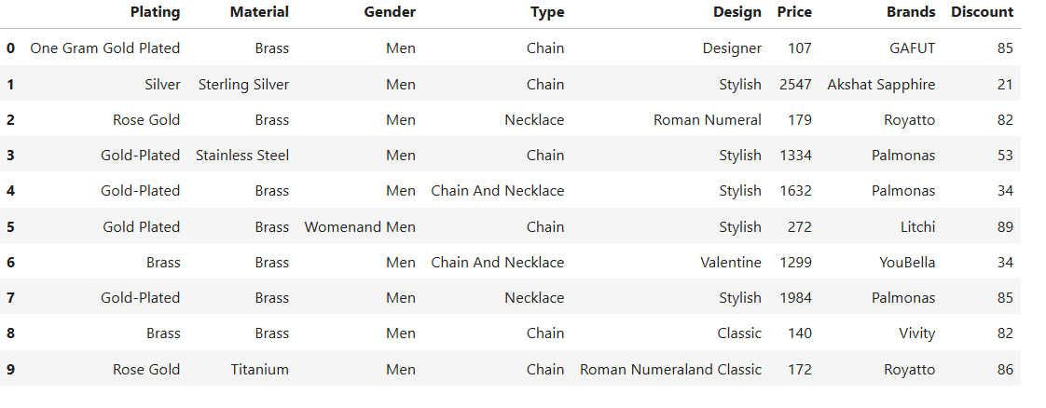
DATASET:

Slide 12
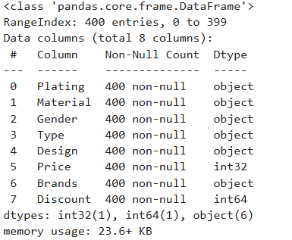

Slide 13
Data Analysis and Data Visualization:
Tool required for Visualization is :
Power BI

Slide 14
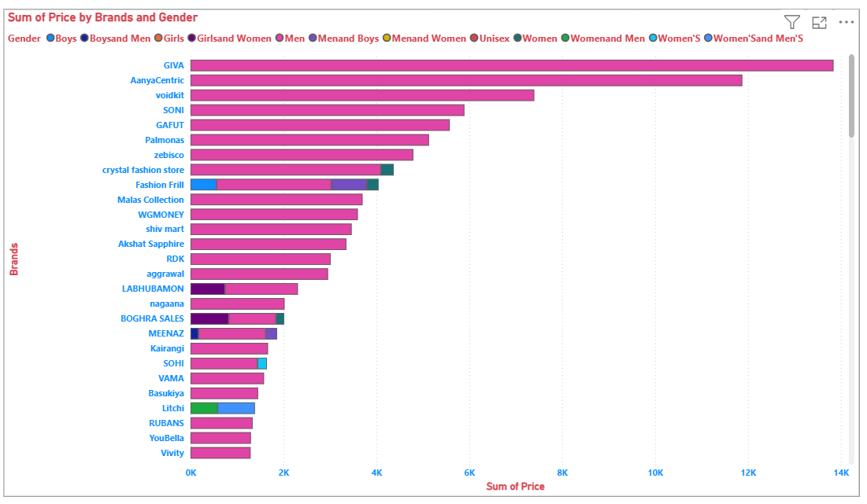
Sum of Price by Brands and Gender:
This Bar chart shows how much money each jewelry brand makes based on product prices for different genders.
GIVA and AanyaCentric have the highest total prices.
Most products are made for women, shown by the pink bars.
A few brands also make jewelry for men, boys, or unisex, but not as much.
Some smaller brands like YouBella and Vivity have lower total prices.
It helps us see which brands are selling the most and who their products are meant for.

Slide 15
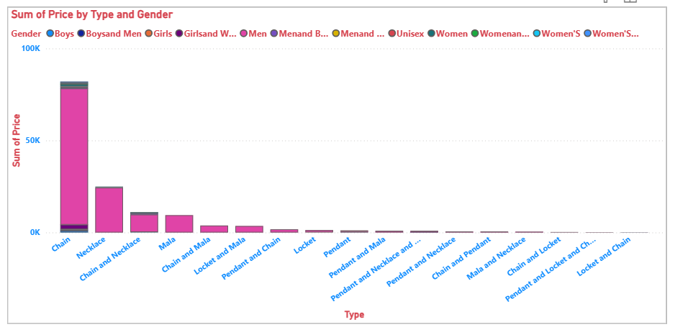
Sum of Price by Type and Gender:
This is a stacked bar chart (horizontal), where:
The X-axis (horizontal) represents different jewelry types.
The Y-axis (vertical) shows the sum of prices.
The bars are stacked by gender, meaning each color segment within a bar shows how much that jewelry type contributes to a specific gender category.
This type of chart helps compare total values across categories (types of jewelry) while also showing the composition by another variable (gender).

Slide 16
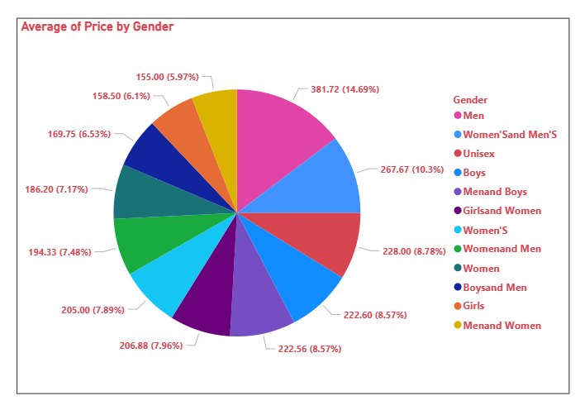
Average of Price by Gender:
A pie chart is used to show how different parts (categories) contribute to a whole, usually as percentages.
In this case:
Each slice represents a gender category.
The size of the slice shows the average price for that category relative to the others.
It’s helpful for comparing proportions visually across multiple gender groups.

Slide 17
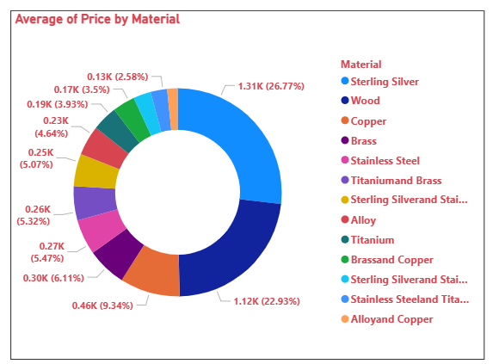
Average of Price by Material:
This is a donut chart (a variation of a pie chart) that shows the average price of jewelry based on material.
Sterling Silver has the highest average price at 1.31K (26.77%), followed by Wood at 1.12K (22.93%).
Other materials like Copper, Brass, and Stainless Steel have moderate average prices.
Materials like Alloy and Copper, Titanium, and Titanium and Brass have relatively lower average prices.
This chart helps us understand which materials generally cost more and are likely used in premium products.

Slide 18
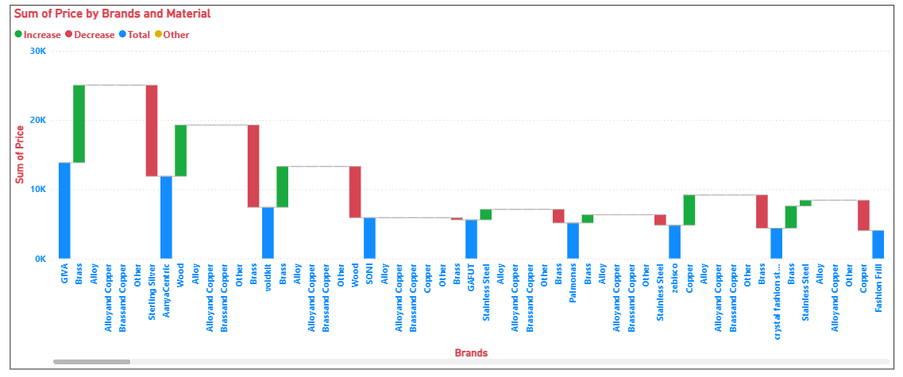
Sum of Price by Brands and Material:
This is a Waterfall Chart showing the sum of prices by brands and material.
It helps track how each material (like Brass, Alloy, Copper, etc.) affects the total price for each brand.
Green bars show an increase in price due to a material.
Red bars show a decrease in price.
Blue bars represent the total price for each brand.
Brands like GIVA and AanyaCentric have high total prices, while materials like Sterling Silver and Wood contribute significantly.
This chart helps compare how different materials impact the pricing of each brand.

Slide 19
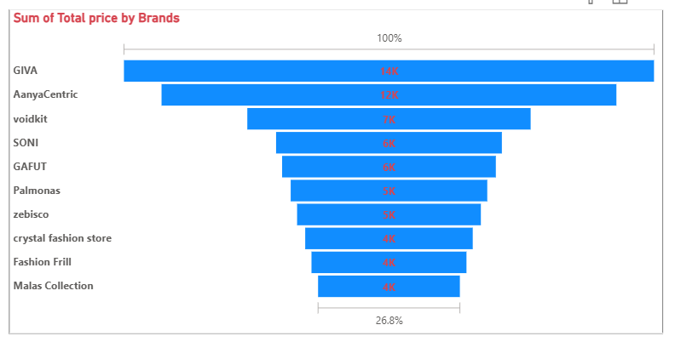
Sum of Total Price by Brands: Top 10 Brands based on Price:
This is a funnel chart specifically showing the top 10 brands based on their sum of total price.
Here's a simpler way to understand it, focusing on the "top 10" aspect:
The chart only includes the 10 brands that have the highest total prices. Other brands with lower total prices are not shown here.
The order of the brands matters. The brand with the absolute highest total price (GIVA) is at the very top, followed by the brand with the second-highest (AanyaCentric), and so on, down to the tenth-highest (Malas Collection).
The length of the blue bars directly compares the total prices of these top 10 brands. The longer the bar, the higher the total price for that brand within this top group.
So, this chart gives you a clear visual ranking of the top 10 brands by how much their total prices add up to, with GIVA being the leader among them.

Slide 20
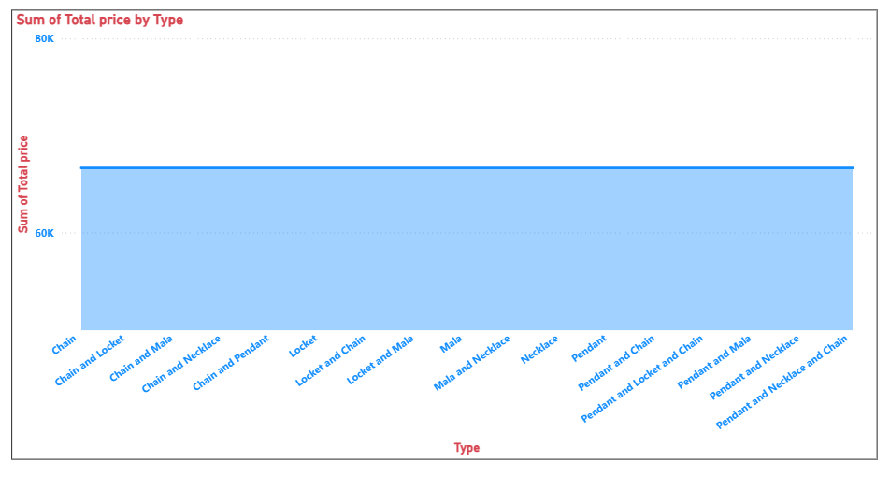
Sum of Total Price by Type:
This chart is a Stacked Area chart showing the sum of the total price for different jewelry types.
Here's a brief explanation:
The different types of jewelry (Chain, Chain and Locket, Chain and Mala, etc.) are listed along the bottom (horizontal axis).
The vertical bar represents the total price for each jewelry type.
In this specific chart, all the bars are the same height. This indicates that the sum of the total price is the same for every single jewelry type shown.
The label on the left (vertical axis) shows the scale for the total price, going up to 80K. The top of each bar aligns with the same value on this scale.
Essentially, this chart tells us that across all the different jewelry types presented, the total amount of money spent on each category is equal.

Slide 21
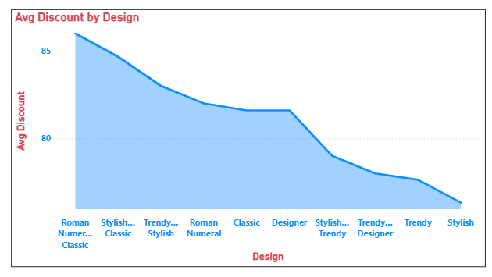
Average Discount by Design:
This Area chart shows how the average discount changes for different jewelry styles.
The highest point on the slide (at the left) shows the style with the biggest average discount.
As the slide goes down towards the right, it means the average discount gets smaller for the different styles.
So, it's a quick way to see which jewelry styles tend to have bigger discounts on average and which ones have smaller discounts. The first few styles on the left have the biggest discounts, and the styles on the right have the smallest.

Slide 22
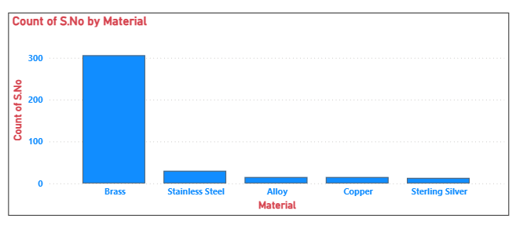
Count of S.No by Material:
This Bar chart shows the number of items for each material.
The tallest bar (for Brass) means there are a lot more items made of Brass than anything else.
The shorter bars for other materials (like Stainless Steel) mean there are fewer items made of those.
So, it's a quick way to see which material is used the most to make these items – and it's clearly Brass!

Slide 23
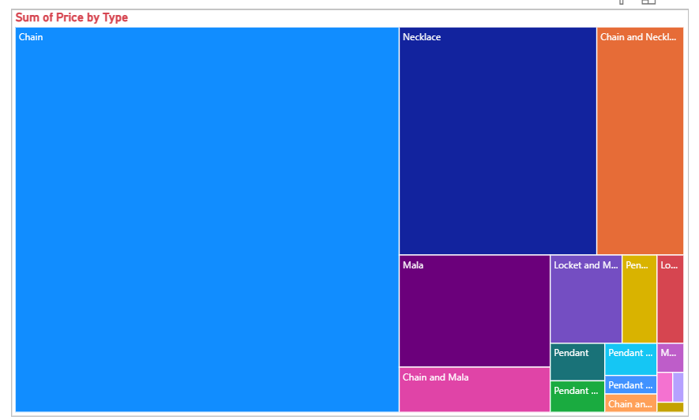
Sum of Price by Type:
This chart is a tree map, visualizing the sum of the price by different jewelry types.
Imagine a bunch of boxes, each representing a type of jewelry.
The bigger the box, the more money people spent on that type of jewelry.
The biggest box here is for "Chain", so that's the type people spent the most money on.
The smaller boxes show the types of jewelry that people spent less money on.
It's like a visual way to see which jewelry types are the most popular in terms of total money spent.

Slide 24
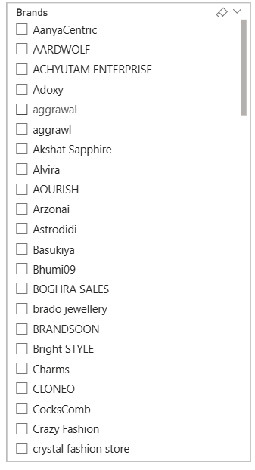
Slicer chart with Brands:
This looks like a filter menu for "Brands" in a software
application, likely for data analysis or visualization.
Here's a brief explanation:
"Brands" at the top indicates that this menu allows you to filter data
based on different brand names.
Each line with a checkbox represents a unique brand
(e.g., AanyaCentric, AARDWOLF, ACHYUTAM ENTERPRISE, etc.).
The checkboxes allow you to select or deselect specific brands.
If a box is checked, it means the data associated with that
brand will be included or shown.
If a box is unchecked, the data for that brand will be excluded or hidden.
The scrollbar on the right suggests that there are more brands
available than what is currently visible in the menu.
The small icons at the top right likely provide options for selecting all
brands, deselecting all brands, or possibly searching for specific brands.
.

Slide 25
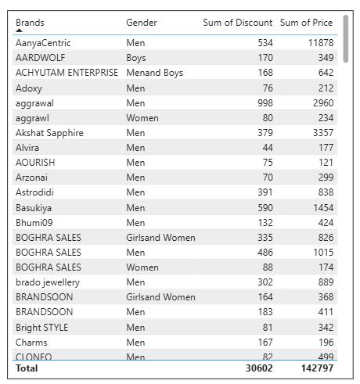
Table Chart:
This table Chart tells you:
Which shops are on the list.
Who buys from them (men, women, boys, etc.).
The total money saved by customers at each shop for each group (Sum of Discount).
The total money spent at each shop by each group (Sum of Price).
The very last line shows the grand total savings and spending across all shops and everyone.
So, it's a quick look at how much discount was given and how much money was made by each shop, broken down by who their customers are.

Slide 26
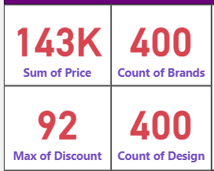
Cards:
The total sales value is 143,000.
There are 400 different brands you're dealing with.
The biggest discount offered was 92.
There are 400 different designs of products.

Slide 27
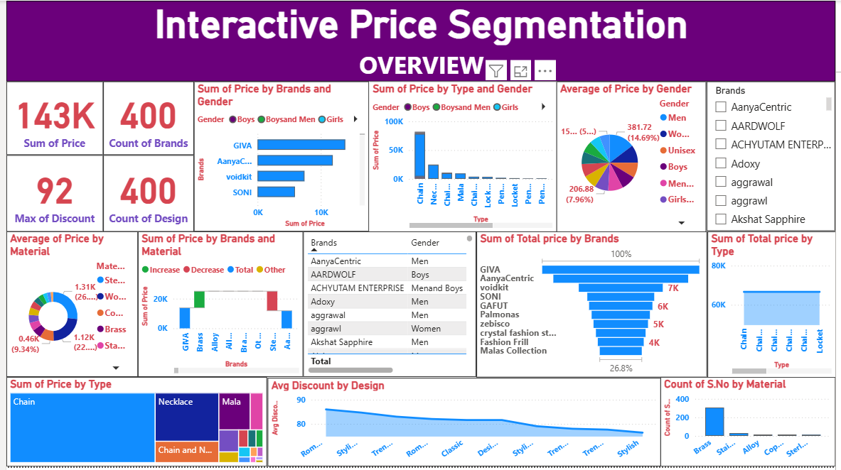
Dashboard:

Slide 28
Observation:
Based on this dashboard, here are some simple observations:
GIVA (for Men) is a big seller: They bring in the most money overall.
Chains are popular: The total sales for chains are very high.
Men are a key customer group: They seem to be a significant portion of the sales.
Brass is used a lot: There are many items made of brass.
Discounts vary by design: Some jewelry styles get bigger discounts than others.
There are many different options: Lots of brands and designs are available.
Basically, this dashboard quickly shows what's selling well, who's buying, and some key details about pricing and product variety.

Slide 29
Conclusion:
This jewellery dataset helped us understand how product features like material, plating, and type affect the price. We analyzed how price varies based on features like material, plating, and jewellery type. Gold-plated and imported items were generally higher priced, while oxidized or antique styles were lower priced. This helps in segmenting products by price and supports smarter pricing and recommendation strategies..

Slide 30

THANK YOU

