Slide 1
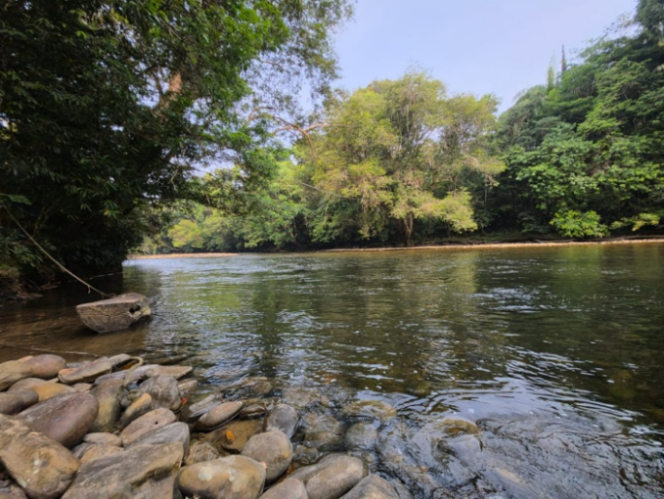

LONG TAA BORNEO ECO STAY
Six hours from Miri.
A world away from the ordinary.
A mobile-first digital journey for a living Sebup village, not a luxury resort.
3-MINUTE PITCH | AI BUSINESS DESIGN HACKATHON 2026
Escape the city. Experience the real Borneo.

Slide 2
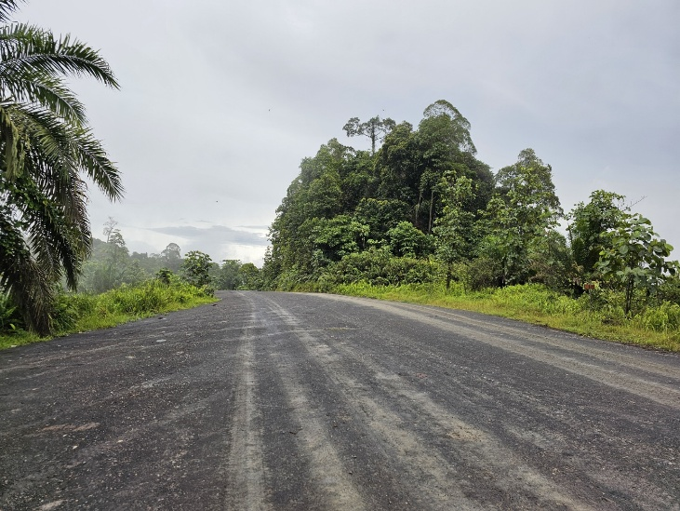
THE BENEFICIARY CHALLENGE
A powerful experience should not require detective work.
Long Taa has a distinctive community-led offer. But for a traveller planning from Miri, essential answers were fragmented across brochures and social channels.
What is Long Taa?
A living Sebup village, not a resort.
What does the journey involve?
About six hours by 4WD from Miri.
What can I expect?
Simple stay, clear costs, conditions and capacity.
How do I book?
A qualified WhatsApp enquiry, not a false instant promise.
Remoteness makes honest, practical planning content part of the experience.

Slide 3
THE SOLUTION
Turn scattered information into one clear visitor journey.
We built a mobile-first five-page website that moves visitors from discovery to a more informed booking conversation.
01
02
03
04
05
DISCOVER
UNDERSTAND
EXPLORE
TRUST
ACT
Home
Stay & Packages
Explore Long Taa
Living Heritage
Plan & Book
Authentic story + the journey inward
Options, inclusions, costs and capacity
River, rainforest and natural wonders
Respectful community and conservation context
Practical guidance + WhatsApp enquiry
Designed for mobile first, then enhanced for larger screens.

Slide 4
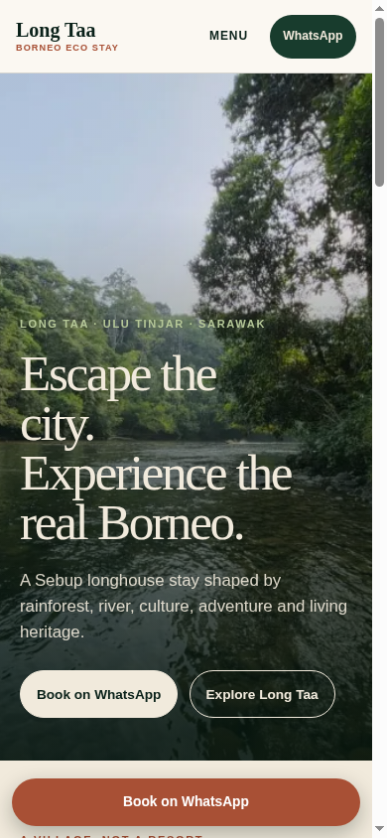
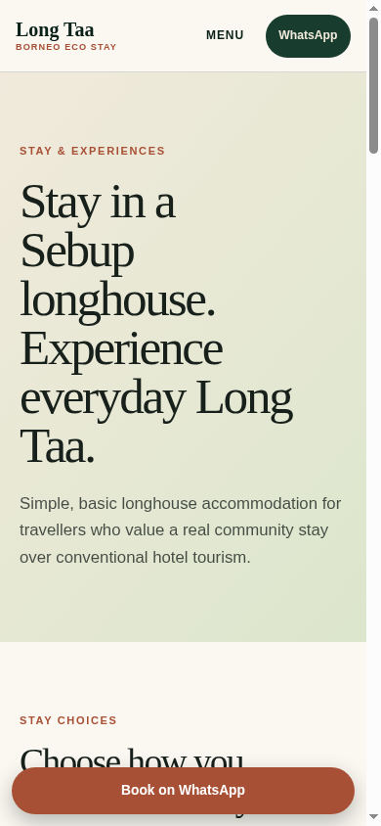
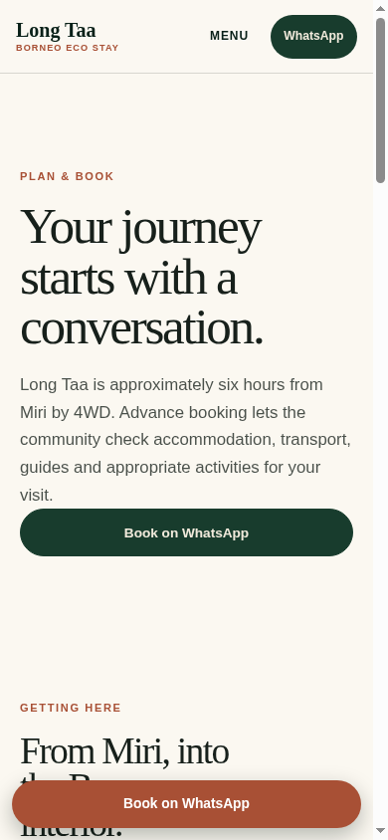
WORKING DEMO
The website makes the next decision obvious.
Designed at phone scale, the live experience replaces vague inspiration with the facts that help a visitor decide whether Long Taa is right for them.
DISCOVER
UNDERSTAND
ACT
Authentic story + a visible WhatsApp CTA
Simple longhouse stay and confirmed rates
Six-hour journey context + qualified enquiry
Mobile screenshots from the final local build. Demo fallback: the deck retains the same conversion path if connectivity is unreliable.

Slide 5
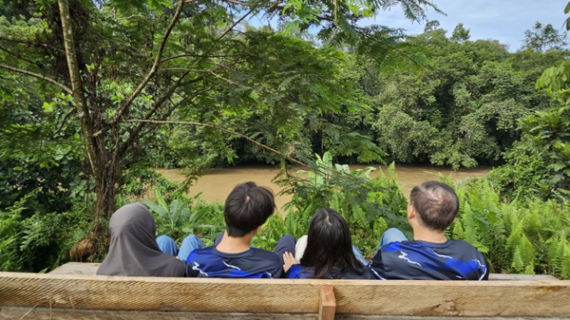
WHAT CHANGES FOR THE VISITOR
Clarity is the conversion strategy.
DISCOVERY
A shareable, credible digital home for a distinctive destination.
EXPECTATIONS
Honest accommodation, journey, capacity and condition information.
ENQUIRIES
A structured WhatsApp prompt that starts with useful details.
TRUST
Community-led conservation and living heritage framed with care.
No invented availability.
No invented package totals.
Every enquiry remains an availability check.

Slide 6
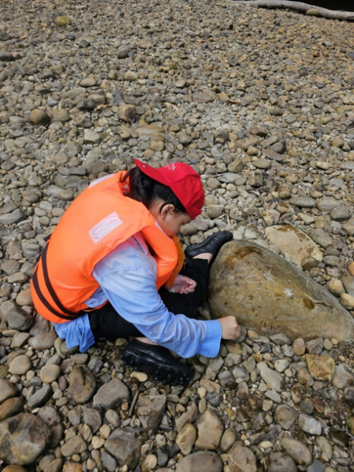
COMMUNITY IMPACT AND PROOF
The story starts with community ownership.
Long Taa is a living Sebup village. The digital experience is designed to set respectful expectations before people arrive, while making community-led conservation visible.
LIVING HERITAGE
CONSERVATION
RESPONSIBLE VISITS
Culture is presented as living identity, not tourist decoration.
Tagang fish conservation and community stewardship are given context.
Community rules, local guidance and conditions stay visible.
Attribution: The Borneo Post (1 Sep 2026) reported the Sebup community received the Gamuda Inspiration Award for Environment and Wildlife. The APPGM-SDG Annual Report 2024 separately records Tagang implementation support in Dapui, Tinjar Baram.

Slide 7
DELIVERY AND CLOSE
Protect nature. Respect culture. Share our heritage.
Long Taa now has a clearer mobile-first path from curiosity to a qualified booking enquiry: authentic imagery, practical planning and a direct WhatsApp conversation with Clement Langet.
LIVE SITE longtaaborneo.vercel.app
BOOKING ENQUIRIES +60 19-856 3536 | Clement Langet
Availability and final quotations are confirmed through WhatsApp.
Come as a visitor.
Leave with a story.

