Slide 1
Python & Excel Data Analytics Course

Slide 2


Lesson Plan
Day 1 (First Half) - Introduction To Anaconda + Jupyter Notebook - learn How to use Jupyter Notebook IDE - learn python basics *Variables *Reserved Keywords in Python *Input Function

Slide 3

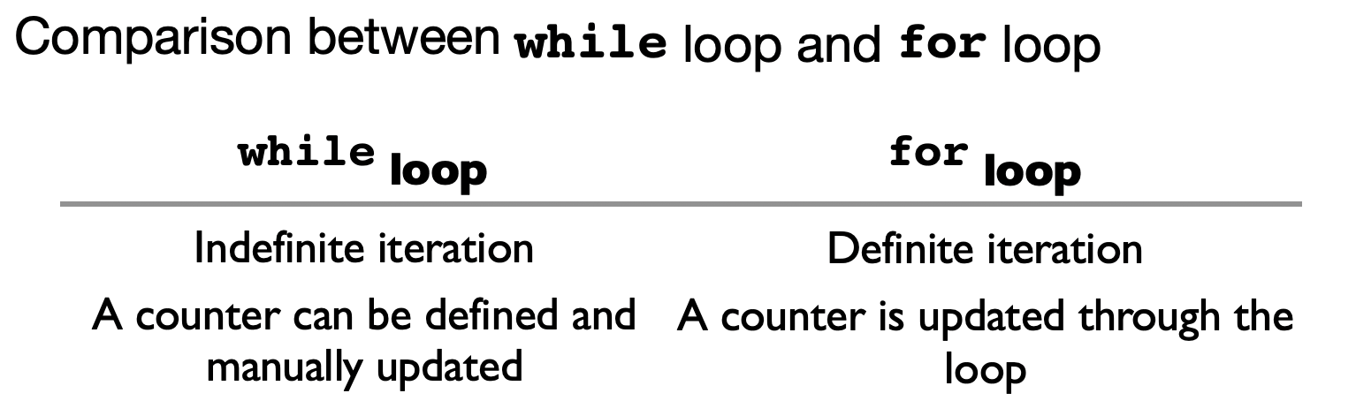
Lesson Plan
Day 1 (Second Half) - Learn How use Github - Learn Markdown Syntax - Learn Python Functions - Learn how to perform iteration *For Loop *While Loop

Slide 4

Lesson Plan
Day 2 (First Half) - Learn how to functions work in Python - Learn how use functions * with argument * without argument

Slide 5

Lesson Plan
Day 2 (Second Half) - Learn how to navigate on Microsoft Excel - Learn how use functions in Excel * DATEDIF function * IF function * COUNTIF function *AND function *OR function

Slide 6
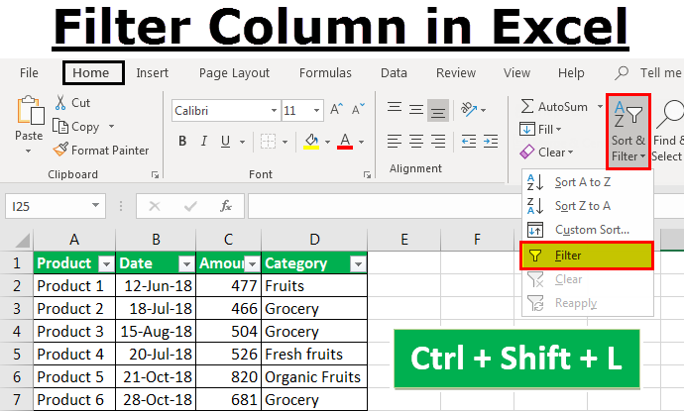
Lesson Plan
Day 3 (First Half) - Learn the CONCEPT of using nested IF in Excel - Use Conditional Formatting in Excel - Learn how use Filter Feature in Excel * Filter One field * Filter Multi Field * Custom Filters

Slide 7
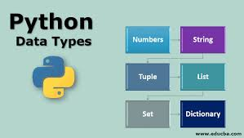
Lesson Plan
Day 3 (Second Half) - Learn how use filter with *date, numbers, strings - Learn how to do subtotaling in Excel - Learn on python datatypes * str – a bunch of characters wrapped in “ ” or ‘ ’ * int – number without decimal * float – number with decimal * list – stores a record of object * bool – only will either return True or False * Dict – stores in the key : value format - Learn If else in python

Slide 8
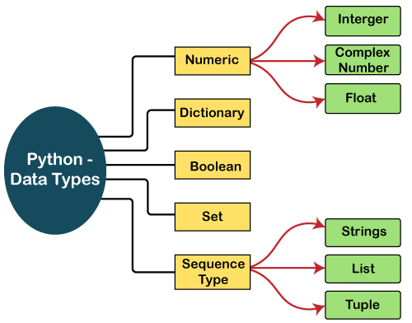
Python – Data Types
Covered in course:
1)Integer 2)Float 3)String 4)List 5)String 6)Dictionary

Slide 9
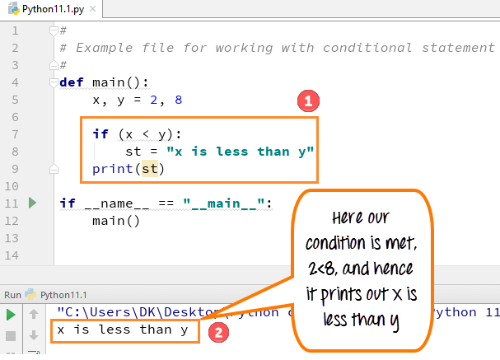
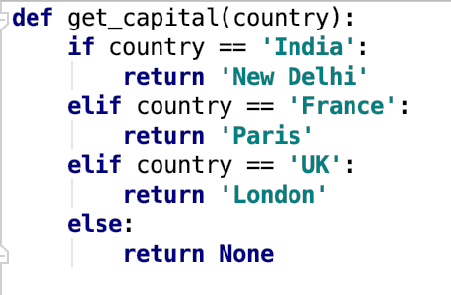
Lesson Plan
Day 4 (First Half) - Learn how to use nested IF in python - Learn how to write else if logic in python - Learn how to do data type conversion - Learn how to manipulate strings

Slide 10
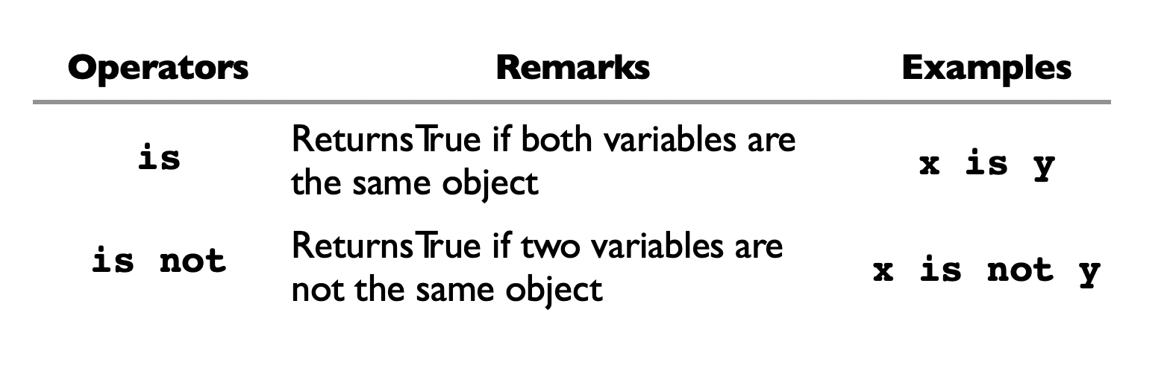
Lesson Plan
Day 4 (Second Half) - Learn how to work with control statements in Python - Learn how to use “AND” & ”OR” reserved keyword - Learn how use “is” AND “is not” reserved keyword

Slide 11
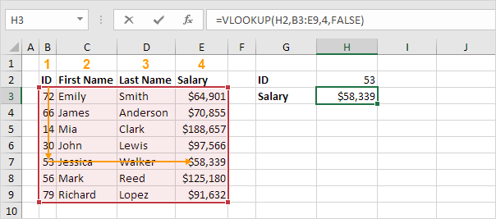
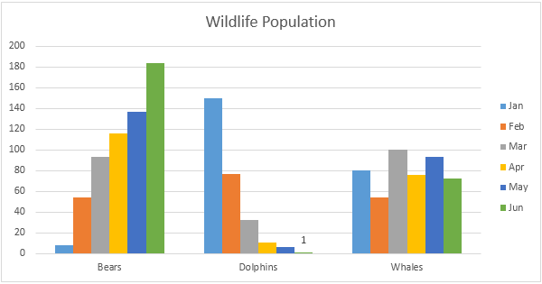
Lesson Plan
Day 5 (First Half) - Learn how to use VLOOKUP & HLOOKUP in excel
Day 5 (Second Half) - Learn how to use excel charting in excel

Slide 12


Lesson Plan
Day 6 (First Half) - Learn numpy python library - Learn array data structure
Day 6 (Second Half) - Learn matplotlib – Learn data visualization with python

Slide 13
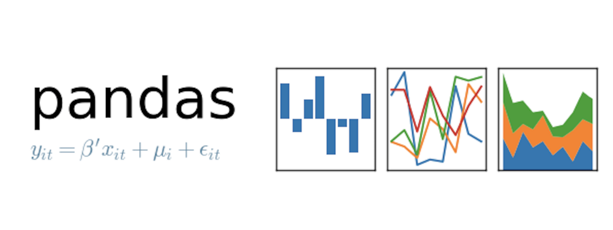
Lesson Plan
Day 7 (First Half) - Learn pandas python library Day 7 (Second Half) - Descriptive Analytics in Python

Slide 14
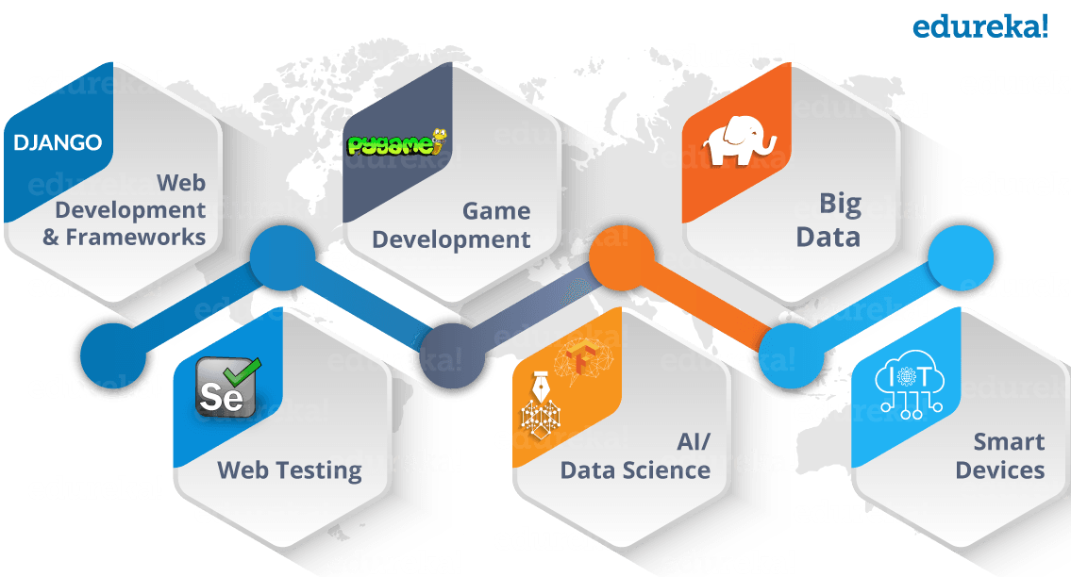
What can I do with this knowledge?
Blockchain developer
Application Developer -> build website(DJANGO) / mobile app
Analyst based careers -> for database engineer, data analyst, data scientist
AI Development
QA Developer – write test case for testing a system

Slide 15

What can I do with this knowledge?
DevOps Engineer -> manage servers
Cybersecurity Engineer -> WhiteHackers
Business Analyst -> Translate Business to technical requirements
Product / Project Manager

