Slide 1
Code Challenge
Create an app that can perform the following:
A map with markers of weather stations provided and additional information when selected (shown in the following slides)
Recommended to use Leaflet engine for map
Recommended to use Angular v17
Bonus if implemented:
Responsive (mobile friendly)
Note:
Map cluster and marker icons can use default one

Slide 2
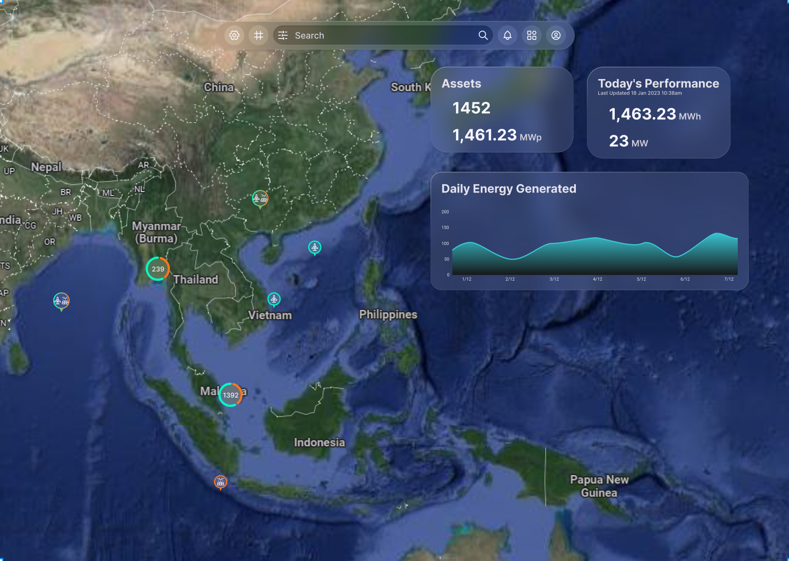
Bonus: Search function that allows autocomplete and panning to marker on submit
Use data from this API:
https://api.open-meteo.com/v1/forecast?latitude=1.29&longitude=103.85&hourly=relativehumidity_2m,direct_radiation&daily=temperature_2m_max,temperature_2m_min&timezone=Asia%2FSingapore&start_date=2024-11-01&end_date=2024-11-10
Marker
Cluster
Use the data from https://api.data.gov.sg/v1/environment/2-hour-weather-forecast for the location
Click to open modal view as shown in second page

Slide 3
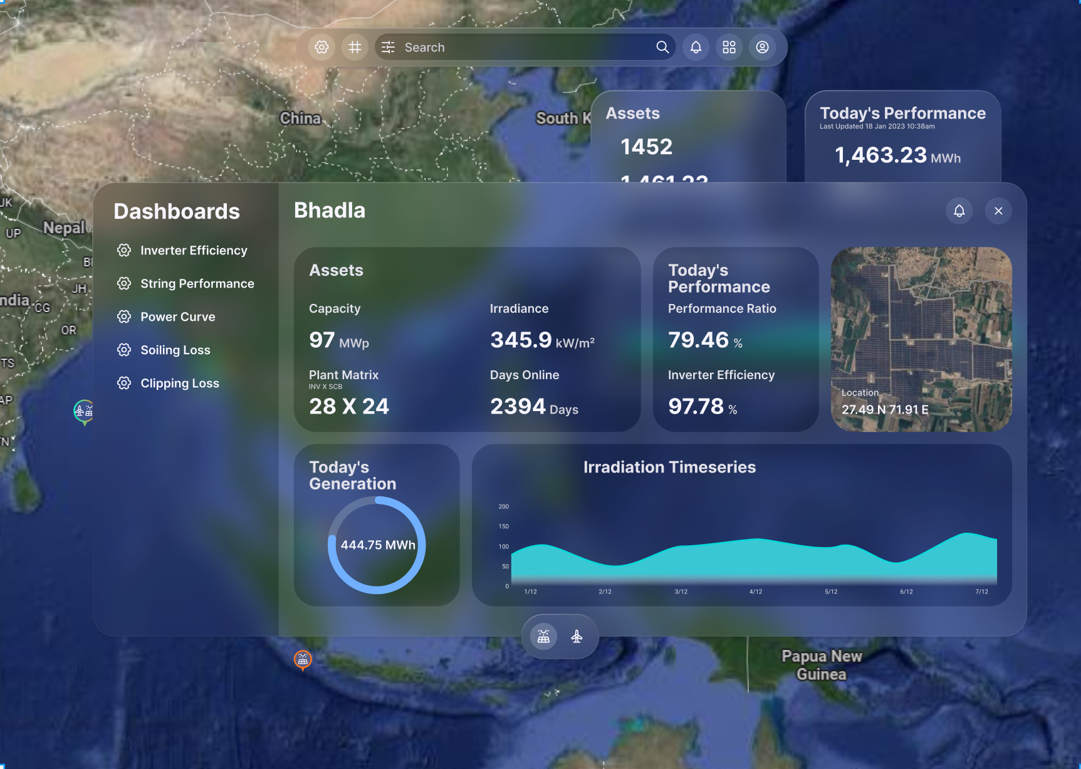
Bonus: Mini-map of the location
Use data from this API:
https://api.open-meteo.com/v1/forecast?latitude=1.29&longitude=103.85&hourly=relativehumidity_2m,direct_radiation&daily=temperature_2m_max,temperature_2m_min&timezone=Asia%2FSingapore&start_date=2024-11-01&end_date=2024-11-10

