Slide 1
Introduction to Web Technologies
Basics of JS
Lecturer: Christen Cao

Slide 2

Topic 3: JavaScript Basics
Notes:
-output messages
-get data from the user
-user of variables & data types
-math operators & functions

Slide 3

JavaScript
Mostly used programming language of HTML & Web.
It can:
add on interactive HCI features
change attributes and styles
send HTTP requests behind the scenes (AJAX)
… produce dynamic HTML page !
Light bulb demo
Game demo
Complete JS Reference at W3S

Slide 4
JavaScript
Mostly used programming language of HTML & Web.
It can:
add on interactive features
change attributes and styles
send HTTP requests behind the scenes (APIs)
… produce dynamic HTML page !
Light bulb demo
Game demo

Slide 5
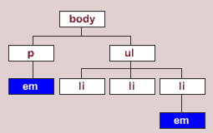
JavaScript (JS)
JavaScript is code run at the browser (client- side)
Usually placed in the <head> and/or <body> section
– Can be inline within container objects
Can access the DOM (Document Obj. Model )
<script type="text/javascript"> function doClick()
{
alert(document.f.t.value);
}
</script>

Slide 6
JavaScript
<!DOCTYPE html>
<html>
<head>
<title>t4</title>
<style type="text/css">
h1 {color:red; background- color:yellow;}
.hilite {color:blue;}
table .hilite {background-color:green;}
</style>
<script type="text/javascript">
function doClick(){
alert(document.getElementById('message').value);
}
</script>
</head>
<body>
<h1 id=“message”>First HTML</h1>
<p>Not too hard</p>
<div>div is a block level tag whereas <span class="hilite">is an inline tag</span></div>
<table border='1'>
<tr><td>(0,0)</td><td><span class="hilite">(0,1)</span></td></tr>
<tr><td>(1,0)</td><td>(1,1)</td></tr>
</table>
<form name="f">
<input name="t" type='text' />
<input type='button' value="Press" onclick="doClick();"/>
</form>
</body>
</html>

Slide 7
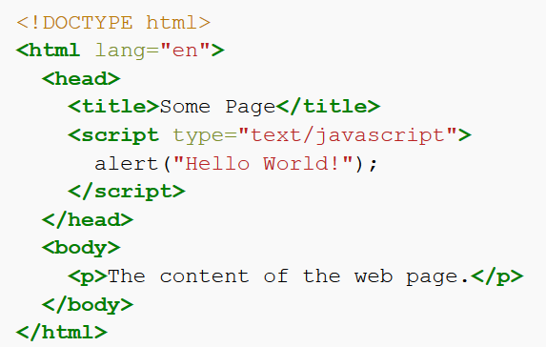

First HTML/JS program
alert("Hello World!");
Client-side JS must be placed inside a <script> element in HTML

Slide 8
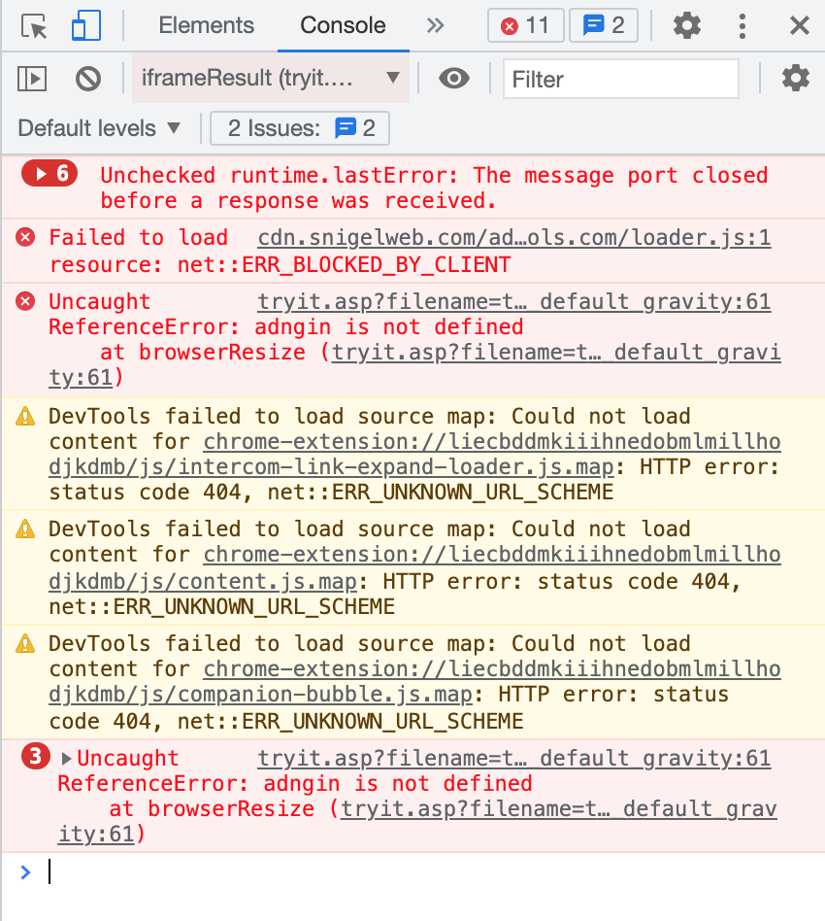
Output a message
alert("Hello World!");
Print message (in string format)
single ‘…’ or double ”…” quotes
escape character \
alert("He said \"GOOD\". ");
Comment
// comment to end of line
/* ….. */ comment in between
Check errors
right click -> inspect -> console

Slide 9
JS Sequencing
Denoted by semicolon alert(“Hello,”); alert(“world!”);
Denoted by newline alert(“Hello,”) alert(“world!”);

Slide 10
Variable
var x = 2;
// declare a variable called x, assign the value 2 to variable x
Use a meaningful name – identifier
Naming rules
can be letters, digits, underscore (_) or $
case sensitive
cannot begin with a digit
cannot use reserved words (e.g. function names)

Slide 11
Declare and assign variables
var x = 42 ;
var name = ”Ben”;
Loosely typed
– do not have to declare the variable using var
It's a good programming practice to declare all variables at the beginning of a script.

Slide 12
How to get data from variables
ans=prompt("...message..."); ans=prompt("...message...", "...default...");
var x = prompt(“please give value for x”) ;
Declare a variable called x, and let user enter its value

Slide 13
Tryout: prompt( “ … ”)
var Z1 = prompt('Type any text:'), z1=2, z3;
alert(Z1);
alert(z1);
alert(z3);
alert(prompt("What day is it?","Monday"));
declaring a list of variables with comma separation

Slide 14
Data types
Strings (a sequence of characters)
var person = "John Doe"; var answer = 'Yes!';
Numbers
var pi = 3.14; // floating var i=10; // integer
others later

Slide 15
We can do stuff with data
Math operators: +, *, -, /, % (modulo operator)
n % d : the remainder of dividing n by d
Get input into a variable: var count = prompt(...);
or in literals: alert(42 * 2);
“+” may do different things based on the type of data
link two strings – concatenated
Math addition
Notes:
Modulo is a math operation that finds the remainder when one integer is divided by another.

Slide 16
Try: Dual meaning +
alert("Hello, " + prompt("Enter a name : "));
[ user enter: Tom ] Hello, Tom
alert(3 + prompt("Enter a number: ")); [ user enter: 2 ] 32
Data from the prompt is always treated as a string!
We need to tell the computer that the data should be interpreted as a number! (Type conversion)

Slide 17
Converting strings to numbers
Number(...)
Number("-6.6");
Number("6a");
// -6.6
// NaN: not a number
parseInt(...)
// less strict than Number()
parseInt ("6.6"); //6 parseInt ("0x10"); //16 parseInt ("6a"); //6

Slide 18
Try: Sum a input number with 2
var n1 = prompt('number:'); var sum1 = n1 + 2;
var n2 = Number(n1); var sum2 = n2 + 2;
alert('sum1= ' + sum1 + "; sum2= " + sum2);
more concisely..
var n = Number(prompt(“number:”));

Slide 19
JavaScript Exercise

Slide 20
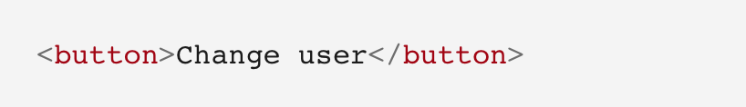
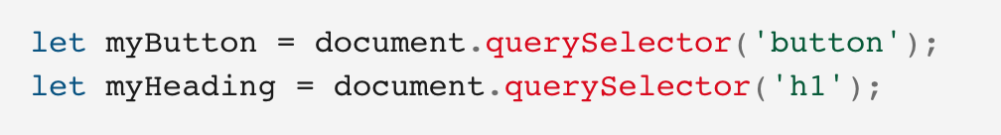
Personalized welcome message (JS)
1. In index.html, add the following line just before the <script> element:
2. In the <script> element, place the following code at the bottom of the file, exactly as it is written. This takes references to the new button and the heading, storing each inside variables:
Notes:
https://developer.mozilla.org/en-US/docs/Learn/Getting_started_with_the_web/JavaScript_basics

Slide 21
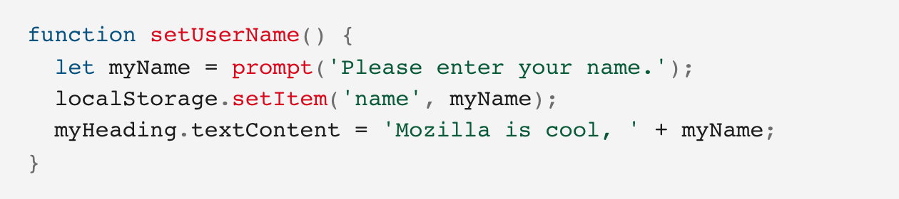
Personalized welcome message (JS)
3. Add the function below to set the personalized greeting. This won't do anything yet, but this will change soon.
Note: localStorage - The Storage interface of the Web Storage API provides access to a particular domain's session or local storage. It allows, for example, the addition, modification, or deletion of stored data items.
Notes:
The setUserName() function contains a prompt() function, which displays a dialog box, similar to alert(). This prompt() function does more than alert(), asking the user to enter data, and storing it in a variable after the user clicks OK. In this case, we are asking the user to enter a name. Next, the code calls on an API localStorage, which allows us to store data in the browser and retrieve it later. We use localStorage's setItem() function to create and store a data item called 'name', setting its value to the myName variable which contains the user's entry for the name. Finally, we set the textContent of the heading to a string, plus the user's newly stored name.

Slide 22
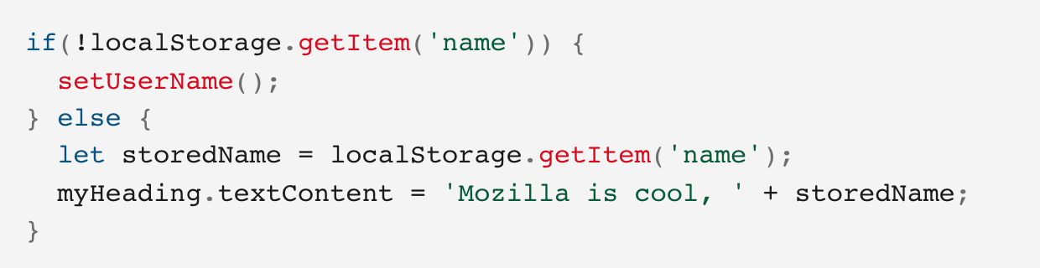
Personalized welcome message (JS)
4. Add the if ... else block (below). We could call this initialization code, as it structures the app when it first loads.
Note: localStorage.getItem() - When passed a key name, will return that key's value.
Notes:
This first line of this block uses the negation operator (logical NOT, represented by the !) to check whether the name data exists. If not, the setUserName() function runs to create it. If it exists (that is, the user set a user name during a previous visit), we retrieve the stored name using getItem() and set the textContent of the heading to a string, plus the user's name, as we did inside setUserName().

Slide 23
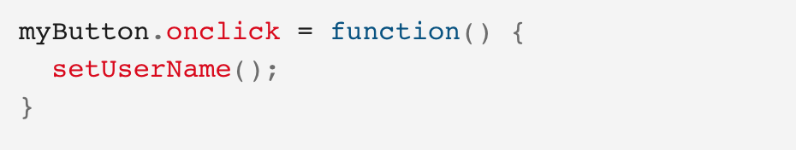
Personalized welcome message (JS)
5. Put this onclick event handler (below) on the button. When clicked, setUserName() runs. This allows the user to enter a different name by pressing the button.
When you are done, please remember to upload your .html file to:
tinyurl.com/nanwpwbu

Slide 24
<Happy coding, everyone!/>
<Thank you!/>

