Slide 1
Introduction to Web Technologies
Basics of HTML
Lecturer: Christen Cao

Slide 2
Course Structure
Basics of HTML
Basics of CSS
Basics of JavaScript
Objects, Functions & Conditionals
JavaScript Logics & HTML functions

Slide 3
To Learn This Course Well
Follow the demonstration and code with me
Try out and submit 3 In-Class Exercises
Final Assessment:
Quiz
Assignment

Slide 5
World Wide Web (WWW)
Communication and information
Widely accessible
Platform independent
Multimedia delivery
...
Education
E-commerce
Social networks
Entertainment
Research

Slide 6




WWW: Client – Server Architecture
Internet LAN/WAN
URL
Web Pages
TCP/IP, HTTP/FTP
Web Server
Client Browsers
Client sends URL via HTTP (Hypertext Transfer Protocol) to servers
Server responds with the requested web page (or error message)
Page is written using HTML (Hyper Text Markup Language), JavaScript, etc.
Client browser renders returned web page
The entire system runs on networking protocols (e.g. TCP/IP) over Internet (LAN/WAN)
Notes:
Domain Name System (DNS)
DNS, or the Domain Name System, translates human readable domain names (for example, www.amazon.com) to machine readable IP addresses (for example, 192.0.2.44)

Slide 7

Web Programming
HTML
CSS
JavaScript
Client-Server web programming
*In this course, we are only teaching client-side web programming!

Slide 8
Main Elements
HTML (HyperText Markup Language): markup language
Document Object Model (DOM): programmatic access to each web elements via a tree structure
CSS (Cascading StyleSheets): specify presentation
JavaScript: client-side scripting language for user interaction

Slide 9



Software (course pre-requisites)
Have Windows or Mac OS and above installed on your computer
Have Google Chrome / Firefox / Brave Browser installed
so long 1 of the 3 is install, it is sufficient
Have Visual Studio Code installed
Know the basics of internet
how to browse the internet, how to install a web browser, etc.

Slide 10
Resources
Online code editors:
codepen.io
replit.com
Documentation References:
w3schools.com
codecademy.com
MDN JS Web Docs

Slide 11

Topic 1: Introduction to HTML

Slide 12
Basic HTML Structure
<html>
<head>
.
.
</head>
<body>
.
.
</body>
</html>
Each HTML has a head and a body
Head: title, CSS, JavaScript, etc.
Body: headings, paragraphs, forms, etc.
<!-- html comment -->

Slide 13
HTML Tags
http://www.w3schools.com/tags/
Also referred to as elements
presented by start/closing angle brackets
<h1>This is a Heading</h1>
…but some are not paired!
New line <br/>, <hr/>
They are nested

Slide 14
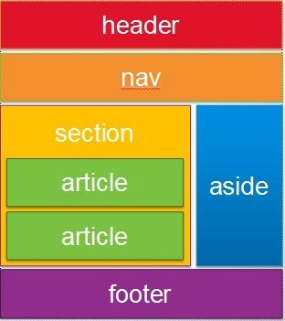
Block Level & Inline Tags
Block <div> …. </div>
Start new lines of text
Contain other tags, e.g. <div>, <p>, inline tags
Style them with CSS or to perform certain tasks with JavaScript
Inline tags
To enhance text, e.g. <strong>, <em>, <span>
Do not start new lines
Generally, can contain only other inline tags and text

Slide 15
HTML Tags
<!DOCTYPE html>
<html>
<head>
<title>t1</title>
</head>
<body>
<h1>First HTML</h1>
<p>Not too hard</p>
<div>div is a block level tag whereas this is <strong>an inline</strong> tag</div>
<table border='1’>
<tr><td>(0,0)</td><td>(0,1)</td></tr>
<tr><td>(1,0)</td><td>(1,1)</td></tr>
</table>
</body>
</html>
Notes:
Open VS,
ENLARGE YOUR VIEW – SHOW BIG FONTS!!!
Code the <doctype>,
teach them to save html file,

Slide 16
Basic HTML Tags
HTML is a fairly straightforward programming language. Each tag starts with a “<“ and ends with a “>”
For example the paragraph tag is <p>
There is a range of HTML tags, they help you to design your web page. There are four required tags in HTML. These are html, title, head and body. The table below shows you the opening and closing tag, a description and an example.
Notes:
https://www.cs.kent.ac.uk/teaching/10/modules/CO/3/32/FIT_Chapters/Chapter04/BasicHTMLTags.html

Slide 17
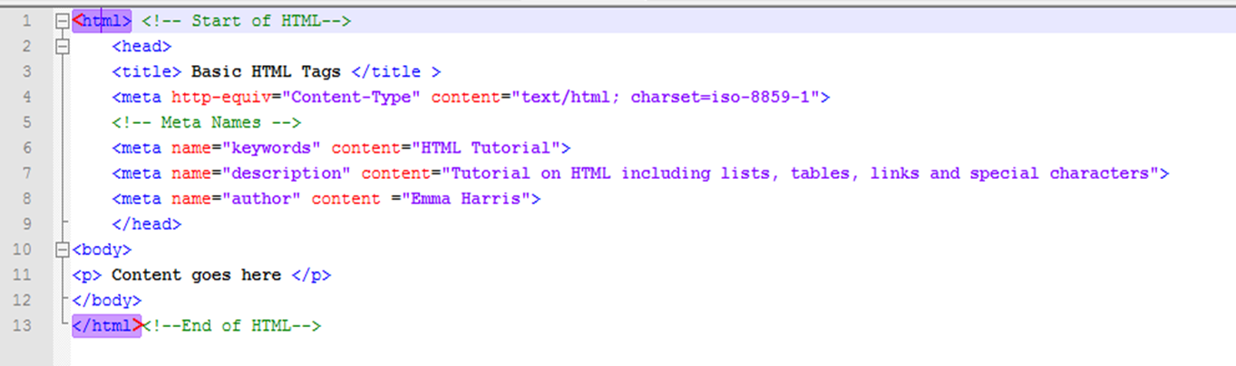
<html></html>
Start HTML Tag | End HTML Tag | Description
<html> | </html> | These are the tags you put at the beginning and end of an HTML file.
Example
Notes:
Start to code tags, one by one

Slide 18
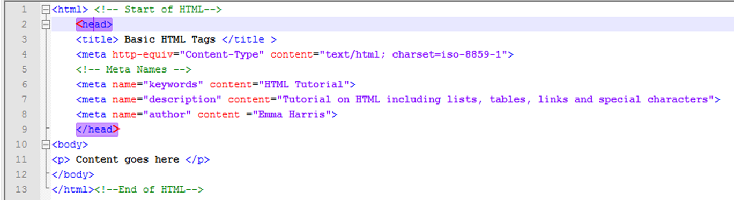
<head></head>
Start HTML Tag | End HTML Tag | Description
<head> | </head> | This includes information including title, meta tags, content type, links to external pages like CSS and JavaScript.
Example

Slide 19
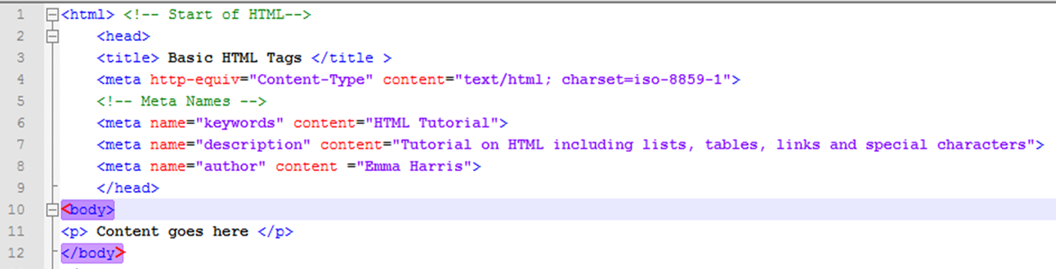
<body></body>
Start HTML Tag | End HTML Tag | Description
<body> | </body> | This contains the contents of the document
Example

Slide 20
<p>, <h1>, <h2>, … <h6>
Open tag | Close tag | Description | Example
<p> | </p> | This tag allows you to create paragraphs | My name is Fred. I live in Medway
<h1> | </h1> | This is the largest heading | Heading 1
<h2> | </h2> | This is second biggest heading | Heading 2
<h3> | </h3> | This is the next heading | Heading 3
<h4> | </h4> | This is another heading | Heading 4
<h5> | </h5> | This is the second smallest heading | Heading 5
<h6> | </h6> | This is the smallest heading | Heading 6
Notes:
Type something in h1 and p,
My first webpage
Hello, my name is…
Nice to meet you!
open .html file from browser,
and learn to refresh page

Slide 21
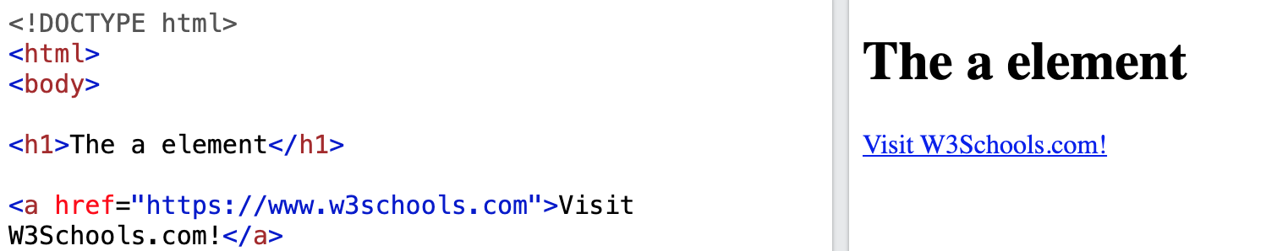
<a></a>
The <a> tag defines a hyperlink, which is used to link from one page to another.
The most important attribute of the <a> element is the href attribute, which indicates the link's destination.
By default, links will appear as follows in all browsers:
An unvisited link is underlined and blue
A visited link is underlined and purple
An active link is underlined and red

Slide 22
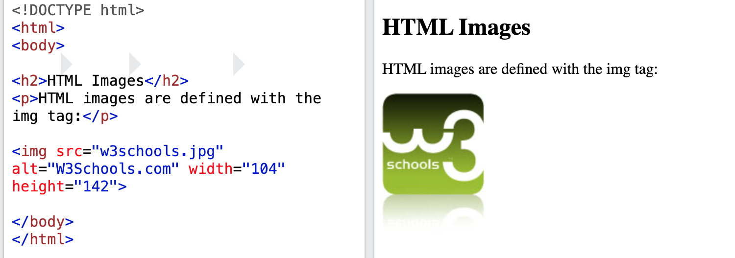
<img>
HTML images are defined with the <img> tag.
The source file (src), alternative text (alt), width, and height are provided as attributes:

Slide 23
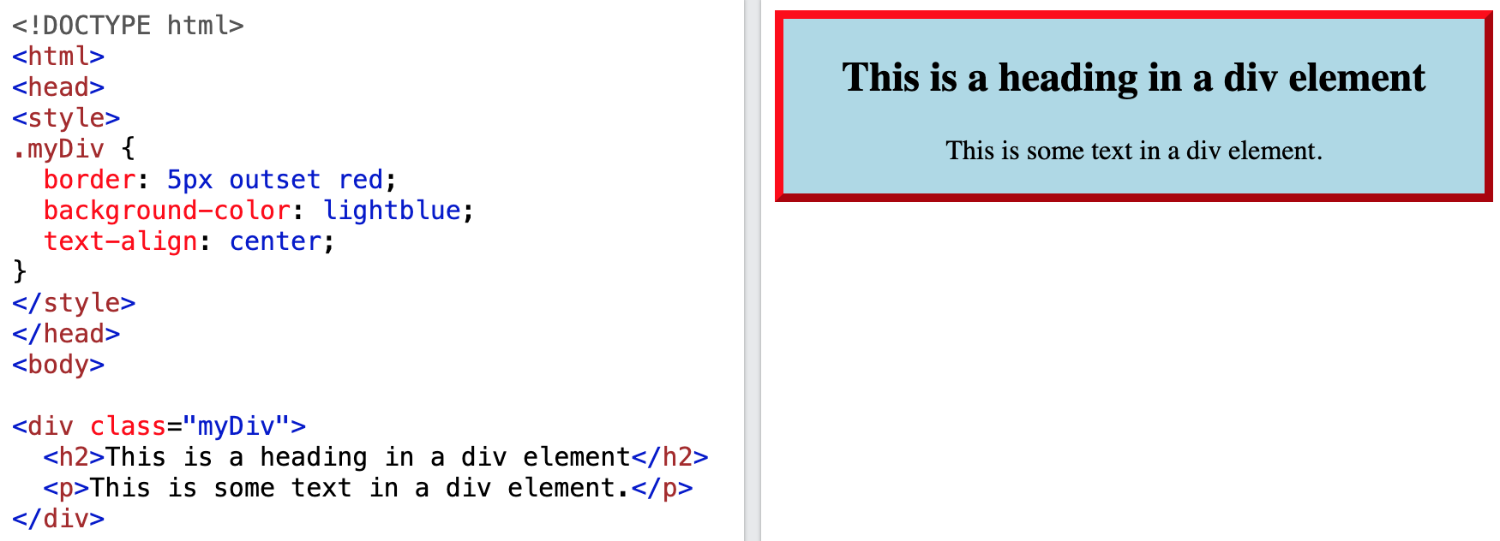
<div></div>
The <div> tag defines a division or a section in an HTML document.
The <div> tag is used as a container for HTML elements - which is then styled with CSS or manipulated with JavaScript.
The <div> tag is easily styled by using the class or id attribute.
Any sort of content can be put inside the <div> tag!

Slide 24
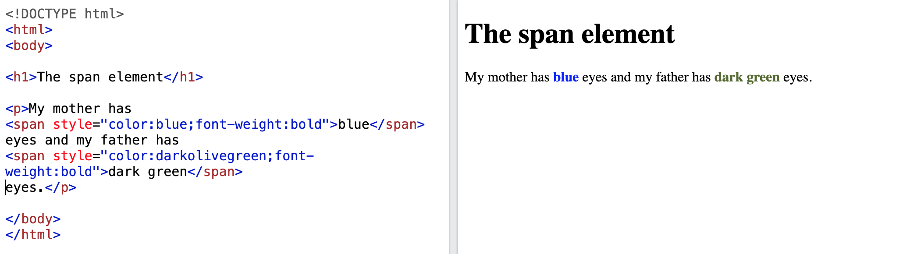
<span></span>
The <span> tag is an inline container used to mark up a part of a text, or a part of a document.
The <span> tag is much like the <div> element, but <div> is a block-level element and <span> is an inline element.

Slide 25

Forms
Forms allow user to enter data
The data can be passed to the server
Require container objects to collect the data
<form
<input
<input
name="f"> name="t"
type='text' />
type='button'
value="Press" />
</form>

Slide 26
Forms
<!DOCTYPE html>
<html>
<head>
<title>t3</title>
<style type="text/css">
h1 {color:red; background- color:yellow;}
.hilite {color:blue;}
table .hilite {background-color:green;}
</style>
</head>
<body>
<h1>First HTML</h1>
<p>Not too hard</p>
<div>div is a block level tag whereas
<span class="hilite">is an inline tag</span></div>
<table border='1'>
<tr><td>(0,0)</td><td><span class="hilite">(0,1)</span></td></tr>
<tr><td>(1,0)</td><td>(1,1)</td></tr>
</table>
<form name="f">
<input name="t" type='text' />
<input type='button' value="Press" />
</form>
</body>
</html>

Slide 27
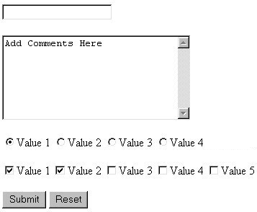
HTML Forms
<form>
<input | type= “…” | … | >
<input | type= “…” | … | >
….
</form>
Use <input> in the <form> tag to declare group of input controls, allowing users to input data.
type attribute: “text”, “submit”,
JavaScript can be used to create interactive behaviours via event handler
Notes:
Form is not tested

Slide 28

Text Fields
Attributes:
•size: onscreen width of text field
•Maxlength: mix-number characters user is able to type into field
•Readonly: text cannot be modified

Slide 29
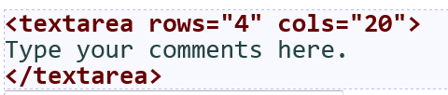
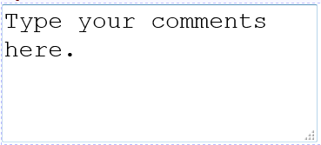
<textarea>
a multi-line text input area.
– initial text is placed inside textarea tag (optional)
rows and cols: height/width in characters

Slide 30





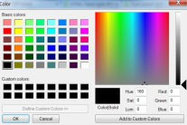



<input type = ” ” … >
text/textarea (multi-lines)
checkbox/radio (one-out-of-n)/selection
button/reset/submit
hidden/password (masked)
file
/image
email(< 9 )
date/ time/datetime/week/month
color/number/range
Search/url <( )
9
But no Combo Box & List Box in form

Slide 31
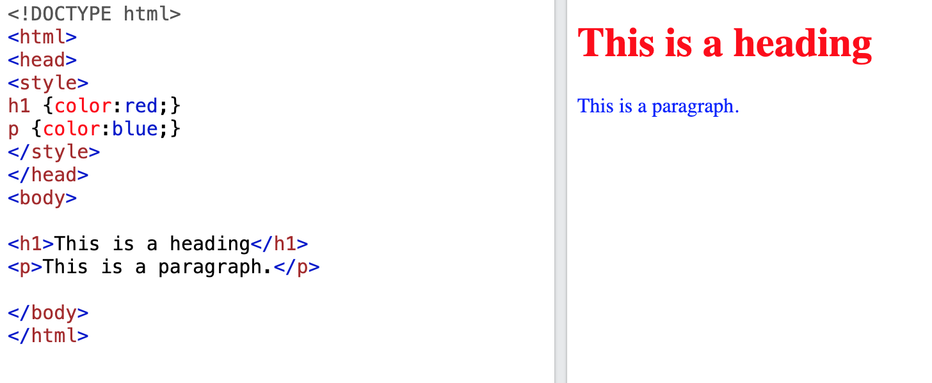
<style></style>
The <style> tag is used to define style information (CSS) for a document.
Inside the <style> element you specify how HTML elements should render in a browser.

Slide 32
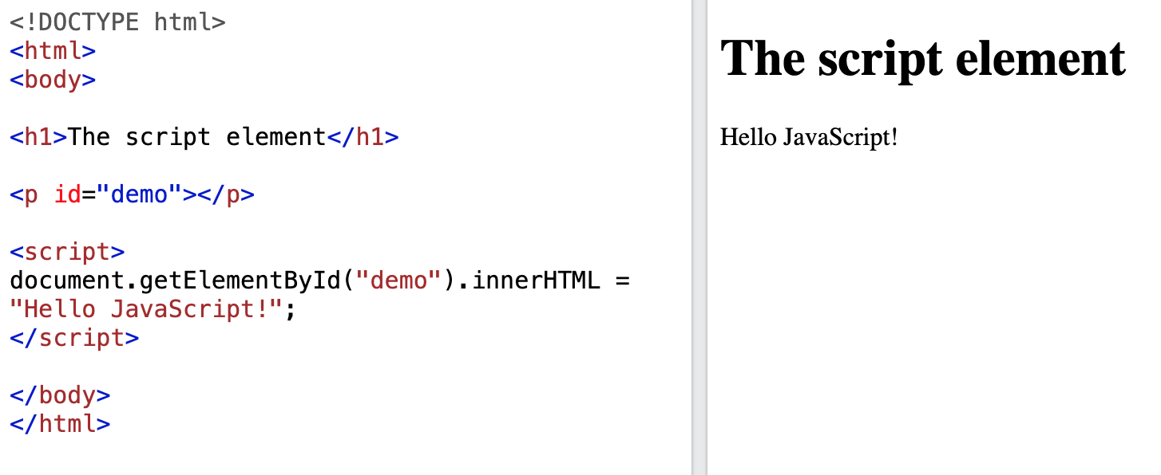
<script></script>
The <script> tag is used to embed a client-side script (JavaScript).
The <script> element either contains scripting statements, or it points to an external script file through the src attribute.
Common uses for JavaScript are image manipulation, form validation, and dynamic changes of content.
Notes:
Need to demo this with console.log() instead

Slide 33
HTML List & Table (not tested)
HTML List
http://www.w3schools.com/html/html_lists.asp
<ul> <ol> <li>
HTML table
examples
https://www.w3schools.com/html/html_tables.asp
<table> tag
http://www.w3schools.com/tags/tag_table.asp
<table>, <tr>, <th>, <td>

Slide 34
HTML Attributes
Elements/tags can have a list of attributes, values are enclosed in quotes
<p name=“myPara" id=“Para1"> …. </p>
Images:
<img src=" smiley.gif" alt="Smiley face" height="42" width="42">
Links
<a href="http://www.lboro.ac.uk/">Loughborough</a>

Slide 35
Class Selector
Specify a style for sub-set instances of HTML tags
Assign to tag of a class: class=“classname"
<p class="special">A different class of paragraph </p>
Defined with a "."
.classname {property1: value1; property2: value2;}
E.g.: .special {text-align: right; color: green;}
Notes:
Just need to identify ID & Class attr in HTML, will cover more CSS later

Slide 36

ID Selector
Apply styles to a single element in the page
an ID is unique
Similar syntax as class, define with a “#”
#idname
id="idname"
<p>The
<span
id="myid">Important</span>bit
of…</p>
#myid
{font-style:
italic;font-weight:
bold;}

Slide 37
HTML Exercise

Slide 38
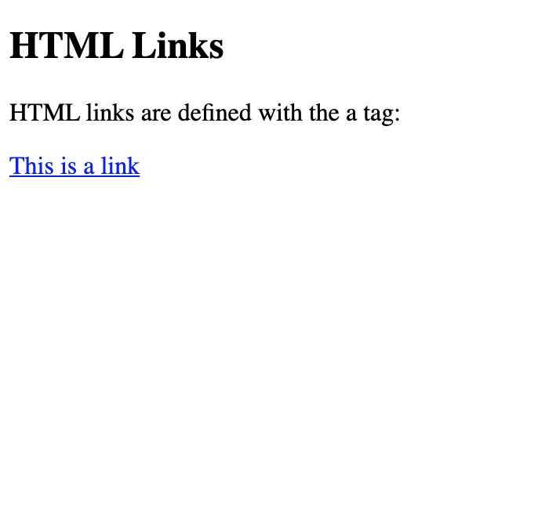

Code this webpage using HTML!
Please use the following tags:
<html>
<body>
<h1>
<p>
<a>
<img>
When you are done, please remember to upload your .html file to:
tinyurl.com/nanwpwbu

Slide 39
<Happy coding, everyone!/>
<Thank you!/>

