Slide 1
Introduction to Web Technologies
Basics of CSS
Lecturer: Christen Cao

Slide 2

Topic 2: CSS Basics
Notes:
-output messages
-get data from the user
-user of variables & data types
-math operators & functions

Slide 3
What is CSS?
CSS stands for Cascading Style Sheets
CSS describes how HTML elements are to be displayed on screen, paper, or in other media
CSS saves a lot of work. It can control the layout of multiple web pages all at once
External stylesheets are stored in CSS files
Explore website: https://www.w3schools.com/css/css_intro.asp

Slide 4
CSS (Cascading Style Sheets)
<style type="text/css"> h1
{ color:red;
background-color:yellow;
}
.hilite
color:blue;
{
}
table .hilite
{ background-color:green;
}
</style>
CSS specifies style rules in the <head> section
Each rule is made up of a selector, e.g. tags, class, id
/* CSS COMMENTS */
Ref: http://www.htmlhelp.com/reference/css/

Slide 5
CSS
When you submit CSS file, submit inline CSS like this. Put <style> tag inside HTML file!
<!DOCTYPE html>
<html>
<head>
<title>t2: ,CSS styles </title>
<style type="text/css">
h1 {color:red; background-color:yellow;}
.hilite {color:blue;}
table .hilite {background-color:green;}
</style>
</head>
<body>
<h1>First HTML</h1>
<p>Not too hard</p>
<div>div is a block level tag whereas <span class="hilite">is an inline tag</span></div>
<table border='1'>
<tr><td>(0,0)</td><td><span class="hilite">(0,1)</span></td></tr>
<tr><td>(1,0)</td><td>(1,1)</td></tr>
</table>
</body>
</html>
Notes:
When you submit CSS file, submit inline CSS. Put style tag in HTML

Slide 6
CSS Selector
3 common CSS selectors:
Element / Type Selector
Class Selector
ID Selector
There are also element-specific and descendent selectors which allow us to be more precise
Naming Conventions
no whitespace or special characters - case-sensitive
do not start with numbers

Slide 7
Element / Type Selector
Target elements by the element type
Example:
target all <div> elements using a type selector of div
CSS
div { ... }
HTML
<div>...</div>
<div>...</div>

Slide 8
Class Selector
Select an element based on the element’s class attribute value
a little more specific than type selectors
select particular elements rather than all elements of a type
apply the same styles to different elements by using the same class attribute value
Denoted by a leading period ., followed by the class attribute value
CSS
.awesome { ... }
HTML
<div class="awesome">...</div> <p class="awesome">...</p>

Slide 9
ID Selector
Target only one unique element at a time
even more precise than class selectors
use an element’s id attribute value as a selector
id attribute values can only be used once per page
should be reserved for significant elements
Denoted by a leading hash sign #, followed by the id attribute value
CSS
#wrapper { ... }
HTML
<div id="wrapper">...</div>

Slide 10
CSS Exercise

Slide 11
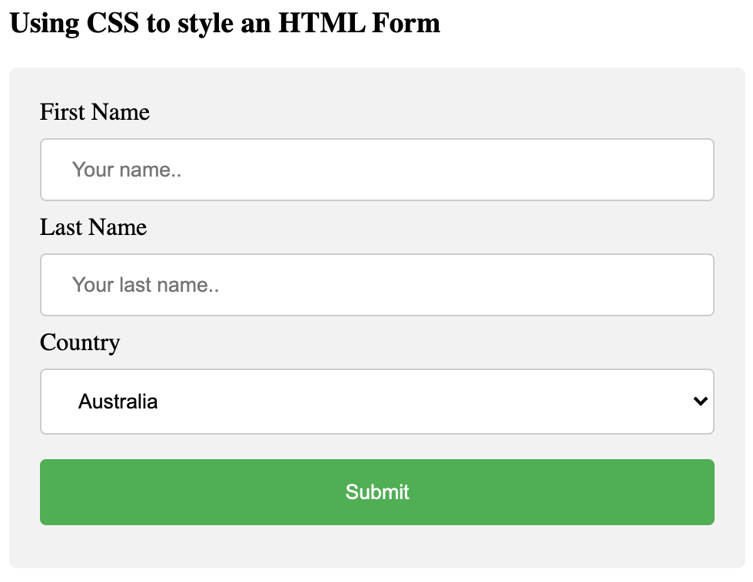
Code this webpage using HTML & CSS!
Please use the following tags:
<h3>
<div>
<form>
<label>
<input>
When you are done, please remember to upload your .html file to:
tinyurl.com/nanwpwbu
Notes:
https://www.w3schools.com/css/tryit.asp?filename=trycss_forms

Slide 12
<Happy coding, everyone!/>
<Thank you!/>

