Slide 1
Introduction to Web Technologies
Basics of HTML, CSS, JavaScript
Lecturer: Christen Cao

Slide 2
Learning Outcome
Module overview
Structure of this module
Exercise & test
Resources
Introduction to HTML
Introduction to CSS
JavaScript Basics
JavaScript with HTML & CSS

Slide 3
World Wide Web (WWW)
Communication and information
Widely accessible
Platform independent
Multimedia delivery
...
Education
E-commerce
Social networks
Entertainment
Research

Slide 4




WWW: Client – Server Architecture
Internet LAN/WAN
URL
Web Pages
TCP/IP, HTTP/FTP
Web Server
Client Browsers
Client sends URL via HTTP (Hypertext Transfer Protocol) to servers
Server responds with the requested web page (or error message)
Page is written using HTML (Hyper Text Markup Language), JavaScript, etc.
Client browser renders returned web page
The entire system runs on networking protocols (e.g. TCP/IP) over Internet (LAN/WAN)
Notes:
Domain Name System (DNS)
DNS, or the Domain Name System, translates human readable domain names (for example, www.amazon.com) to machine readable IP addresses (for example, 192.0.2.44)

Slide 5

Web Programming
HTML
CSS
JavaScript
PHP
MySQL
Client-Server web programming

Slide 6
Main Elements
HTML (HyperText Markup Language): markup language
Document Object Model (DOM): programmatic access to each web elements via a tree structure
CSS (Cascading StyleSheets): specify presentation
JavaScript: client-side scripting language for user interaction
PHP: server-side programming
MySQL: database
JQuery/AJAX/JSON: smart data/page exchanges

Slide 7
Software (course pre-requisites)
Have Windows 10 or Mac OSX Leopard and above installed on your computer
Have Google Chrome / Firefox / Brave Browser installed
so long 1 of the 3 is install, it is sufficent
Know the basics of internet
how to browse the internet, how to install a web browser, etc.

Slide 8
Resources
Online code editors:
codepen.io
replit.com
Documentation References:
w3schools.com
codecademy.com
MDN JS Web Docs

Slide 9

Topic 1: Introduction to HTML

Slide 10
Basic HTML Structure
<html>
<head>
.
.
</head>
<body>
.
.
</body>
</html>
Each HTML has a head and a body
Head: title, CSS, JavaScript, etc.
Body: headings, paragraphs, forms, etc.
<!-- html comment -->

Slide 11
HTML Tags
http://www.w3schools.com/tags/
Also referred to as elements
presented by start/closing angle brackets
<h1>This is a Heading</h1>
…but some are not paired!
New line <br/>, <hr/>
They are nested

Slide 12
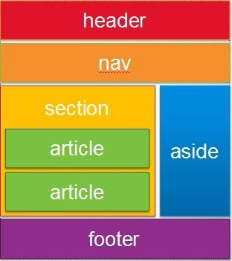
Block Level & Inline Tags
Block <div> …. </div>
Start new lines of text
Contain other tags, e.g. <div>, <p>, inline tags
Style them with CSS or to perform certain tasks with JavaScript
Inline tags
To enhance text, e.g. <strong>, <em>, <span>
Do not start new lines
Generally, can contain only other inline tags and text

Slide 13
HTML Tags
<!DOCTYPE html>
<html>
<head>
<title>t1</title>
</head>
<body>
<h1>First HTML</h1>
<p>Not too hard</p>
<div>div is a block level tag whereas this is <strong>an inline</strong> tag</div>
<table border='1’>
<tr><td>(0,0)</td><td>(0,1)</td></tr>
<tr><td>(1,0)</td><td>(1,1)</td></tr>
</table>
</body>
</html>

Slide 14
HTML List & Table
HTML List
http://www.w3schools.com/html/html_lists.asp
<ul> <ol> <li>
HTML table
examples
https://www.w3schools.com/html/html_tables.asp
<table> tag
http://www.w3schools.com/tags/tag_table.asp
<table>, <tr>, <th>, <td>

Slide 15
HTML Attributes
Elements/tags can have a list of attributes, values are enclosed in quotes
<p name=“myPara" id=“Para1"> …. </p>
Images:
<img src=" smiley.gif" alt="Smiley face" height="42" width="42">
Links
<a href="http://www.lboro.ac.uk/">Loughborough</a>

Slide 16
Class Selector
Specify a style for sub-set instances of HTML tags
Assign to tag of a class: class=“classname"
<p class="special">A different class of paragraph </p>
Defined with a "."
selector. classname {property1: value1; property2: value2;}
E.g.: p.special {text-align: right; color: green;}

Slide 17

ID Selector
Apply styles to a single element in the page
an ID is unique
Similar syntax as class
selector#idname
id="idname"
<p>The
<span
id="myid">Important</span>bit
of…</p>
#myid
{font-style:
italic;font-weight:
bold;}

Slide 18
Topic 2: CSS Basics
Notes:
-output messages
-get data from the user
-user of variables & data types
-math operators & functions

Slide 19
CSS (Cascading Style Sheets)
<style type="text/css"> h1
{ color:red;
background-color:yellow;
}
.hilite
color:blue;
{
}
table .hilite
{ background-color:green;
}
</style>
CSS specifies style rules in the <head> section
Each rule is made up of a selector, e.g. tags, class, id
/* CSS COMMENTS */
Ref: http://www.htmlhelp.com/reference/css/

Slide 20
CSS
<!DOCTYPE html>
<html>
<head>
<title>t2: ,CSS styles </title>
<style type="text/css">
h1 {color:red; background-color:yellow;}
.hilite {color:blue;}
table .hilite {background-color:green;}
</style>
</head>
<body>
<h1>First HTML</h1>
<p>Not too hard</p>
<div>div is a block level tag whereas <span class="hilite">is an inline tag</span></div>
<table border='1'>
<tr><td>(0,0)</td><td><span class="hilite">(0,1)</span></td></tr>
<tr><td>(1,0)</td><td>(1,1)</td></tr>
</table>
</body>
</html>

Slide 21

Forms
Forms allow user to enter data
The data can be passed to the server
Require container objects to collect the data
<form
<input
<input
name="f"> name="t"
type='text' />
type='button'
value="Press" />
</form>

Slide 22
Forms
<!DOCTYPE html>
<html>
<head>
<title>t3</title>
<style type="text/css">
h1 {color:red; background- color:yellow;}
.hilite {color:blue;}
table .hilite {background-color:green;}
</style>
</head>
<body>
<h1>First HTML</h1>
<p>Not too hard</p>
<div>div is a block level tag whereas
<span class="hilite">is an inline tag</span></div>
<table border='1'>
<tr><td>(0,0)</td><td><span class="hilite">(0,1)</span></td></tr>
<tr><td>(1,0)</td><td>(1,1)</td></tr>
</table>
<form name="f">
<input name="t" type='text' />
<input type='button' value="Press" />
</form>
</body>
</html>

Slide 23
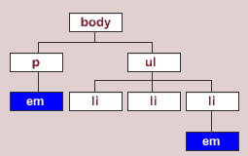
JavaScript (JS)
JavaScript is code run at the browser (client- side)
Usually placed in the <head> section
– Can be inline within container objects
Can access the DOM (Document Obj. Model )
<script type="text/javascript"> function doClick()
{
alert(document.f.t.value);
}

Slide 24
JavaScript
<!DOCTYPE html>
<html>
<head>
<title>t4</title>
<style type="text/css">
h1 {color:red; background- color:yellow;}
.hilite {color:blue;}
table .hilite {background-color:green;}
</style>
<script type="text/javascript">
function doClick(){
alert(document.getElementById('message').value);
}
</script>
</head>
<body>
<h1 id=“message”>First HTML</h1>
<p>Not too hard</p>
<div>div is a block level tag whereas <span class="hilite">is an inline tag</span></div>
<table border='1'>
<tr><td>(0,0)</td><td><span class="hilite">(0,1)</span></td></tr>
<tr><td>(1,0)</td><td>(1,1)</td></tr>
</table>
<form name="f">
<input name="t" type='text' />
<input type='button' value="Press" onclick="doClick();"/>
</form>
</body>
</html>

Slide 25
Topic 3: JavaScript Basics
Notes:
-output messages
-get data from the user
-user of variables & data types
-math operators & functions

Slide 26

JavaScript
Mostly used programming language of HTML & Web.
It can:
add on interactive HCI features
change attributes and styles
send HTTP requests behind the scenes (AJAX)
… produce dynamic HTML page !
Light bulb demo
Game demo
Complete JS Reference at W3S

Slide 27
JavaScript
Mostly used programming language of HTML & Web.
It can:
add on interactive features
change attributes and styles
send HTTP requests behind the scenes (APIs)
… produce dynamic HTML page !
Light bulb demo
Game demo

Slide 28
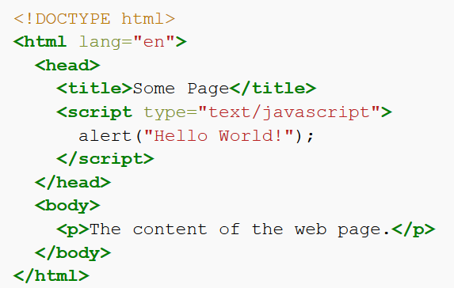

First HTML/JS program
alert("Hello World!");
Client-side JS must be placed inside a <script> element in HTML

Slide 29
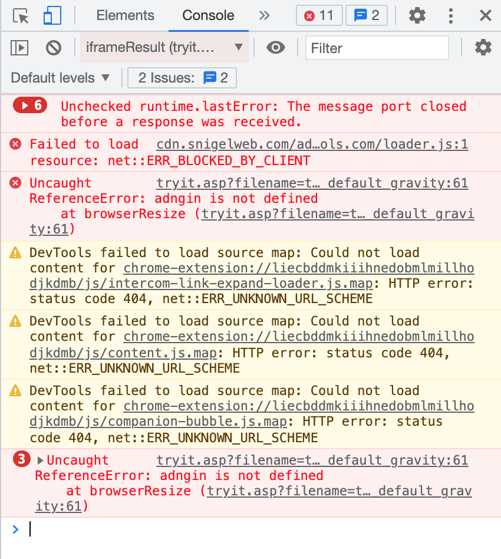
Output a message
alert("Hello World!");
Print message (in string format)
single ‘…’ or double ”…” quotes
escape character \
alert("He said \"GOOD\". ");
Comment
// comment to end of line
/* ….. */ comment in between
Check errors
right click -> inspect -> console

Slide 30
JS Sequencing
Denoted by semicolon alert(“Hello,”); alert(“world!”);
Denoted by newline alert(“Hello,”) alert(“world!”);

Slide 31
Variable
var x = 2;
// declare a variable called x, assign the value 2 to variable x
Use a meaningful name – identifier
Naming rules
can be letters, digits, underscore (_) or $
case sensitive
cannot begin with a digit
cannot use reserved words (e.g. function names)

Slide 32
Declare and assign variables
var x = 42 ;
var name = ”Ben”;
Loosely typed
– do not have to declare the variable using var
It's a good programming practice to declare all variables at the beginning of a script.

Slide 33
How to get data from variables
ans=prompt("...message..."); ans=prompt("...message...", "...default...");
var x = prompt(“please give value for x”) ;
Declare a variable called x, and let user enter its value

Slide 34
Tryout: prompt( “ … ”)
var Z1 = prompt('Type any text:'), z1=2, z3;
alert(Z1);
alert(z1);
alert(z3);
alert(prompt("What day is it?","Monday"));
declaring a list of variables with comma separation

Slide 35
Data types
Strings (a sequence of characters)
var person = "John Doe"; var answer = 'Yes!';
Numbers
var pi = 3.14; // floating var i=10; // integer
others later

Slide 36
We can do stuff with data
Math operators: +, *, -, /, % (modulo operator)
n % d : the remainder of dividing n by d
Get input into a variable: var count = prompt(...);
or in literals: alert(42 * 2);
“+” may do different things based on the type of data
link two strings – concatenated
Math addition
Notes:
Modulo is a math operation that finds the remainder when one integer is divided by another.

Slide 37
Try: Dual meaning +
alert("Hello, " + prompt("Enter a name : "));
[ user enter: Tom ] Hello, Tom
alert(3 + prompt("Enter a number: ")); [ user enter: 2 ] 32
Data from the prompt is always treated as a string!
We need to tell the computer that the data should be interpreted as a number! (Type conversion)

Slide 38
Converting strings to numbers
Number(...)
Number("-6.6");
Number("6a");
// -6.6
// NaN: not a number
parseInt(...)
// less strict than Number()
parseInt ("6.6"); //6 parseInt ("0x10"); //16 parseInt ("6a"); //6

Slide 39
Try: Sum a input number with 2
var n1 = prompt('number:'); var sum1 = n1 + 2;
var n2 = Number(n1); var sum2 = n2 + 2;
alert('sum1= ' + sum1 + "; sum2= " + sum2);
more concisely..
var n = Number(prompt(“number:”));

Slide 40
Summary
Overview
Introduction to HTML
Tags, attributes, class/ID selector, CSS etc.
Introduction to JS
Input/output: prompt(…), alert(…);
Variable var & data types
– Variables：arithmetic operators: +
- * / % (modulo)
Conversion (strings -> numbers): Number(…); parseInt(...)
Math object: Math.sqrt(...), round(...), ceil(...), floor(...),
max(...,...), min(...,...), PI
Next lesson

