Slide 1
Introduction to Web Technologies
Basics of JS
Lecturer: Christen Cao

Slide 2

Topic 3: JavaScript Basics
Notes:
-output messages
-get data from the user
-user of variables & data types
-math operators & functions

Slide 3

JavaScript
Mostly used programming language of HTML & Web.
It can:
add on interactive HCI features
change attributes and styles
send HTTP requests behind the scenes (AJAX)
… produce dynamic HTML page !
Light bulb demo
Game demo
Complete JS Reference at W3S

Slide 4
JavaScript
Mostly used programming language of HTML & Web.
It can:
add on interactive features
change attributes and styles
send HTTP requests behind the scenes (APIs)
… produce dynamic HTML page !
Light bulb demo
Game demo

Slide 5
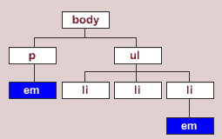
JavaScript (JS)
JavaScript is code run at the browser (client- side)
Usually placed in the <head> section
– Can be inline within container objects
Can access the DOM (Document Obj. Model )
<script type="text/javascript"> function doClick()
{
alert(document.f.t.value);
}

Slide 6
JavaScript
<!DOCTYPE html>
<html>
<head>
<title>t4</title>
<style type="text/css">
h1 {color:red; background- color:yellow;}
.hilite {color:blue;}
table .hilite {background-color:green;}
</style>
<script type="text/javascript">
function doClick(){
alert(document.getElementById('message').value);
}
</script>
</head>
<body>
<h1 id=“message”>First HTML</h1>
<p>Not too hard</p>
<div>div is a block level tag whereas <span class="hilite">is an inline tag</span></div>
<table border='1'>
<tr><td>(0,0)</td><td><span class="hilite">(0,1)</span></td></tr>
<tr><td>(1,0)</td><td>(1,1)</td></tr>
</table>
<form name="f">
<input name="t" type='text' />
<input type='button' value="Press" onclick="doClick();"/>
</form>
</body>
</html>

Slide 7
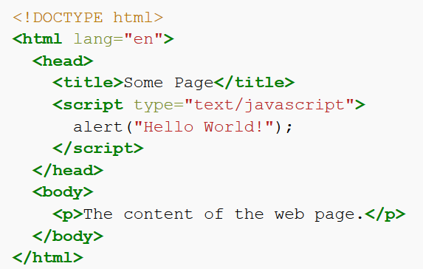

First HTML/JS program
alert("Hello World!");
Client-side JS must be placed inside a <script> element in HTML

Slide 8
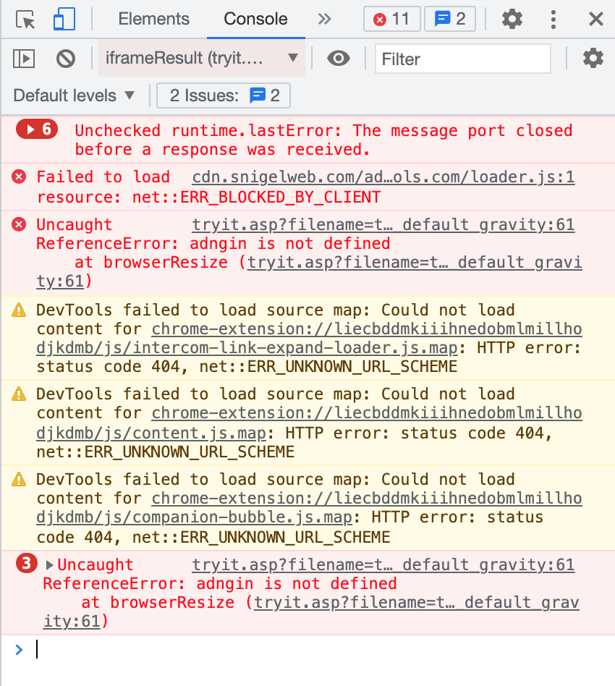
Output a message
alert("Hello World!");
Print message (in string format)
single ‘…’ or double ”…” quotes
escape character \
alert("He said \"GOOD\". ");
Comment
// comment to end of line
/* ….. */ comment in between
Check errors
right click -> inspect -> console

Slide 9
JS Sequencing
Denoted by semicolon alert(“Hello,”); alert(“world!”);
Denoted by newline alert(“Hello,”) alert(“world!”);

Slide 10
Variable
var x = 2;
// declare a variable called x, assign the value 2 to variable x
Use a meaningful name – identifier
Naming rules
can be letters, digits, underscore (_) or $
case sensitive
cannot begin with a digit
cannot use reserved words (e.g. function names)

Slide 11
Declare and assign variables
var x = 42 ;
var name = ”Ben”;
Loosely typed
– do not have to declare the variable using var
It's a good programming practice to declare all variables at the beginning of a script.

Slide 12
How to get data from variables
ans=prompt("...message..."); ans=prompt("...message...", "...default...");
var x = prompt(“please give value for x”) ;
Declare a variable called x, and let user enter its value

Slide 13
Tryout: prompt( “ … ”)
var Z1 = prompt('Type any text:'), z1=2, z3;
alert(Z1);
alert(z1);
alert(z3);
alert(prompt("What day is it?","Monday"));
declaring a list of variables with comma separation

Slide 14
Data types
Strings (a sequence of characters)
var person = "John Doe"; var answer = 'Yes!';
Numbers
var pi = 3.14; // floating var i=10; // integer
others later

Slide 15
We can do stuff with data
Math operators: +, *, -, /, % (modulo operator)
n % d : the remainder of dividing n by d
Get input into a variable: var count = prompt(...);
or in literals: alert(42 * 2);
“+” may do different things based on the type of data
link two strings – concatenated
Math addition
Notes:
Modulo is a math operation that finds the remainder when one integer is divided by another.

Slide 16
Try: Dual meaning +
alert("Hello, " + prompt("Enter a name : "));
[ user enter: Tom ] Hello, Tom
alert(3 + prompt("Enter a number: ")); [ user enter: 2 ] 32
Data from the prompt is always treated as a string!
We need to tell the computer that the data should be interpreted as a number! (Type conversion)

Slide 17
Converting strings to numbers
Number(...)
Number("-6.6");
Number("6a");
// -6.6
// NaN: not a number
parseInt(...)
// less strict than Number()
parseInt ("6.6"); //6 parseInt ("0x10"); //16 parseInt ("6a"); //6

Slide 18
Try: Sum a input number with 2
var n1 = prompt('number:'); var sum1 = n1 + 2;
var n2 = Number(n1); var sum2 = n2 + 2;
alert('sum1= ' + sum1 + "; sum2= " + sum2);
more concisely..
var n = Number(prompt(“number:”));

