Slide 1
♥
Heart Disease Prediction
Using Machine Learning Techniques
SVM
Random Forest
Flask API
UCI Dataset
Presented by:
Sazeda Nisha (03CITM231044)
L. Anita (03CITM231025)
Fakiya Firdous (03CITM231018)
Stutee Das (03CITM231052)
Dipti Ranjan Sahoo (03CITM231017)
Dept. of B.Sc ITM · Ajaya Binay Degree College

Slide 2
Problem Statement
01
Heart disease is the world's leading cause of death — ~17.9 million lives lost annually.
02
Traditional diagnosis heavily depends on expensive lab tests and specialist availability.
03
Cardiovascular disease is extremely difficult to detect early without clinical expertise.
04
Machine learning bridges this gap — enabling fast, low-cost, data-driven screening.
.

Slide 3
UCI Heart Disease Dataset
1,025
14
2
Total Records
Features
Target Classes
Key Features Used
Feature | Type | Description
age | Numeric | Patient age in years
sex | Binary | Male / Female
chest_pain_type | Categorical | Typical / Atypical / Non-anginal
resting_blood_pressure | Numeric | mm Hg at rest
cholesterol | Numeric | Serum cholesterol mg/dL
max_heart_rate | Numeric | Maximum heart rate achieved
oldpeak | Numeric | ST depression induced by exercise
fasting_blood_sugar | Binary | Indicates if blood sugar level is high after fasting.
ECG | Categorical | Measures the heart’s electrical activity at rest.
target | Binary | 1 = Disease · 0 = No Disease

Slide 4
Heart Disease Dataset Distribution
1,025
Total Samples
499
No Disease
526
Disease
Dataset is nearly balanced — ideal for unbiased classification.

Slide 5
Data Preprocessing Pipeline
1
Load Dataset
1025 rows · 15 columns including target variable
pd.read_csv('heart.csv')
2
Encoding
Converts categorical columns into binary dummy variables
pd.get_dummies(data, drop_first=True)
3
Feature / Target Split
Separates feature matrix from the label column
X = data.drop('target', axis=1)
4
Train-Test Split
80% training · 20% held-out test set
train_test_split(X, y, test_size=0.2)
5
Standard Scaling
mean=0, std=1 — fit only on train to prevent data leakage
StandardScaler().fit_transform(X_train)

Slide 6
Support Vector Machine (SVM)
Finds the optimal hyperplane maximising margin between two classes.
Linear kernel used: SVC(kernel='linear') — best for linearly separable medical data.
Support vectors are critical boundary data points that define the decision margin.
Works well with high-dimensional, normalised feature spaces like scaled vitals.
Effective even on small datasets like UCI's 1025 records.
80.49%
SVM Accuracy
76.92%
SVM Precision
87.38%
SVM Recall

Slide 7
Random Forest Classifier
Builds 100 decision trees (n_estimators=100), each trained on random feature subsets.
Aggregates predictions by majority vote — significantly reduces overfitting vs a single tree.
Inherently handles non-linear feature relationships and complex interactions.
Provides feature importance scores — extremely useful for medical insight.
More robust to outliers in cholesterol and blood pressure readings.
98.54%
RF Accuracy
100%
RF Precision
97.68%
RF Recall

Slide 8
LightGBM (Light Gradient Boosting Machine)
Builds multiple decision trees sequentially — each new tree corrects previous errors.
Uses the Gradient Boosting technique for iterative optimisation.
Leaf-wise tree growth makes it faster and more memory-efficient than traditional GBDT.
Final prediction is a weighted combination of all individual tree outputs.
98.05%
LGBM Accuracy
99.01%
LGBM Precision
97.08%
LGBM Recall

Slide 9
KNN (K-Nearest Neighbors)
Selects the K nearest data points (neighbours) from the training set.
Uses Euclidean distance to quantify similarity between feature vectors.
Assigns the class label based on majority voting among the K neighbours.
Simple, non-parametric — no explicit training phase required.
89.76%
KNN Accuracy
88.68%
KNN Precision
91.26%
KNN Recall

Slide 10
Model Comparison & Results

Slide 11
Accuracy vs Train-Test Split
Split Summary
Test % | Accuracy | Correct
20% | 99% | 203/205
30% | 99% | 305/308
40% | 98% | 402/410
50% | 97% | 498/513
Higher accuracy at smaller test sizes is expected — more training data → better generalisation.

Slide 12
SVM vs Random Forest vs LightGBM vs KNN
Model | Accuracy | Precision | Recall | Verdict
SVM | 80.49% | 76.92% | 87.38% | Baseline — lower accuracy
KNN | 89.76% | 88.68% | 91.26% | Moderate — no explicit training
LightGBM | 98.05% | 99.01% | 97.08% | Excellent — fast gradient boosting
Random Forest | 98.54% | 100% | 97.68% | ⭐ Best — ensemble stability
Key Takeaway
Random Forest achieved the highest accuracy (98.54%) with perfect precision (100%), making it the best-performing model on this dataset. LightGBM is a close second with comparable metrics. SVM, while lower in accuracy, achieved the highest recall (87.38%) — useful for minimising false negatives in clinical screening.

Slide 13
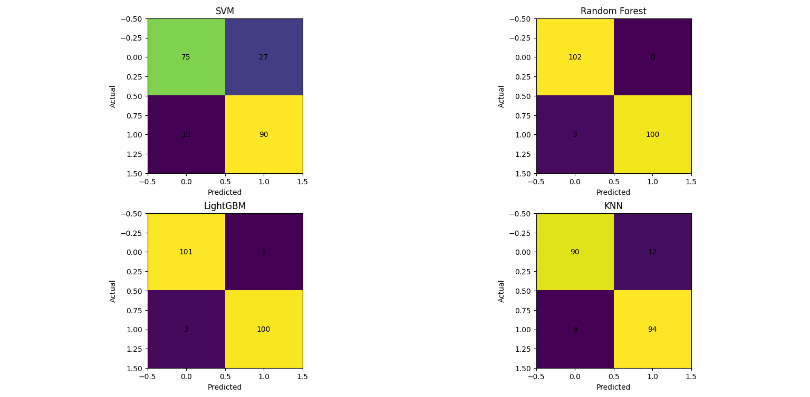
Confusion Matrix’s

Slide 14
Flask REST API Backend
User Input (Frontend / UI)
What the Backend Does
IN
Takes patient clinical data as input
▼
Flask REST API Server
PP
Preprocesses data using StandardScaler
▼
Data Preprocessing (Scaling)
ML
Runs SVM & Random Forest inference
▼
ML Models — SVM & Random Forest
▼
OUT
Returns prediction result + probability
Prediction + Probability
▼
Key Tech: Flask · StandardScaler · joblib · JSON response format
JSON Response to User

Slide 15
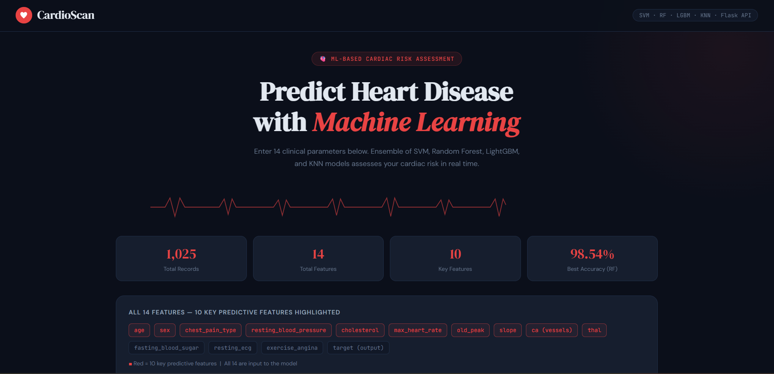
User Interface Design

Slide 16
Conclusion
A
ML Effectiveness:
Machine learning can effectively and reliably predict heart disease from clinical parameters.
B
Best Model:
Random Forest achieved the highest accuracy (98.54%) and perfect precision (100%).
C
SVM Insight:
SVM delivered acceptable results but with lower overall accuracy than ensemble methods.
D
Real-Time API:
Flask REST API enables real-time prediction accessible via any web or mobile frontend.
E
Healthcare Impact:
System can aid early detection of heart disease, especially in resource-limited settings.

Slide 17
♥
Thank You for Your Attention
Heart Disease Prediction using Machine Learning
Any Questions?
Dept. of B.Sc ITM · Ajaya Binay Degree College

