Slide 1
Employee Job Relocation

Slide 2
Job Relocation Process
Job Relocation occurs very often to improve profitability
How to present as a good opportunity to employees
How to ease transition for those who have agreed to transfer
Employee
Understanding effects of job relocation to employee
Understanding effects of job relocation to family
Adjustment time, finding location to choose a new home, climate differences

Slide 3
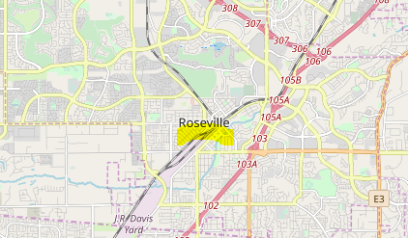
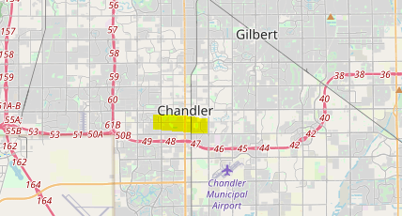
Data Considered
Data applies to scenario of an Insurance company that moves their claims department from Roseville CA to Chandler AZ.

Slide 4
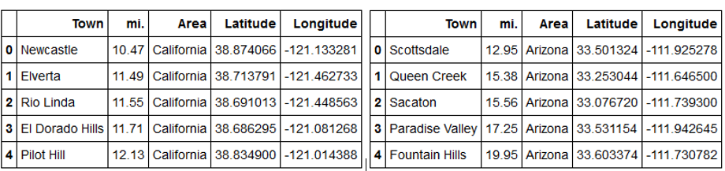
Candidate Cities
Venue comparison from the top five city locations that are a minimum 10 miles from Roseville, CA and Chandler, AZ.

Slide 5
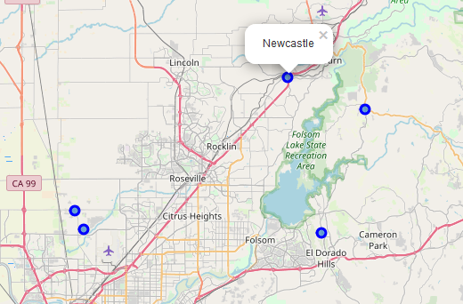
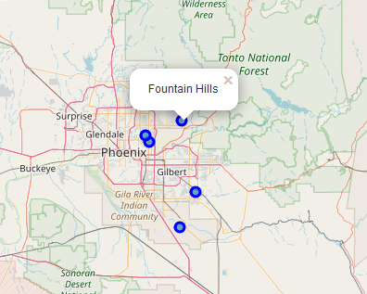
Chandler, AZ Map
Maps of job origin and relocation as well as surrounding cities
Roseville, CA Map

Slide 6
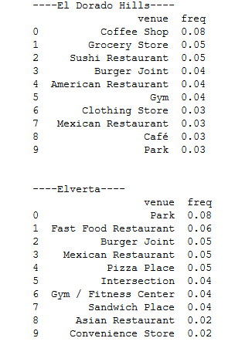
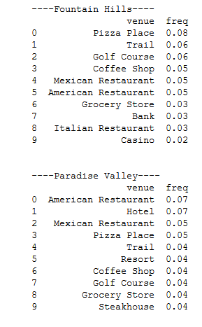
Venue Comparisons
Venue top ten venues at origin and relocation state.

Slide 7
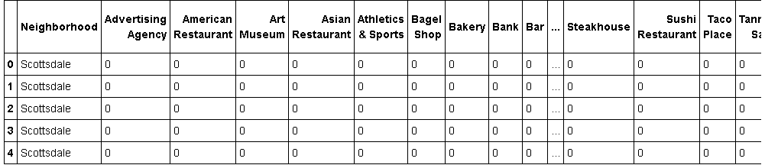
K-means Cluster
Onehot Coding of venue data
K-means using k=3 on unsupervised data

Slide 8
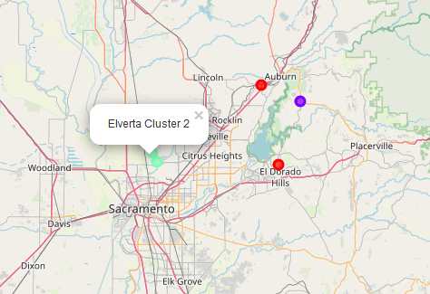
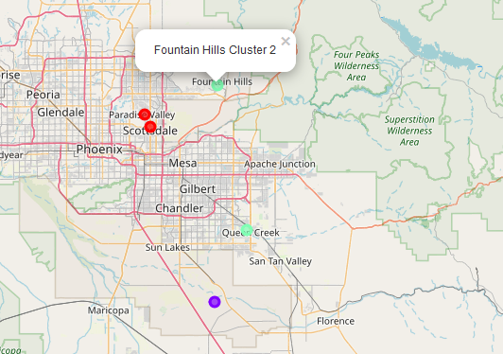
K-means Cluster
Cluster two has most variety of venues. Employees should further examine Fountain Hills & Queen Creek as good options to search for residence.
Roseville, CA
Cluster 2 – Elverta, Rio Linda
Chandler, AZ
Cluster 2 – Fountain Hills, Queen Creek

Slide 9
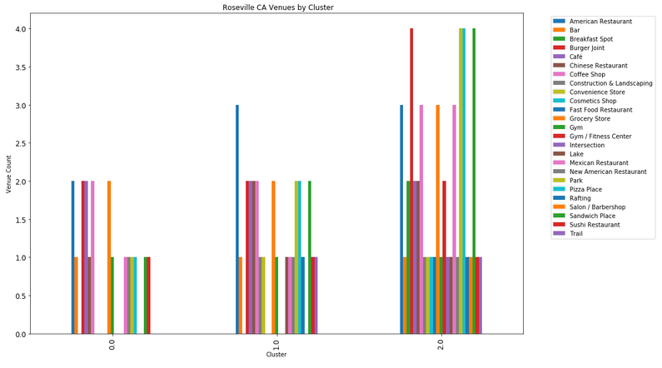
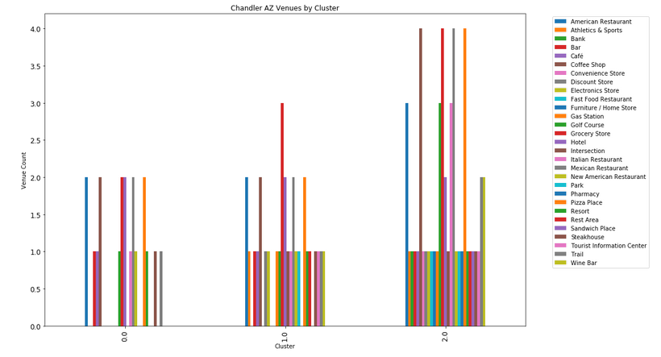
Comparison & Conclusions
The clusters follow a similar pattern with cluster 2 offering access to the most common venues
Chart & maps show between Fountain Hills & Queen Creek is a good area to begin housing search
There could be some challenges in find venues i.e gyms as well as some additional venue options like resorts.
Additional venues will be available to employee as well and may factor into decision
Improvements may result when employee can identify family special needs or most important venues.
Roseville, CA
Chandler, AZ

