Slide 1



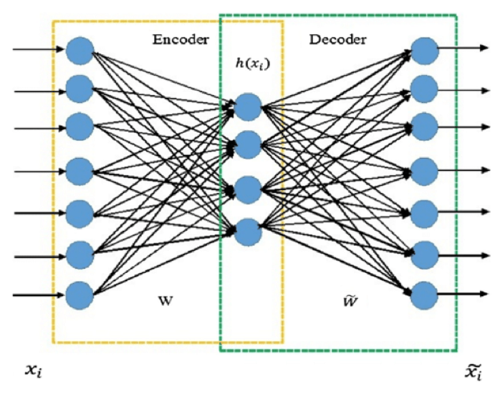
A Solution to the Evaluation Exercise for GSoC2021 - ATLAS Autoencoders
Simone Azeglio^{1, 2}
¹ Student in Physics of Complex Systems – University of Turin
² Visiting Student Researcher – University of Ottawa

Slide 2

Preprocessing - Data Manipulation
Channel 3 signal from (Dataset Description, M. van Beekveld)
Data are not a proper .csv file Regular Expressions (from “;” to “,”)
Retrieving the original splitting
Selecting jets (obj = “j”) , each has 4 features (i.e. potentials)
Features are on different scales Min-Max Normalization

Slide 3
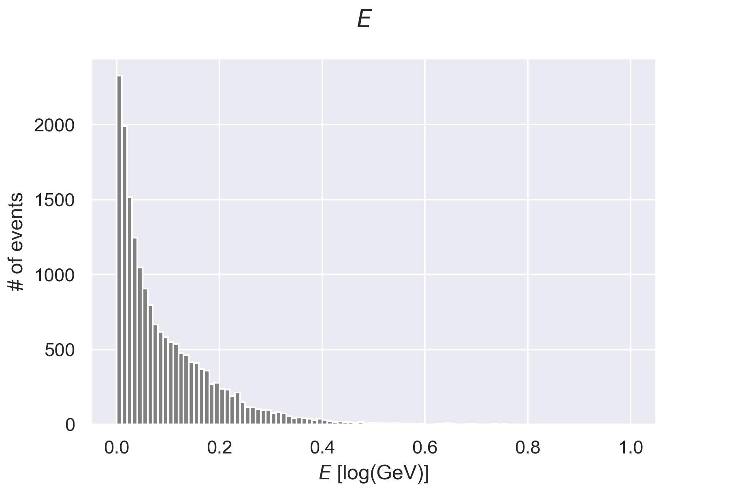
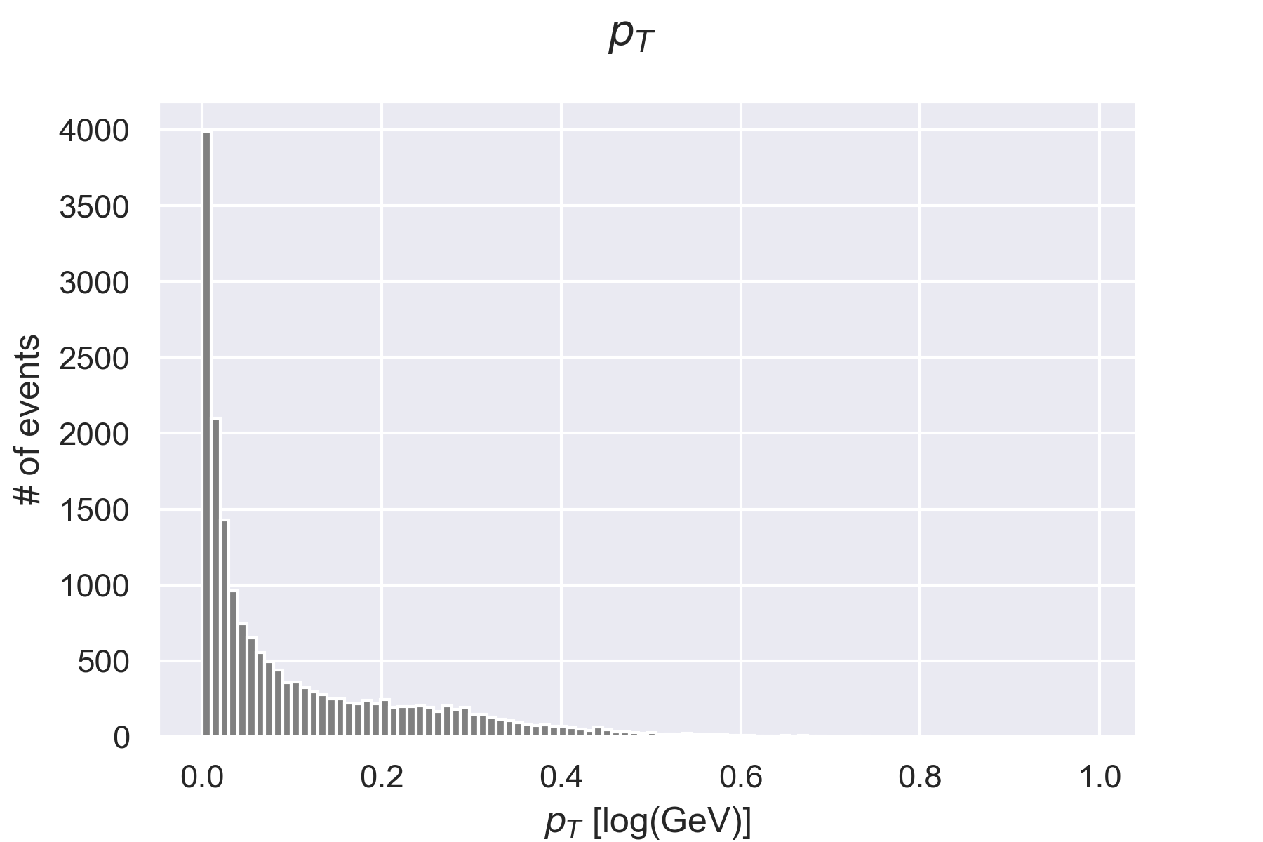
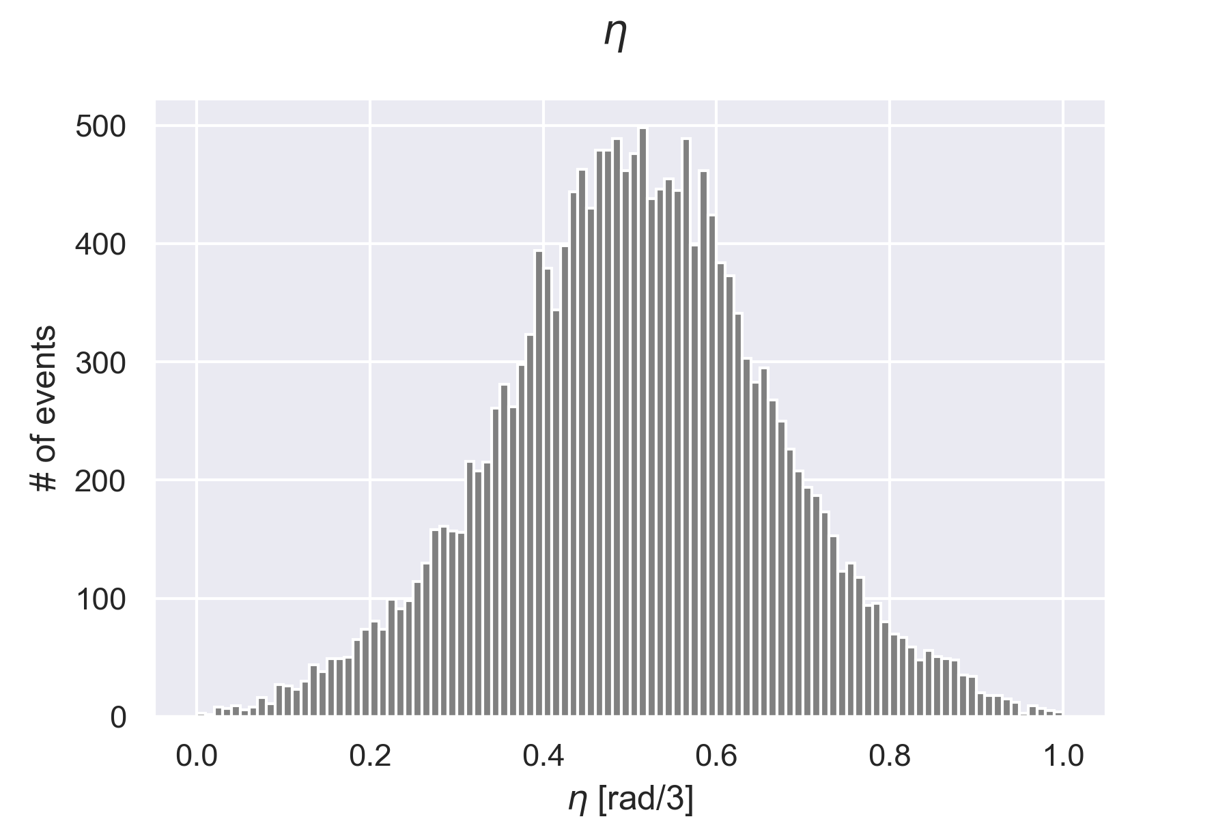
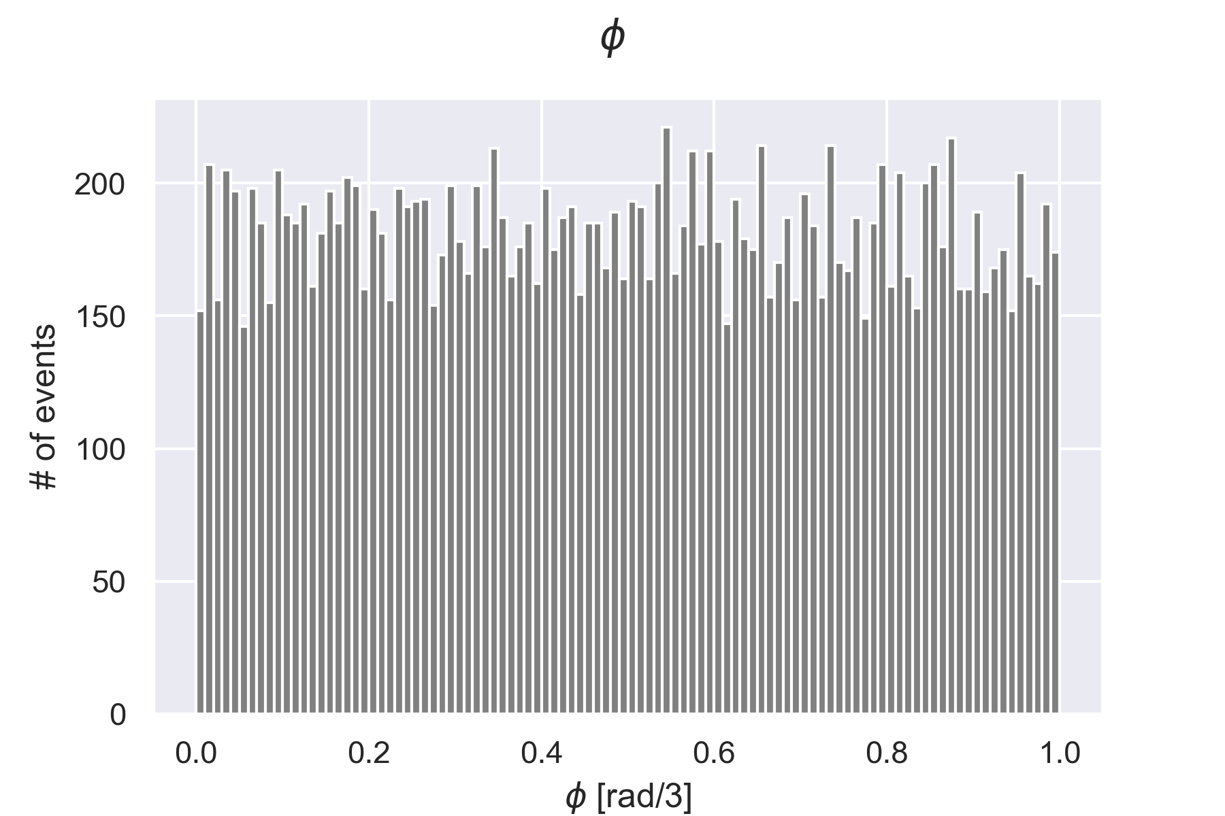

Exploratory Data Analysis & Architecture
Histogram for the 4 features (# of samples = 22661 , i.e. X_data)
Train / Validation split with ratio 80/20
Employing Autoencoder Architecture
for dimensionality reduction
A compressed representation is forced by imposing a bottleneck, the network is trained by minimizing the reconstruction error

Slide 4
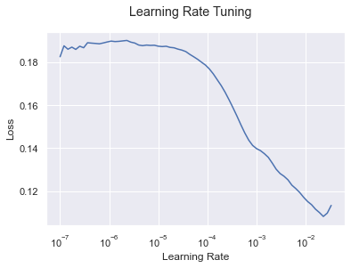

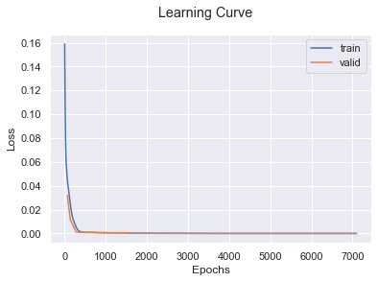

Training Autoencoder Model
Autencoder Architecture in our case
Bottleneck
“input -> 200 -> 200 -> 20 -> 3 -> 20 -> 200 -> 200 - >output”
Hidden Neurons
Hyperparameter, i.e. Learning Rate (LR) Tuning led to
LRopt =
L. N. Smyth, IEEE WACV (2017)
Autoencoder trained with cyclical LRs ending with LRopt
Learning Curve shows stability in the convergence
Validation Loss =

Slide 5
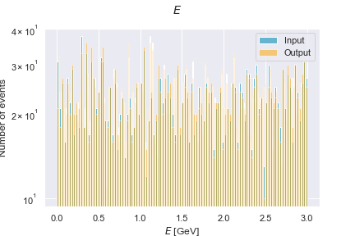
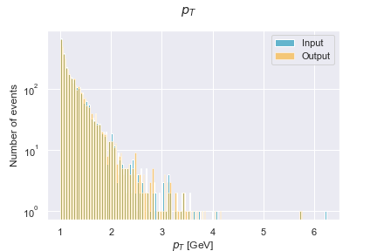
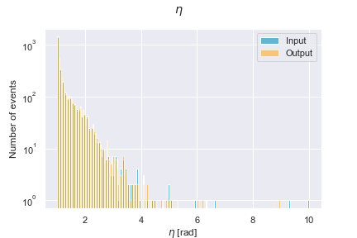
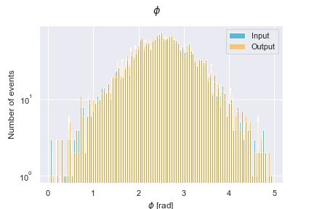

Results & Conclusions
Histogram for the 4 features :
input
reconstructed output
Visual inspection of results confirms that there is no overfitting (i.e. no regularization needed)
| Training Loss - Validation Loss | =
Our Autoencoder architecture successfully reduced the dimensionality of the problem: 4 features 3 features

