Slide 1
Collision Severity Prediction modeling

Slide 2
Predicting accident severity is important for medical personnel
Ambulance personnel
Hospital staff
Police
All these responders need to know accident severity in order to help any victims.

Slide 3
Data acquisition and cleaning
Shared dataset used as provided for the course project.
Data has 38 attributes and 194673 observations.
Insufficient data from year 2020 was dropped.
Missing values were calculated based on related data
Columns holding keys were dropped.

Slide 4
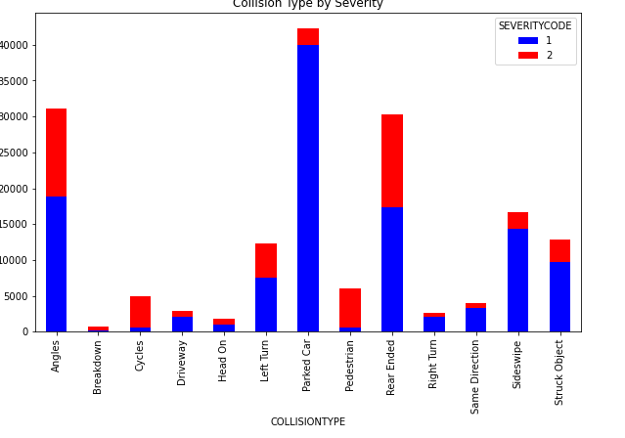
Who are at high risk?
High severity if cycles or pedestrian are hit
Parked cars get hit a lot
Many instances of rear ending a vehicle.

Slide 5
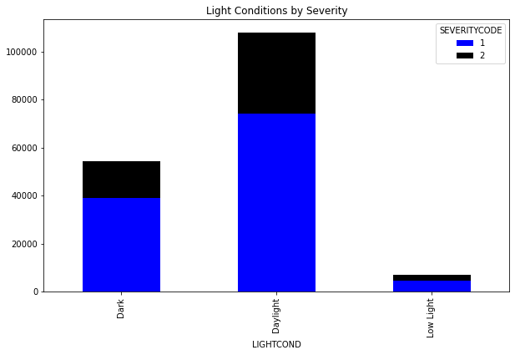
When does collision occur
Most collisions happen in daylight

Slide 6
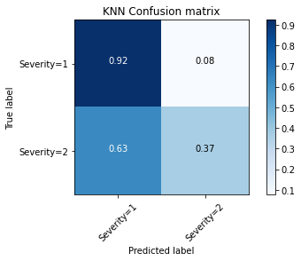
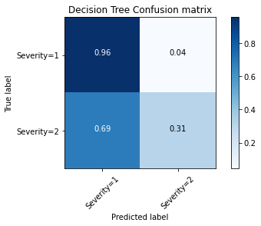
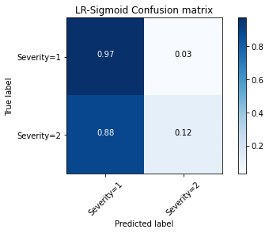
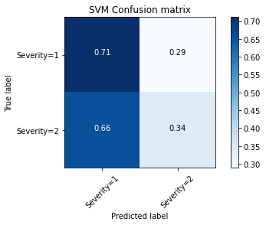
Modeling
4 classification models were used
  KNN
  Decision Tree
  Logistic Regression
  SVM
KNN showed the highest accuracy

Slide 7
Conclusion
Based on the dataset the model selected yielded accuracy of 74%, which is good but still can be improved.
This model will be helpful to medical personnel to access the collision and direct resources to reach the collision site.
Further available data such as age of drivers, new vs old vehicles can provide more information for better modeling.

