Slide 1
Smart Education System
Team Members
Md. Mafizul Islam (011 143 004)
Md. Ashraful Islam(011 143 084)
Dewan Asikuzzaman Sazol(011 143 050)
Zarin Wamia(011 143 088)

Slide 2
Project proposal
Smart Education System is a computer-based learning system which is simple and user friendly
This website is made for the school Smart Education. It is basically for students for Class 6 to Class 9.
Notes:
As we all know ‘Digital Bangladesh’ projects is going on . Our Smart Education System is a part of this project. Student can study his/her courses in home.

Slide 3
Why this project
Our main objective is to allow students to access their school materials at home
Smart Education System empowers learners to study at their own pace have access to high-quality educational material
Through this system students can view school materials and download them easily

Slide 4
BenchMark Analysis
Following are the list of features that we collected from analyzing benchmark products

Slide 5



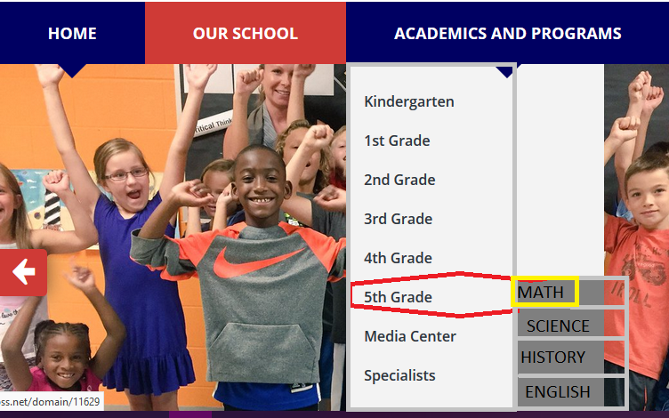
Benchmark
Notes:
Our Benchmark products are The Oxford Academy Heritage School

Slide 6
Benchmark Website
https://www.science.edu/acellus/
http://www.theoxfordacademy.org.uk/
http://www.wcpss.net/Page/21510
https://www.bellevuecollege.edu/bcconnect/

Slide 7
Our Feature Fixation

Slide 8
Our features
Online Admission
Courses
Events
News
Faculty

Slide 9
Our features :Courses
Course Overview
Learning Outcome
Video-based Lessons
Lecture
E-Textbook
Sample Question
Notes:
s delivers short video lessons taught by some of our nation’s greatest teachers. After each lesson, students receive practice problems to reinforce their understanding of the concepts.

Slide 10
Comparison Table
Websites | Online Admission | Attendance | Courses | Result | Academic Calendar | Events | Email
The Oxford Academy | Yes | No | Yes | Yes | Yes | Yes | Yes
Acellus Learning System | Yes | Yes | Yes | Yes | Yes | Yes | Yes
Smart Education System | Yes | Yes | Yes | Yes | Yes | Yes | Yes

Slide 11
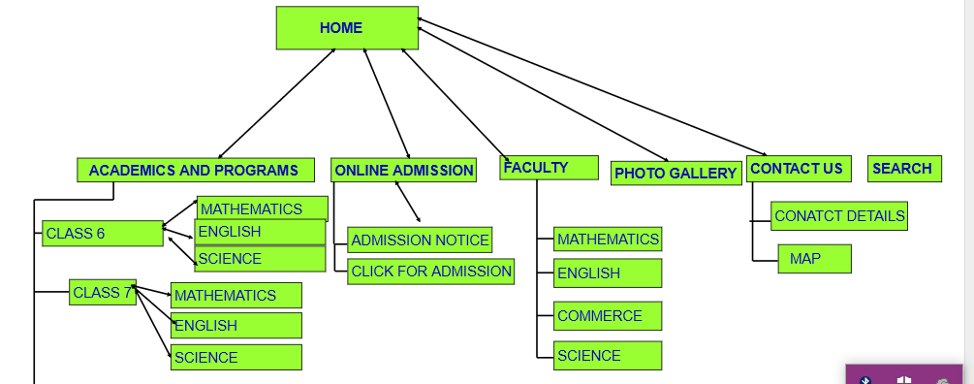
Site Map

Slide 12
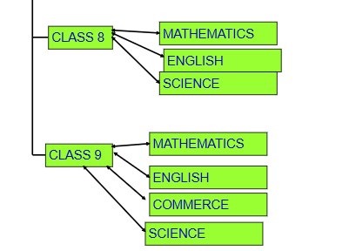
Site map continued

Slide 13
Mockup
https://app.moqups.com/Zarin/vhInv0rjXL/view/page/aa9df7b72

Slide 14

Our project at glance
Navbar

Slide 15
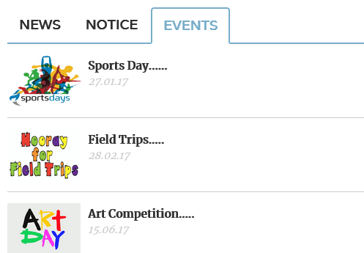

News and Events
Our Tutors

Slide 16
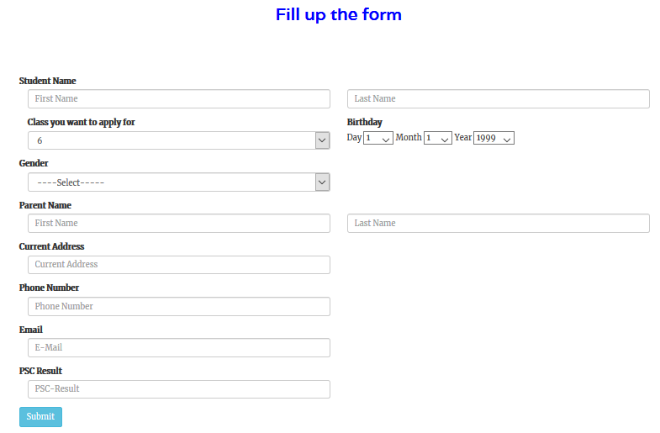
Online Admission Form

Slide 17

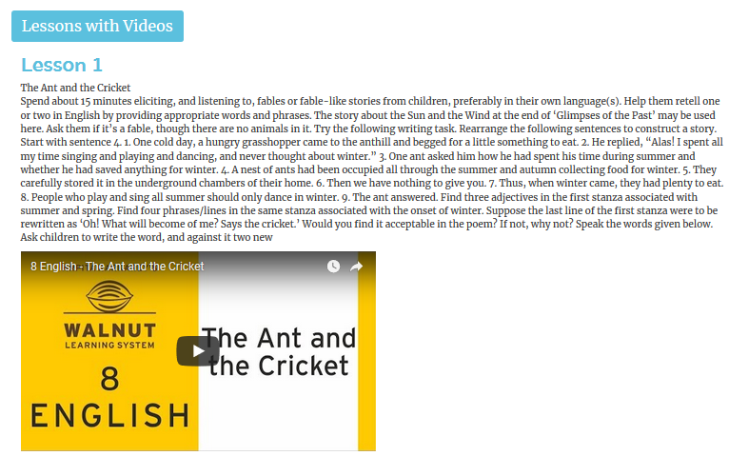
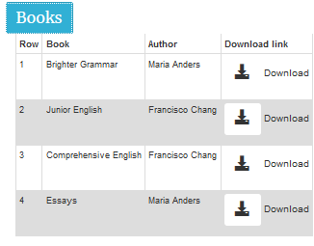
Courses

Slide 18
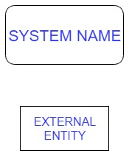
Context Diagram: Symbols
←-> means 2 way data flow.
→ means single way data flow.

Slide 19
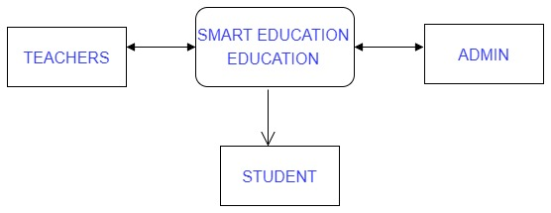
Context Diagram
0

Slide 20
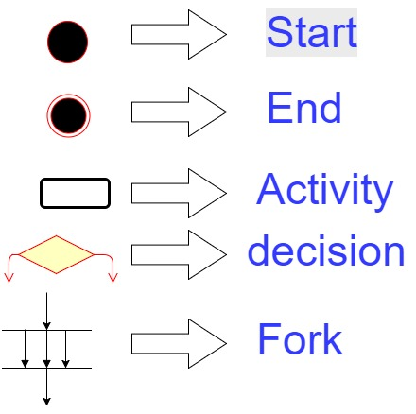
Activity diagram: Symbol

Slide 21
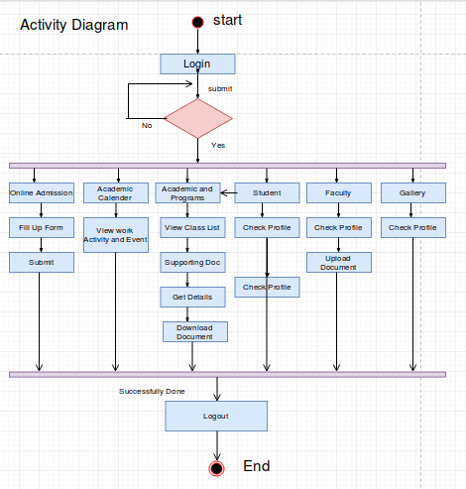
Activity Diagram
decide

Slide 22
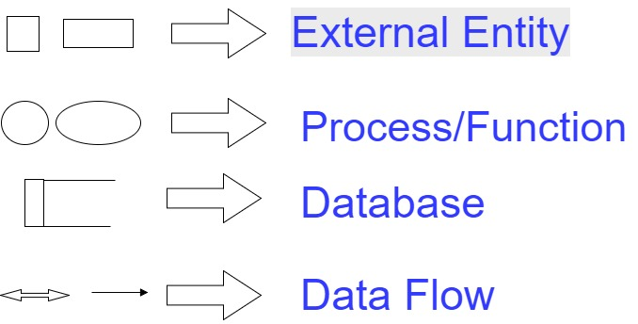
DFD : Symbols

Slide 23
DFD : Rules
Each process has name and number.
Database will be named in capital letter.
Start from top left and ended at right bottom.
Database will be connected with process only.
Database - database, external entity - database, external entity to external entity connection is not allowed.

Slide 24
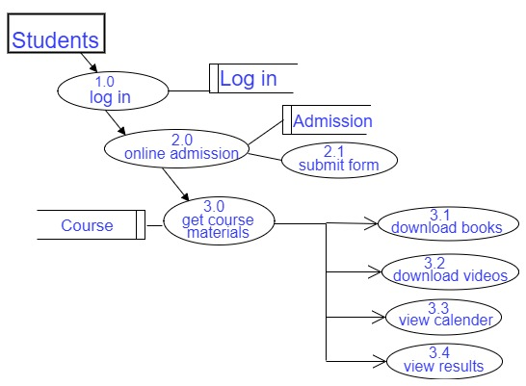
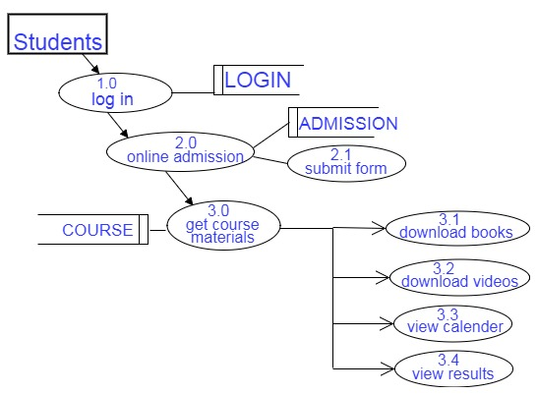
Student DFD

Slide 25
Use Case Diagram

Slide 26
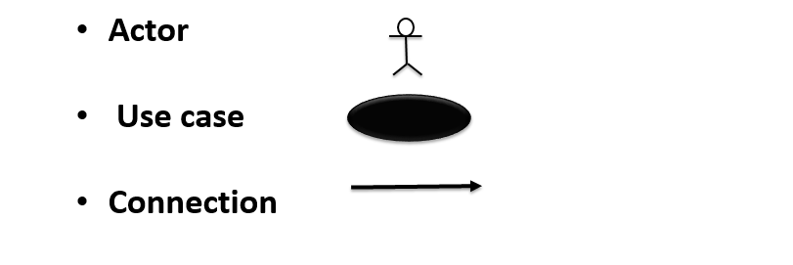
Use Case symbols
System

Slide 27
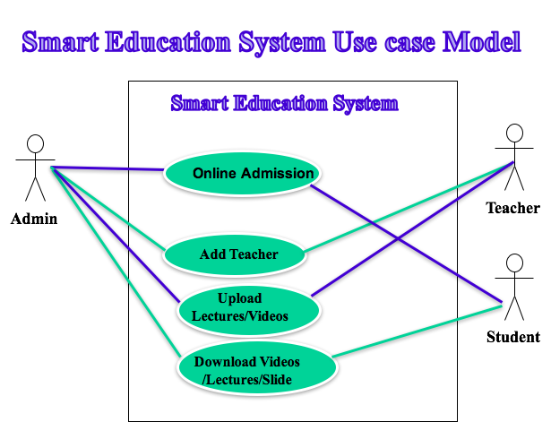

Slide 28
Use Case: Online Admission
Use Case 02: Online Admission 02
Primary Actor :Student
Stakeholder and Purposes:
Admin- Upload admission form and adds the selected students to system
Student -Fill up Admission form and submit
Precondition: Admin has to Login to the system

Slide 29
Online Admission
Success Scenario:
Step 1: Admin uploads the Application Form
Step 2: Student visit the site downloads the form and fills up the details of the form and clicks submit button for submission
Step3:When the admission process finishes email is send to the selected students

Slide 30
Online Admission
Alternate Scenario:
For Step2: If not submitted then error message is shown with a dialogue box
For Step 1-3: In case of system failure restart the system
Post Condition:
Database is updated
New Students are added

Slide 31
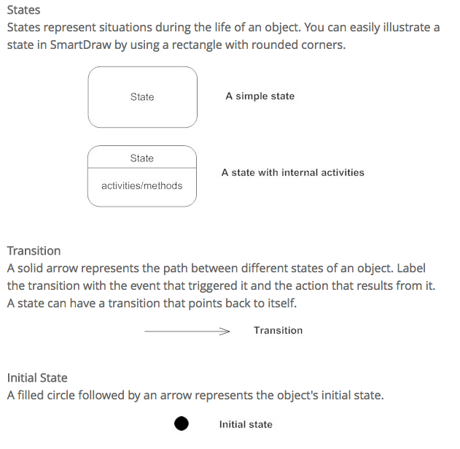
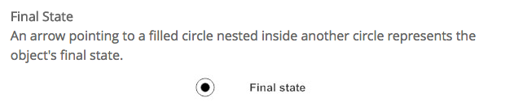
State Diagram Rules & Symbols

Slide 32
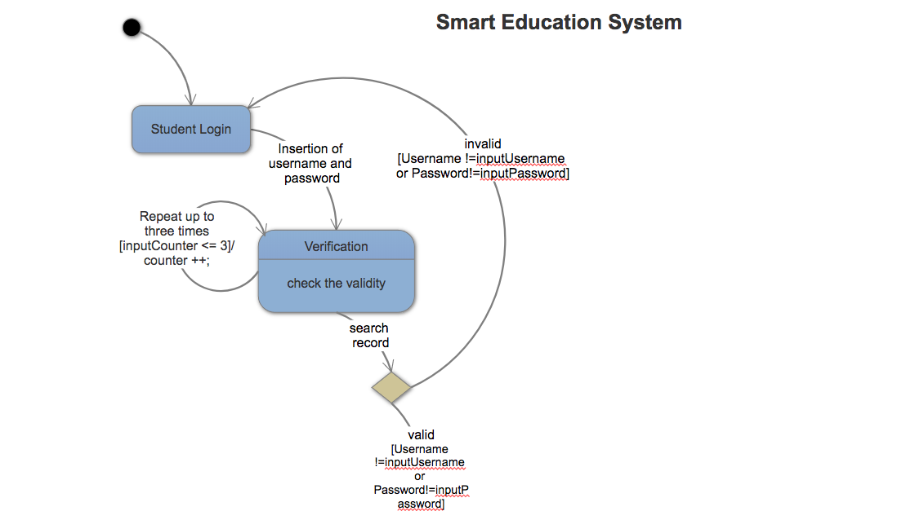
State Diagram

Slide 33
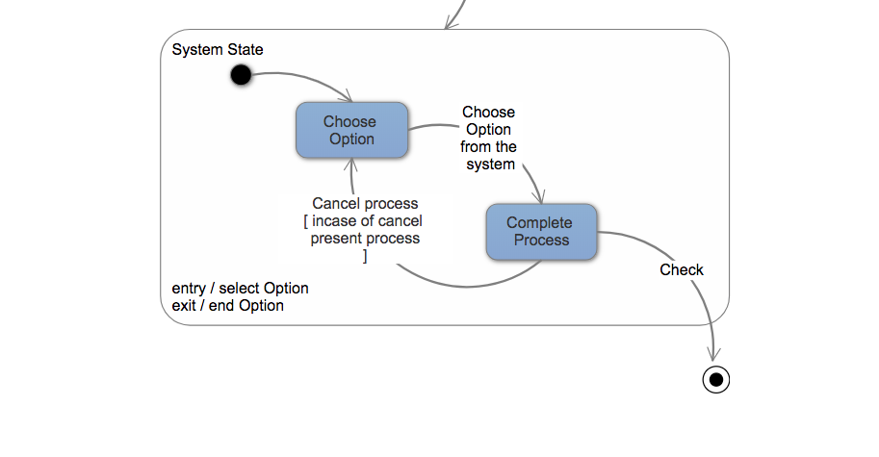
State Diagram

Slide 34
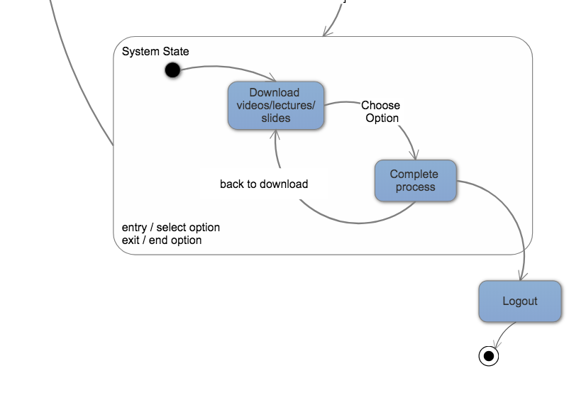

Slide 35
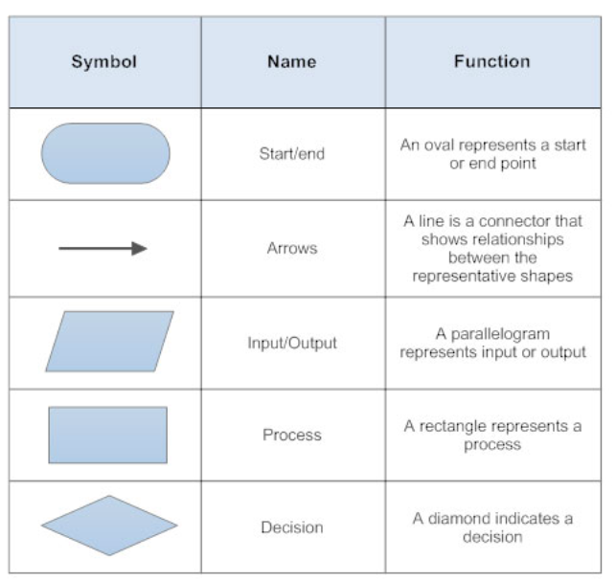
Swimlane Diagram Rules & Symbols

Slide 36
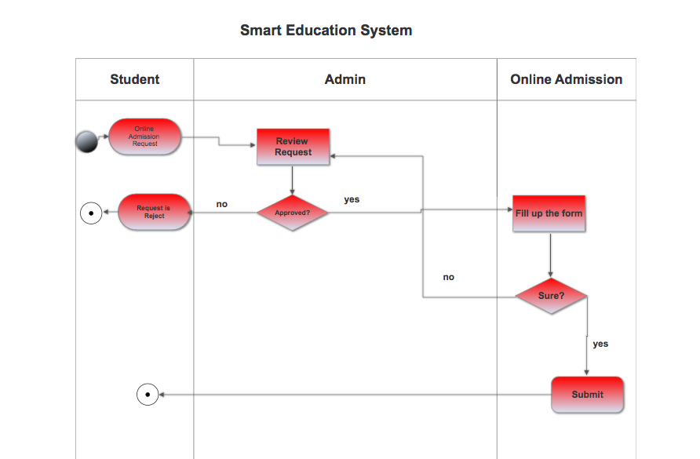
Swimlane Diagram(Online Admission)

Slide 37
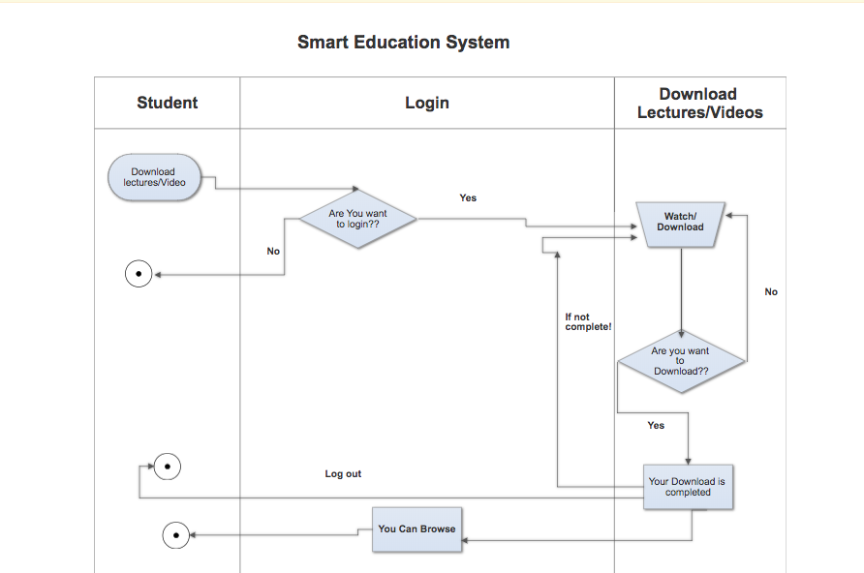
Swimlane Diagram(Download)

Slide 38
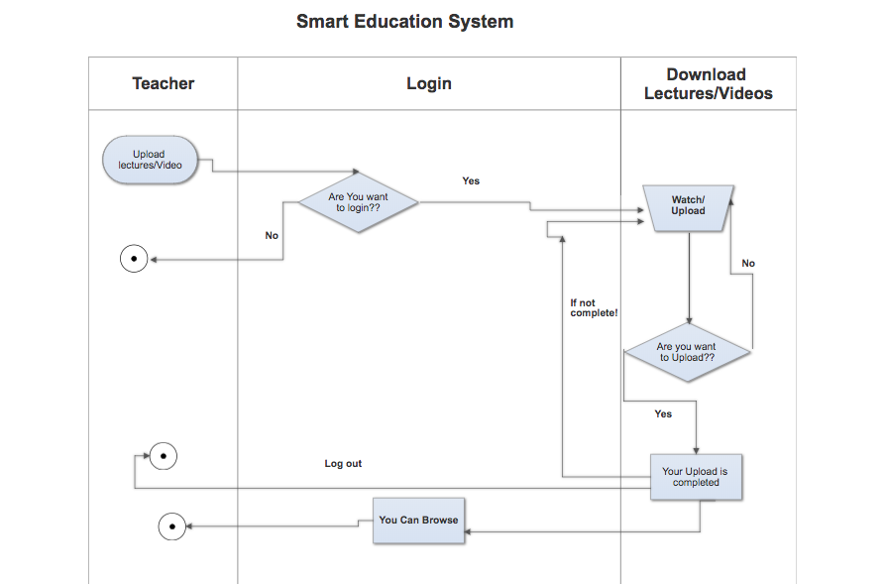
Swimlane Diagram(Upload)

Slide 39
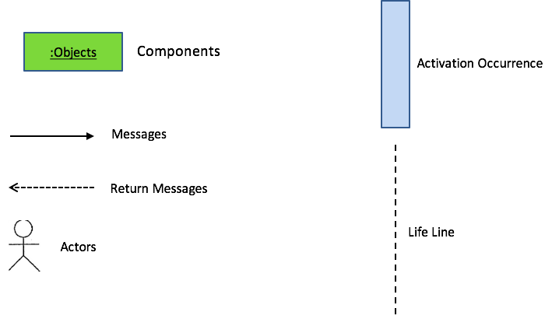
Sequence Diagram Symbols

Slide 40
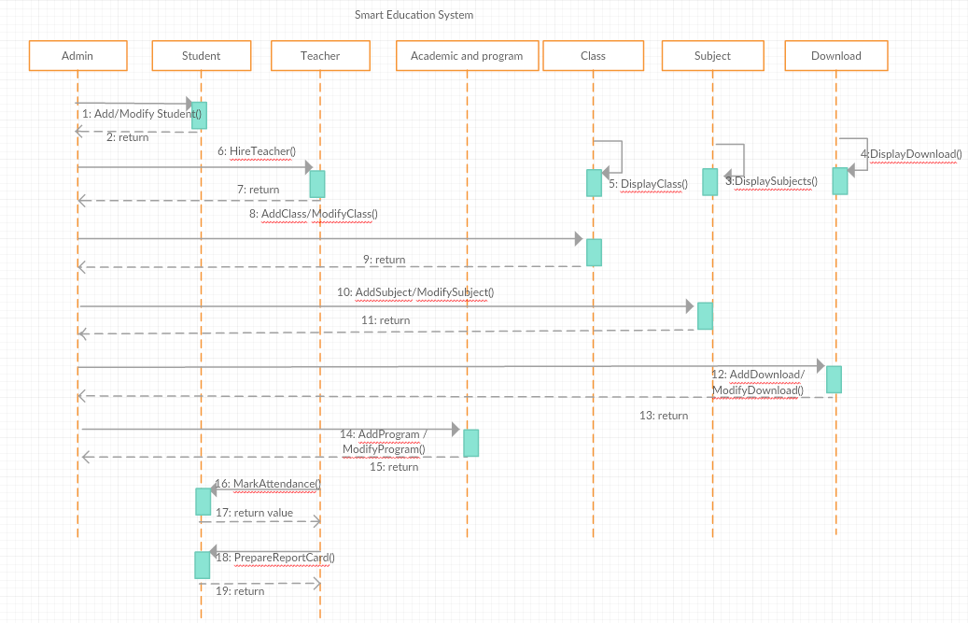
Sequence Diagram

Slide 41
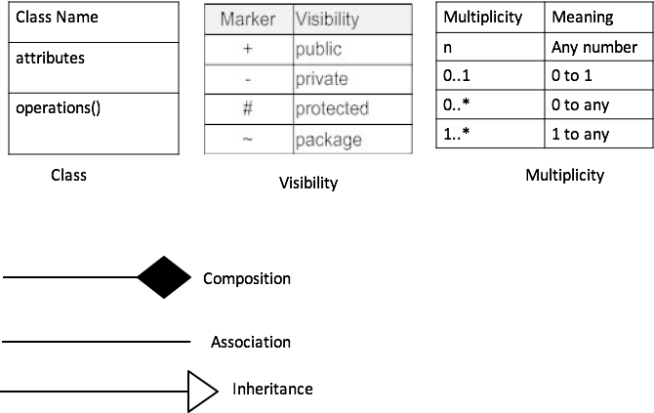
Class Diagram Rules & Symbols

Slide 42
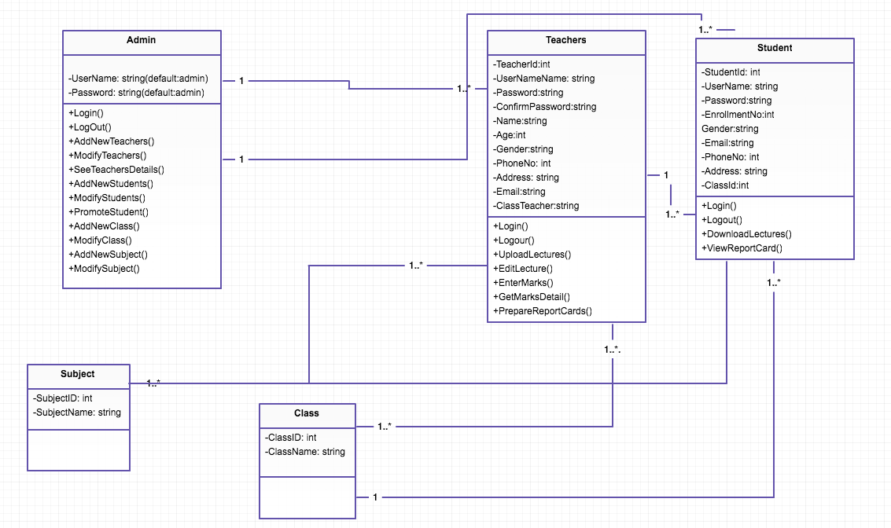
Class Diagram

Slide 43
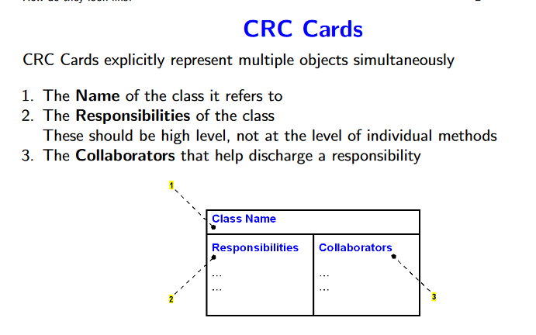
CRC Rules & Symbols
CRC: Class-Responsibility-Collaborator
CRC cards provide the means to validate the class model with the use case model
Responsibilities are a way to state the rationale of the system design
CRC cards support responsibility-based modelling

Slide 44
CRC Diagram
Admin
Student
Responsibility | Collaboration
LogIn to system Add/Remove Teacher Add/Remove Student Modify Database | Student faculty
Responsibility | Collaboration
LogIn to system Online admission Download Lectures ,videos,slides. | Admin Online admission
Admin
Responsibility | Collaboration
LogIn to system Take attendance Upload materials | Faculty Admin Attendance

Slide 45
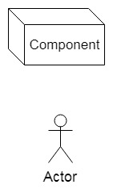
Deployment Diagram
Deployment diagrams are used to visualize the topology of the physical components of a system, where the software components are deployed.
Deployment Diagram Symbols

Slide 46
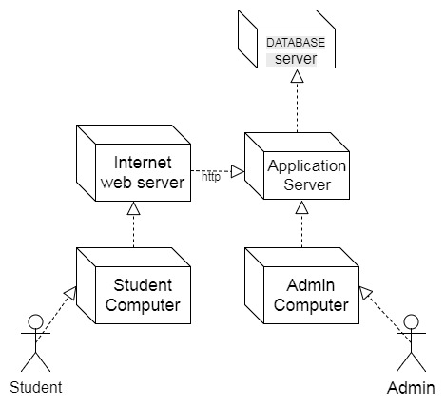
Deployment diagram

Slide 47
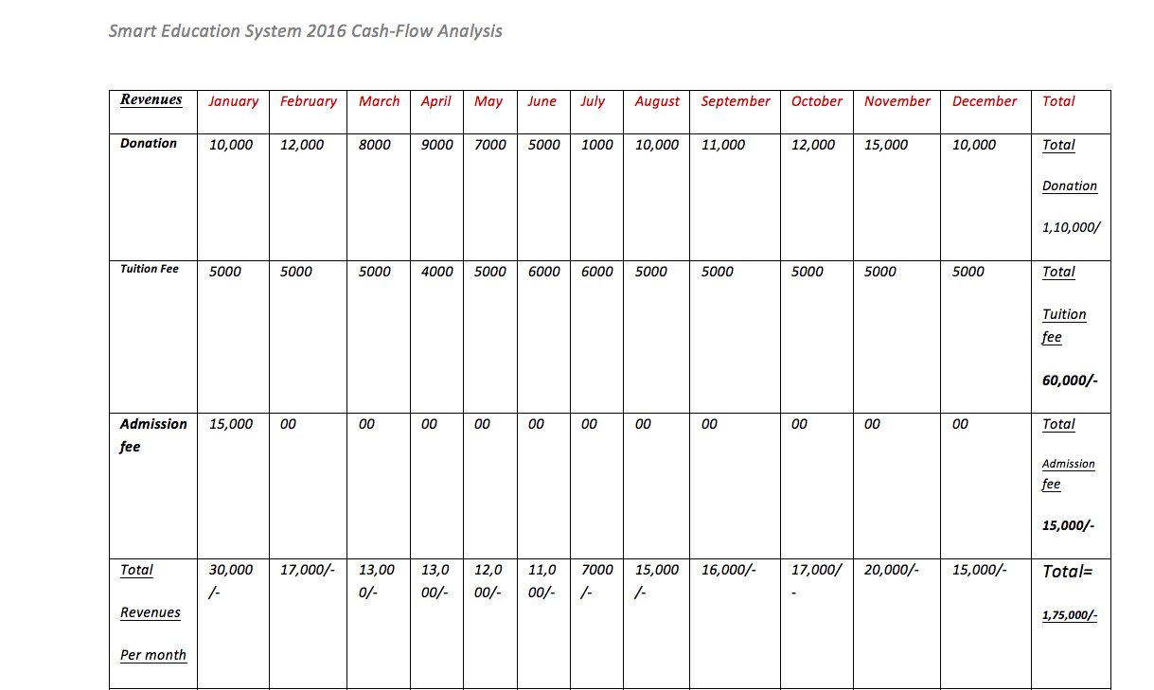
Cash Flow

Slide 48
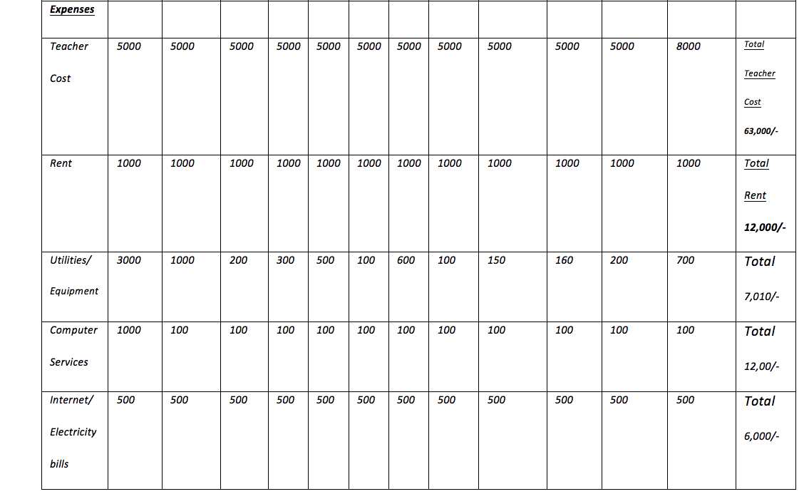

Slide 49
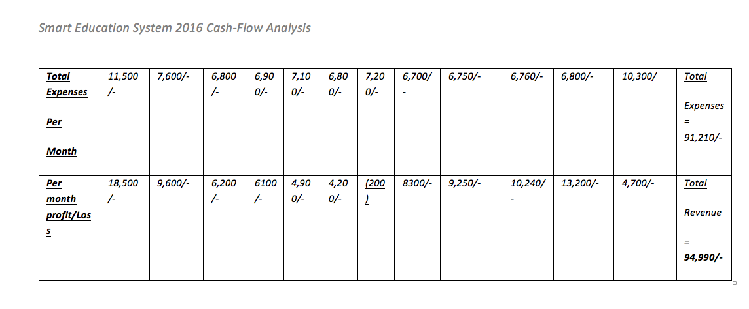

Slide 50
SWOT Analysis
Strength: Our team is very organised we can work together and have good understanding between us. Our strength is web development.
Weakness: We are not that expert in this field We are just beginners in this field.
Opportunity: In the future we can develop this project further,we can add new features. Learn new techniques such as learning new jquery functions can help to improve project. We can even sell our project when it is finished
Threat: We might not be able to complete the whole project if we do not utilize our time efficiently

Slide 51
Project Management Tools

Slide 52
The PM tools studied by us are:
Zoho Projects
Scoro
Smartsheets

Slide 53
We choose Smartsheets PM tool for our project
The following are the reasons why we choose it:
Easy to Use- Smartsheet’s spreadsheet interface makes it easy to adopt for users of any technical ability. Provides customizable project management templates to get started quickly.
Scheduling- Easy to create interactive timelines with Gantt charts.Can also attach files and add notes.
Mobile- Smartsheet’s mobile apps enable you to access project details from anywhere at any time.
Cost effective- It provides a 30 day free trial period

Slide 54
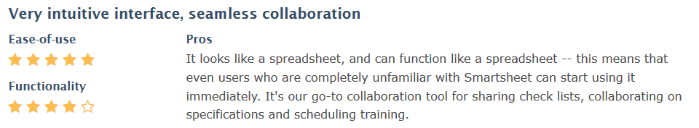
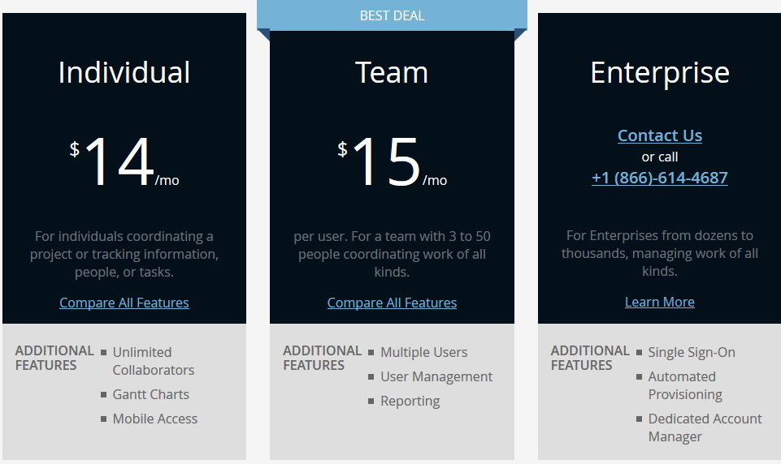
Review
Pricing

Slide 55
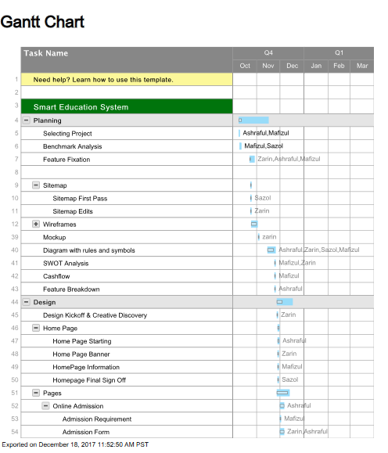
This how we incorporated Smartsheet in our project

Slide 56
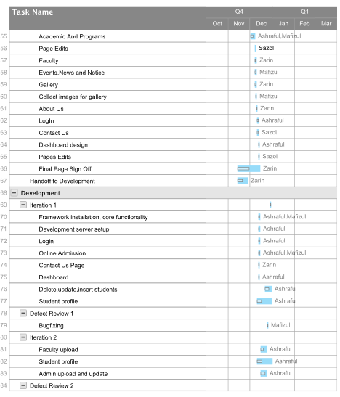
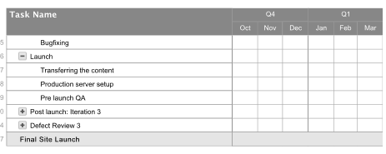

Slide 57
Hope you all like our project
Thank You :)

