Slide 1
H.O.P.E
Home Of Primary Envisage
Healthcare Administration RPA Robot
Robotic Process Automation (CAI2C01) | AY2026/2027 April Semester
Syed Ghazi Bin Syed Muhammad Shafeeq Alsagoff | 2504242E | Group P02

Slide 2
Problem statement
The problem
  Clinic staff manually re-type the same patient details across PDF registration forms, Excel records, appointment schedules, Word reports and emails — for every patient. This causes typing errors, duplicate records, missed appointments and slow confirmations, and it does not scale at peak periods.
Why it matters
  The WHO projects a global shortfall of over 11 million health workers; Singapore’s MOH needs about 15,000 more healthcare professionals by 2030. Understaffed teams make more errors, so time lost to paperwork carries a direct patient-safety cost.
The solution — H.O.P.E
  An unattended robot that automates the full patient administration pipeline: registration, appointment scheduling, record maintenance, medical report generation, email confirmation and daily management reporting.
  Target users: clinic receptionists, healthcare administrative staff, the Medical Records department, appointment-scheduling teams and clinic managers.
  Value: staff redirect time from re-typing data to patient care, while records stay accurate, de-duplicated and fully audit-logged.

Slide 3
Process
End-to-end automated flow—application shown per step
Appointment Scheduling
Report + Email
Find and book the earliest
free slot on/after the date
[Excel]
Merge Word template to PDF,
email it to the patient
[Word + PDF + Outlook]
01.
02.
03.
04.
05.
Patient Registration
Patient Data Entry
Daily Summary
Extract fields with regex,
validate, de-duplicate, write
[PDF + Excel + Python]
Update doctor, time, report
status and follow-up by NRIC
[Excel]
Total the day and email the
summary to the manager
[Excel + Outlook]

Slide 4
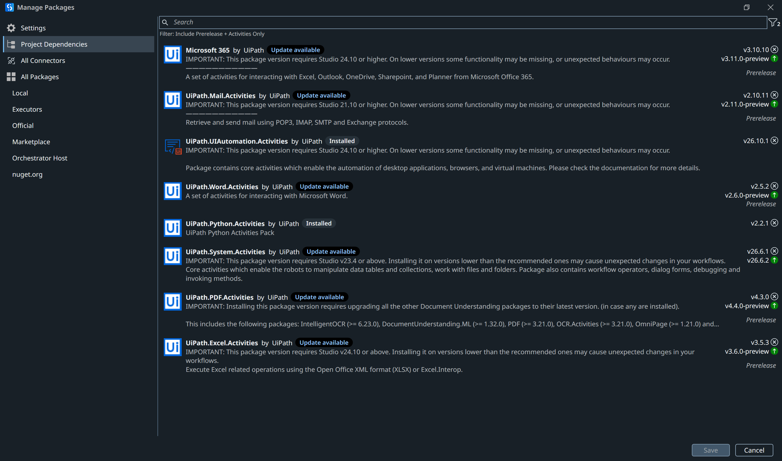
Packages (Project Dependencies) used
UiPath.System.Activities — core (Try Catch, If, For Each, Assign, Append Line, Log Message, Build Data Table, Add Data Row, Invoke Workflow File)
UiPath.PDF.Activities — Read PDF Text and Read PDF With OCR
UiPath.Excel.Activities — Use Excel File, Read Range, Write Range, Write Cell
UiPath.Word.Activities — Word Application Scope, Replace Text in Document, Export to PDF
UiPath.Mail.Activities — Send Outlook Mail Message
UiPath.Python.Activities — Python Scope, Load Script, Invoke Method, Get Object
UiPath.OCR.Activities — UiPath Document OCR engine

Slide 5
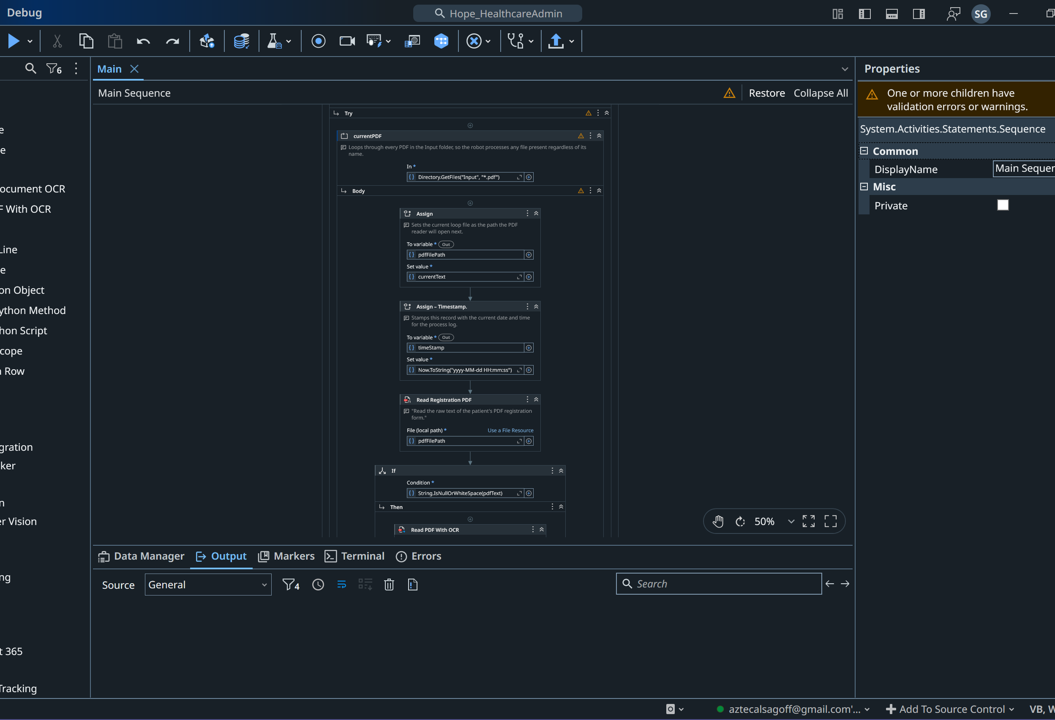
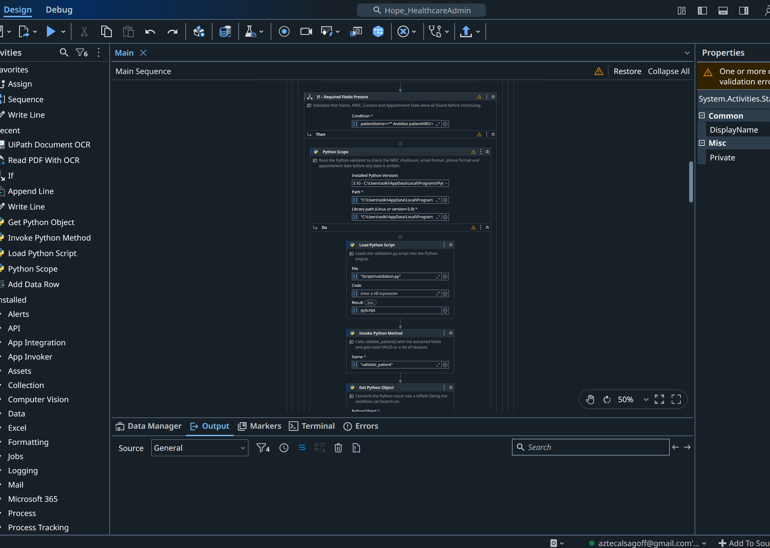
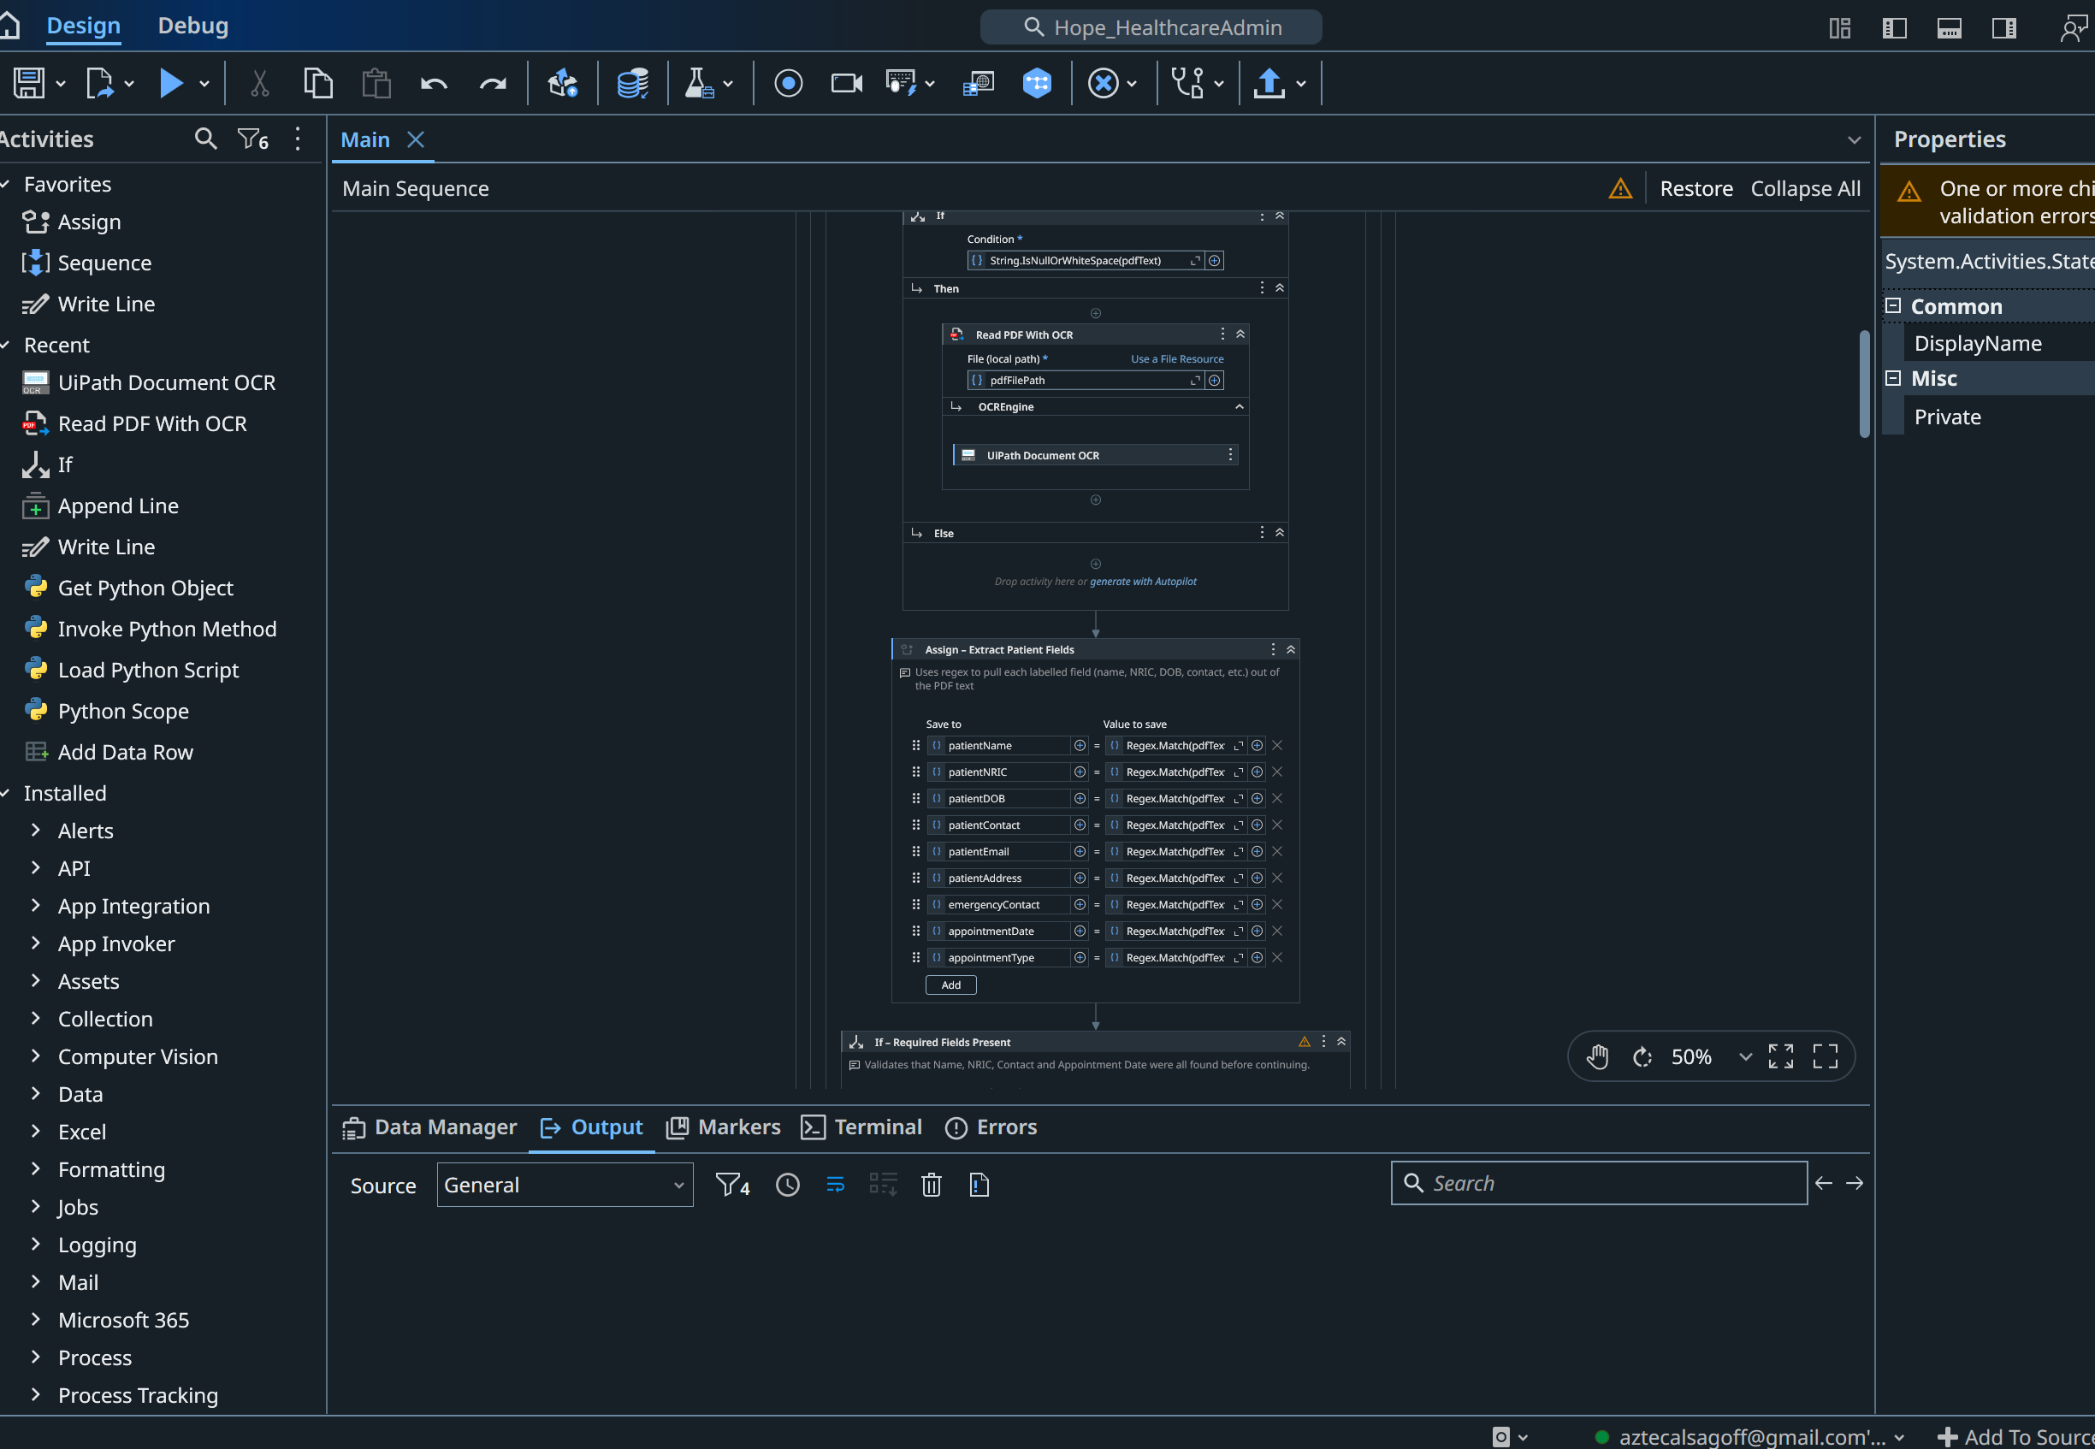
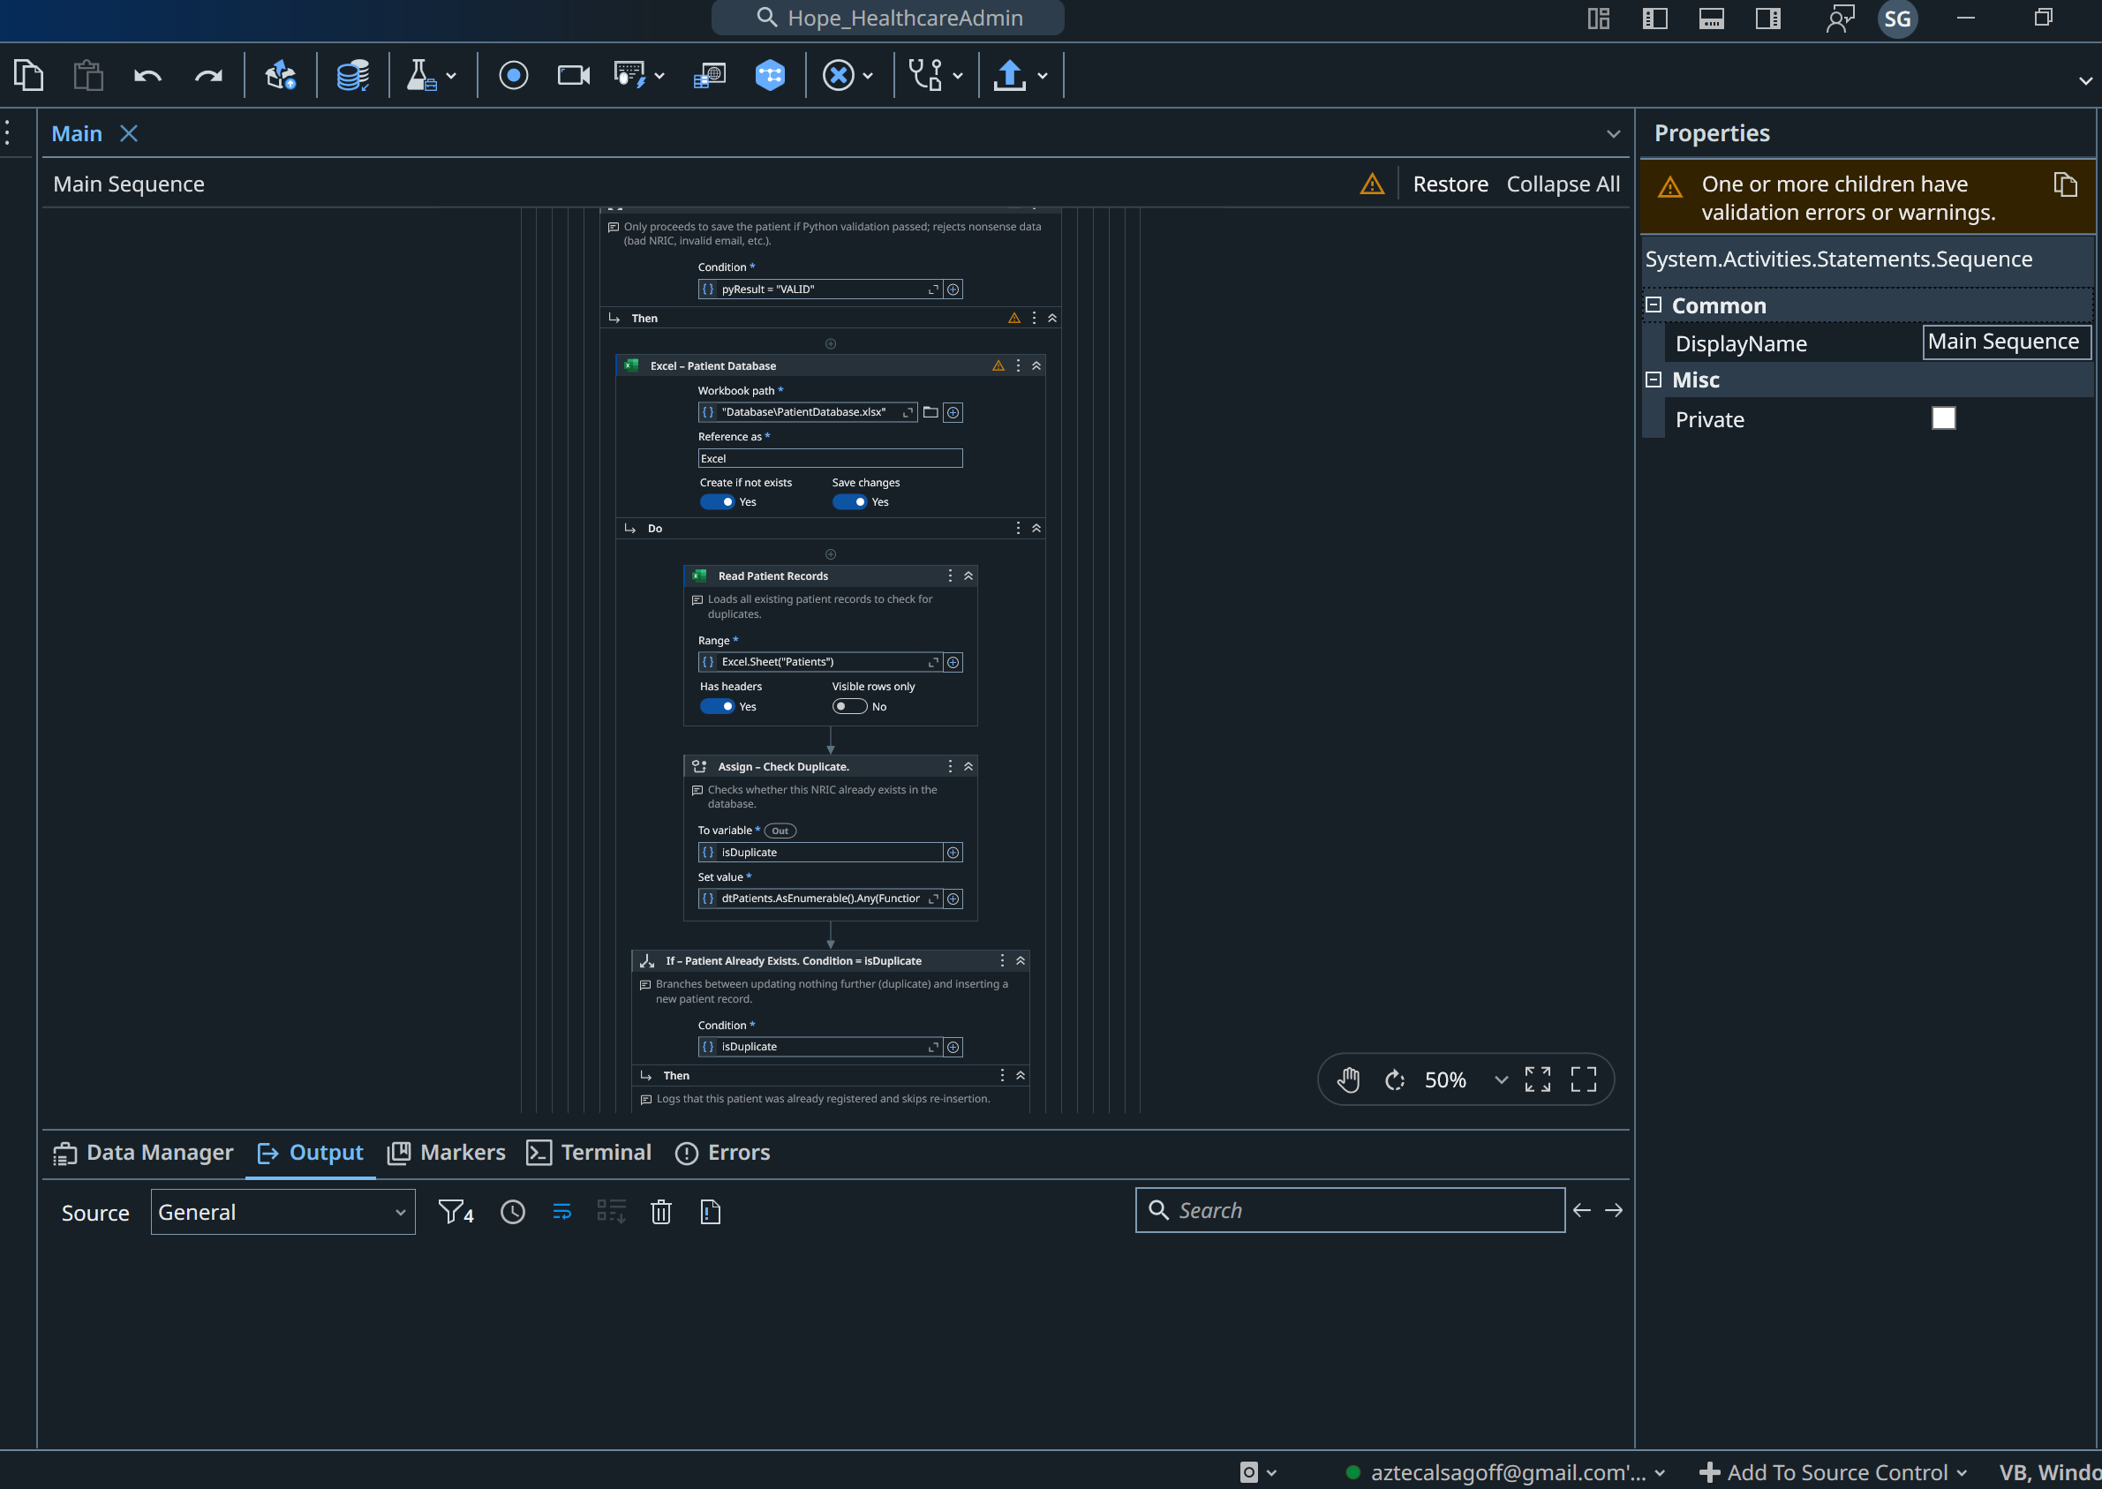
Solution 1 — Patient Registration (Main.xaml)
PDF in, validated Excel record out.
  For Each over Directory.GetFiles processes every PDF in the Input folder — no filenames hard-coded.
  Read PDF Text, with an If falling back to Read PDF With OCR for scanned forms.
  Regex Multiple Assign extracts each labelled field into structured data.
  Validation: required-field If, then Python checksum/format checks.
  LINQ duplicate check, then Add Data Row + Write Range insert the new patient.
  Every outcome logged: SUCCESS / MISSING / INVALID / DUPLICATE / ERROR.

Slide 6
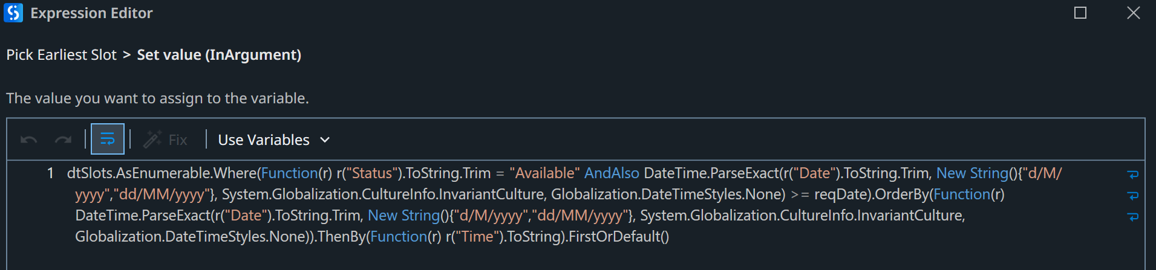
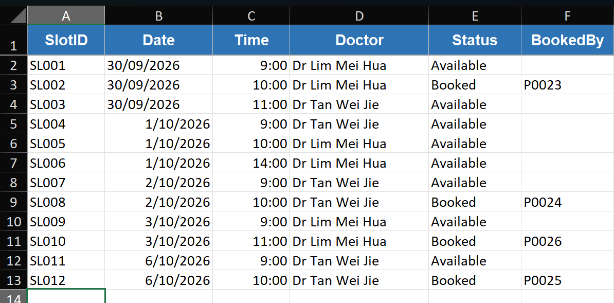
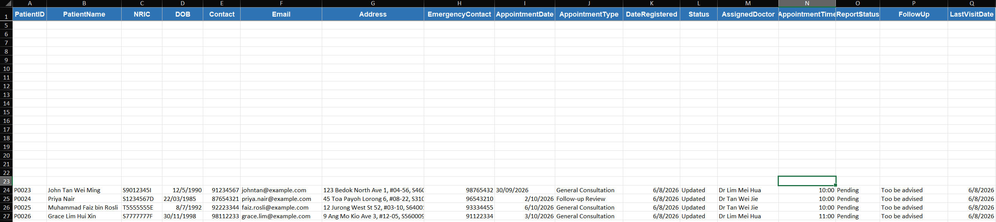
Solution 2 — Appointment Scheduling & Patient Data Entry
AppointmentScheduling.xaml
  One LINQ expression filters to available slots on/after the date, orders by date then time, and takes the earliest.
  Marks the slot Booked, writes the table back, returns doctor / date / time. Logs BOOKED or NO SLOT.
PatientDataEntry.xaml
  Finds the patient by NRIC and updates doctor, time, report status, follow-up and last visit date.
  Shows the robot maintains records, not only creates them. Logs UPDATED or NOT FOUND.

Slide 7
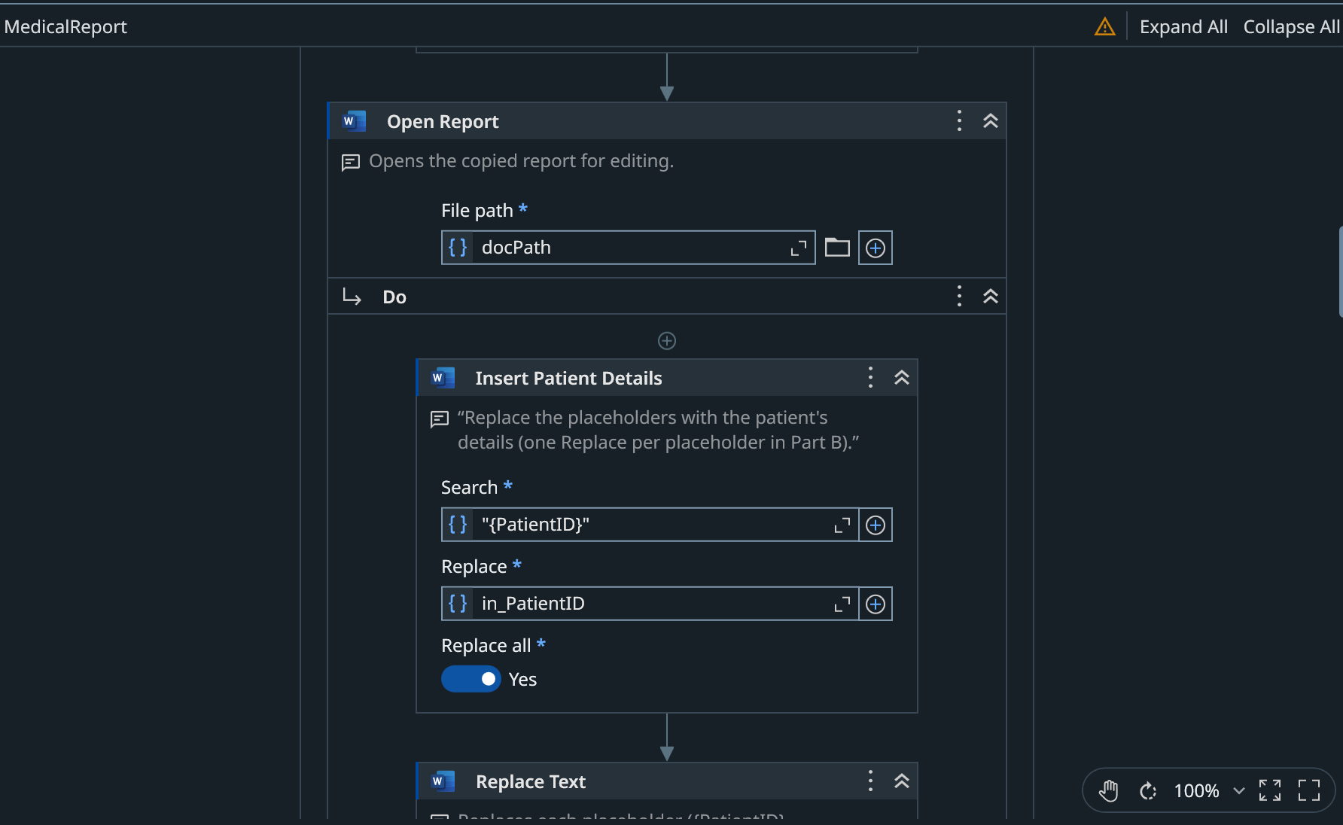
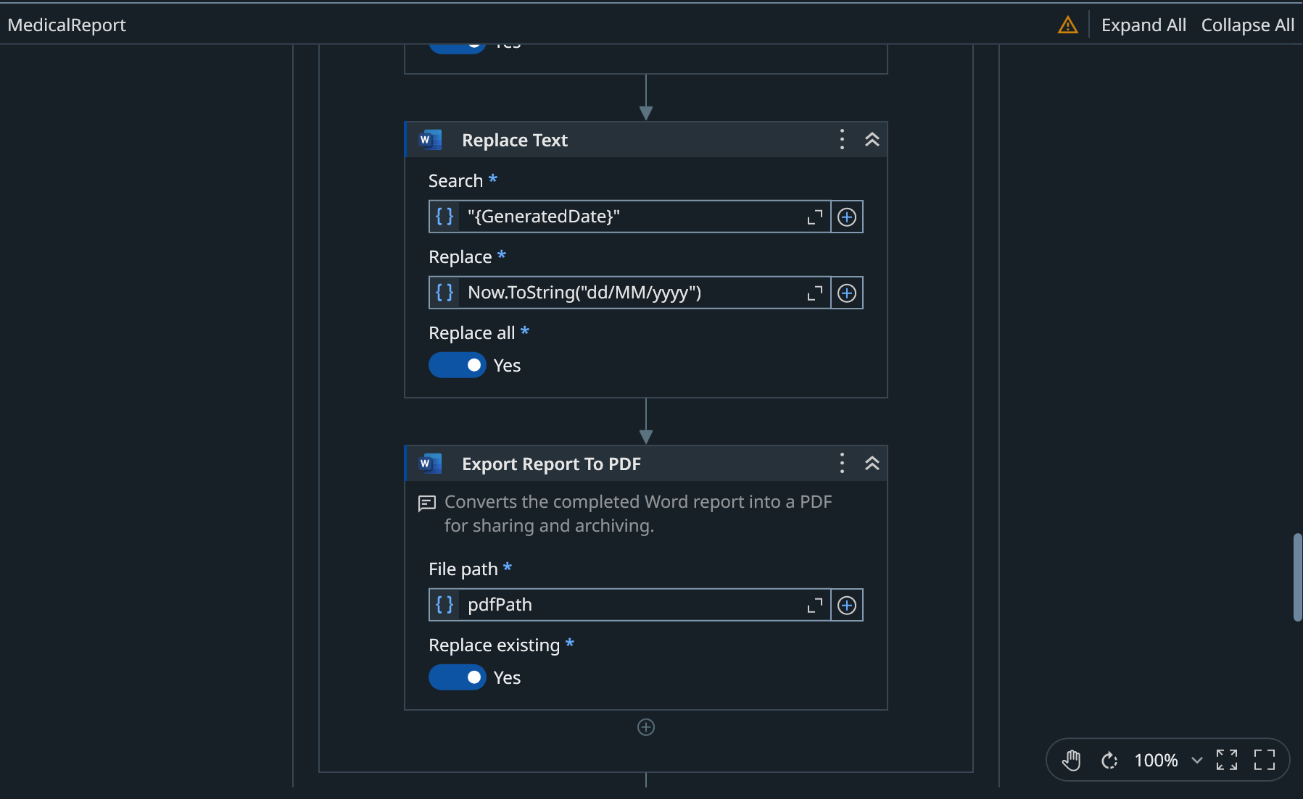
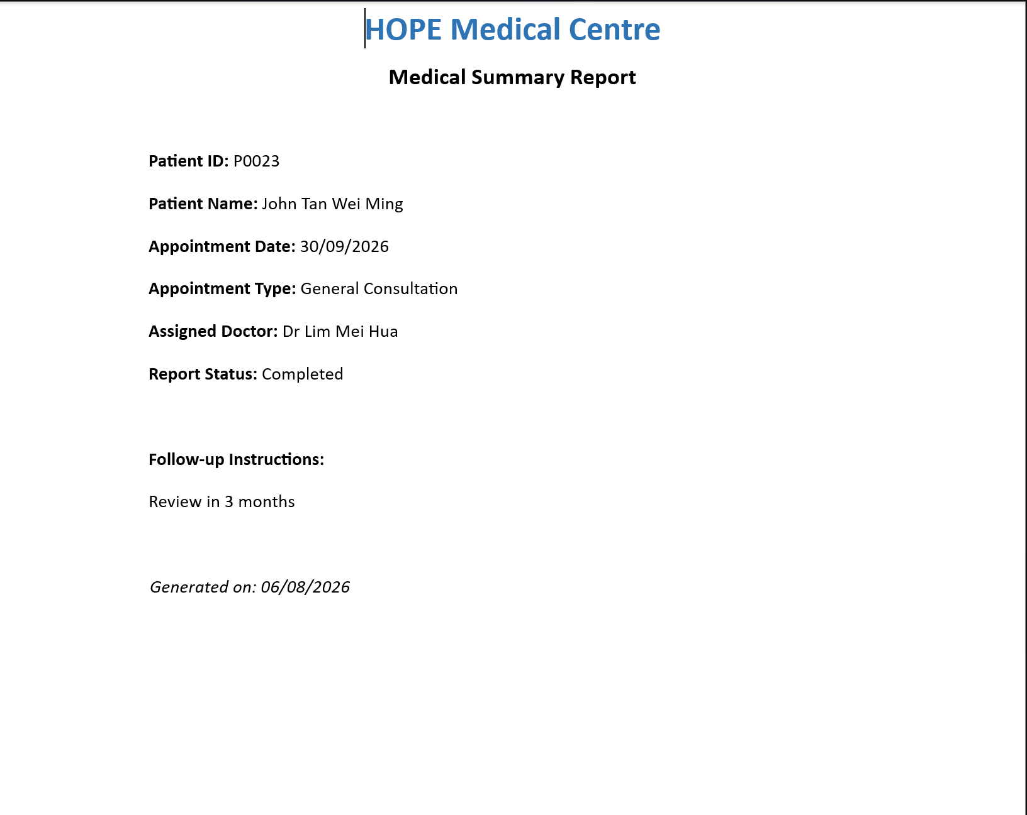
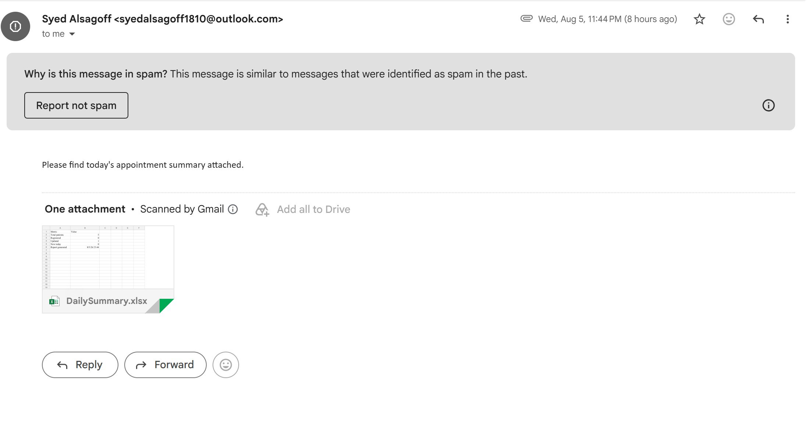
Solution 3 — Medical Report, Email & Daily Summary
MedicalReport.xaml
  Copy File takes a fresh template; eight Replace Text in Document activities fill the placeholders; Export to PDF saves the report.
EmailConfirmation.xaml
  A personalised HTML confirmation with the report PDF attached.
DailySummary.xaml
  LINQ counts the day’s totals, Write Range saves the summary, and it is emailed to the clinic manager.

Slide 8
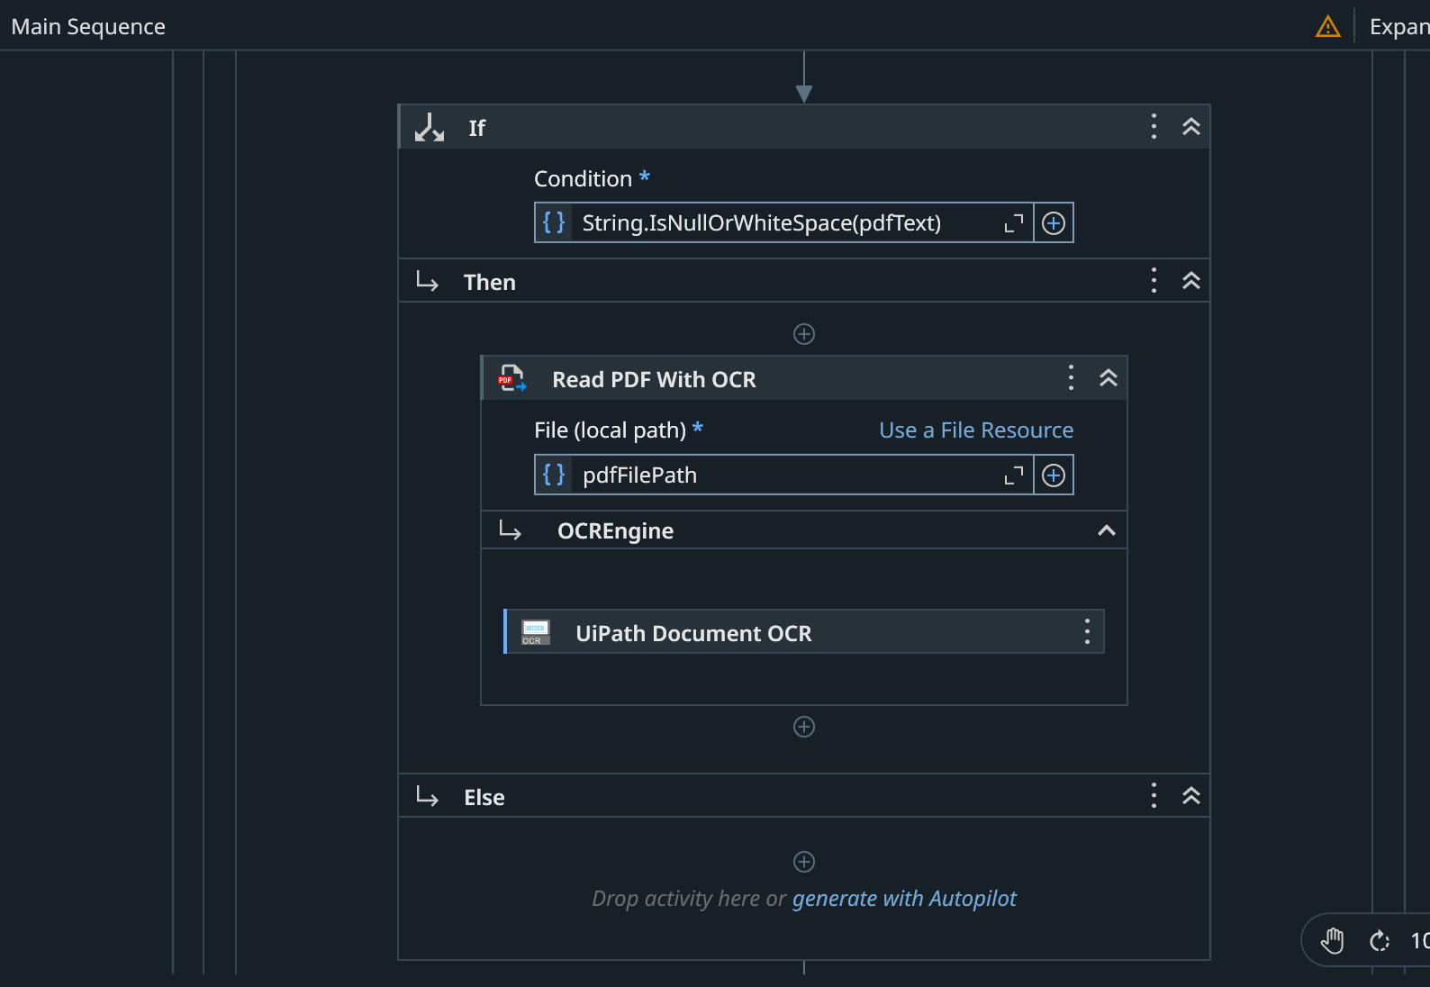
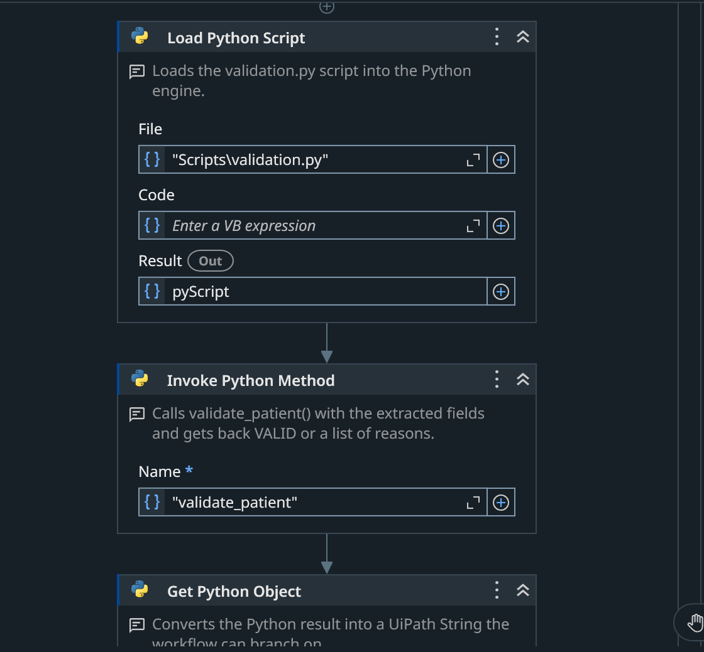
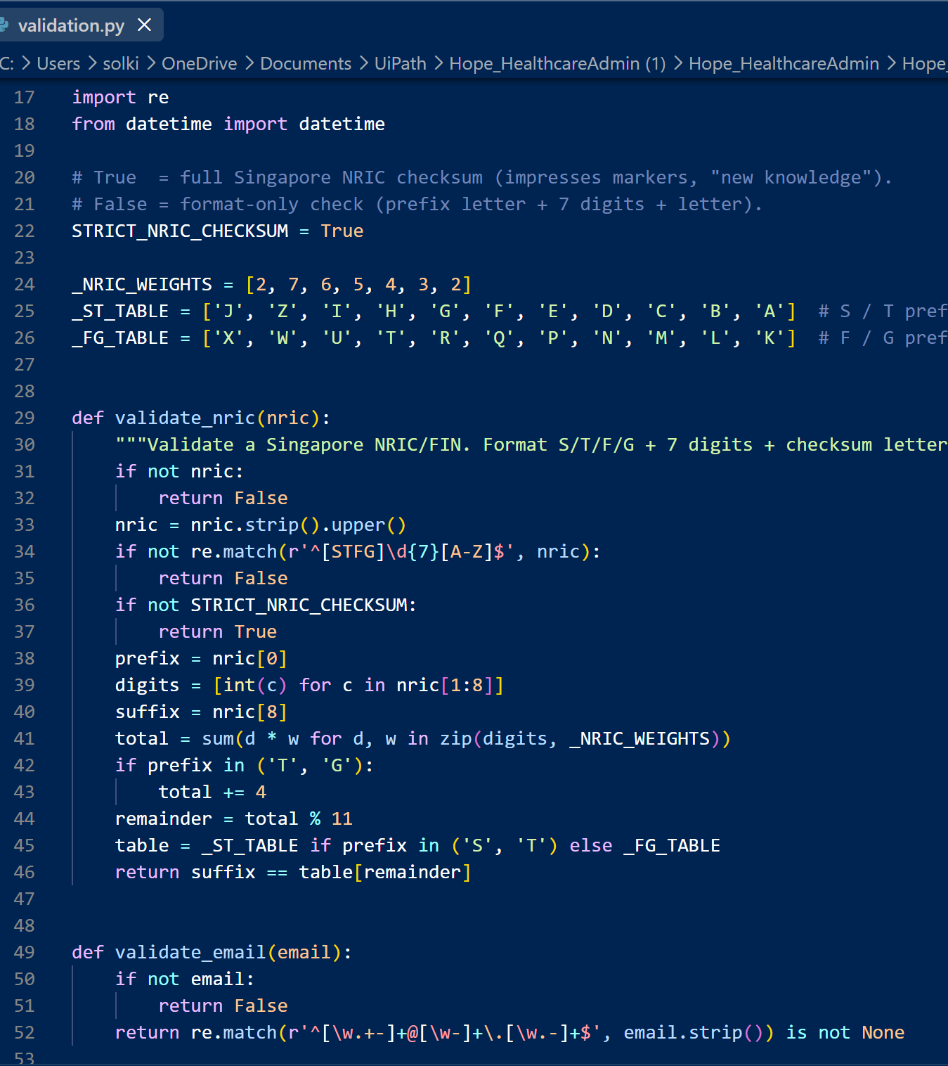
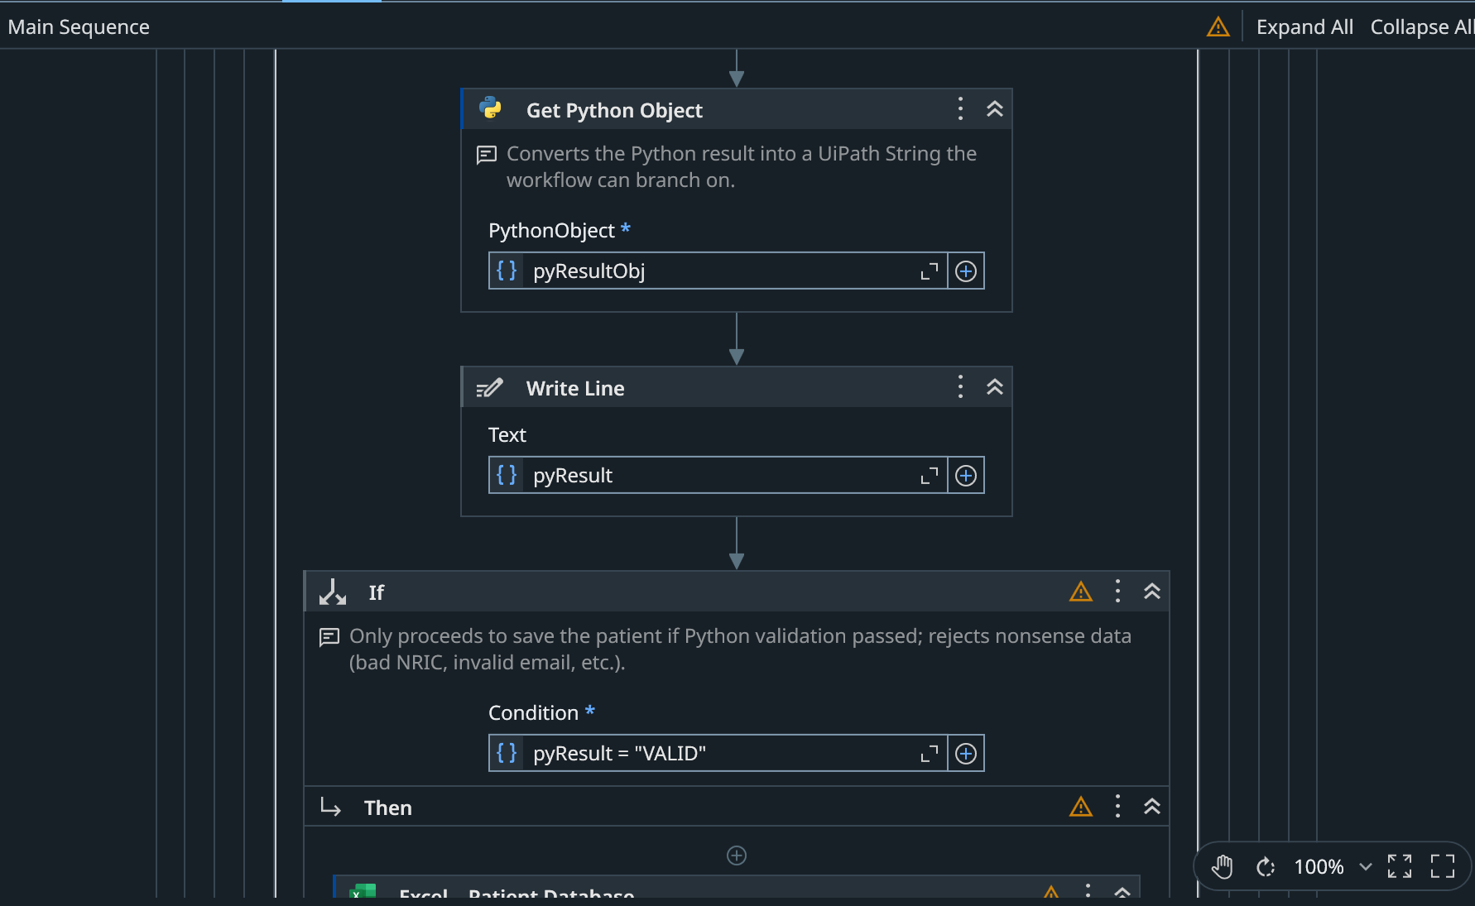
Interesting functions — beyond opening & reading files
Python validation engine — the most complex piece
  An external validation.py I wrote runs the real Singapore NRIC checksum — the weighted-digit algorithm and check letter — so IDs that pass a simple format check but are mathematically invalid are still rejected. It also validates email, phone and appointment-date logic. A genuine 5th application, beyond the syllabus.
AI-powered OCR fallback
  The robot detects when Read PDF Text returns nothing (a scanned or image-based form) and self-recovers by re-reading the same file with Read PDF With OCR (UiPath Document OCR) — resilience through decision logic, not a fixed path.
Regex extraction & LINQ querying
  Regex.Match turns unstructured PDF text into structured fields. A single LINQ chain — Where + OrderBy + ThenBy + FirstOrDefault, with culture-aware parsing across two date formats — finds the earliest suitable slot in one expression; Any() handles de-duplication.
  Dynamic multi-file loop, Word→PDF merge, HTML email with attachments.

Slide 9
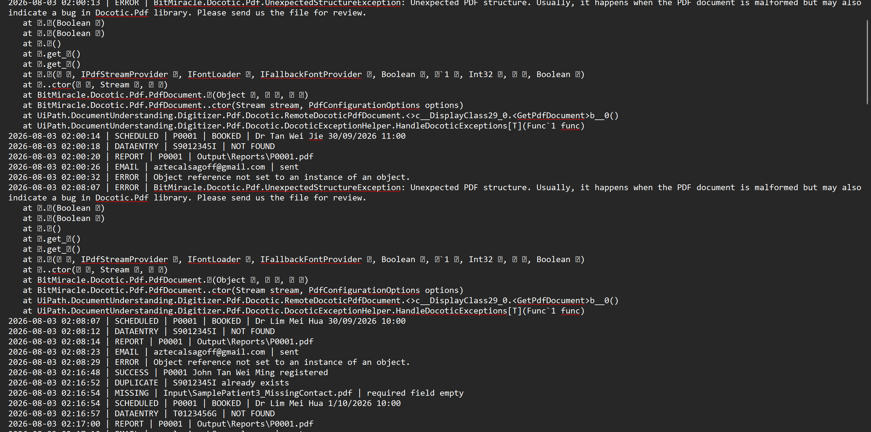
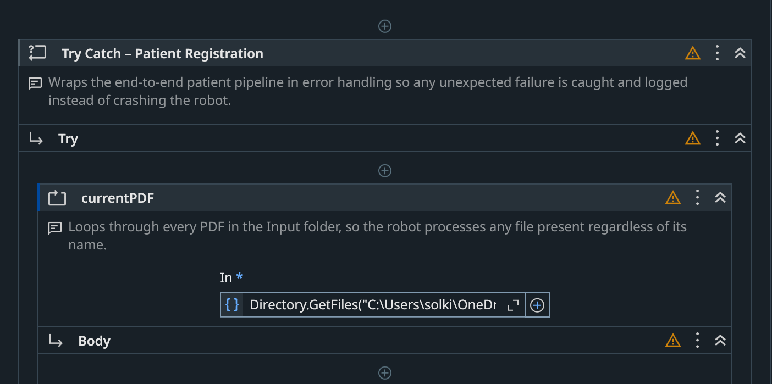
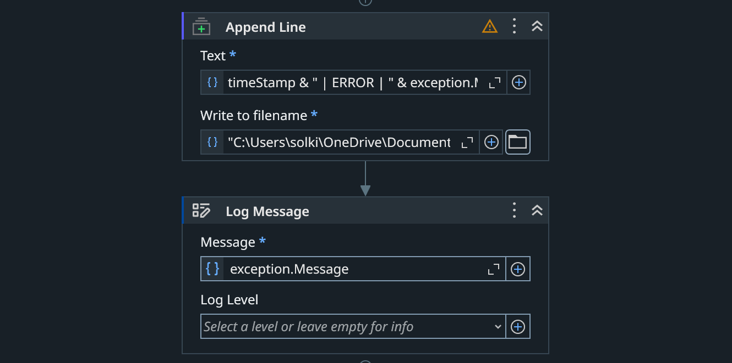
Error handling & validation
Layer 1 — Try Catch everywhere
  Main and all five sub-workflows are wrapped in Try Catch; each Catch logs the error and the robot ends cleanly instead of crashing.
Layer 2 — validation first
  Required fields, Python checksum/format checks, duplicate detection, no-slot and not-found paths — bad data never reaches the database.
Layer 3 — full transaction logging
  Every outcome is written to ProcessLog.txt with a timestamp — a complete audit trail.
  Tested: unreadable/renamed PDF, missing field, invalid NRIC, duplicate, no slot, bad date, locked Excel — all caught, none crashed.

Slide 10
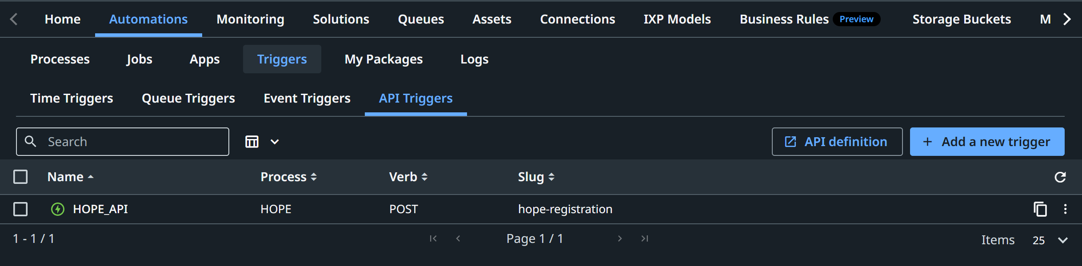
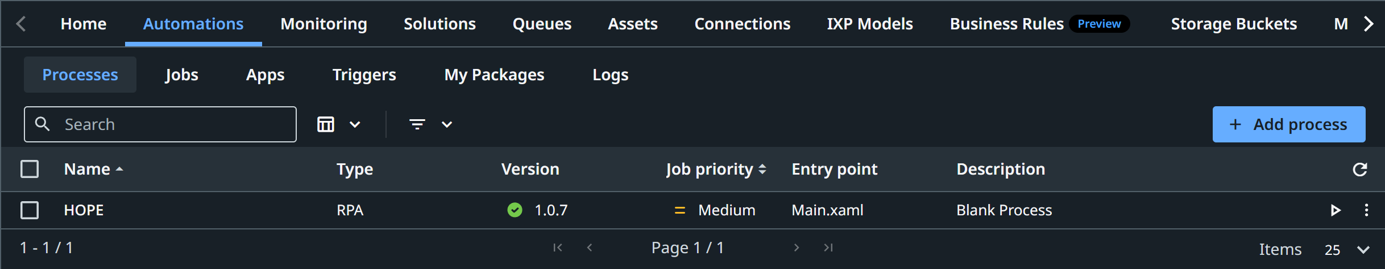
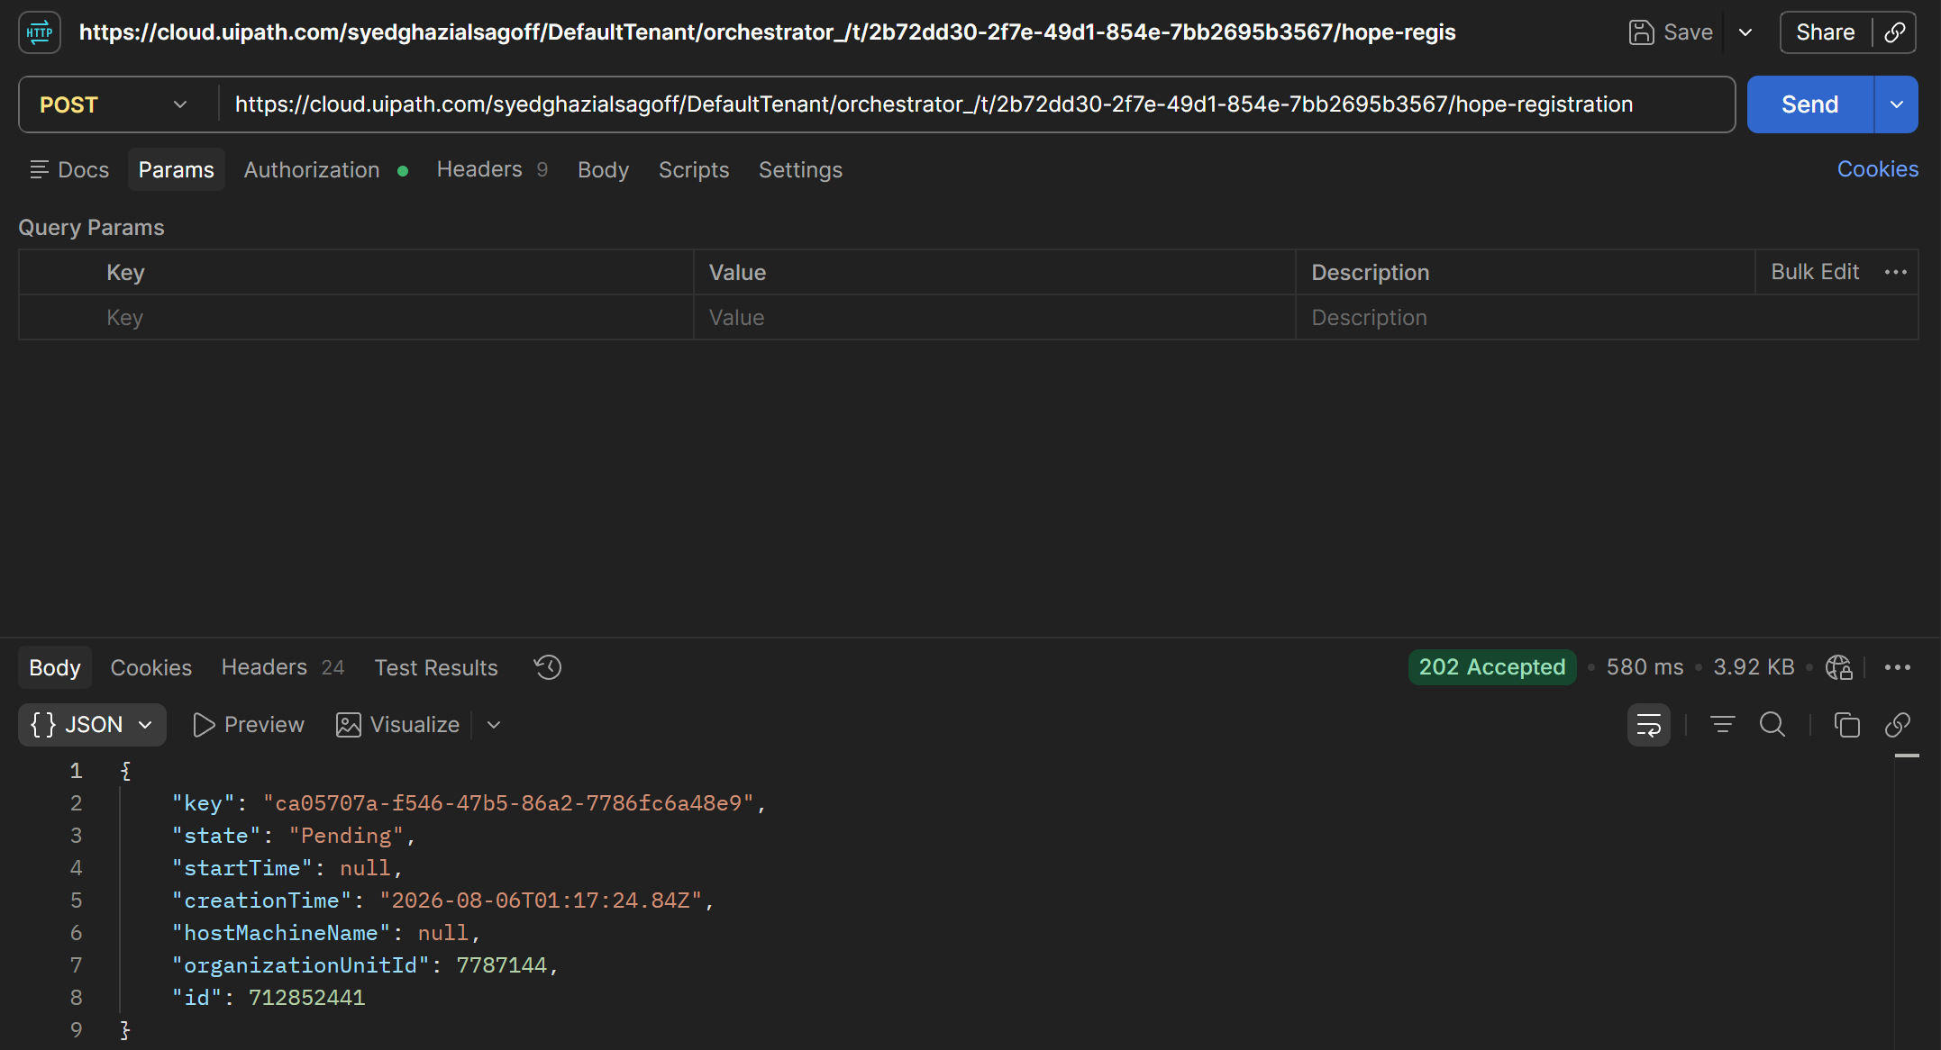
Deployment & Orchestration — UiPath Orchestrator
Published & deployed
  Published from Studio to the Orchestrator Tenant feed as Hope_HealthcareAdmin, then deployed in the workspace as the process HOPE — entry point Main.xaml, runtime Production (Unattended).
Two triggers — scheduled + on-demand
  Time trigger HOPE_TIME runs the process automatically at 08:00 daily — the scheduled overnight batch, no human needed.
  API trigger HOPE_API exposes an HTTP endpoint (POST /hope-registration) so an external system — e.g. the clinic’s online form — can start the robot on demand, in real time. Secured with a bearer personal access token (scoped OR.Jobs + OR.Execution); async polling returns a job ID to poll.
Why two triggers
  Forms accumulate overnight, so a scheduled batch clears them and emails the manager a summary before the clinic opens — while the API trigger handles real-time registrations the moment a form is submitted. One robot, both scheduled and event-driven.

Slide 11
YouTube link for demo
Demonstration video
  https://youtu.be/l6jAJ_IoZ1s?si=WhRtD23LPnYX5bYq

Slide 12
References
UiPath. (2026). UiPath Studio and Orchestrator documentation. https://docs.uipath.com
UiPath. (2026). Python Activities package documentation. https://docs.uipath.com/activities/other/latest/developer/python-scope
UiPath. (2026). PDF Activities — Read PDF With OCR. https://docs.uipath.com/activities/other/latest/developer/read-pdf-with-ocr
Microsoft. (2026). LINQ query expressions (Visual Basic). https://learn.microsoft.com/en-us/dotnet/visual-basic/programming-guide/language-features/linq/
Leuchter, R. K., Delarmente, B. A., Vangala, S., Tsugawa, Y., & Sarkisian, C. A. (2025). Health care staffing shortages and potential national hospital bed shortage. JAMA Network Open, 8(2), e2460645.
Executive Board, & Director-General. (2024). Global strategy on human resources for health: workforce 2030. World Health Organisation.
Ministry of Health Singapore. (n.d.). Healthcare manpower demand. https://www.moh.gov.sg/newsroom/healthcare-manpower-demand/
Ministry of Health Singapore. (n.d.). Current healthcare workforce strength compared against projected service demand.
Corestaff Pte Ltd. (2026). Healthcare recruitment Singapore: addressing the critical shortage of medical professionals in 2026.
Generative AI (Anthropic Claude) was used to assist with planning the workflow structure, troubleshooting UiPath activity configuration and drafting documentation. All output was reviewed, modified and implemented by the author.

