Slide 1
Sudoku template generator
Haochen Zhang

Slide 2
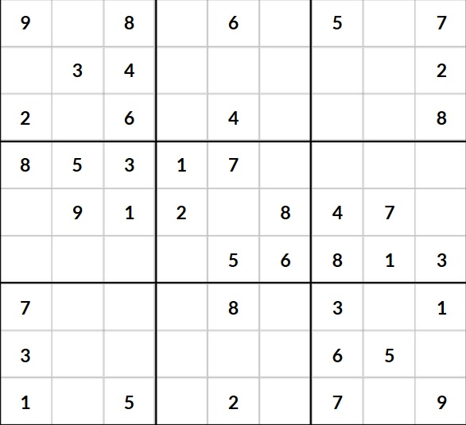
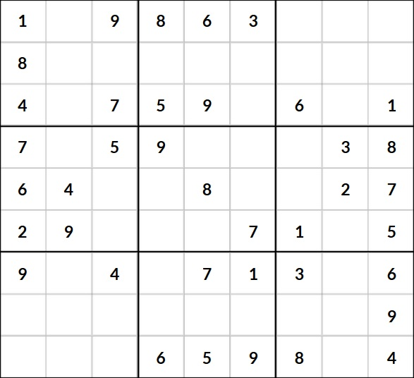
What is Sudoku??
Game that consist of a 9x9 grid filled with numbers 1 to 9
Rules :
No numbers from 1 to 9 can be repeated in any horizontal roll, vertical column, or one of the 9 3x3 boxes

Slide 3
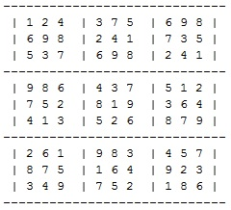
What this program does?
This program generates a completed template of a Sudoku grid.
The first step to creating a Sudoku puzzle.

Slide 4
Structure of template class
Instance
1 2D Array representing the actual template grid.
3 Hash maps with 9 boolean Arrays in each Hash map.
Methods
templateGenerator()
Val(int , int, int)
fillin(int,int,int) and unfillin(int, int, int)
generateRandom()

Slide 5
Design Challenge
How to validate each number as the program generate through rows.
Brute force
Hashmap instances
Infinite loops cause by logic errors

Slide 6
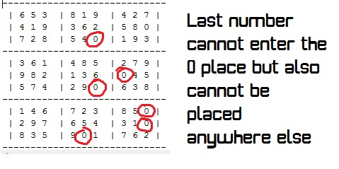
Logic Error

Slide 7
Solution : Backtracking
Backtracking is a general algorithms for finding solutions to some problem, usually problems with constraint, that incrementally builds candidates to the solutions, and abandons each partial candidate c ("backtracks") as soon as it determines that c cannot possibly be completed to a valid solution.

Slide 8
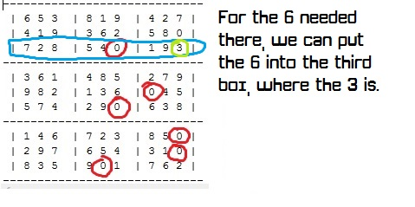
Backtracking example

Slide 9
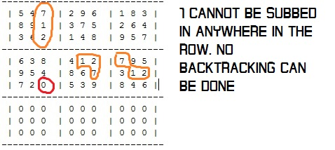
Unsolved bug

Slide 10
Possible solution
Fill in each row by 3s and check so that no where vertically does the 3 numbers stack.

