Slide 1
SPL-1 Presentation
Presented by:
Mashiat Amin Farin
BSSE 1202
Topic:
Image compression and processing tool
Supervised by:
Mohd. Zulfiquar Hafiz

Slide 2
Image structure
Image file checking
Image reading
Image writing
Pixel data

Slide 3
Image Structure
The image that I will be working on is .bmp images. BMP images are structured into 3 parts.
File header contains the file signature, file size and pixel size.
Info header contains height, width,image size, compression type, RGB bit masks.
Pixel array contains 3 data for each pixel. Red, green and blue.
File Header [contains general information]
Information Header [Detailed information]
Pixel array [Color data for each pixel]

Slide 4
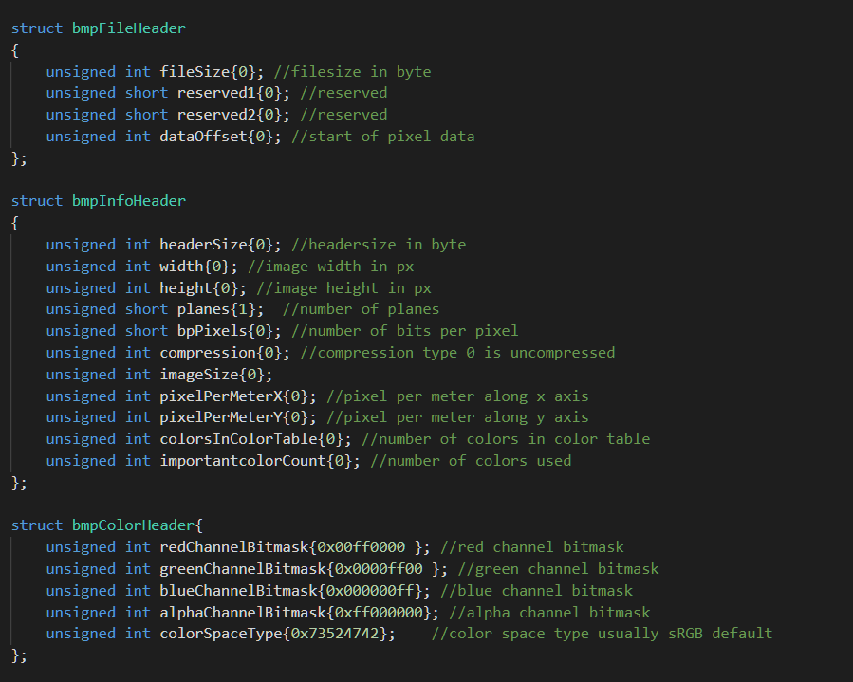
Image Structure
Image structure helps us retrieve data from the image and to check if everything is in order.

Slide 5
Image file Checking
Image files need to be checked as there are numerous restrictions to image data and the code can only handle .bmp images. Reading and checking if the file is valid is an important step to image processing/compression.
Checking if file is .bmp
Checking if height and width is positive
Checking if file exists in the directory

Slide 6
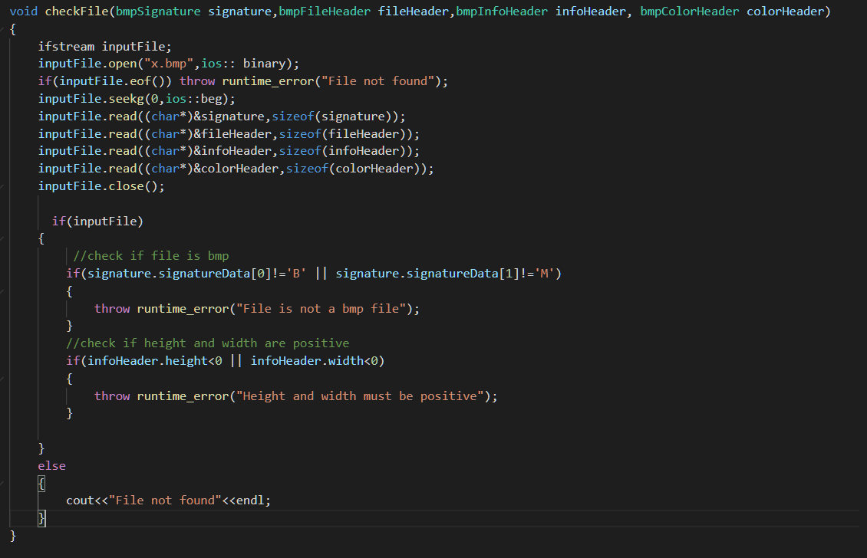
Image file checking

Slide 7
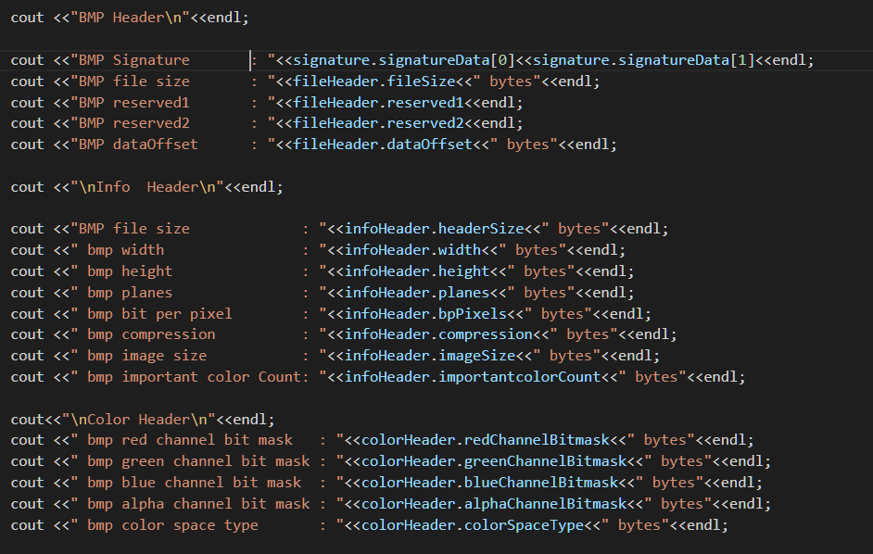
Image information reading
Image information gives us valuable insight on the image

Slide 8
Image Information reading

Slide 9
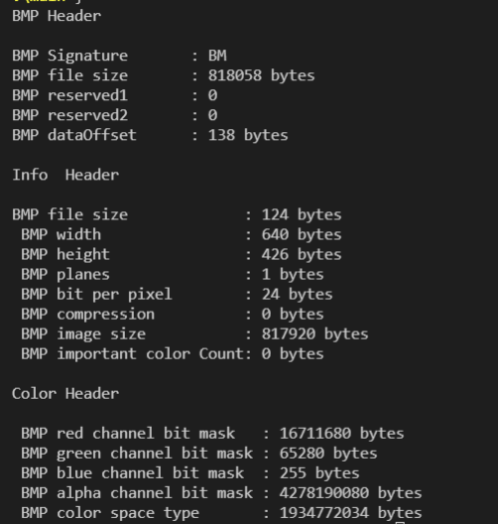
Image Information reading output
Here, the bit masks are in decimal values.
The hexadecimal values are:
Red channel: FF0000
Green channel: 00FF00
Blue channel: 0000FF
Alpha channel: FF000000
Color space type: 73524742 (default for sRGB)

Slide 10
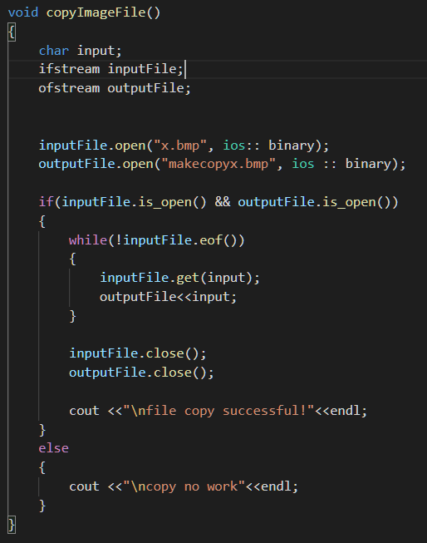
Image writing
Exporting an image is important for us to view the compressed/filtered image. For now, image is being copied and exported.

Slide 11
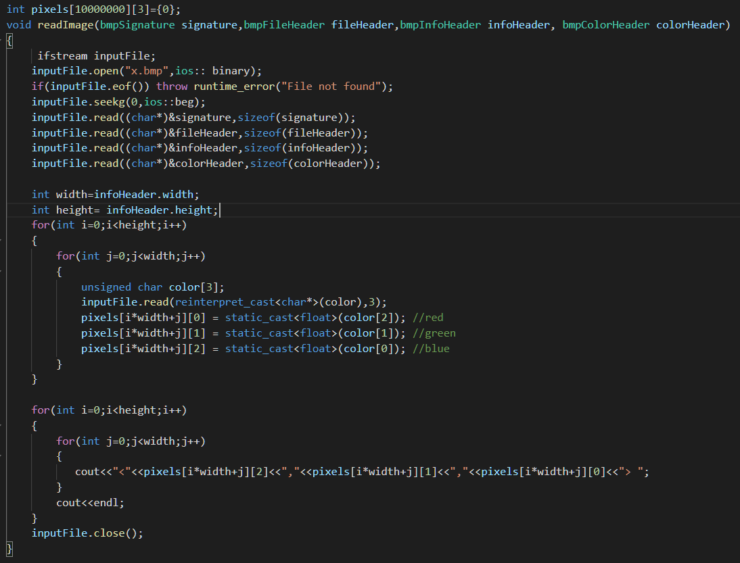
Pixel Data
Accessing the pixel data, and being able to modify the pixel data is how we can add different filters and compress pixel data.
In my program the pixel data is accessed by a 2D array, where the row indicated the pixel number [i*width+j] and the column indicates the RGB type.

Slide 12
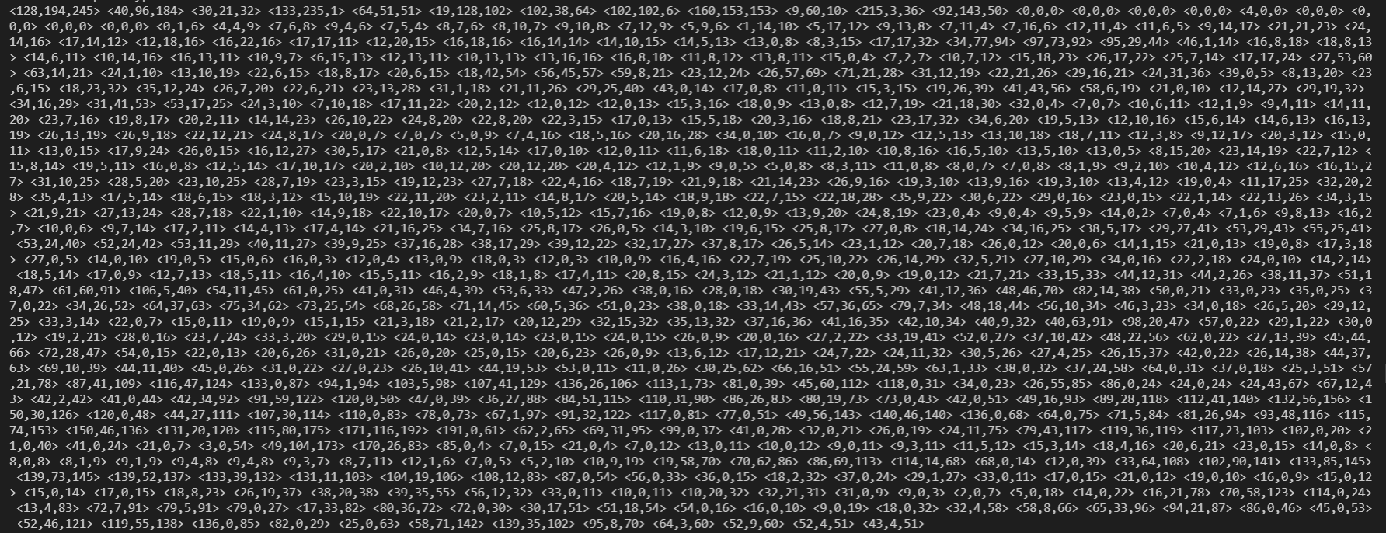
Pixel Data Output format
The pixel output is formatted as <red,green,blue> for per pixel.
Output for pixel data of the first row:

