Slide 1

Bangla-WhisperDiar:Fine-Tuning Whisper and PyAnnote for Bangla Long-Form Speech Recognition and Speaker Diarization
Slides by-
Team BitwiseMind (North South University)

Slide 2
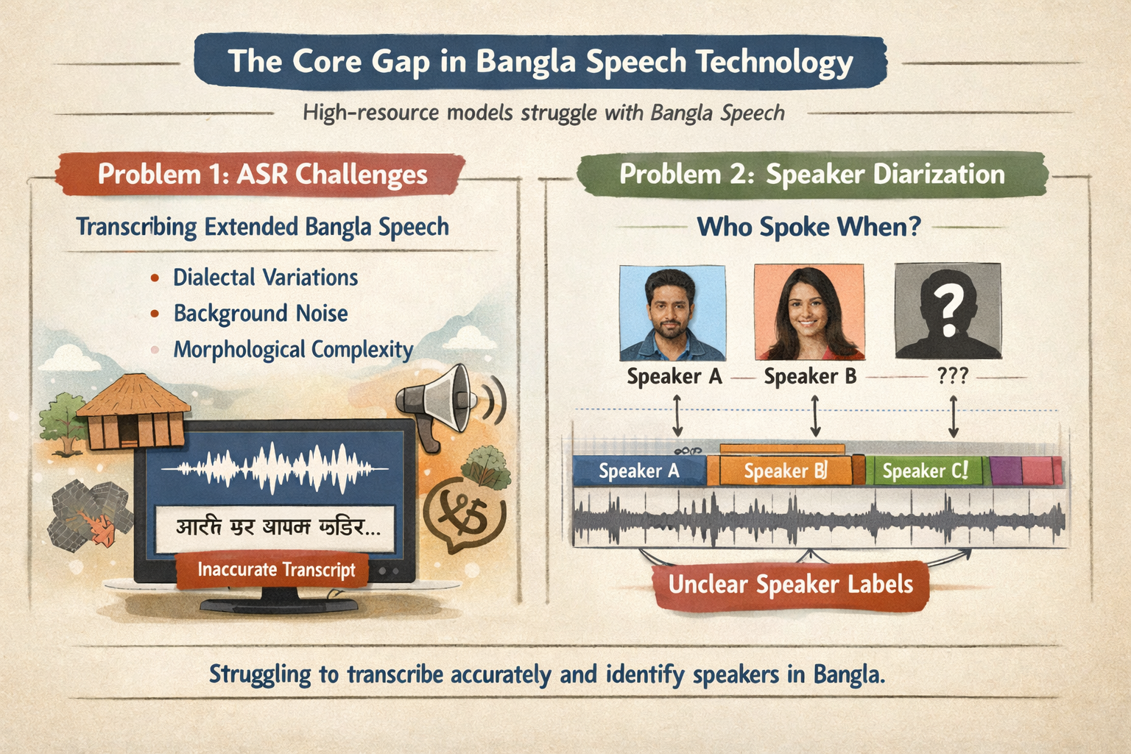

Problem Statement
The Core Gap: Bangla is widely spoken but under-resourced in speech tech. State-of-the-art models (like Whisper) are optimized for high-resource languages, degrading heavily on spontaneous, diverse Bangla audio.
Problem 1 (ASR): Transcribing extended Bangla speech recordings into text accurately, evaluated via Word Error Rate (WER). Must handle dialectal variation, noise, and morphological complexity.
Problem 2 (Diarization): Determining precisely "who spoke when" via speaker-labelled time segments, evaluated via Diarization Error Rate (DER).

Slide 3
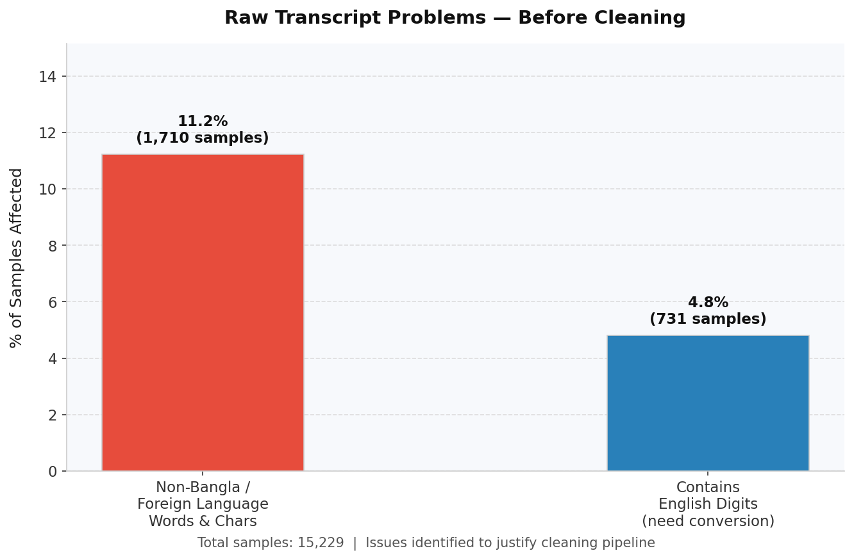
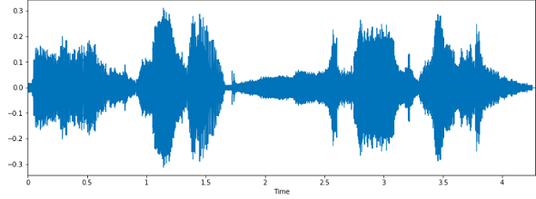
EDA of Dataset
Annotations Issues
English Digits: Numerals like 42 or 2024 must be converted to Bangla words
Non-Bangla / Foreign Characters: Latin, Arabic,(e.g. .com,الله) or other (e.g. \n\r\t\d।.,?!\-—:;"\'()\[\]{}]) script characters mixed into Bangla transcripts
Audio Issues
1hr Long Audio: Training can not be done with direct 1hr long audio
Extremely distorted Test Set: Many test audio’s are very noisy and heavily augmented.
✜ Ref: Bengali-Loop: Community Benchmarks for Long-Form Bangla ASR and Speaker Diarization. Retrieved from: https://arxiv.org/abs/2602.14291

Slide 4
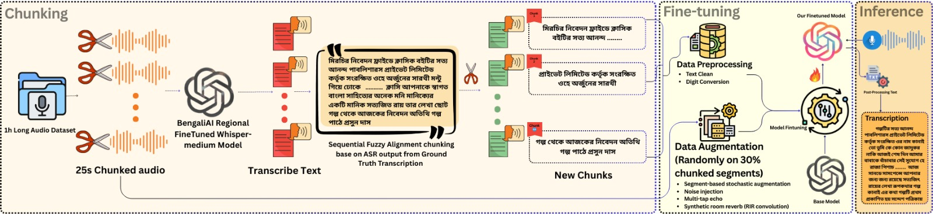
Pipeline for Long-Form Audio Transcription
Chunking Strategy
Data Preprocessing & Augmentation
Inference
Trim the audio in 25s chunked length
Utilized tugstugi model to intermidiate transcription
Sequential Fuzzy Alignment - a novel algorithm linking the ground-truth text spans to our 25-second audio chunks perfectly while preserving reading order.
Produced total 15,229 chunked segments.
Clean all non-Bangla texts & convert digits to words (e.g. 4-digit numbers in the range 1000–2099 are treated as calendar years)
Injected Noise, Reverb, Echo, RIR, Bandpass filter on random 30% segment of chunked audio.
Unicode Normalization: NFC normalization was applied
Hallucination Removal: three regex patterns iteratively collapse repeated multi-word phrases, single words, and character n-grams (e.g. হেহেহেহে)
Garbage Cleanup: >> turn-change tokens or any other injected by Whisper are stripped from final output
✜ Ref: BengaliAI:tugstugi-bengaliai-regional-asr-whisper-medium, Retrieved from: bengaliAI/tugstugi_bengaliai-regional-asr_whisper-medium · Hugging Face

Slide 5
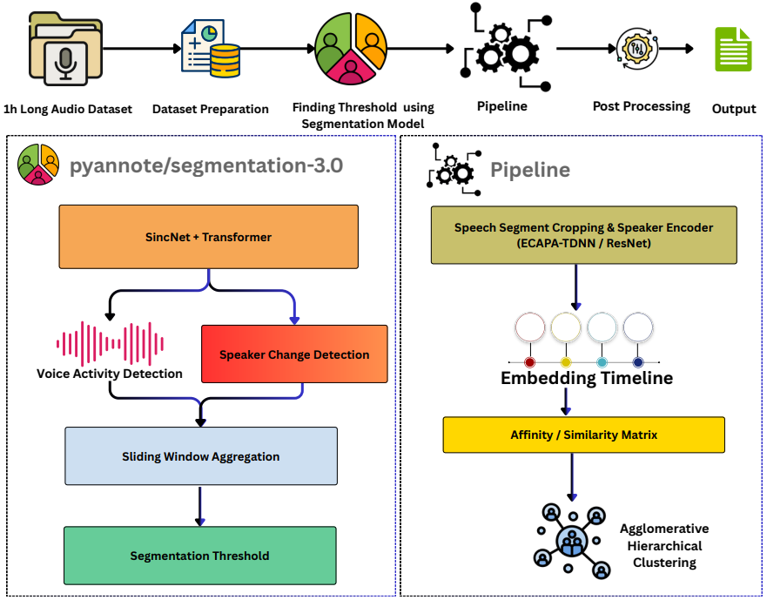
Pipleline for Speaker Diarization
Isolated Segmentation Fine-Tuning: Fine-tuning the pyannote/segmentation-3.0 neural network exactly when Bangla speakers talk on 10-second chunks using PyTorch Lightning.
Training: Fine-tune the segmentation model for 50 epochs using BCE loss, with early stopping (patience = 15).
Frozen Attributes: Leaving the pretrained "Speaker Embedding" and "Hierarchical Clustering" completely frozen to preserve how it identifies what a human voice sounds like.
The Pipeline-Swap Strategy: Loading the community PyAnnote pipeline at inference, but replacing only the internal segmentation layer with our fine-tuned weights.
Post-Processing: Using a 0.3s temporal filter post-processing to instantly drop ultra-short noise artifacts masked as false-alarm speech.
.
✜ Ref: pyannote.audio: neural building blocks for speaker diarization. Retrieved from: https://arxiv.org/abs/1911.01255

Slide 6
Test Results
Model | WER(%)
HisabTitu-BN | 50.67
Tugstugi (pretrained) | 34.07
Tugstugi (LoRA) | 31.32
Ours | 24.41*
Model | WER(%)
WebRTCVAD+ECAPA+Clustering | 73.71
SileroVAD+ECAPA+Clustering | 61.50
Pyannote.audio(pretrained) | 40.08
Ours | 23.92*
Table-1: ASR Perfomance Comparision
Table-3: Speaker Diariziation Performance Comparison
Method | WER(%)
Without Post-Processing | 25.76
With Post-Processing | 24.41*
Task | Public(29%) | Private(71%)
Long Form ASR (WER %) | 23.580 | 24.750
Speaker Diarization (DER %) | 18.518 | 26.133
Table-2: Effectiveness of Post-Processing
Table-4: Leaderboard Score for both Public and Private set

Slide 7
Inference Time & RTF
Task | Hardware | Inference Time | Error | RTF
Long Form ASR | T4x1(GPU) | 3hr 38min | 24.41%(WER) | 0.1659
Long Form ASR (Inference Optimized) | T4x2(GPU) | 25 min** | 25.60%(WER) | 0.0190
Speaker Diarization | T4x1(GPU) | 1hr 20min** | 23.92%(DER) | 0.1054
Table-5: Inference Efficiency Analyis (Real-Time Factor)

Slide 8
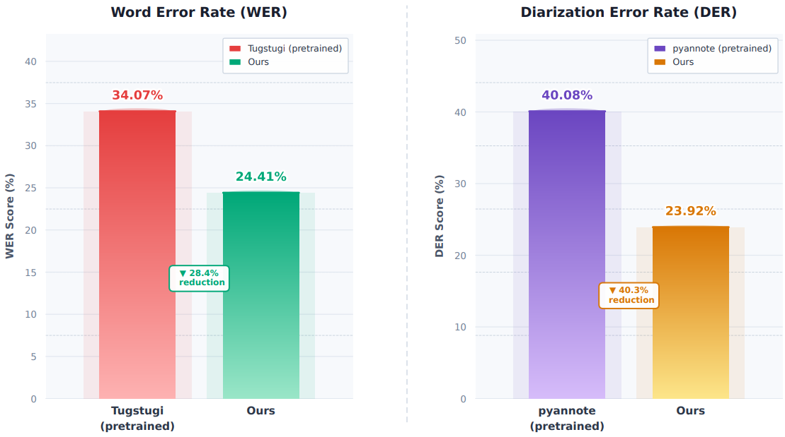
Perfomance Improvement Compared to Baselines
ASR Performance: Achieved 24.41% Word Error Rate (WER), reducing errors by 28.4% compared to the pretrained Tugstugi baseline (34.07%).
Diarization Performance: Achieved 23.92% Diarization Error Rate (DER), a 40.3% reduction relative to the pretrained pyannote model (40.08%).

Slide 9
Limitations & Future Work
Limitations:
Due to limited GPU resources, full-weight fine-tuning was not performed, although it could potentially improve representation learning under the current task setting.
The diarization training dataset was very small (10 full recordings), which limited the model’s ability to adapt.
Future Work:
Develop a joint ASR–diarization system capable of generating transcripts while accurately assigning speaker labels with precise temporal alignment.
Apply model compression methods such as Quantization and Pruning to reduce latency and support efficient deployment on edge devices.

Slide 10
Thank You!

