Slide 1


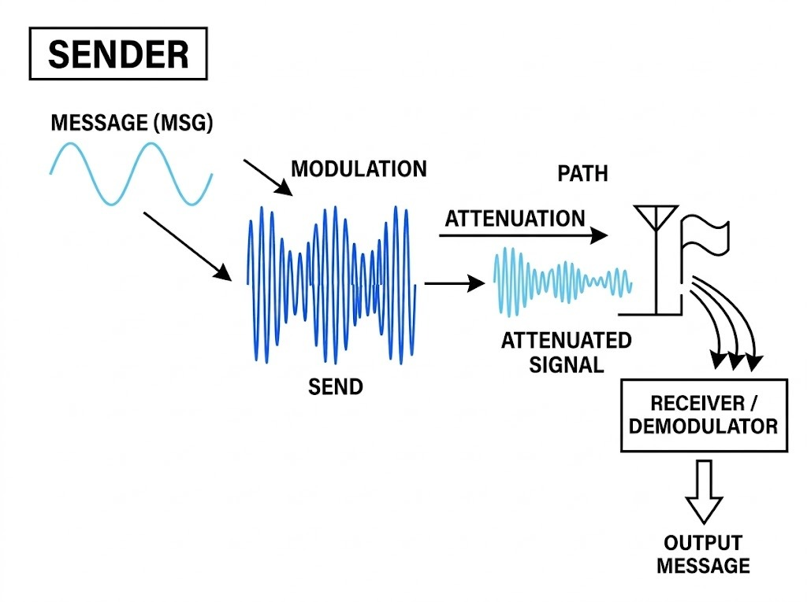


Slide 2


Design of a 2.45 GHz RF
Receiver in CMOS 45nm technology
BPF
Mixer
LNA
LPF
Demodulated
Message Signal

Slide 3






Co-Supervisor:
Dr. Raqibul Mostafa
Professor, Dept. of EEE
Chair:
Azad Hossain Saykat
021 221 017
Member:
Sazzad Hossen
021 221 026
Co-Supervisor:
Dr. Md. Hasanuzzaman
Associate Professor, Dept. of EEE
Recorder:
Suvom Karmakar
021 221 027
Member:
Md. Tahman Hossain
021 221 099

Slide 4


Table of Content
Overview of RF Receiver
Low Pass Filter
Mixer
Low Noise Amplifier
Band Pass Filter
Integrated RF Receiver
Conclusion
Shakil Sikder
021 213 048
01

Slide 5

Why RF Receivers Matter?
Motivation
Compact and Low-power.
RF front-end performance directly affects signal quality and power usage.
Receiver performance defines signal sensitivity, power consumption, and noise tolerance.
Global 2.45 GHz ISM Band.
Single-Chip CMOS Integration.
Real-Life Applications
Wireless communication: Wi-Fi, Bluetooth etc.
Wearable devices
Azad Hossain Saykat
021 221 017
05
01

Slide 6

Block Diagram of RF Receiver Design
Mixer
LPF
I (Baseband)
Local Oscillator (LO)
BPF
LNA
$$\frac{π}{2}$$
LPF
Q (Baseband)
Mixer
Figure: Proposed Block Diagram of the RF Receiver System
Azad Hossain Saykat
021 221 017
06
01
01

Slide 7
Literature Review
Azad Hossain Saykat
021 221 017
07
01
01

Slide 8
Proposed Improvements
1. 2.45 GHz LNA Optimization
Apply systematic S-parameter methodology for achieving 15-20 dB gain with < 3 dB noise figure at 1.2V supply.
2. CMOS Technology Scaling
Leverage 45nm CMOS advances for integrated system-level design to achieve target 45mW power consumption.
2. CMOS Technology Scaling
Leverage 45nm CMOS advances for integrated system-level design to achieve target <10mW power consumption.
3. Integrated BPF Design
Implement optimized bandpass filtering for 2.45 GHz range with precise 20-100 MHz passband control.
4. System-Level Architecture
Focus on total RF receiver system integration for 2.45 GHz applications.
Azad Hossain Saykat
021 221 017
08
01
01

Slide 9
RF Receiver Block Specification
1
Low Noise Amplifier (LNA) Specification
Parameter | Value
Supply Voltage | 1.2 V
Power Consumption | <2mW
NF (50 Ω) | < 3dB
Gain | 15 - 20 dB
S11 | ≤ -10dB
S22 | ≤ -10dB
S21 | 15 – 20 dB
S12 | ≤ -25dB
2
Low Pass Filter (LPF) Specification
Parameter | Specification
Passband Frequency | 20 MHz
Stopband Frequency | 30 MHz
Stopband Attenuation | > 40 dB
Bandwidth | 20 MHz
Passband Ripple | 1dB
Source Impedance | 50 ohm
Band Pass Filter (BPF) Specification
Parameter | Value
Supply Voltage | 1.2 V
Passband Width | 20 MHz to 100 MHz
Center Frequency | 2.45 GHz
Upper Cutoff Frequency | 2.45 GHz + 10 MHz
Lower Cutoff Frequency | 2.45 GHz - 10 MHz
Mixer Specification
Parameter | Specification
Supply voltage | 1.2 V
Power Consumption | <2.5 mW
RF frequency | 2.45 GHz
Lo Frequency | 2.43GHz
Conversion Gain | >10 dB
3
4
Azad Hossain Saykat
021 221 017
09
01
01

Slide 10
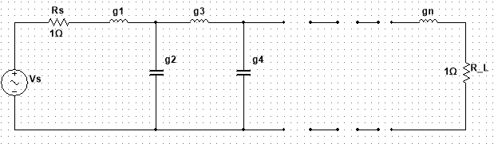
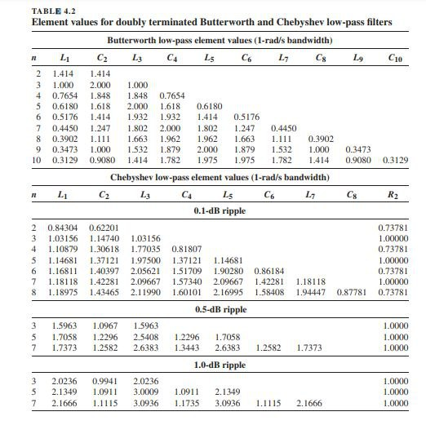



Passive Low Pass Filter
Theoretical Background
in
LPF
out
Fig. Nth Order Passive Low Pass Filter Prototype
Equations for Conversion of Normalize Value into Actual Circuit Element
Series Inductors:
$$L_{k}=\frac{R_{s}∗g_{k}}{w_{c}}$$
Table:
Coefficients of the Chebyshev lowpass prototype filter normalized
to 1 rad/s corner frequency and impedance.
Shunt Capacitors:
$$C_{k}=\frac{g_{k}}{{R_{s}∗w}_{c}}$$
$$1Ω$$
Azad Hossain Saykat
021 221 017
10
01

Slide 11
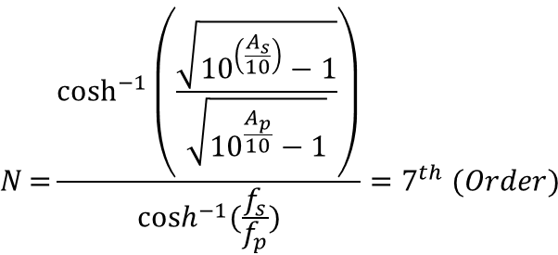
Passive Low Pass Filter
Calculation
Component | Type | Index (n) | Formula | Value | Units
Rs | Source Impedance | g0 |  | 50 | Ω
L1 | Series Inductor | g1 = 2.1666 | L1​=Rs.​g1/ωc​​ | 862.08 | nH
C2 | Shunt Capacitor | g2 = 1.1115 | C2​=g2 / Rs.​ωc​​​ | 176.9 | pF
L3 | Series Inductor | g3 = 3.0936 | L3=Rs.g3 /ωc​​ | 1230.96 | nH
C4 | Shunt Capacitor | g4 = 1.1735 | C4​=g4 / Rs.​ωc​​​ | 186.77 | pF
L5 | Series Inductor | g5 = 3.0936 | L5​=Rs.g5 /ωc​​ | 1230.96 | nH
C6 | Shunt Capacitor | g6 =1.1115 | C6​=g6 / Rs.​ωc​​​ | 176.9 | pF
L7 | Series Inductor | g7 = 2.1666 | L7​=Rs.g7 /ωc | 862.08 | nH
Rl | Load Impedance | g8​ |  | 50 | Ω
Low Pass Filter (LPF) Specification
Parameter | Specification
Passband Frequency | 20 MHz
Stopband Frequency | 30 MHz
Stopband Attenuation | > 40 dB
Bandwidth | 20 MHz
Passband Ripple | 1dB
Source Impedance | 50 ohm
Load Impedance | 50 ohm
Chebyshev Type I:
$$N={\frac{\cosh^{−1}\left(\frac{\sqrt{{10}^{\left(\frac{A_{s}}{10}\right)}−1}}{\sqrt{{10}^{\frac{A_{p}}{10}}−1}}\right)}{\cosh^{−1}(\frac{f_{s}}{f_{p}})}=7^{th} (Order)}$$
Azad Hossain Saykat
021 221 017
11
01
01

Slide 12
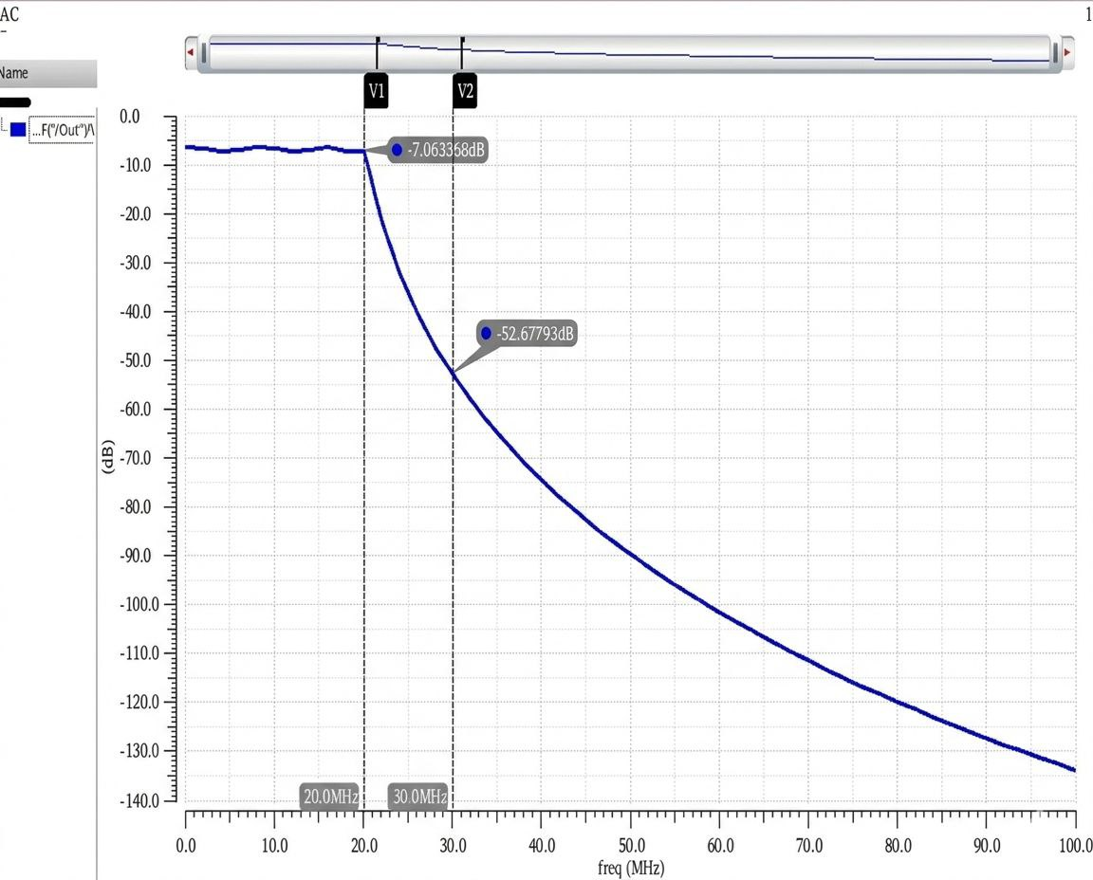
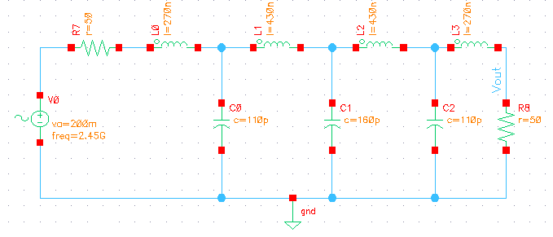
Passive Low Pass Filter
Schematic Diagram
AC Analysis
Azad Hossain Saykat
021 221 017
12
01
01

Slide 13
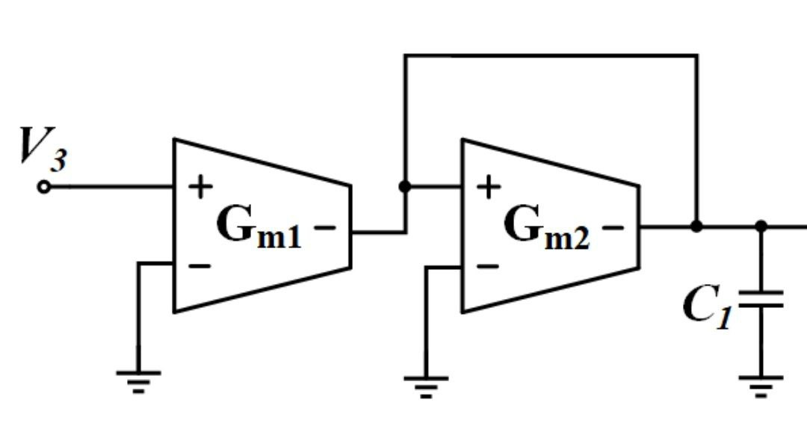
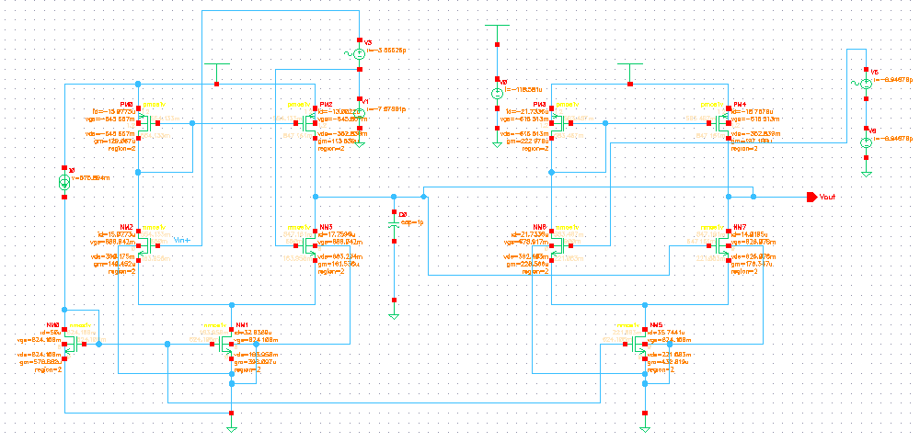

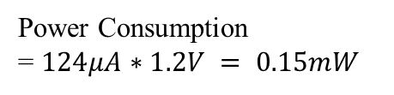
Active Low Pass Filter
Block Diagram
Schematic Diagram
Fig. 1st Order Gm-C Filter Block Diagram
Power Consumption
= $124μA∗1.2V = 0.15mW$
Azad Hossain Saykat
021 221 017
13
01
01

Slide 14
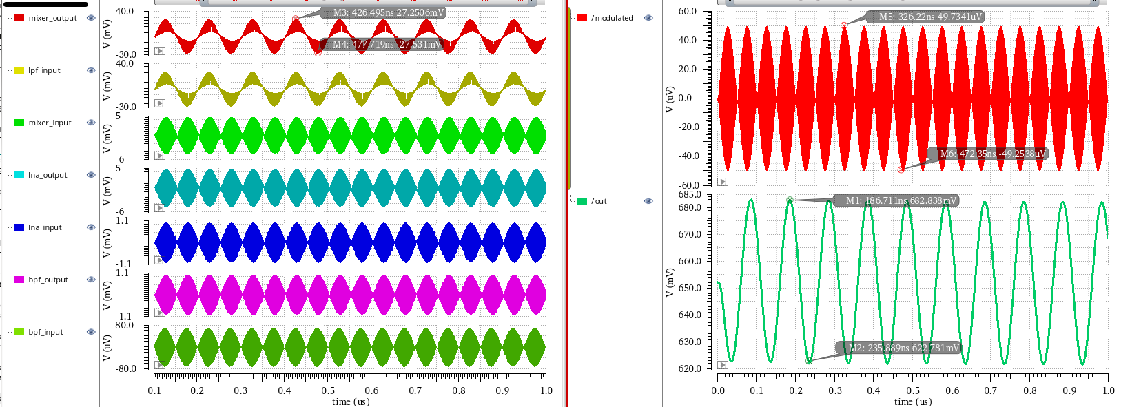
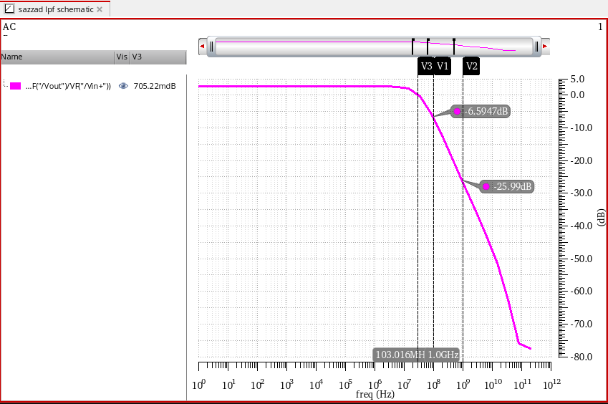
Active Low Pass Filter
Transient Analysis
AC Analysis
Azad Hossain Saykat
021 221 017
14
01
01

Slide 15
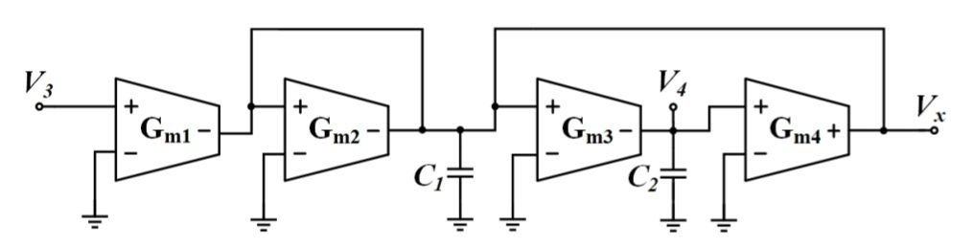
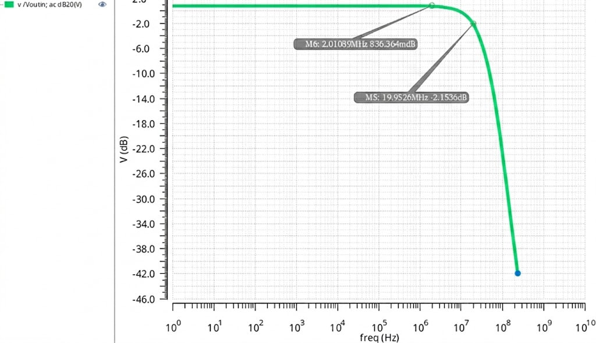
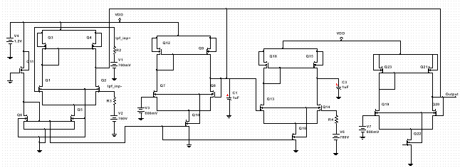
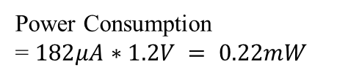
Active 2nd Order Low Pass Filter
Block Diagram
AC Analysis
Circuit Diagram
Power Consumption
= $182μA∗1.2V = 0.22mW$
Azad Hossain Saykat
021 221 017
15
01
01

Slide 16
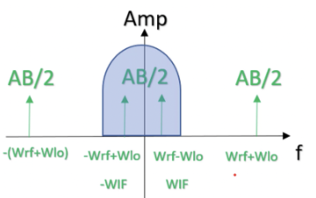

Mixer
Theoretical Background
Mixer
To convert a high-frequency RF signal (2.45 GHz) down to a lower IF signal for easier filtering or processing.
It does this by multiplying the RF signal with a Local Oscillator (LO) signal:
$$v_{IF}(t)=v_{RF}(t)×v_{LO}(t)$$
Because of trigonometric properties:
$$cos⁡(ω_{RF}t)cos⁡(ω_{LO}t)=\frac{1}{2}[cos⁡(ω_{RF}−ω_{LO})t+cos⁡(ω_{RF}+ω_{LO})t]$$
output contains sum and difference frequencies (IF = |RF – LO|).
Mixer
Local Oscillator
Suvom Karmakar
021 221 027
16
01
01

Slide 17
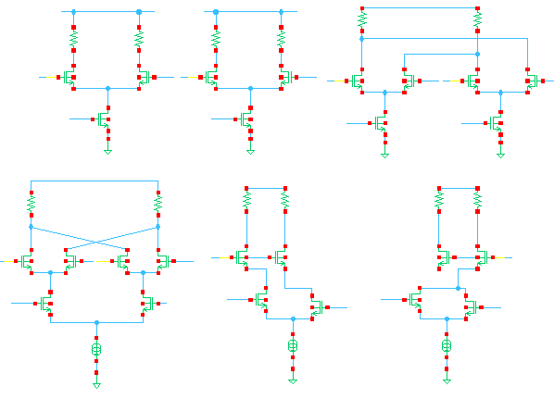
Mixer
How the Gilbert Cell Circuit is Developed?
LO
RF
Suvom Karmakar
021 221 027
17
01
01

Slide 18
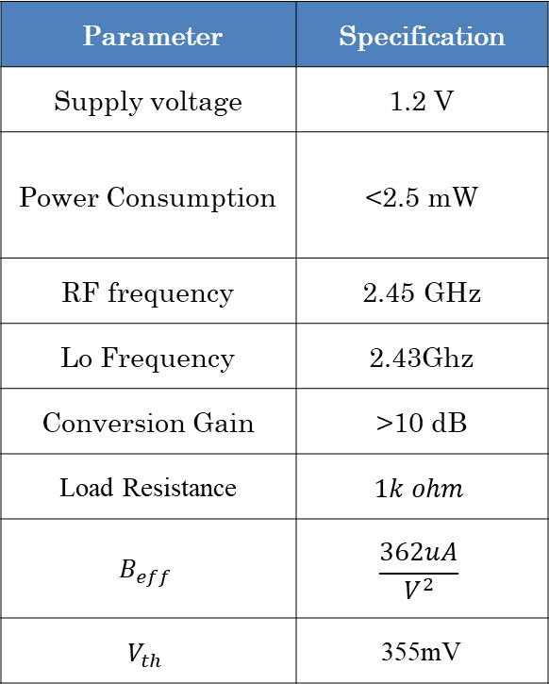
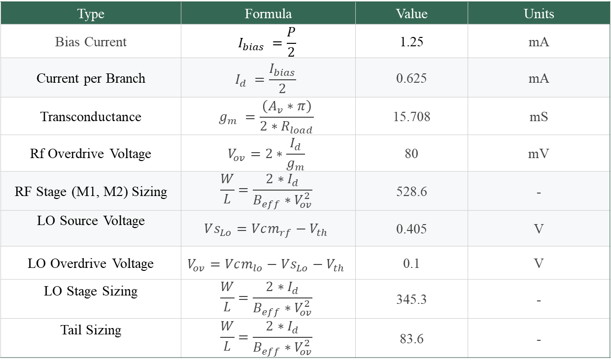
Mixer
Calculation
Parameter | Specification
Supply voltage | 1.2 V
Power Consumption | <2.5 mW
RF frequency | 2.45 GHz
Lo Frequency | 2.43Ghz
Conversion Gain | >10 dB
Load Resistance | $$1k ohm$$
$$B_{eff}$$ | $$\frac{362uA}{V^{2}}$$
$$V_{th}$$ | 355mV
Type | Formula | Value | Units
Bias Current | $$I_{bias} =\frac{P}{2}$$ | 1.25 | mA
Current per Branch | $$I_{d} =\frac{I_{bias}}{2}​​$$ | 0.625 | mA
Transconductance | $$g_{m} =\frac{\left(A_{v}∗π\right)}{2∗R_{load}}$$ | 15.708 | mS
Rf Overdrive Voltage | $$V_{ov}=2∗\frac{I_{d}}{g_{m}}$$ | 80 | mV
RF Stage (M1, M2) Sizing | $$\frac{W}{L}=\frac{2∗I_{d}}{B_{eff}∗V_{ov}^{2}}$$ | 528.6 | -
LO Source Voltage | $$Vs_{Lo}=Vcm_{rf}−V_{th}$$ | 0.405 | V
LO Overdrive Voltage | $$V_{ov}=Vcm_{lo}−Vs_{Lo}−V_{th}$$ | 0.1 | V
LO Stage Sizing | $$\frac{W}{L}=\frac{2∗I_{d}}{B_{eff}∗V_{ov}^{2}}$$ | 345.3 | -
Tail Sizing | $$\frac{W}{L}=\frac{2∗I_{d}}{B_{eff}∗V_{ov}^{2}}$$ | 83.6 | -
Suvom Karmakar
021 221 027
18
01
01

Slide 19
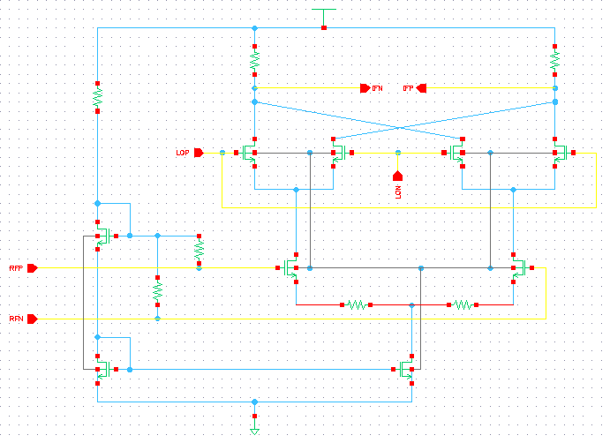

Mixer
Schematic Diagram
Power Consumption $=2.51mW$
Suvom Karmakar
021 221 027
19
01
01

Slide 20
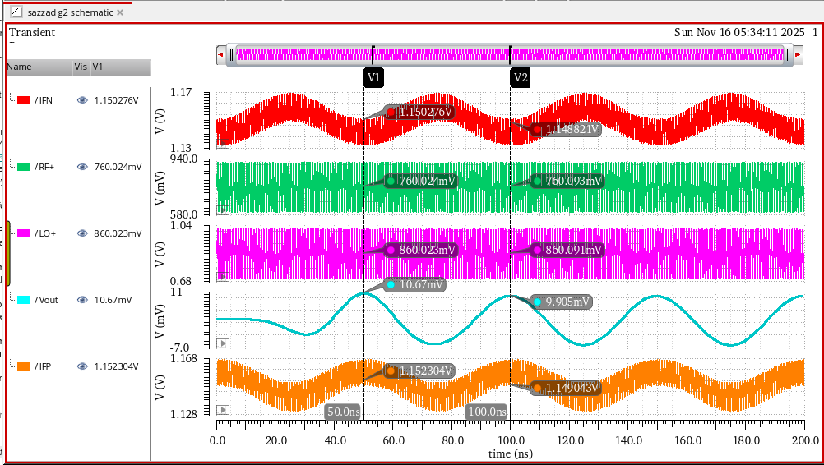
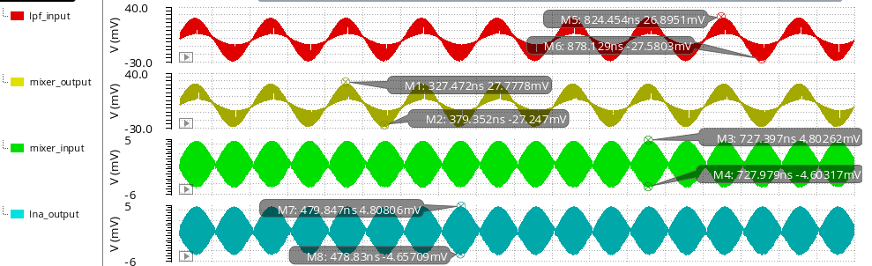
Mixer
Transient Analysis
Gain = 15.34 dB
Suvom Karmakar
021 221 027
20
01
01

Slide 21
Low Noise Amplifier
Description
Low Noise Amplifier (LNA) Specification
Parameter | Value
Supply voltage | 1.2 V
Power Consumption | 2mW
Frequency | 2.45 GHz
NF (50 Ω) | < 3dB
Gain | 15 - 20 dB
S11(Input Return Loss) | ≤ -10dB
S22(Output Return Loss) | ≤ -10dB
S21(Forward Gain) | 15dB - 20dB
S12(Reverse Isolation) | ≤ -25dB
in
out
LNA
The LNA amplifies the weak received signal with minimal noise.
Suvom Karmakar
021 221 027
21
01
01

Slide 22

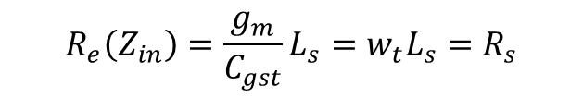
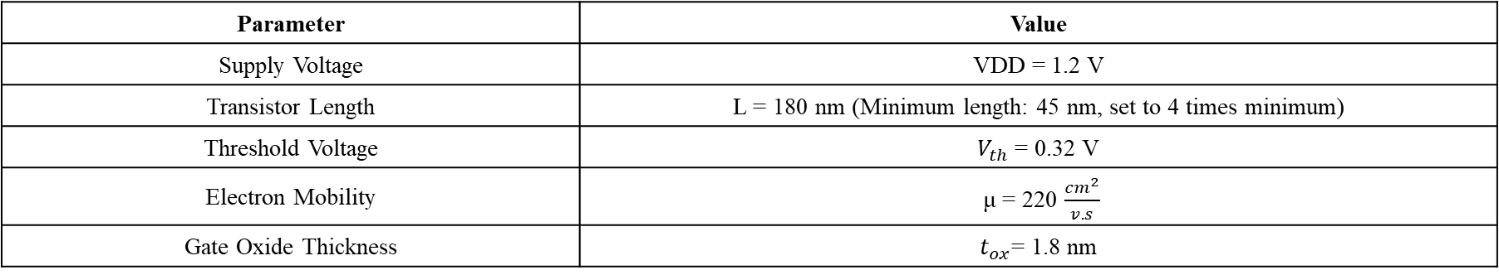
Low Noise Amplifier
Theoretical Background
Input impedance, $Z_{in}=R_{g}+R_{Ls}+R_{Lg}+s\left(L_{s}+L_{g}\right)+\frac{1}{sC_{gst}}+\frac{g_{m}}{C_{gst}}L_{s}$
$$R_{e}\left(Z_{in}\right)=\frac{g_{m}}{C_{gst}}L_{s}=w_{t}L_{s}=R_{s}$$
$Im\left(Z_{in}\right)=w\left(L_{s}+L_{g}\right)−\frac{1}{{w C}_{gst}}=$0
Some transistor parameters in 45 nm technology are,
Parameter | Value
Supply Voltage | VDD = 1.2 V
Transistor Length | L = 180 nm (Minimum length: 45 nm, set to 4 times minimum)
Threshold Voltage | $V_{th}$= 0.32 V
Electron Mobility | μ = 220 $\frac{cm^{2}}{v.s}$
Gate Oxide Thickness | $t_{ox}$= 1.8 nm
Suvom Karmakar
021 221 027
22
01
01

Slide 23
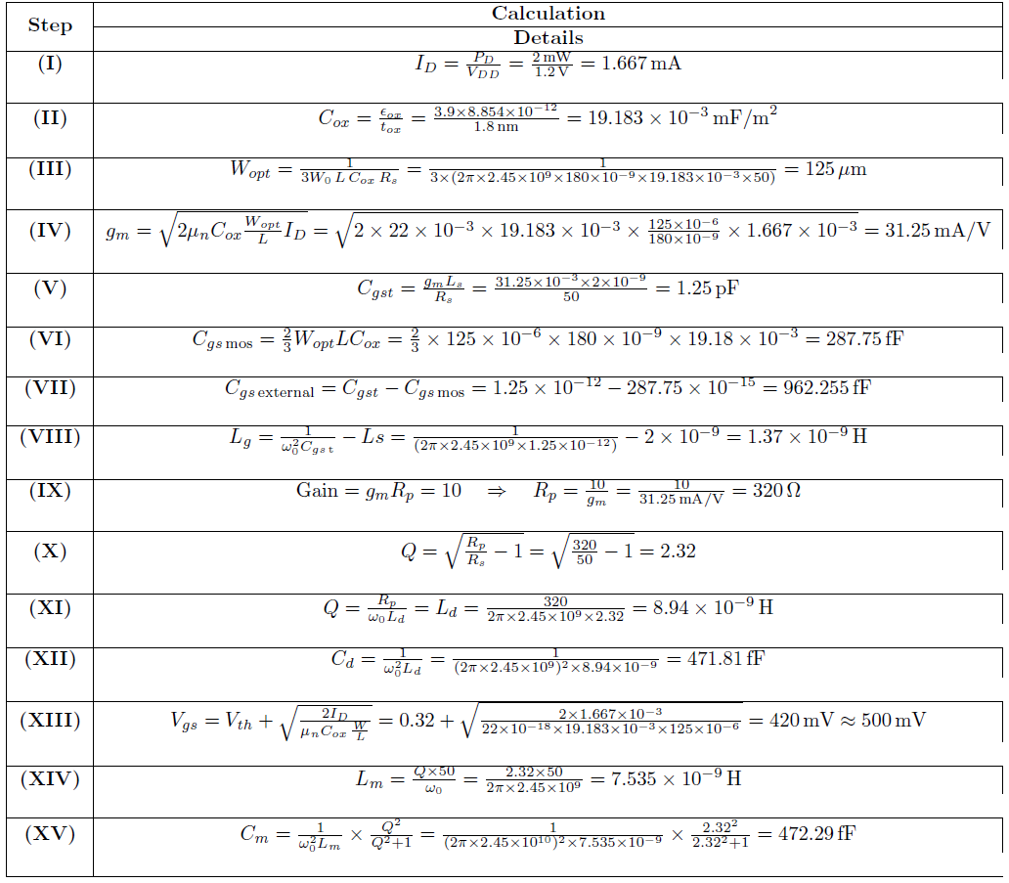
Low Noise Amplifier
Calculation
Suvom Karmakar
021 221 027
23
01
01

Slide 24
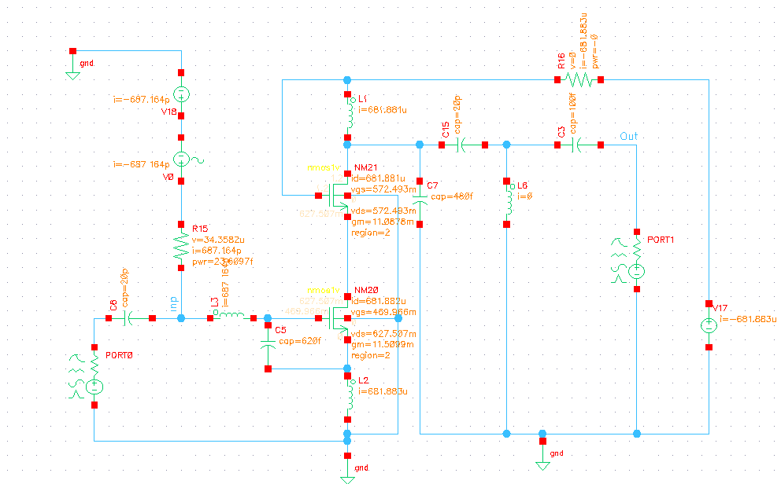
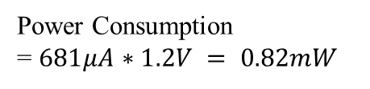
Low Noise Amplifier
Schematic Design
Power Consumption
= $681μA∗1.2V = 0.82mW$
Suvom Karmakar
021 221 027
24
01
01

Slide 25
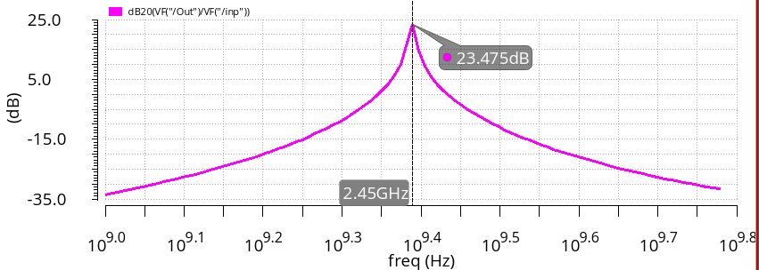
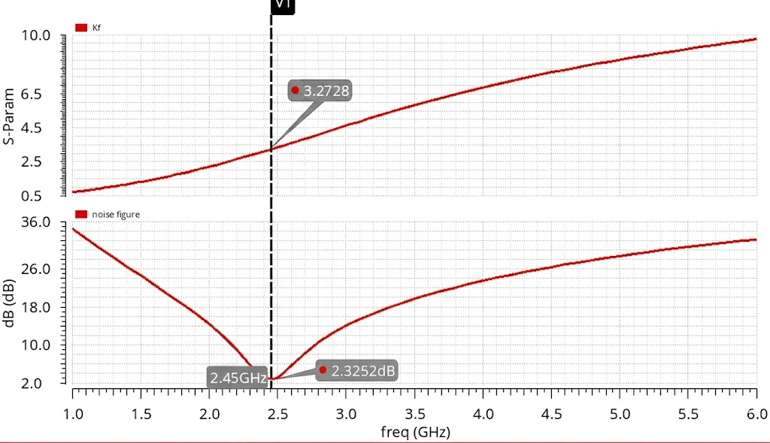
Low Noise Amplifier
AC Analysis
Stability Factor & NF Analysis
Suvom Karmakar
021 221 027
25
01
01

Slide 26
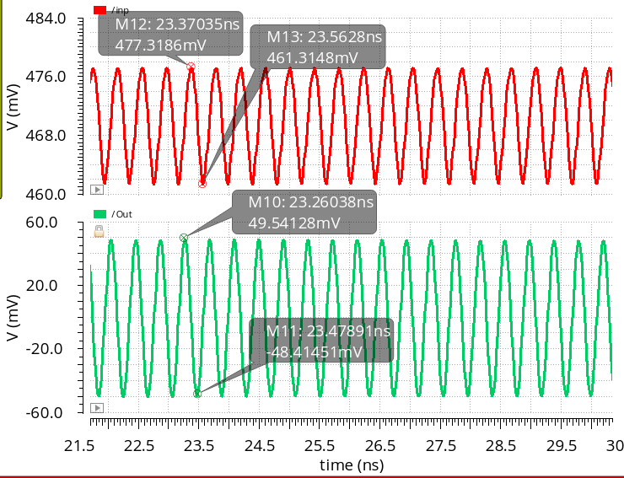
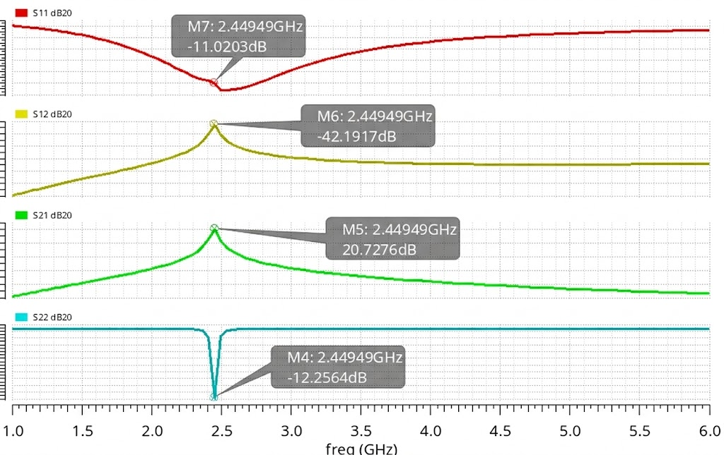

Low Noise Amplifier
Transient Analysis
S-Parameter Analysis
$$A_{v}=20\log_{10}{(\frac{\left(49.541+48.414\right)mV}{\left(477.318−461.314\right)mV})}$$
$$A_{v}=16.3 dB$$
Suvom Karmakar
021 221 027
26
01
01

Slide 27
Low Noise Amplifier
Performance Summary:
Design Metric | Measurement | Simulation Result | Requirement
Input Return Loss | S11​ at 2.45 GHz | −11.03 dB | ≤−10 dB
Forward Gain | S21 at 2.45 GHz | 20.72 dB | 15 dB −20 dB
Maximum Gain | Gain at 2.45 GHz | 23.47 dB | ≥15 dB
Noise Figure | NF at 2.45 GHz | 2.32 dB | <3.0 dB
Output Return Loss | S22​ at 2.45 GHz | −12.25 dB | ≤−10 dB
Reverse Isolation | S12​ at 2.45 GHz | −42.19dB | ≤−25 dB
Suvom Karmakar
021 221 027
27
01
01

Slide 28
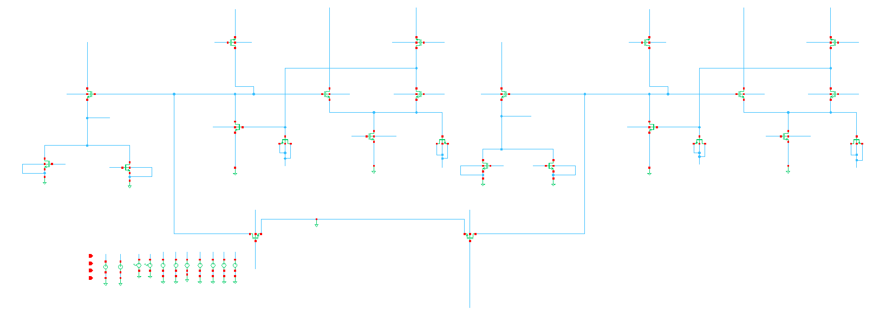

Band Pass Filter
Schematic Design
Power Consumption $=$1.63mW
Tahman Hossain
021 221 099
28
01

Slide 29

Band Pass Filter
Buffer
LC Tank
Half Circuit
Tahman Hossain
021 221 099
29
01

Slide 30
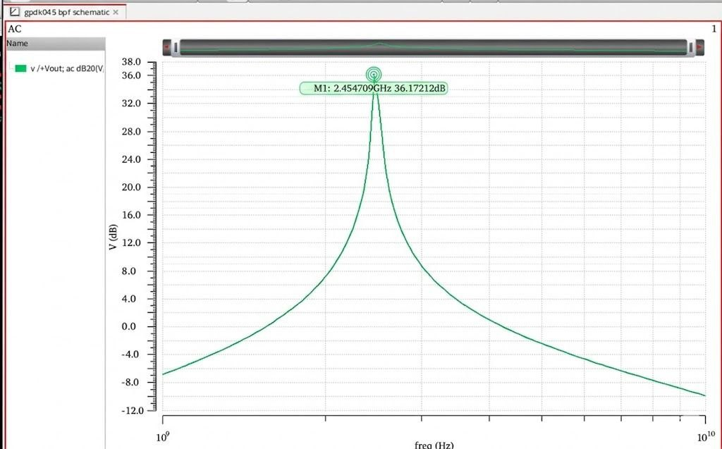
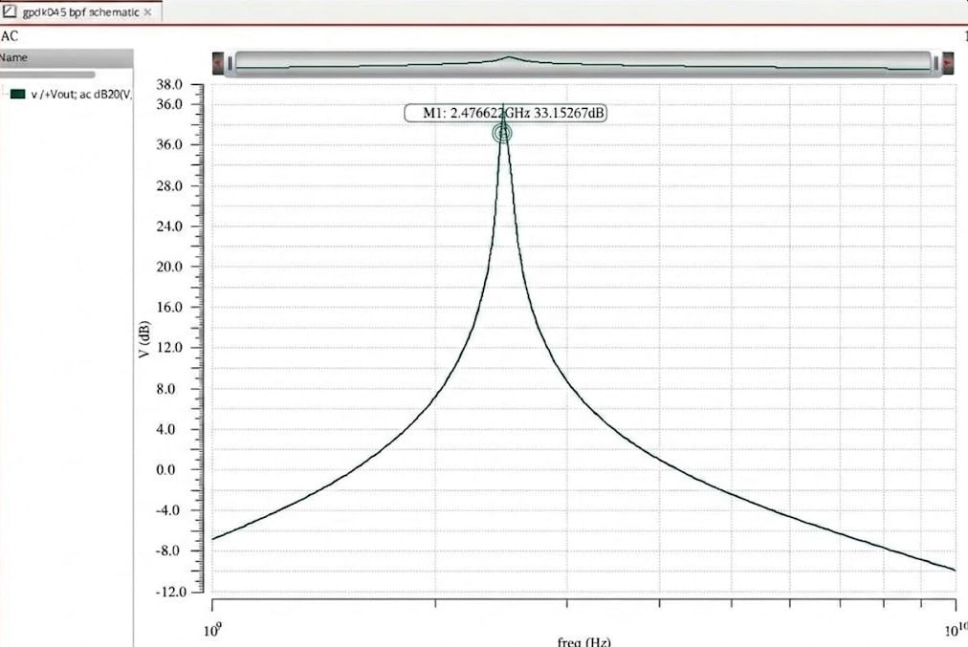
Band Pass Filter
Center Frequency
3 dB Point
Tahman Hossain
021 221 099
30
01

Slide 31
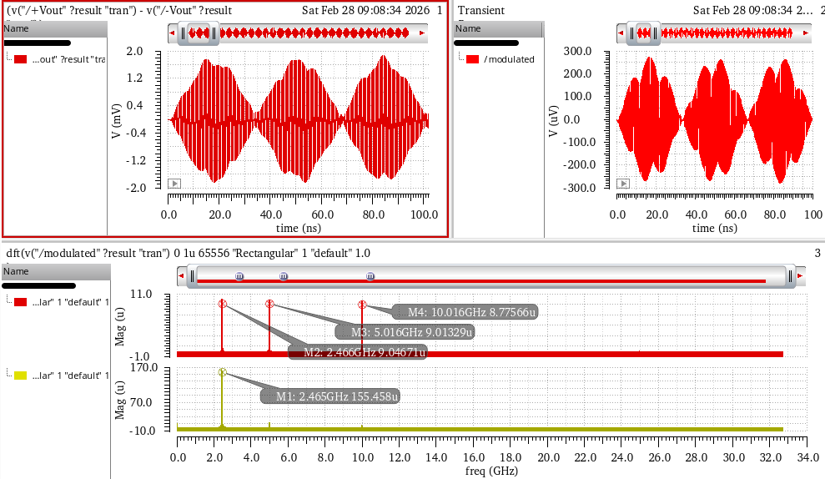
Band Pass Filter
Transient & DFT Analysis
Tahman Hossain
021 221 099
31
01

Slide 32
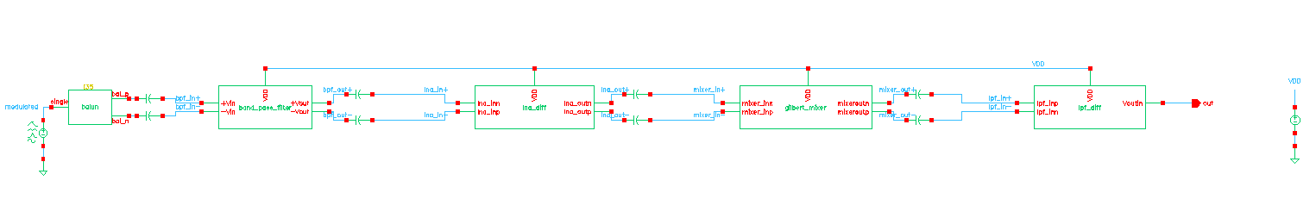
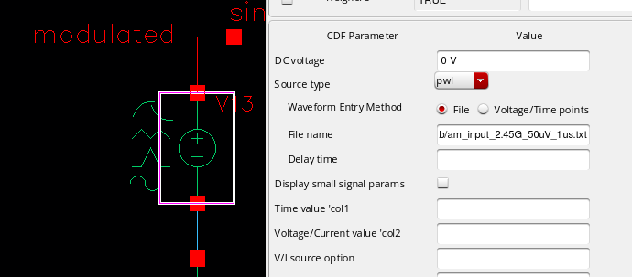
RF Receiver
Integration of RF Blocks
Uploading MATLAB Generated Modulation Signal
Tahman Hossain
021 221 099
32
01

Slide 33
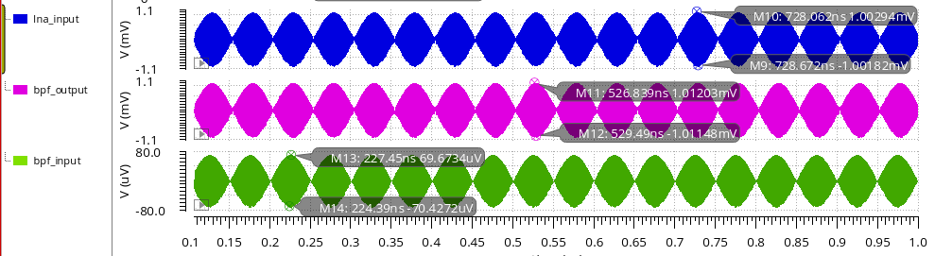
RF Receiver
DSB-SC Transient analysis
Massage signal - 10MHz
Carrier frequency - 2.45GHz
Amplitude - 50uV
Sazzad Hossen
021 221 026
33
01

Slide 34
RF Receiver
DSB-SC Transient analysis (cont.)
Sazzad Hossen
021 221 026
34
01

Slide 35
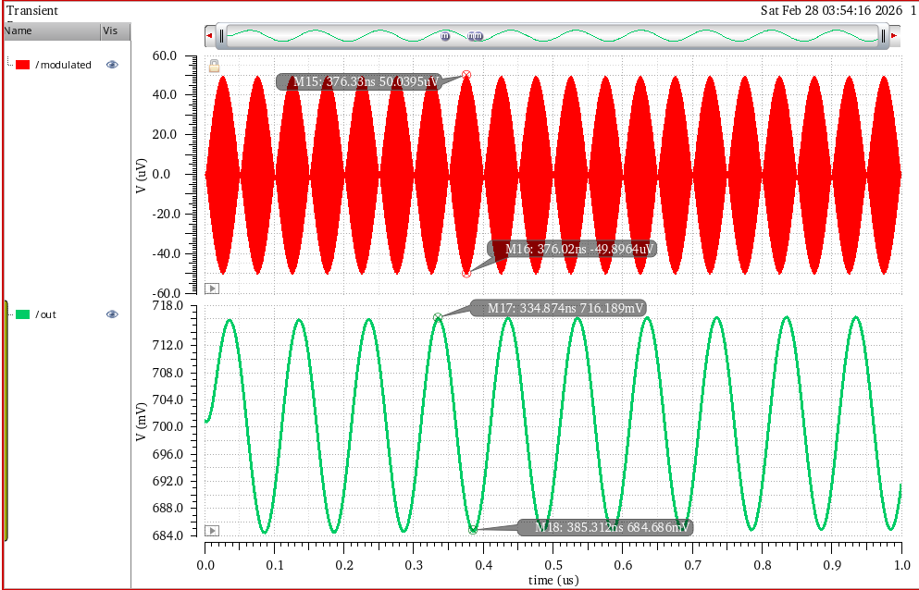

RF Receiver
DSB-SC Transient analysis (cont.)
$$Av​=\frac{V_{out}\left(peak_to_peak\right)}{V_{in}(peak_to_peak)}​​$$
= $\frac{31.5×{10}^{−3}}{100×{10}^{−6}}=$ 320
${ A}_{v}=$ 50 dB
Sazzad Hossen
021 221 026
35
01

Slide 36
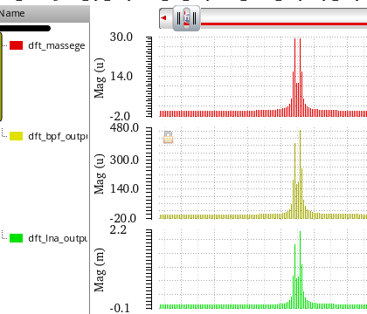
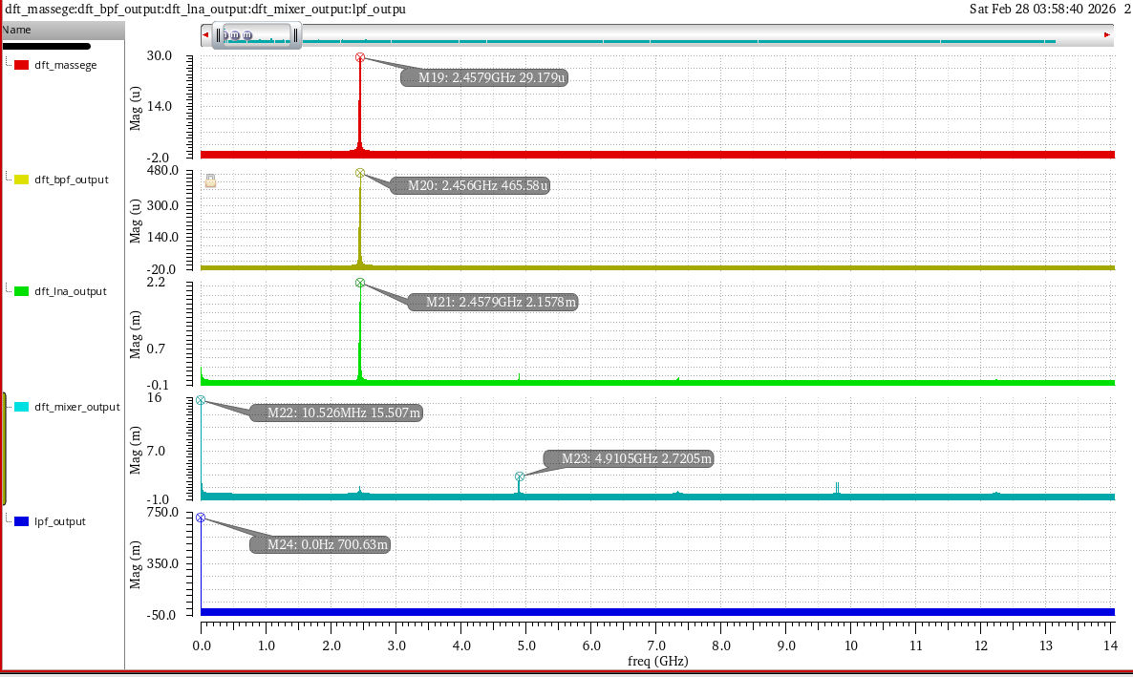
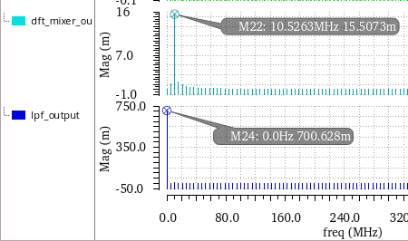
RF Receiver
DSB-SC DFT Analysis
Sazzad Hossen
021 221 026
36
01

Slide 37
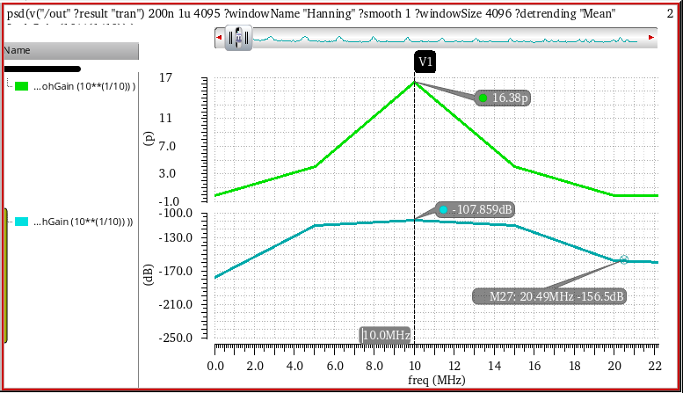
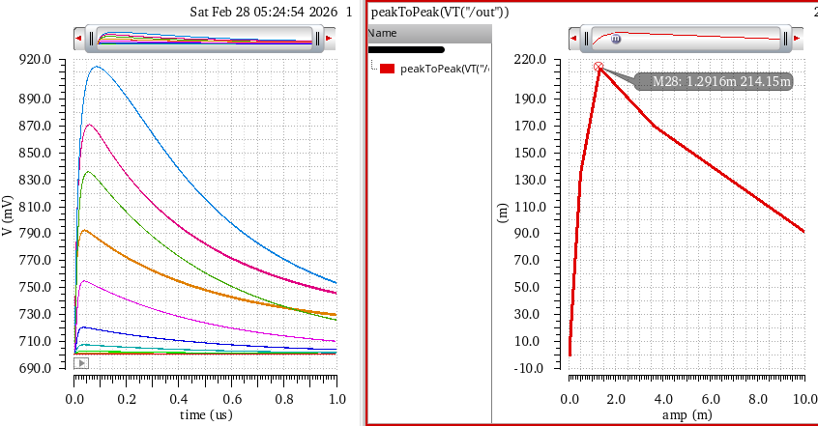
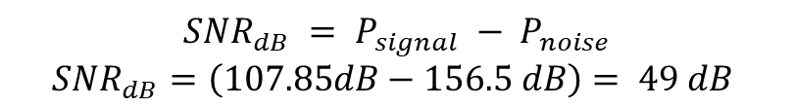
RF Receiver
PSD Analysis
Linearity Analysis
$$SNR_{dB} = P_{signal} − P_{noise}$$
$$SNR_{dB}=\left(107.85dB−156.5 dB\right)= 49 dB$$
Linearity range : 1uV – 1.3mV
Sazzad Hossen
021 221 026
37
01

Slide 38
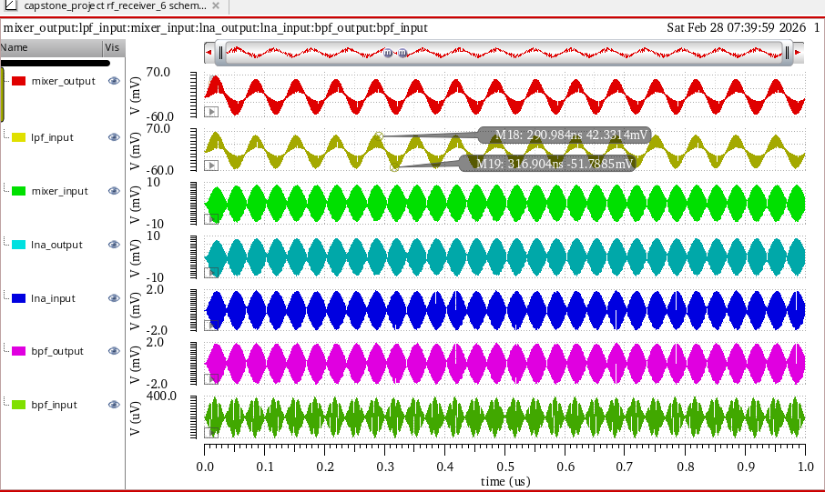
RF Receiver
FDM Transient Analysis
Massage signal – 15MHz
Carrier frequency – 2.45GHz, 5GHz, 10GHz
Amplitude – 100uV
Sazzad Hossen
021 221 026
38
01

Slide 39
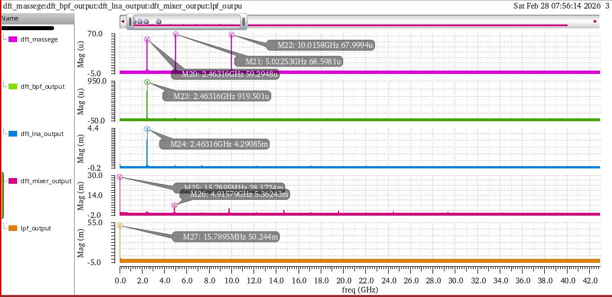
RF Receiver
FDM DFT Analysis
Sazzad Hossen
021 221 026
39
Shakil Sikder
021 213 048
01

Slide 40
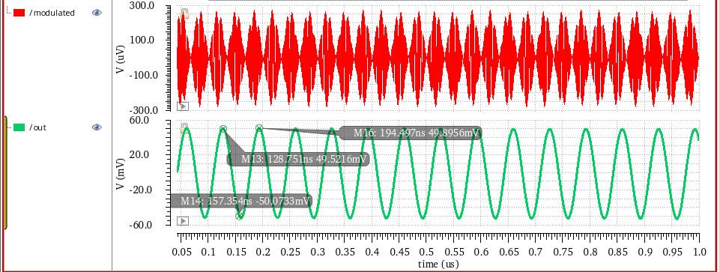
RF Receiver
FDM Transient Analysis (cont.)
Sazzad Hossen
021 221 026
40
01

Slide 41
RF Receiver
Output Summary
Future Direction
Integration of Advanced Blocks
THD
SNR
Physical Layout Design
6mW
1.3%
49 dB
Further Power Optimization
Sazzad Hossen
021 221 026
41
01
01

Slide 42

RF Receiver
I/Q (In-phase & Quadrature) Structure
Power Consumption of 8.79mW
Sazzad Hossen
021 221 026
42
01

Slide 43

RF Receiver
Single Tone Test
Sazzad Hossen
021 221 026
43
01

Slide 44

RF Receiver
Lissajous pattern
The perfect circular Lissajous pattern confirms 0 dB gain mismatch and 0 phase error between the I and Q channels.
Sazzad Hossen
021 221 026
44
01

Slide 45



Project Attributes
Program Outcomes (POs)
Knowledge Profile (K) Sustainability & SDG Alignment
POs
K’s
SDG
PO2: Problem Analysis
K01
SDG 4 Quality Education
PO3: Design/Development of Solutions
K03
SDG 7 Affordable and Clean Energy
K04
SDG 9 Industry, Innovation, and
Infrastructure
PO4: Investigation
K05
PO5: Modern Tool Usage
SDG 12 Responsible Consumption
and Production
PO6: Engineer and Society
K08
Sazzad Hossen
021 221 026
45
01
01

Slide 46
Communication & Co-ordination
Work Division
Specific responsibilities for BPF, LNA, Mixer, and LPF design, with cross-support for testing and integration.
Weekly Meetings
Documentation
Regular check-ins with supervisors to discuss progress, address challenges, and plan next steps.
Comprehensive technical reports and design logs to ensure knowledge transfer and traceability.
Key Takeaways
Robust RF receiver design for ISM band applications.
Strong alignment with engineering program outcomes and knowledge profiles.
Sazzad Hossen
021 221 026
46
01

Slide 47
Comparison Table
Category | Parameter | [1] | [2] | [3] | [4] | [5] | [6] | This Work
Process | Technology (nm) | - | 180 | 600 | 180 | 180 | 40 | 45
 | Supply Voltage (V) | - | 1.5 | 3 | 1.8 | 1.5 | 1.1 | 1.2
System | Frequency (GHz) | 2.4 | 24 | 2.4 | 24 | 2.42 | - | 2.45
 | Total Gain (dB) | 35 | 14.5 | 12 - 20 | 25 | - | - | 50
 | Total Power (mW) | 40 | 45 | 100 | 25.2 | - | - | 6.261
LNA | Gain (dB) | - | 15 | 14 | 14.7 | - | - | 23.03
 | NF (dB) | - | 6 | 3.5 | 4.3 | - | - | 2.4
 | Topology | - | Common Gate | Common Source Cascode | Transformer-Coupled | - | - | Common Source Inductive Degeneration
Mixer | Conv. Gain (dB) | - | 12.5 | 10 | 8.7 | - | -
 | Type | - | Active Gilbert Cell | Active Gilbert Cell | Current-Bleeding Mixer | - | - | Active Gilbert Cell
BPF | Bandwidth (MHz) | - | - | - | - | 38 | - | 20-100 (Tunable)
 | Power Consumption (mW) | - | - | - | - | 1.3 (Single Stage) | - | 1.63 (Differential)
LPF | Bandwidth (MHz) | - | - | - | - | - | 20 | 20
 | Power Consumption (mW) | - | - | - | - | - | 2 | 0.2
Sazzad Hossen
021 221 026
47
01
01
Notes:
[1] Al-Rawi, Muhanned. "Design of 2.4 GHz Transceiver for Wireless Communication." Land Forces Academy Review, vol. 24, no. 3, Nicolae Balcescu Land Forces Academy, 2019, pp. 232-241. https://doi.org/10.2478/raft-2019-0028.
[2] Guan, Xiang, and Ali Hajimiri. “A 24-GHz CMOS Front-End”. IEEE Journal of Solid-State Circuits 39 (2): 368–73. https://doi.org/10.1109/JSSC.2003.821783..
[3] Razavi, Behzad. "CMOS RF receiver design for wireless LAN applications." RAWCON 99. IEEE Radio and Wireless Conference (Cat. No. 99EX292).
[4] Chu, Chen-Yuan, et al. "A 24GHz low-power CMOS receiver design "IEEE International Symposium on Circuits and Systems (ISCAS).
[5] Bhuiyan, Arif. “Design of a Band-Pass Filter in 0,18 Μm CMOS for 2,4 GHz Reader-Less RFID Transponder.” Tehnicki Vjesnik - Technical Gazette, Mechanical Engineering Faculty in Slavonski Brod, 2017.
[6] X. Wang, C. C. Boon, K. Yang and L. Kong, "A 20–80 MHz Continuously Tunable Gm-C Low-Pass Filter for Ultra-Low Power WBAN Receiver Front-End," in IEEE Access, vol. 9, pp. 154136-154142,

Slide 48
Conclusion
2.45 GHz CMOS RF Receiver Design (45 nm).
Reliable wireless application.
Effective weak-signal restoration.
Low power consumption (6.261 mW).
Gain: 320 & THD: 1.319%
Scalable for advanced modulation.
Sazzad Hossen
021 221 026
48
01
01

Slide 49




Thank You

Slide 50

Any Question?

Slide 51


Slide 52

Receiver Design
AM (Transient analysis)
Massage signal – 5MHz
Carrier frequency – 2.45GHz
Amplitude – 50uV

Slide 53




Receiver Design
QPSK Transient Analysis
Lissajous pattern
Eye Diagram

Slide 54

Mixer Design
Mixer schematic with Impedance matching

Slide 55

Mixer Design
Voltage Conversion Gain Vs. LO Signal Power
01

Slide 56

Mixer Design
Mixer S- Parameter Analysis

Slide 57


Receiver Design
Before Impedance Matching After Impedance Matching

Slide 58

LNA Design
Differential LNA

Slide 59

Receiver Design
Mixer + LPF (Noisy Output)

Slide 60

Receiver Design
Transient (Noisy)

Slide 61

Receiver Design
LNA + Mixer + LPF (Clean Output)

Slide 62

Receiver Design
Transient (Clean Output)

Slide 63

Receiver Design

