Slide 1
Database Fundamentals
CSE 370 PROJECT

Slide 2

Project Name:
Inventory Management System

Slide 3
Members:
Md. Sazzadul Islam
13201081
Md. Maqsud Ul Anwar
13101033
Tahanima Chowdhury
13101108

Slide 4
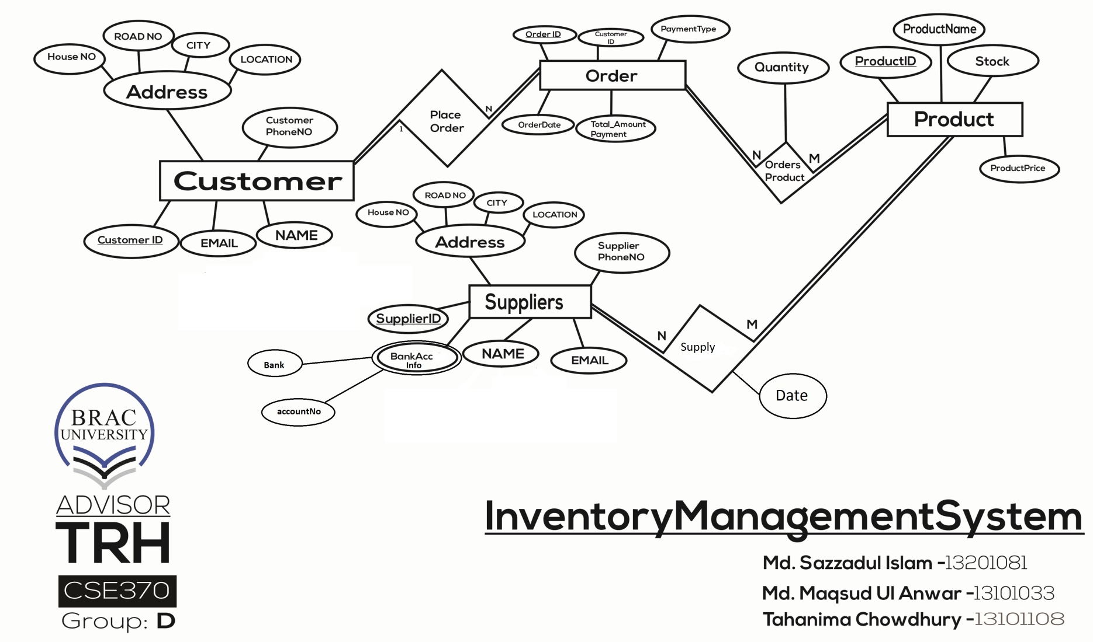
ER DIAGRAM:

Slide 5
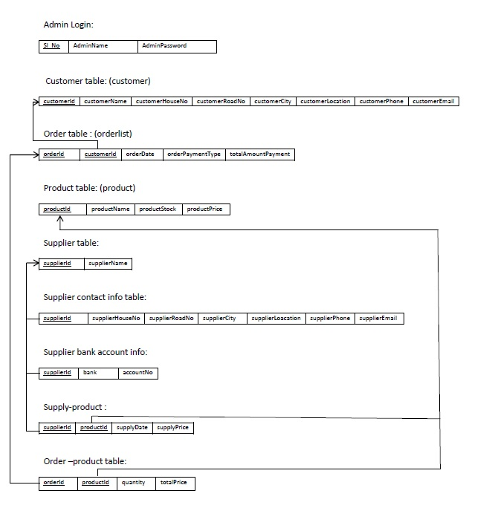
Schema Diagram:

Slide 6
Query List:
1) Extract details of all customers.
2) Extract details of a particular customer.
3) Extract payment information of a particular customer.
4) Extract total number of customers till date
5) Extract details of all products.
6) Extract details about a particular product.

Slide 7
Query List:
7) Extract quantity left of a particular product.
8) Extract products out of stock.
9) Get most expensive product.
10) Get cheapest product.
11) Extract details of all suppliers.
12) Extract all the dates a given supplier has supplied products.
13) Extract details of a particular supplier.
14) Extract all the products a given supplier has supplied.
15) Extract total number of suppliers till date.

Slide 8
Features:
Our database has two multiple views: one for admin and another for sales person
Our database can only add, delete and update items through admin view and can edit and delete through salesman view.
Our Database has used different tables and relation to make the database more efficient.
Our Database Can come up with Different Queries and extract data from different table
Our Database Has Login System to make the Database more secured.

Slide 9
Thank You

