Slide 1


A helping tool for doctors and intern
CSE470

Slide 2



GROUP MEMBER:
MD. Sazzadul Islam – 13201081
MD. Maqsud Ul Anwar -13101033
RAFID AHMED -13101209

Slide 3



OUTLINE OF THE SLIDE
What is ?
Motivation.
Project Overview
Implementation
Limitations
Future Scope
Conclusions
Project Demonstration

Slide 4
What is
MedAid+ is a Doctor helping software
Provides Symptom checking for junior doctors.
Senior Doctors gets a great helping hand for RESEARCH
It’s a software which also helps patient to keep their record and take them on PDF .
A software which is maintained and moderate by SOFTWARE ENGINEER all the time.
Doctors can observe other doctors activity so that they can take help from those.

Slide 5

MOTIVATION
Few years back there was an incidence where an old man in his sixties had experienced sudden difficulty to speak, so his family took him immediately to a clinic. There a young doctor probably an intern was only available at that moment. The young doctor thought the old man was suffering from cold and prescribed medicines for cold and sent them home. Later that night that old man died. It was found out later that he died of stroke. The members of the family was furious about the mistreatment given by the doctor. Mistakes like these are often heard in the news these days, which could have been avoid had the doctor been more careful or had some other doctors to consult with. It was these incidents that inspired us to develop MedAid+ in order to assist doctors in diagnosing their patients.

Slide 6

PROJECT OVERVIEW
DIAGRAM (EER Diagram)
FEATURES WE HAVE

Slide 7
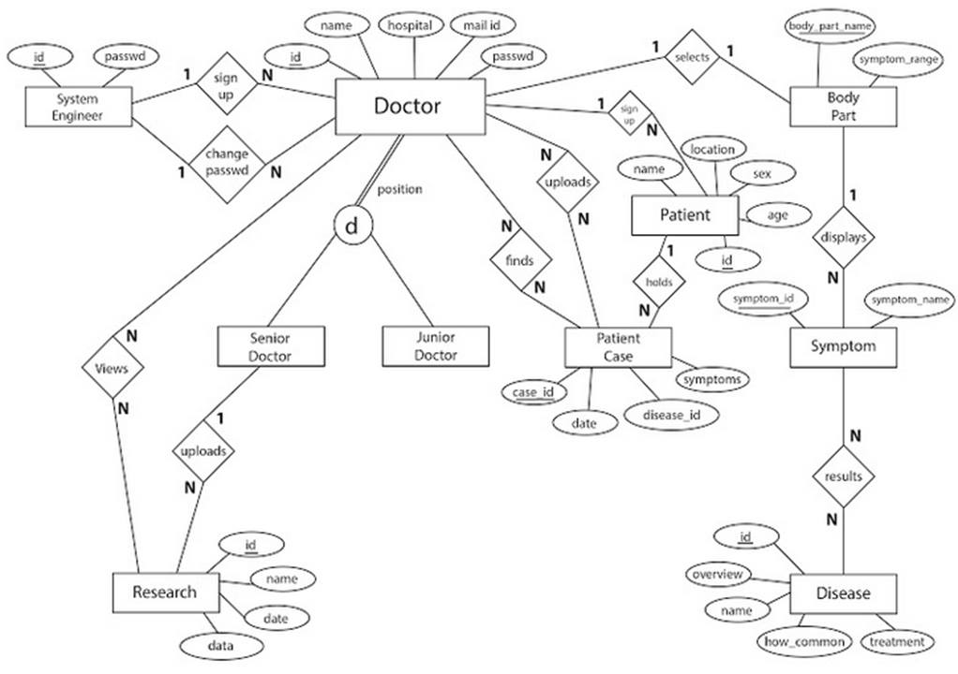
EER DIAGRAM

Slide 8
FEATURES WE HAVE

Slide 9
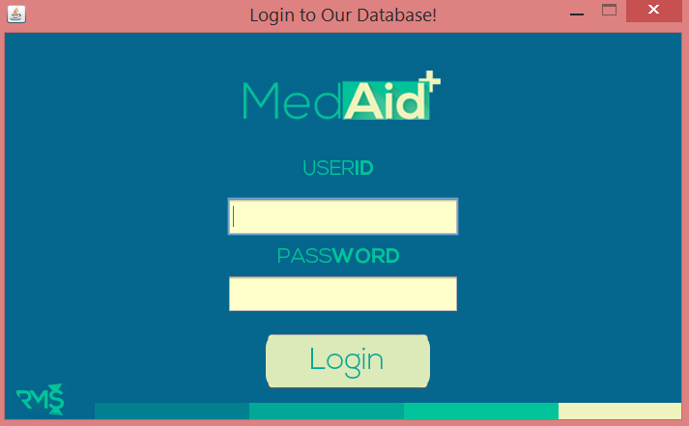
LOGIN PROTECTION

Slide 10
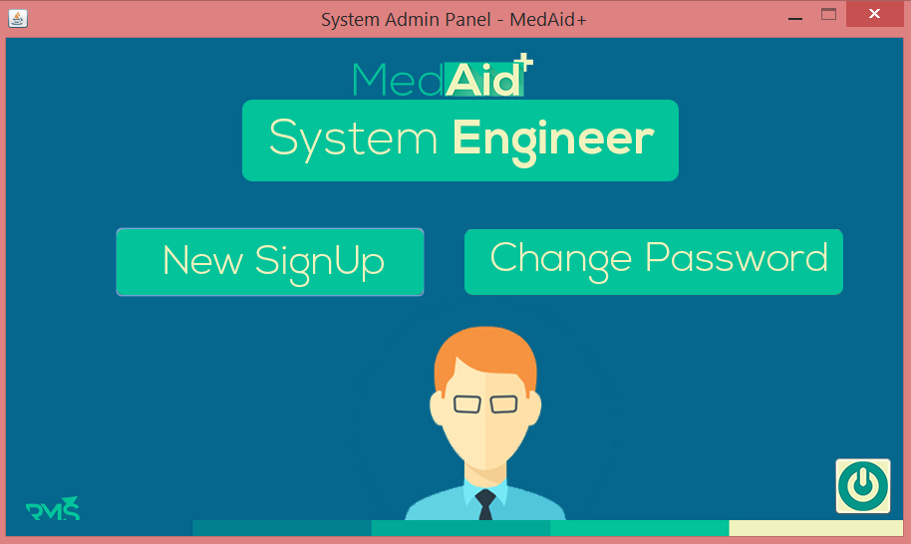
ALL TIME MAINTAINANCE BY SYSTEM ENGINEER

Slide 11
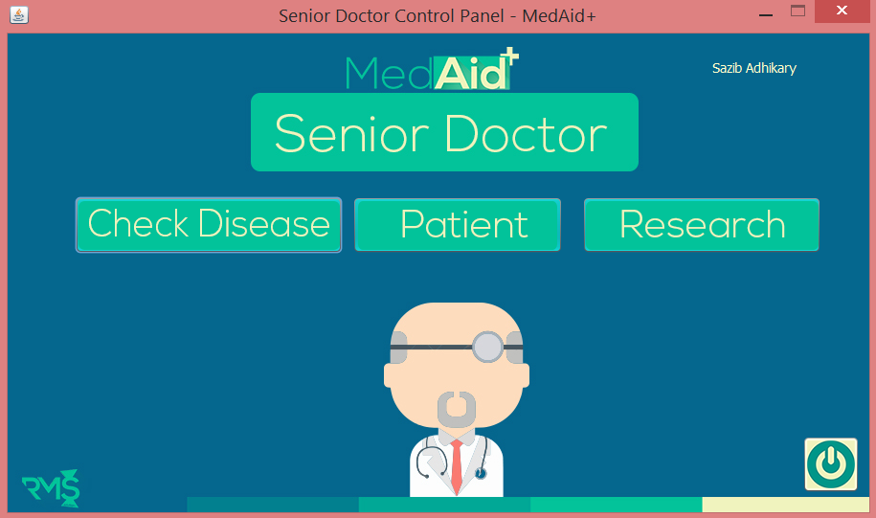
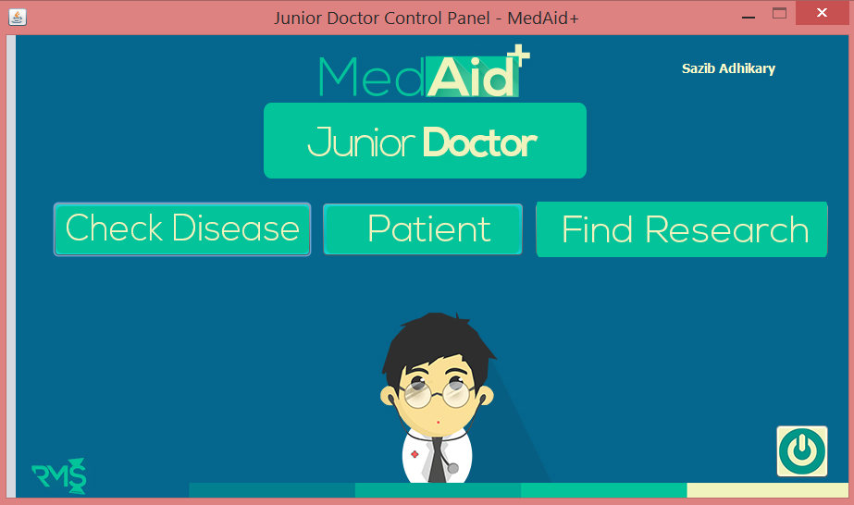
MULTIPLE VIEW
SYSTEM ENGINEER
SENIOR DOCTOR
JUNIOR DOCTOR

Slide 12
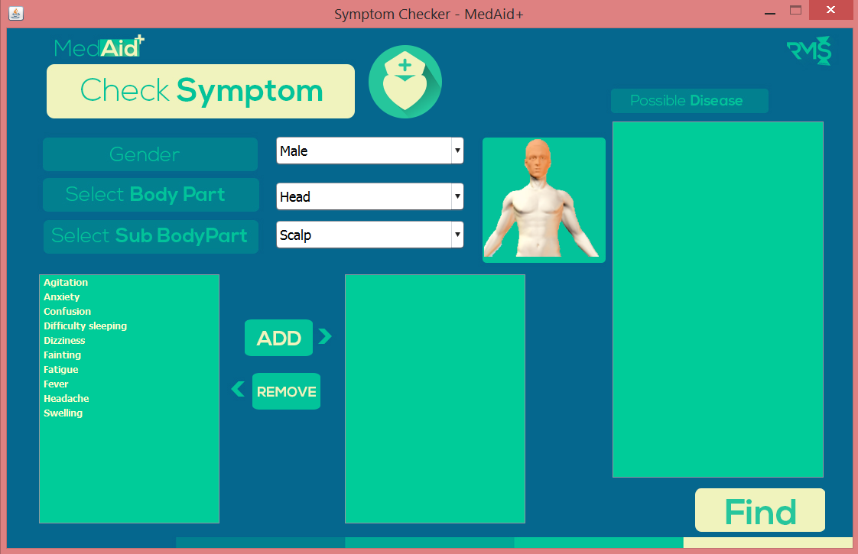
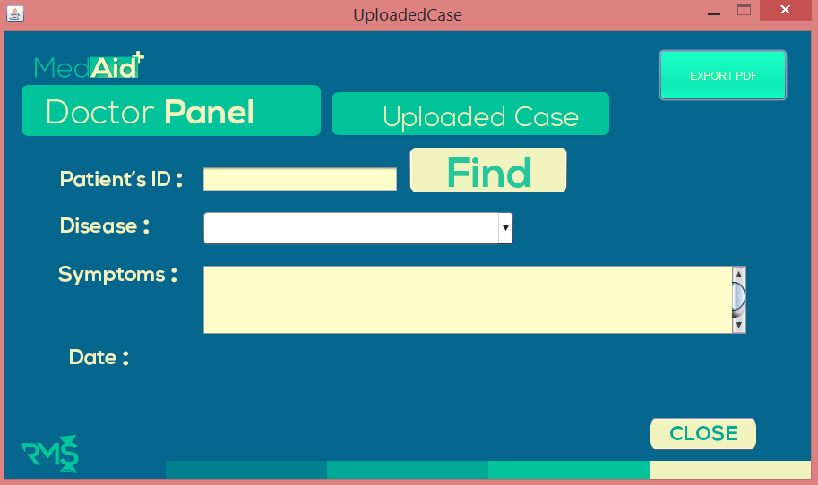
USER FRIENDLY UI

Slide 13

CENTRALIZED DATABASE

Slide 14
SYMPTOM CHECKER

Slide 15
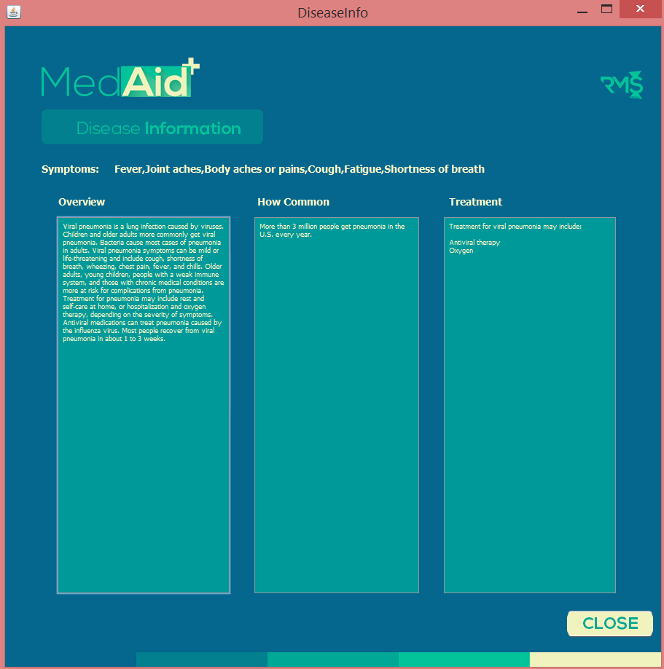
DISEASE INFO

Slide 16
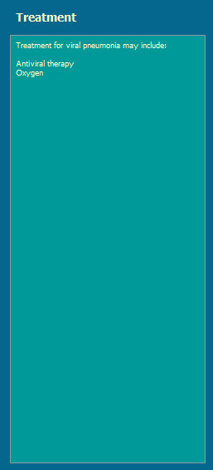
POSSIBLE TREATMENT FOR CERTAIN DISEASE

Slide 17
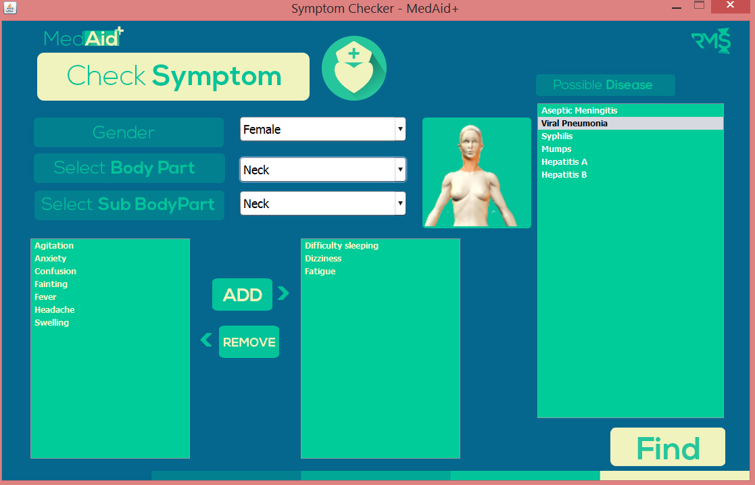


GRAPHICAL VIEW FOR BODY PART

Slide 18
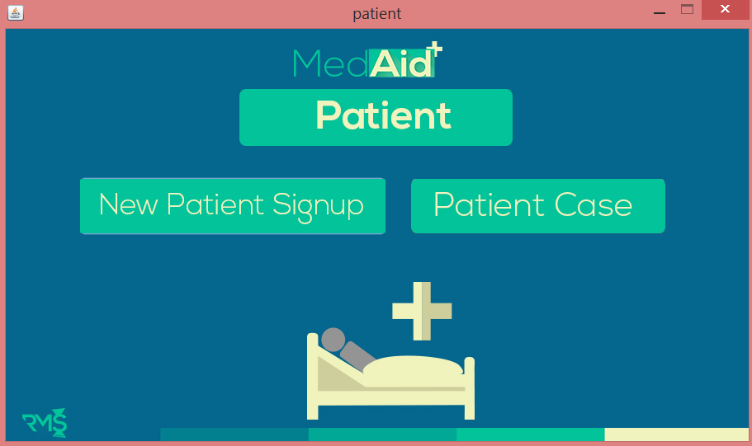
PATIENT RECORD SYSTEM

Slide 19
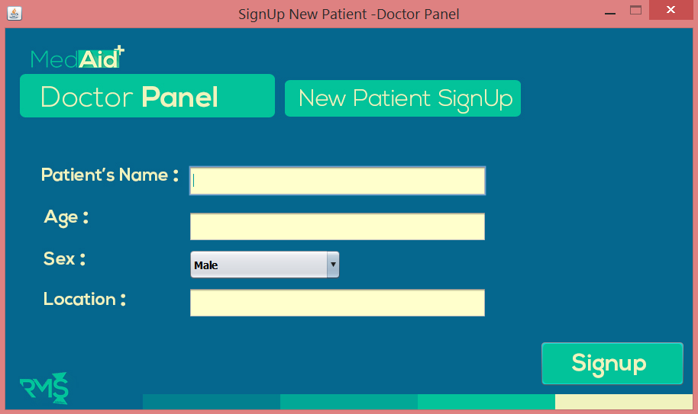
PATIENT SIGNUP

Slide 20
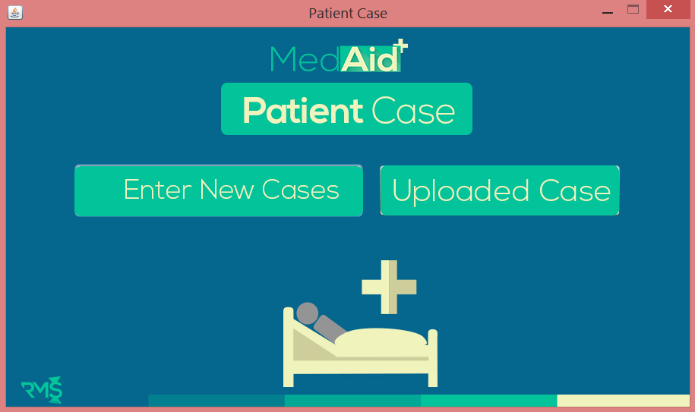
PATIENT CASE

Slide 21
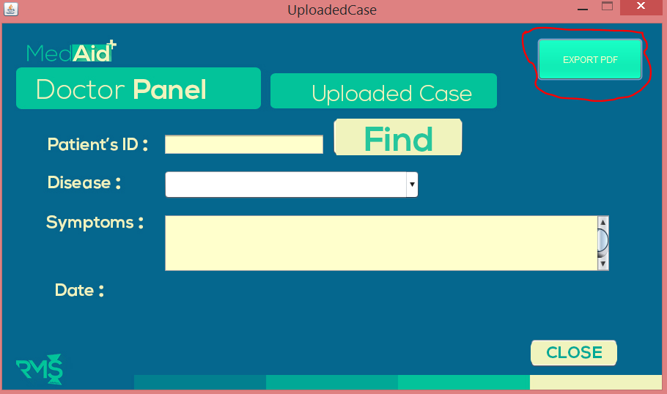
UPLOADED CASE

Slide 22
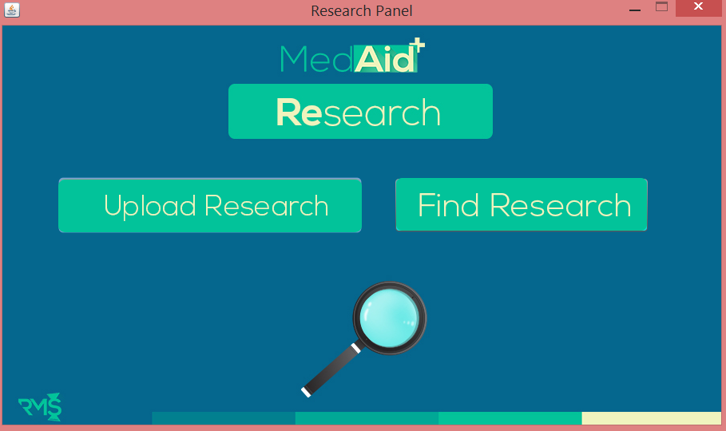
RESEARCH

Slide 23


IMPLEMENTATION
SWING
IDE
LANGUAGE

Slide 24
LIMITATIONS
The Software Limitations are,
Doctors need to be trained to use the system properly
Doctors need to insert new information correctly otherwise result will be affected by incorrect data.
As the number of servers are limited, if one server crashes it will largely affect the other servers.
As we are using one database now, for the long run we might need to add more database in the system.
This system is limited to personal computer.

Slide 25
FUTUTRE SCOPE
Implement a AI which can check the case and remove less important case
Chat system over logged in Doctors who can chat among themselves
Introduce as website and android app
Making dashboard where doctor can ask question in software and other doctors can reply
OUR SOFTWARES FUTURE SCOPE CAN BE MANY LIKE THIS

Slide 26
CONCLUSIONS
There are many sectors where computer science is doing huge advancement such as military, Agriculture, Medical sector etc. But in Bangladesh Medical sector don’t have that much advancement on computer science still some doctor uses analog system to check their patient this is exactly why we choose to work on medical sector and do help this kind of issues.
And we strongly believe it will bring a great advancement in Medical Sector

Slide 27
PROJECT DEMONSTRATION
A helping tool for doctors and intern

Slide 28




