Slide 1
Course Information
Cmpe150.01 Lab+PS: Thursday 3-4-5, BM B4
Zeynep Yirmibeşoğlu
Contact: zeynep.yirmibesoglu@boun.edu.tr
Lab Content: https://github.com/zeynepyirmibes/cmpe150-spring20
Student Assistants:
Ömer Cihan
Hatice Şule

Slide 2
Course Information
Quizzes each week (%10)
Midterm 1 (25%) March 31
Midterm 2 (30%) May 5
Final (35%)

Slide 3
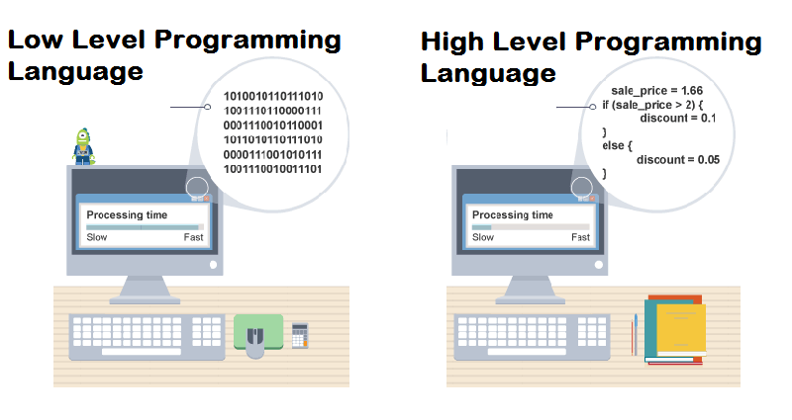
Programming Languages

Slide 4
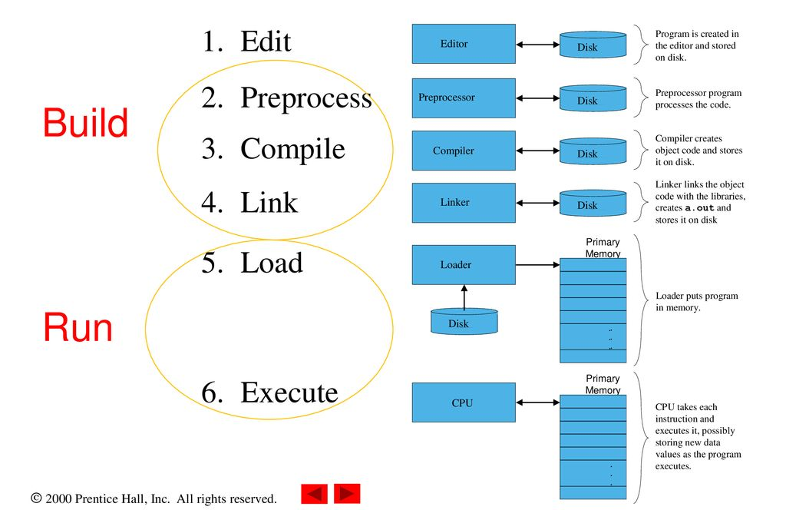
Build & Run

Slide 5

Eclipse IDE
IDE: An integrated development environment (IDE) is a software application that provides comprehensive facilities to computer programmers for software development. An IDE normally consists of at least a source code editor, build automation tools and a debugger.

Slide 6
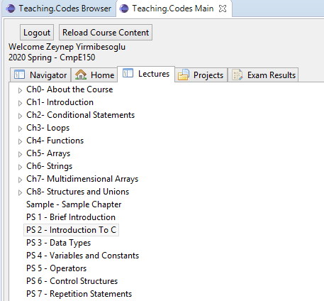
Teaching Codes
https://programming.cmpe.boun.edu.tr/welcome

Slide 7
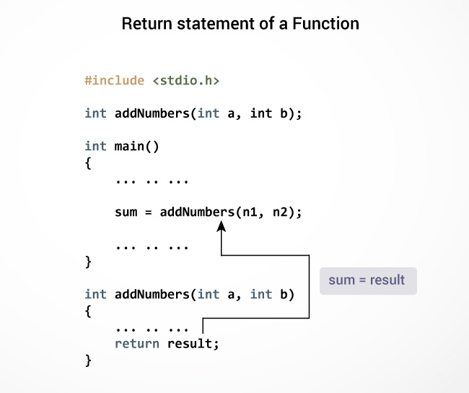
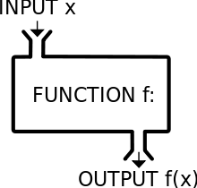
C Functions

Slide 8
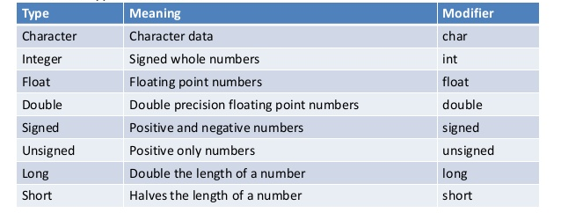
Variables in C
int number1;
int number2;
int number1, number2;

Slide 9
Declaration & Assignment
Declaration:
int number1;
char character1;
Assignment: Not a mathematical equality
number1 = 62;
character1 = ‘a’;
2 = x; WRONG

Slide 10
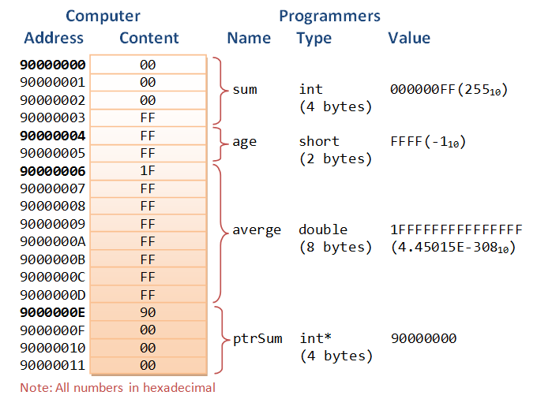
Memory Layout

