Slide 1
Ubertemplate
Automatic generation of SSE annotation template
5. 10. 2018

Slide 2
Methods
- These diagrams are generated from random 50 PDBs in each family
- helices = gray
- β-strands = each sheet has a separate colour

Slide 3
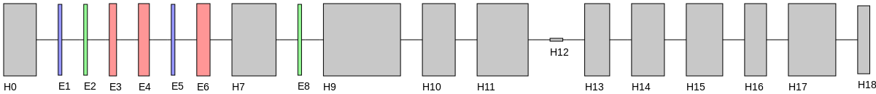
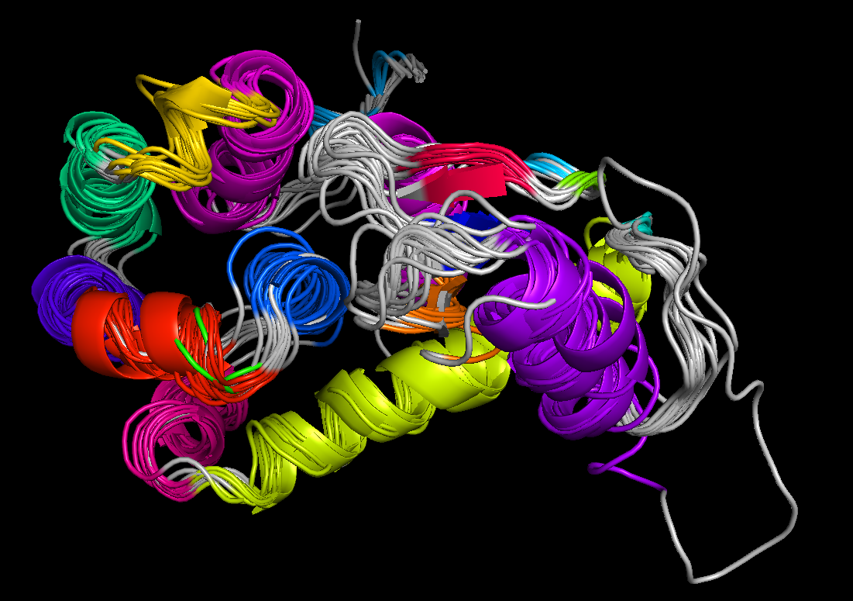
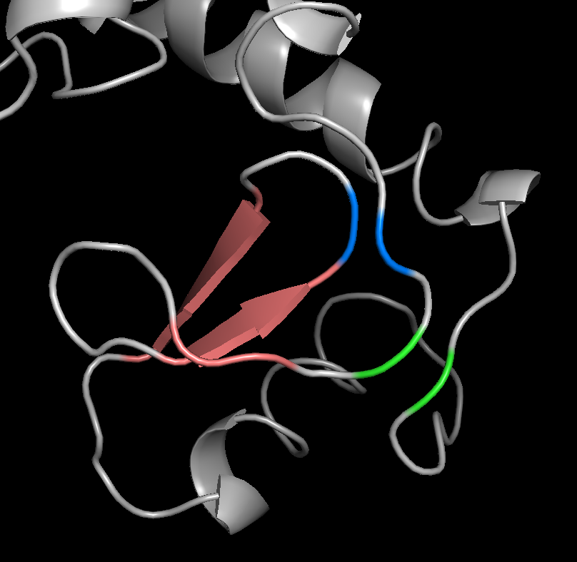
Lysozyme 1.10.530.40
This should be one sheet.

Slide 4
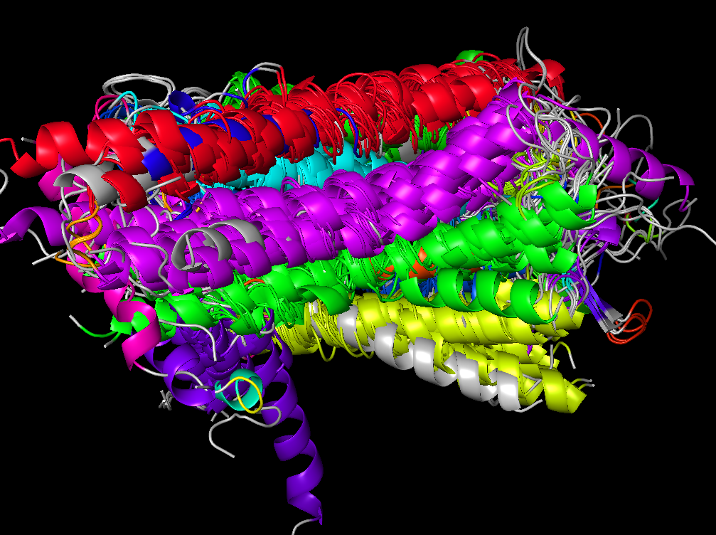
GPCR 1.20.1070.10

Slide 5
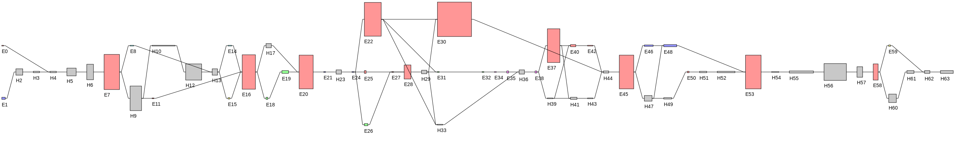
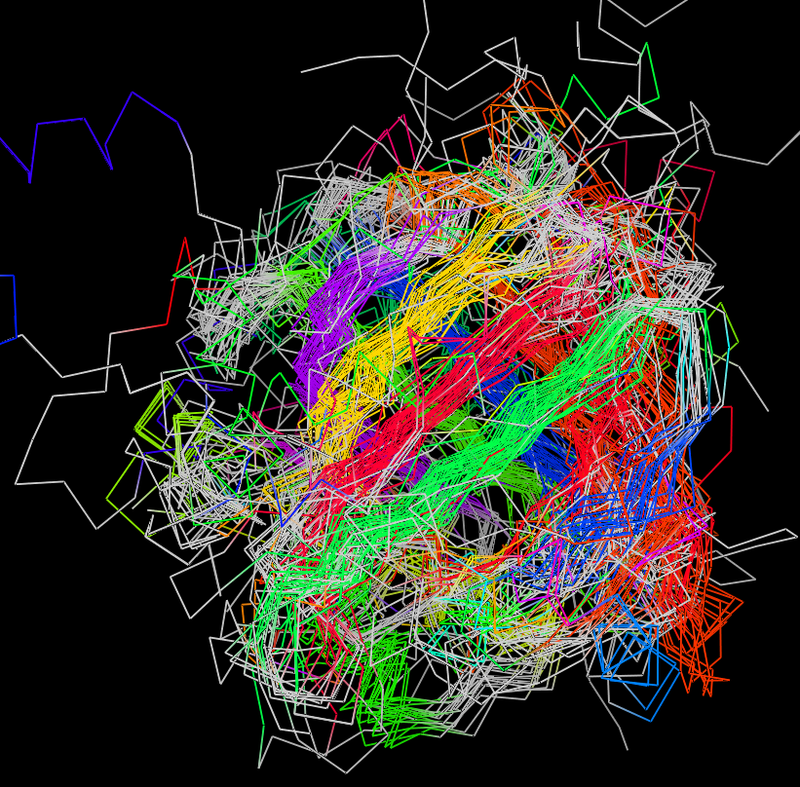
Lipocalin (β barrel) 2.40.128.20
Ordering of β5 - β6?

Slide 6
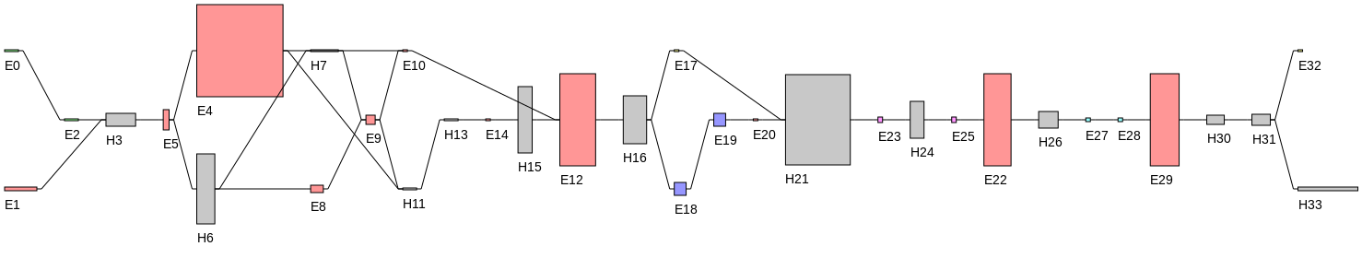
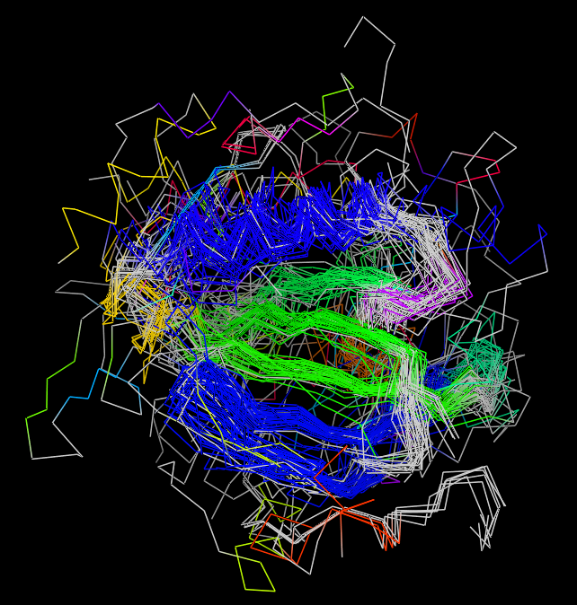
Protein of Death 3.30.200.20
Where is the 5th strand???

Slide 7
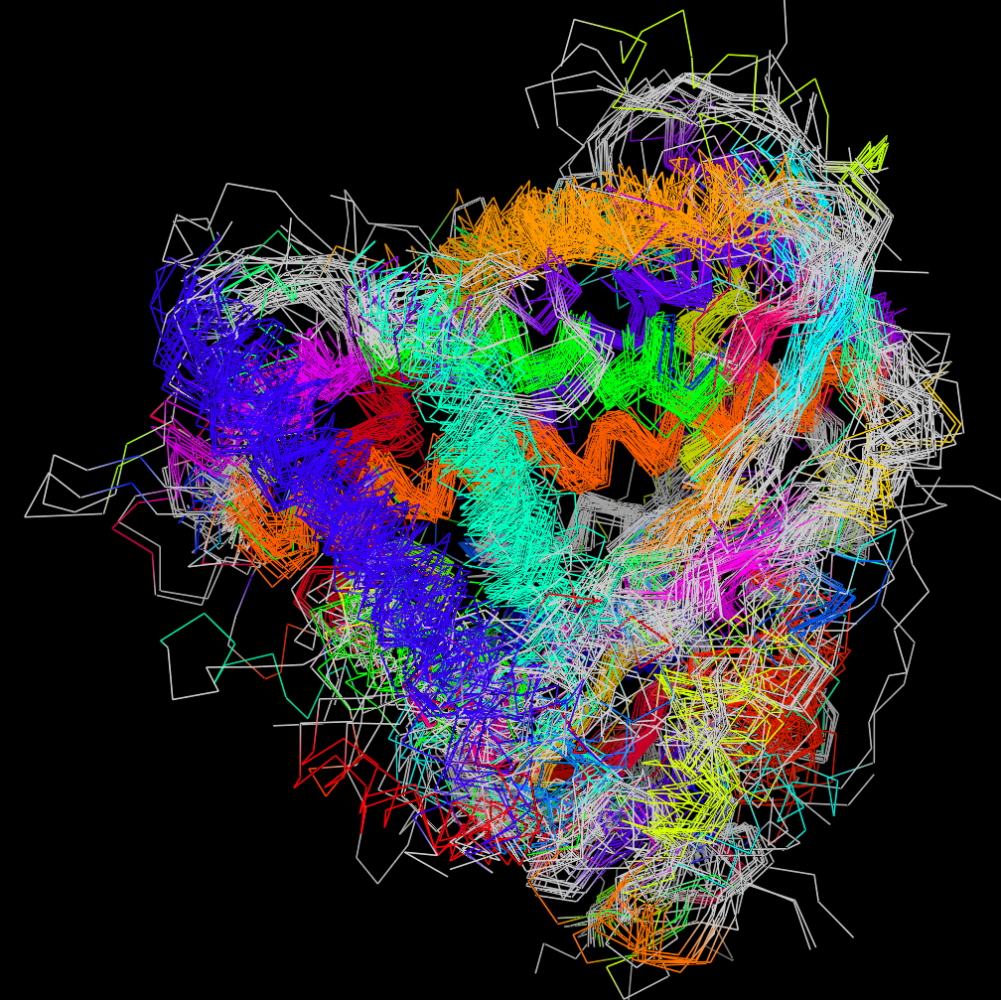
CYPs 1.10.630.10
B C D E F G H I J K L
A

