Slide 1
Testcases for 2DProt
...
2. 11. 2018

Slide 2
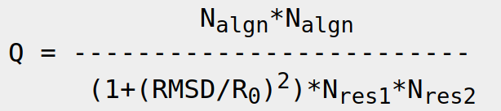
Methods
Select 6 test-families
Should cover all classes: (class = first number in CATH code)
1. Mainly α
2. Mainly β
3. Mixed α/β
(we ignore class 4. Few SSEs)
Select a few representants (~6) for each family
Some very similar (low RMSD, high Q-score)
Some very different (high RMSD, low Q-score)
http://www.ebi.ac.uk/msd-srv/ssm/rl_qscore.html

Slide 3
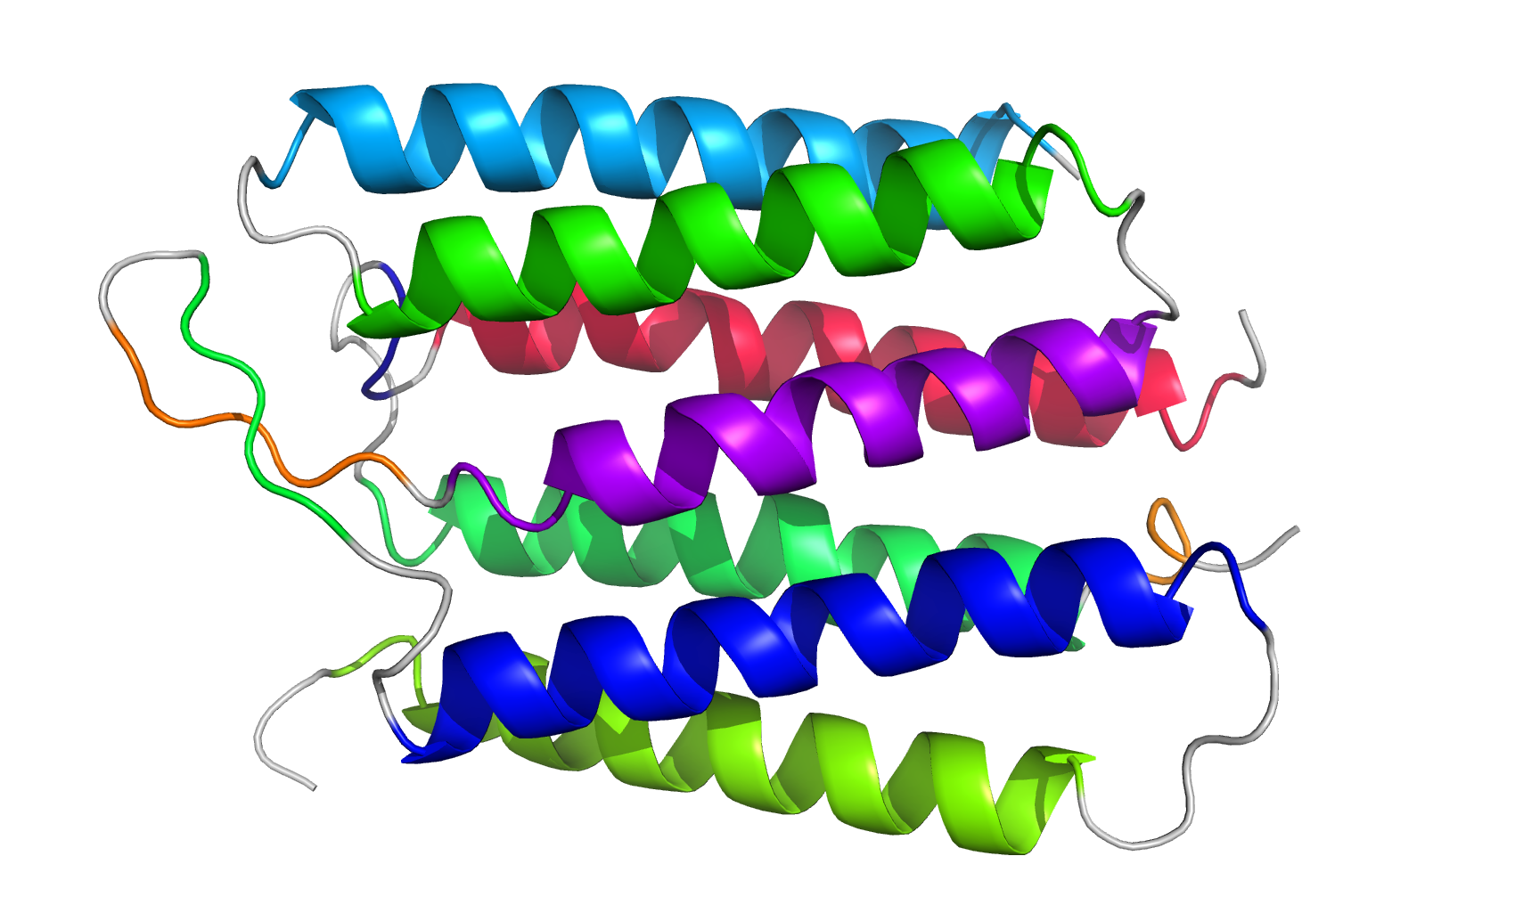
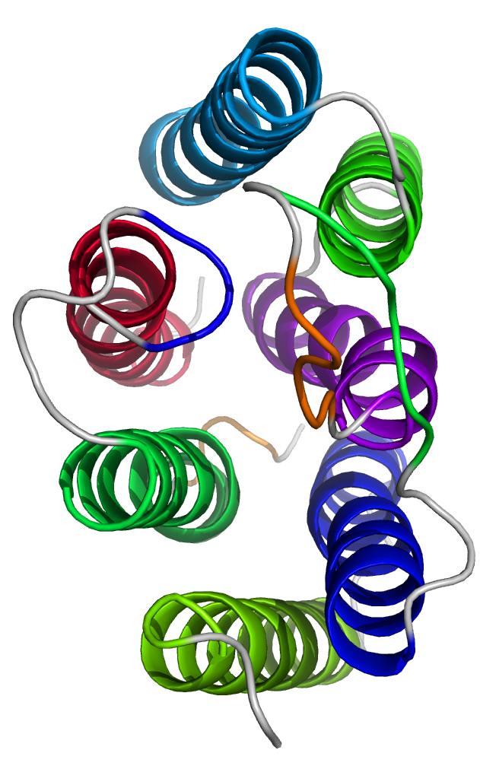
GPCR 1.20.1070.10
- Up-down helix bundle: 7 parallel helices
 | Q-score | RMSD
5b6xA00 | 1.000 | 0.00
5b6yA00 | 0.999 | 0.09
1kg9A00 | 0.948 | 0.39
2jagA00 | 0.666 | 1.90
5g28A00 | 0.291 | 4.16
2vt4A00 | 0.135 | 5.90
Q-score against the first domain
RMSD against the first domain

Slide 4
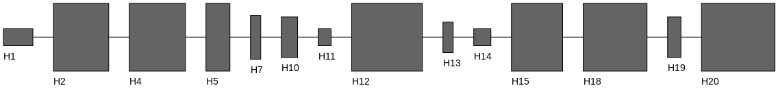
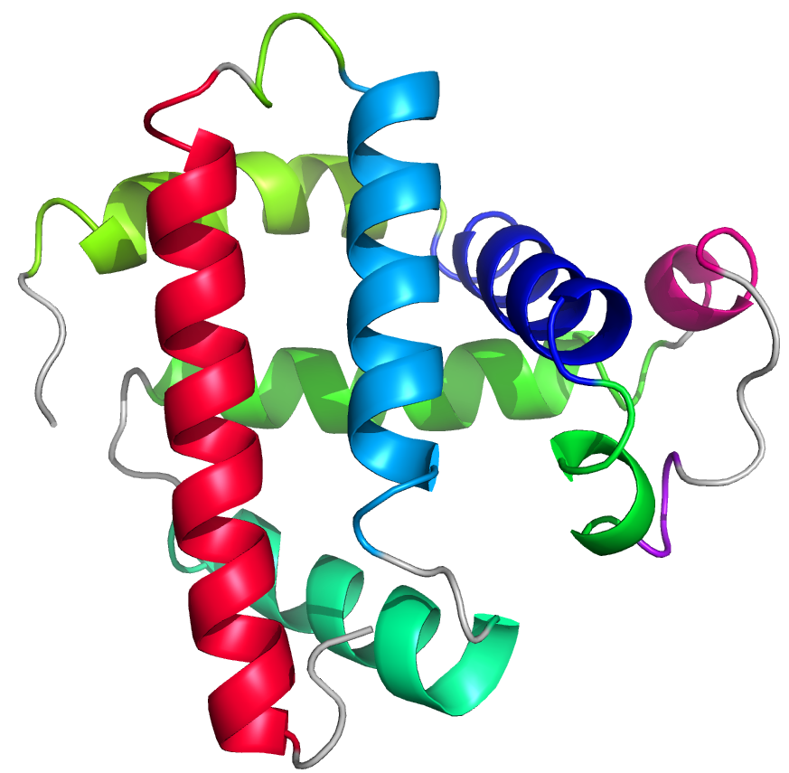
Globins 1.10.490.10
- Orthogonal helix bundle: non-parallel helices
 | Q-score | RMSD
111mA00 | 1.000 | 0.00
1co9A00 | 0.997 | 0.16
5jomA00 | 0.960 | 0.60
5hu6A00 | 0.705 | 1.55
2lh5A00 | 0.441 | 3.06
3zjqA00 | 0.232 | 4.08

Slide 5
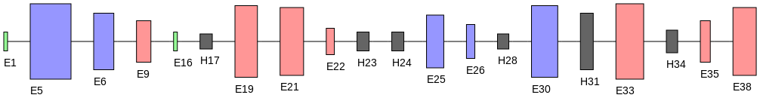
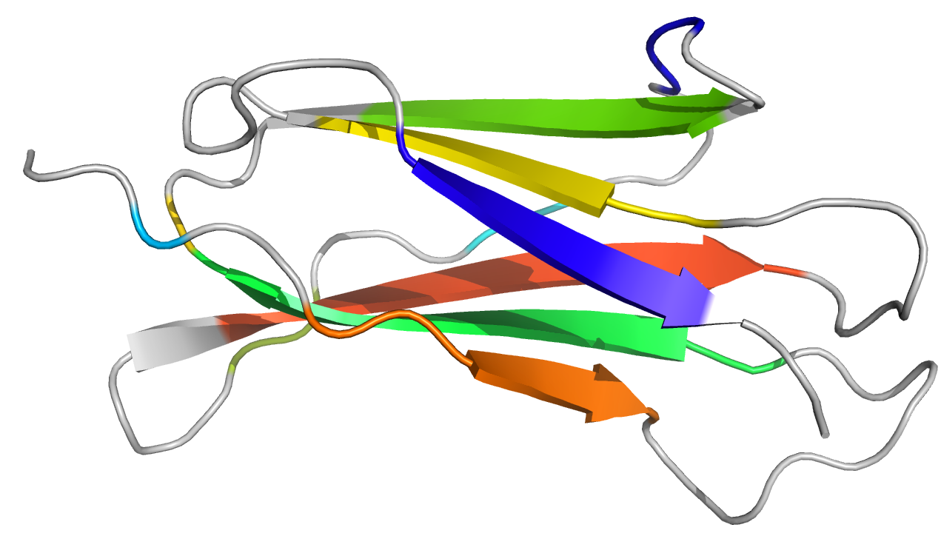
Immunoglobulins 2.60.40.10
- Sandwich = 2 sheets
 | Q-score | RMSD
1aqdA02 | 1.000 | 0.00
4p5mA02 | 0.978 | 0.45
1p7qA02 | 0.603 | 2.17
1t0pB00 | 0.362 | 3.42
4urtB01 | 0.166 | 5.35

Slide 6
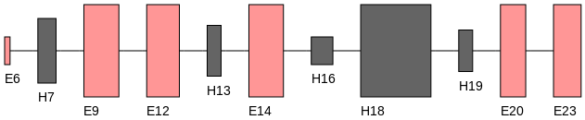
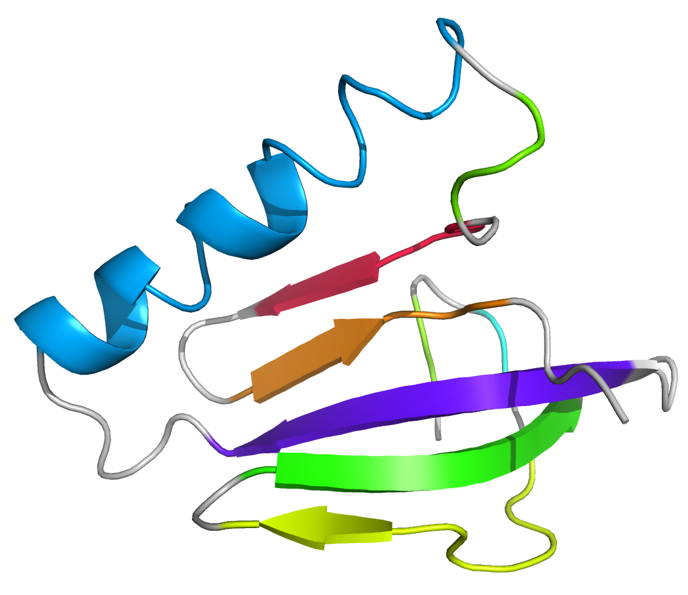
Protein of Death 3.30.200.20
- 2-layer sandwich = 1 sheet + 1 layer of helices
 | Q-score | RMSD
1e9hA01 | 1.000 | 0.00
2wfyA01 | 0.903 | 0.98
5ap1A01 | 0.570 | 2.32
3gopA01 | 0.232 | 3.90
4fgrA01 | 0.131 | 6.11

Slide 7
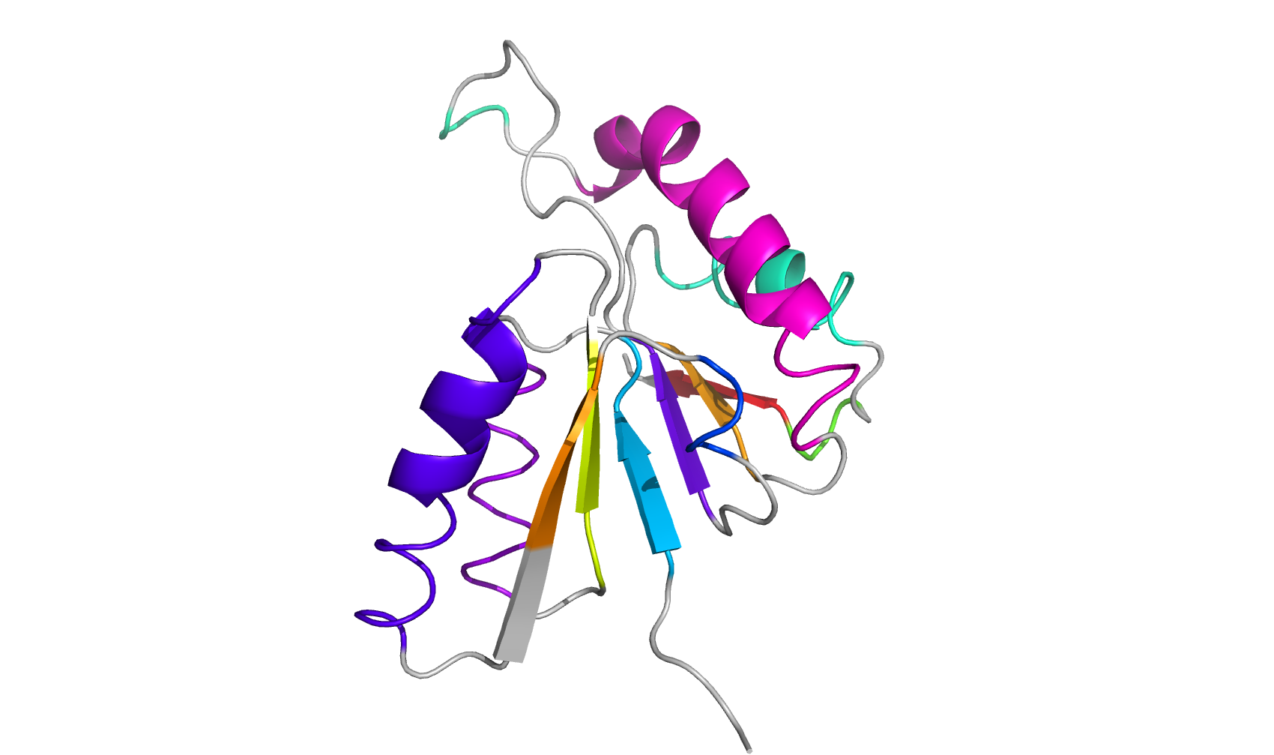
NAD(P)-binding Rossmann-like Domain 3.40.50.720
- Rossmann fold = 1 sheet + helices on both sides
 | Q-score | RMSD
1r0lA01 | 1.000 | 0.00
3iieA01 | 0.802 | 1.28
1rjwA02 | 0.259 | 3.64
3sc6A01 | 0.110 | 4.16
2bmaA02 | 0.088 | 6.04

Slide 8
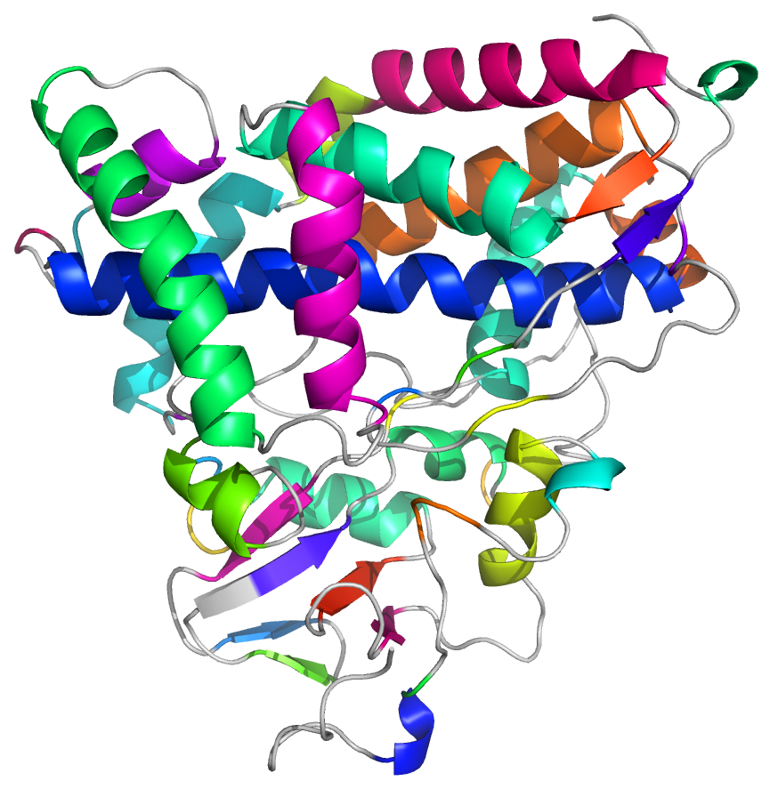
CYPs 1.10.630.10
- Big helix mess
 | Q-score | RMSD
1iwkA00 | 1.000 | 0.00
4l4dA00 | 0.983 | 0.40
3p6xA00 | 0.720 | 1.80
4triA00 | 0.494 | 2.79
4uvrA00 | 0.255 | 4.04
4xryA00 | 0.208 | 4.75

Slide 9
Methods
Návrh metriky Comp (comparativity, nevymyslel som lepšie meno):
Diff3D(i,j) = miera odlišnosti proteínov i a j v 3D, napr.:
RMSD
Q-score
Σ_{(X,Y)} [(vzdialenosť X a Y) + const * (1-cos(uhol medzi X a Y))]
kde (X,Y) sú všetky spoločné SSEs (X je v i, Y je v j)
Diff2D(i,j) = miera odlišnosti proteínov i a j v 2D, napr.:
Σ_{(X,Y)} [(vzdialenosť X a Y) + const * (1-cos(uhol medzi X a Y))]
Comp(A) = corr(Diff3D(i,j), Diff2D(i,j))
kde (i,j) sú všetky kombinácie proteínov z rodiny A
Comp↑ podobné vyzerajú podobne, rôzne vyzerajú rôzne, sme happy :)
Comp↓ niečo je špatne :(

