Slide 1
Ubertemplate
Comparison of acyclic clustering
with sides vs simple

Slide 2
Methods
Each family – select random 50 domains and run
(select more random samples to see repeatability)

Slide 3
Methods
Before – acyclic clustering with sides
  cluster helices and ladders, then join ladder sides into strands
After – acyclic clustering simple
  cluster helices and strands directly
  distance = unweighted start-start + end-end distance
            (with ladder correction)
        + 10 * fuckup-index from dyn. programming
        (1 * fuckup produces even a bit nicer results)
  TODO: try size-weighted distance (+ length-diff penalty)

Slide 4
Methods
After – acyclic clustering simple
  finding edges between clusters: “strong edges”
  ∀s, t∈V, ∀e∈E on s-t path: w(e) ≥ 0.5 * min{w(s), w(t)}
  where w is number of occurrences of vertex (strand) or edge (ladder)
1D diagrams – only SSEs with occurrence ≥ 20%
  color – sheet ID (connected components)
  upper arc – antiparallel ladder
  lower arc – parallel ladder

Slide 5
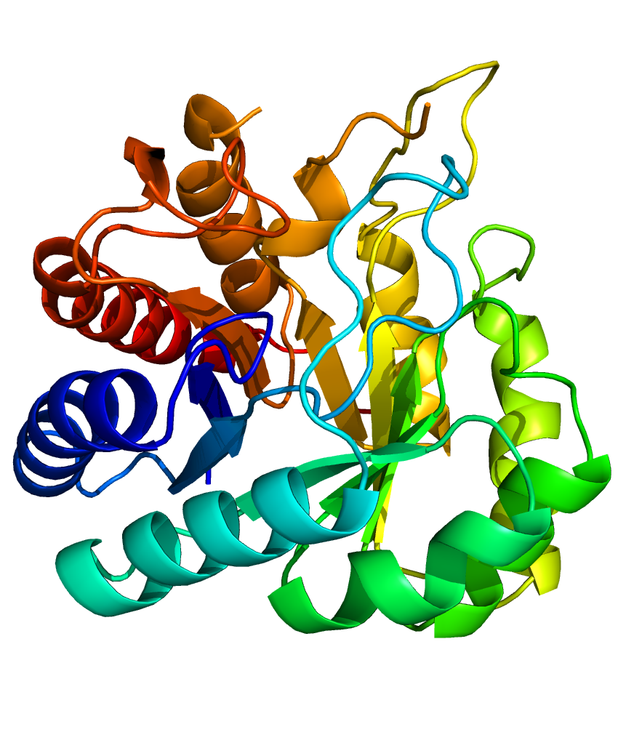
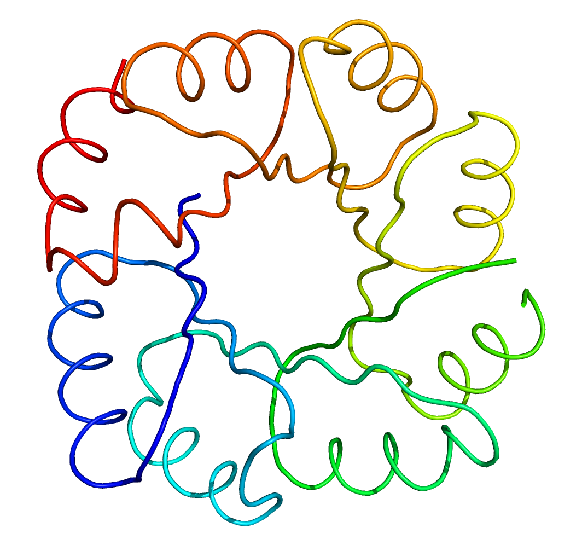
3.20.20.70 Aldolase class 1
TIM barrel – 8-strand barrel with 8 helices around

Slide 6
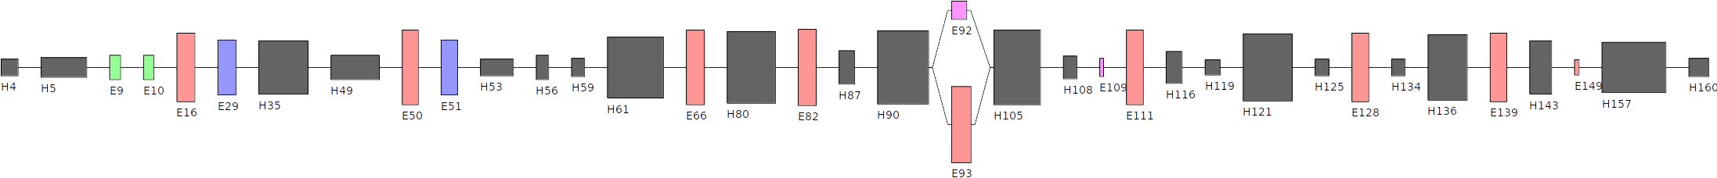
3.20.20.70 Aldolase class 1
Before (acyclic_clustering_sides)
After (acyclic_clustering_simple)

Slide 7
2.40.128.20 Lipocalin
β-barrel – 8-strand barrel
  or 10-strand barrel (interupted between strands 4–5)
subgroups ~ 50:50 :(

Slide 8
2.40.128.20 Lipocalin
Before
After

Slide 9
2.60.40.10 Immunoglobulin
2 sheets – each with ±4 strands

Slide 10
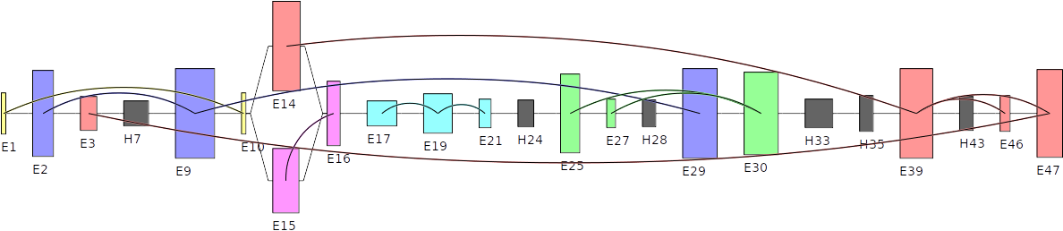
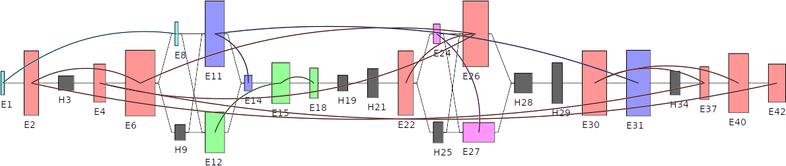
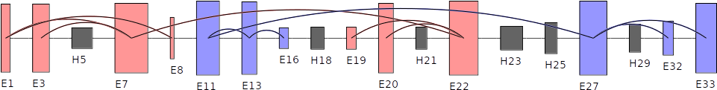
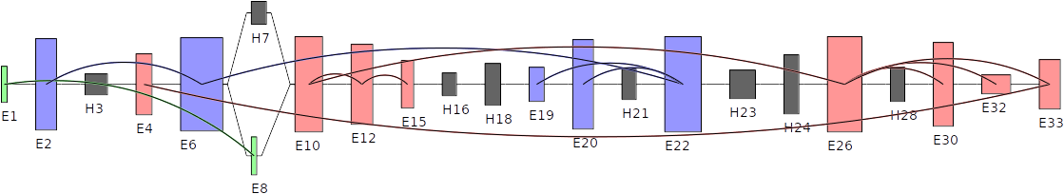
2.60.40.10 Immunoglobulin
Before
After

Slide 11
3.30.200.20 Phosphorylase kinase domain 1
1 sheet – with ±5 strands

Slide 12
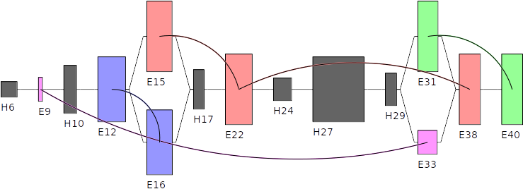
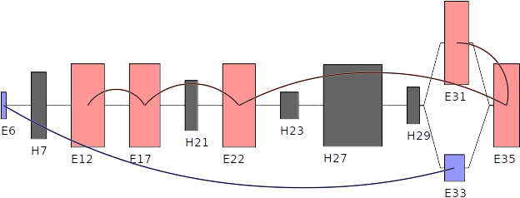
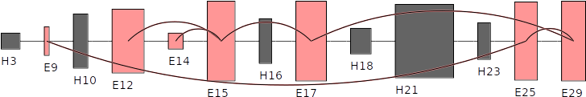
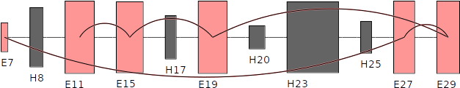
3.30.200.20 Phosphorylase kinase domain 1
Before
After

Slide 13
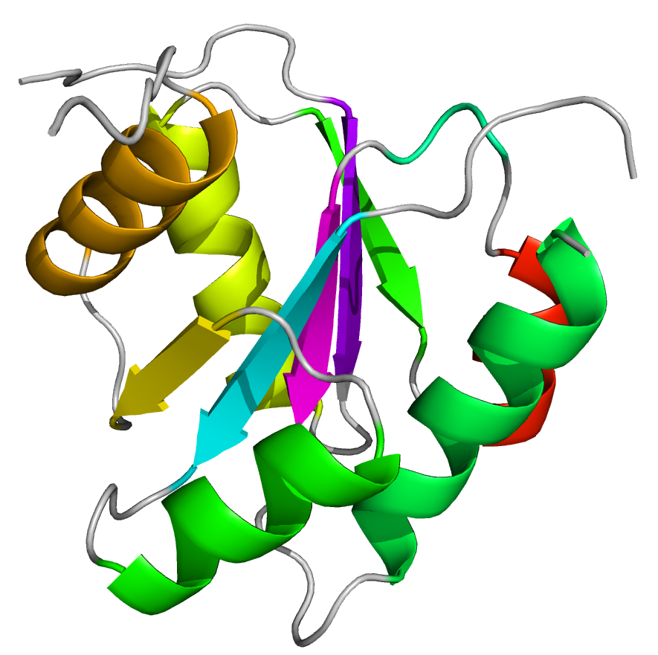
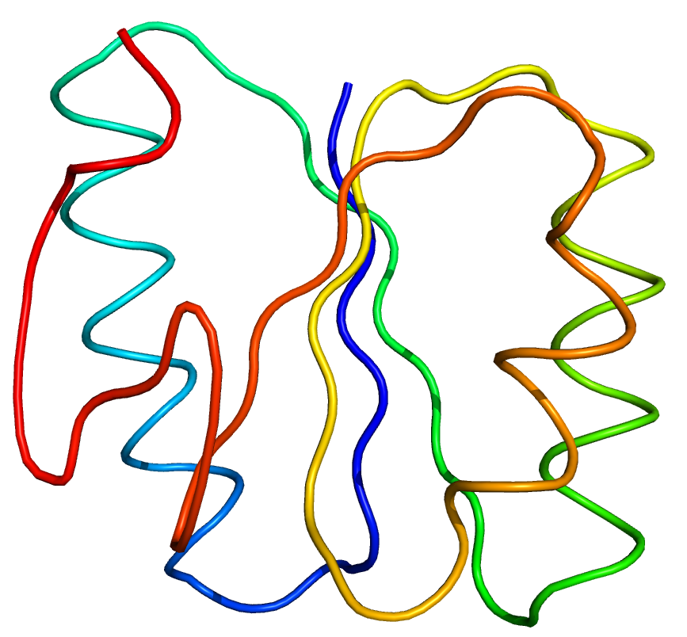
3.40.50.2300 Rossmann fold
1 sheet with ±5 strands and helices on both sides

Slide 14
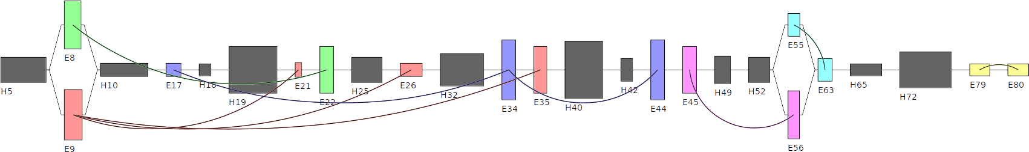
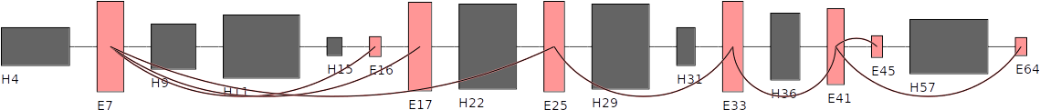
3.40.50.2300 Rossmann fold
Before
After

