Slide 1
Ubertemplate
Comparison of acyclic clustering
with sides vs simple

Slide 2
Methods
Each family – select random 250 domains and run
(select more random samples to see repeatability)

Slide 3
Methods
Before – acyclic clustering with sides
  cluster helices and ladders, then join ladder sides into strands
Now – acyclic clustering simple
  cluster helices and strands directly

Slide 4
Methods
Distance between SSEs =
  start-start + end-end distance
  + “ladder correction”
  + fuckup-index from dynamic programming
  + size-weighting (divide distance by the length of the shorter SSE)
Score in dynamic programming =
  (30 – distance) * length of the shorter SSE

Slide 5
Methods
Rematching:
  after the clustering, SSEs are once again matched to the cluster centers
  this is repeated until convergence
  nonadhesive (all clusters have same weight)
  vs. adhesive (bigger clusters have more weight)
  (and possible combinations)

Slide 6
Methods
Finding edges between clusters: “strong edges”
  ∀s, t∈V, ∀e∈E on s-t path: w(e) ≥ 0.5 * min{w(s), w(t)}
  where w is number of occurrences of vertex (strand) or edge (ladder)
1D diagrams – only SSEs with occurrence ≥ 20%
  color – sheet ID (connected components), helices grey
  upper arc – antiparallel ladder
  lower arc – parallel ladder

Slide 7
Family overview
CATH code | Name | #domains | #pdb entries | #SSEs/domain
1.10.30.10 | high_mobility_group_box_domain | 86 | 63 | 3.6
1.10.490.10 | globin | 2570 | 1089 | 10.6
1.10.510.10 | phophotransferase_dom1 | 5809 | 3970 | 18.9
1.10.530.40 | lysozyme | 739 | 617 | 17.9
1.10.630.10 | cyp | 1386 | 728 | 39.2
1.20.1070.10 | gpcr | 507 | 348 | 11.7
1.20.990.10 | nadph_cyp_reductase_chainA_dom3 | 61 | 34 | 12.6
2.40.128.20 | lipocalin | 1101 | 706 | 15.0
2.40.160.10 | porin | 221 | 107 | 30.0
2.60.40.10 | immunoglobulin | 25913 | 5697 | 13.4
3.20.20.70 | aldolase_class1 | 5327 | 2108 | 28.4
3.30.200.20 | phosphorylase_kinase_dom1 | 5996 | 4058 | 12.2
3.40.50.2300 | rossmann | 2359 | 897 | 14.1
3.40.50.620 | hup | 1448 | 678 | 19.2
3.40.50.720 | nadp_binding_rossmann | 9944 | 3205 | 19.7

Slide 8
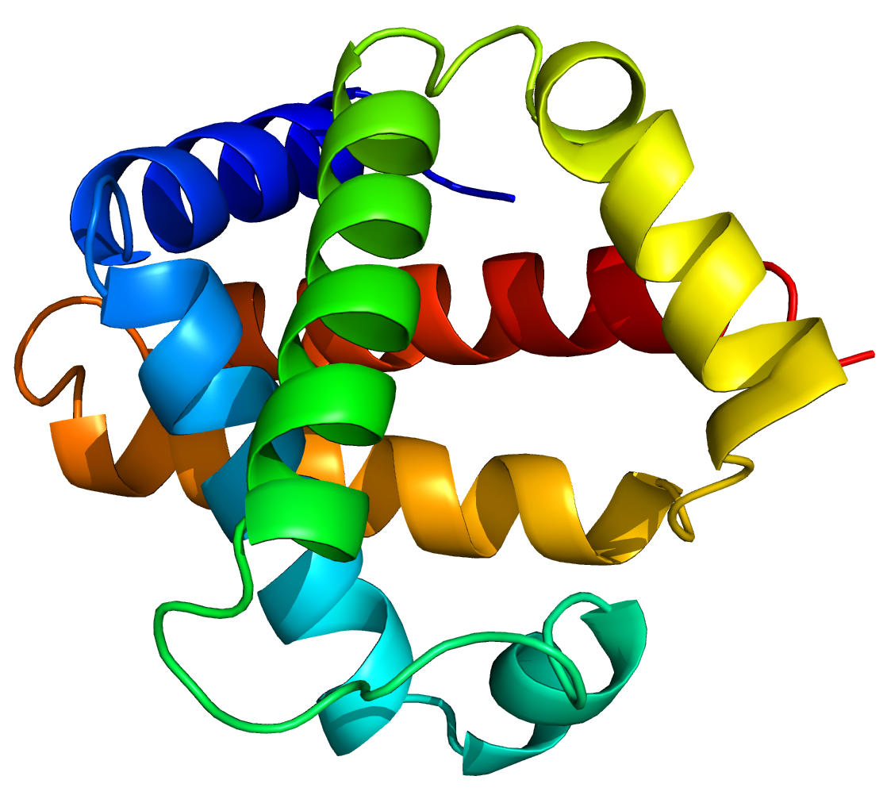
1.10.490.10 Globins
Orthogonal helix bundle
1a3oA00

Slide 9
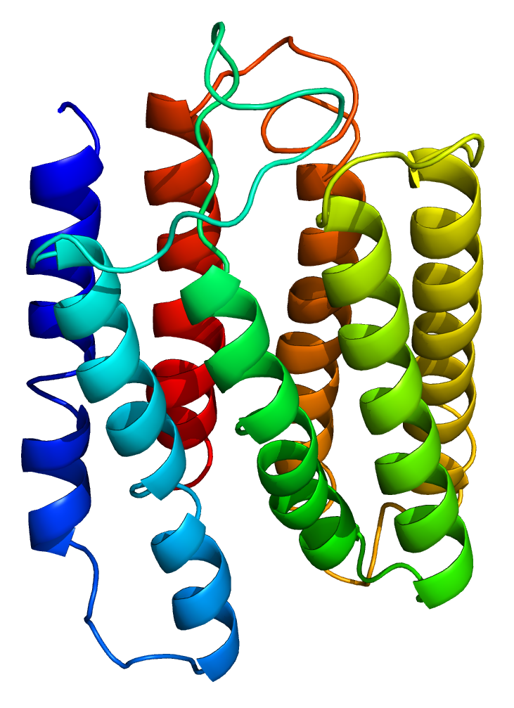
1.20.1070.10 Rhodopsin 7-helix transmembrane proteins (GPCR)
Up-down helix bundle – 7 transmembrane helices
1ap9A00

Slide 10
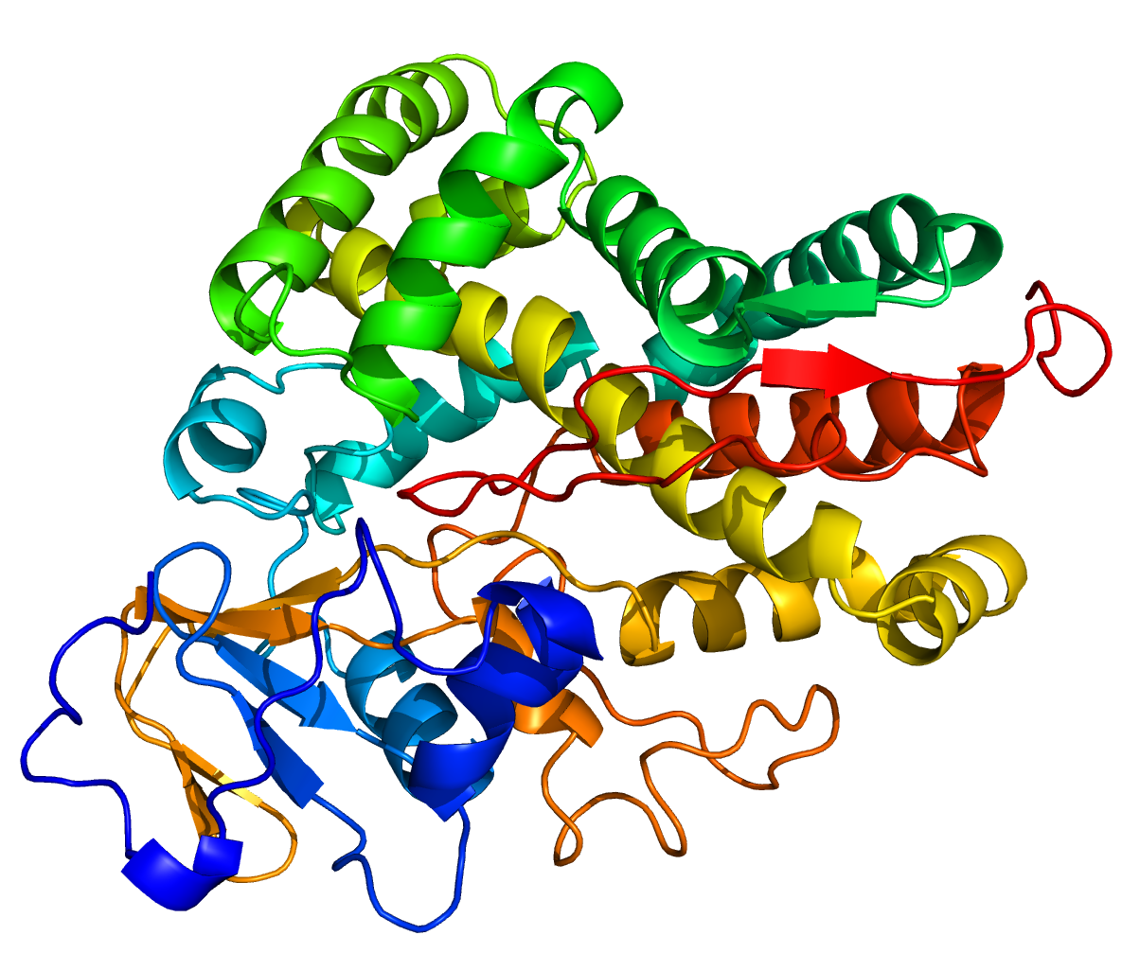
1.10.630.10 Cytochrome P450
Orthogonal helix bundle
7cppA00

Slide 11
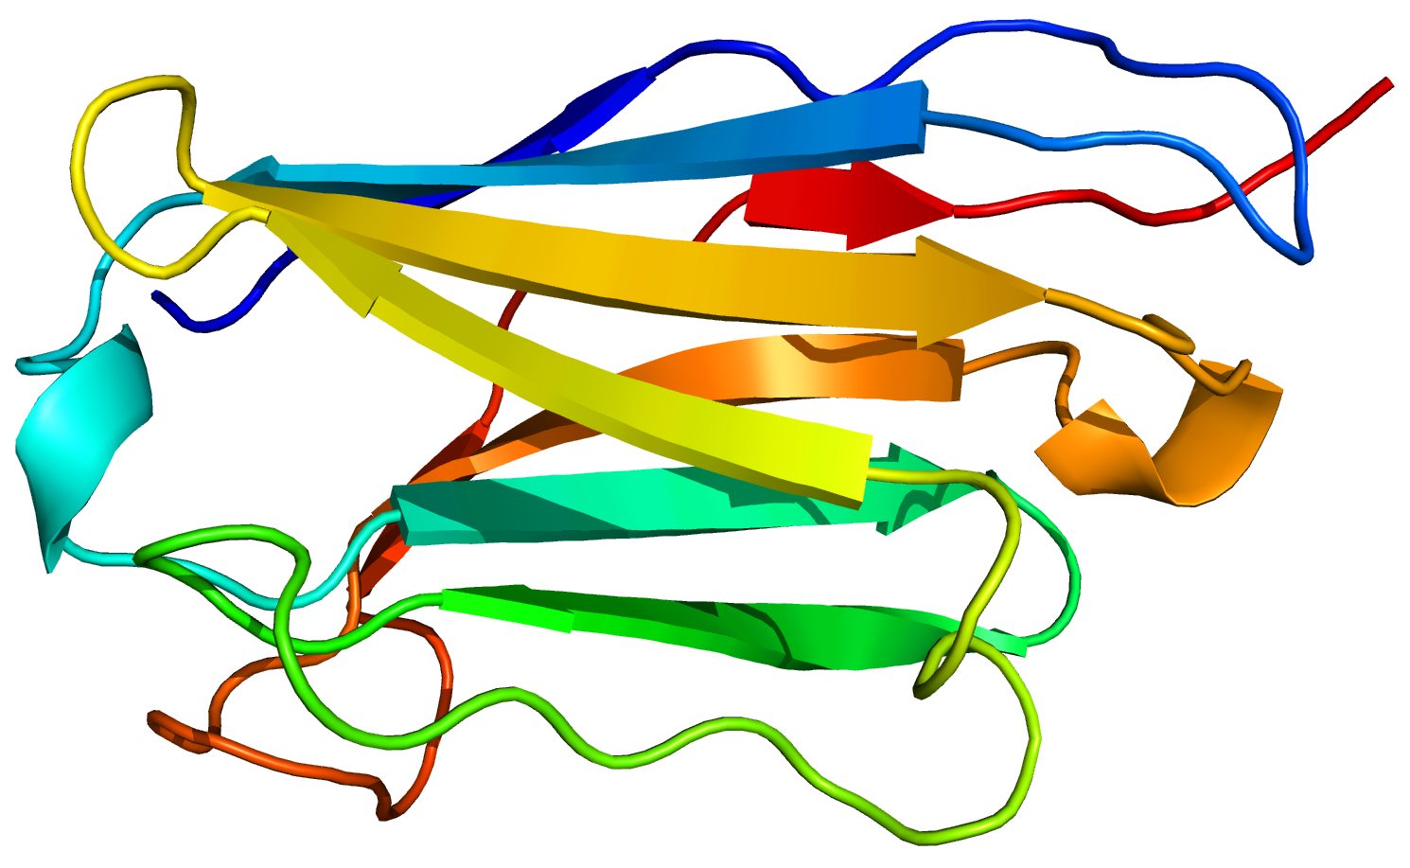
2.60.40.10 Immunoglobulin
2 sheets – each with ±4 strands
2adjB01

Slide 12
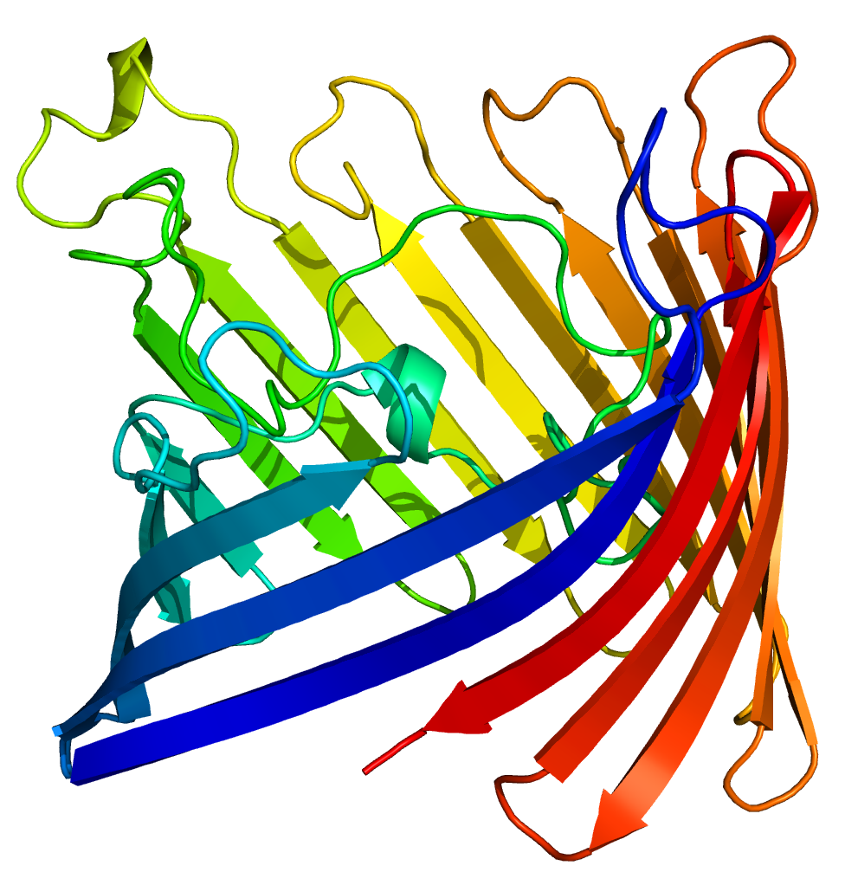
2.40.160.10 Porin
β-barrel – 16-strand barrel
8prnA00

Slide 13
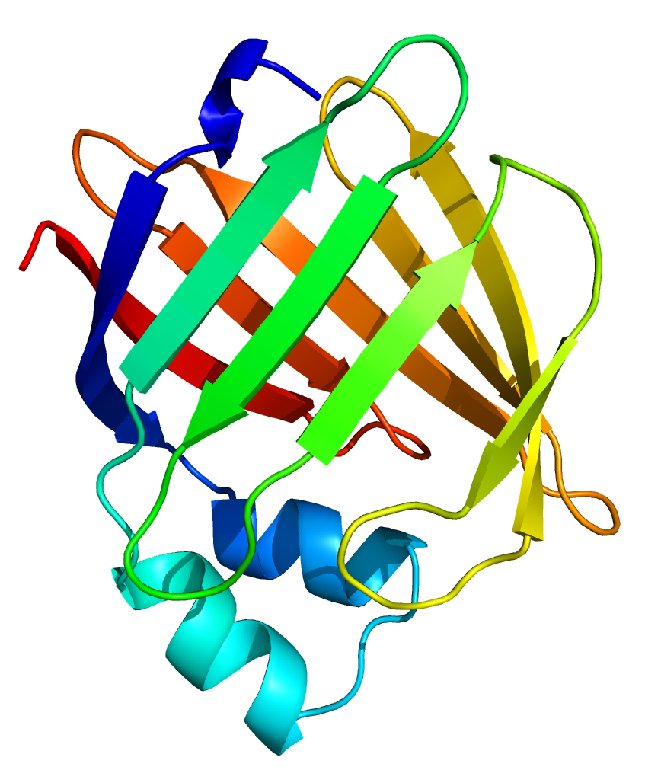
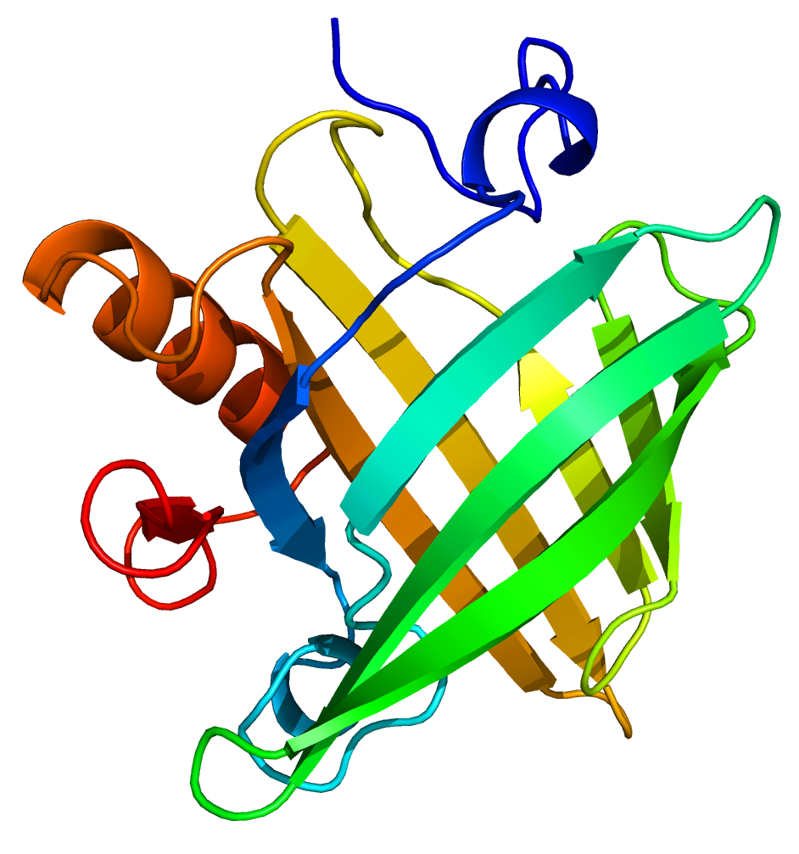
2.40.128.20 Lipocalin
β-barrel – 8-strands
      or 10-strands (interupted between strands 4–5)
subgroups ~ 50:50 :(
1i06A00
1albA00

Slide 14
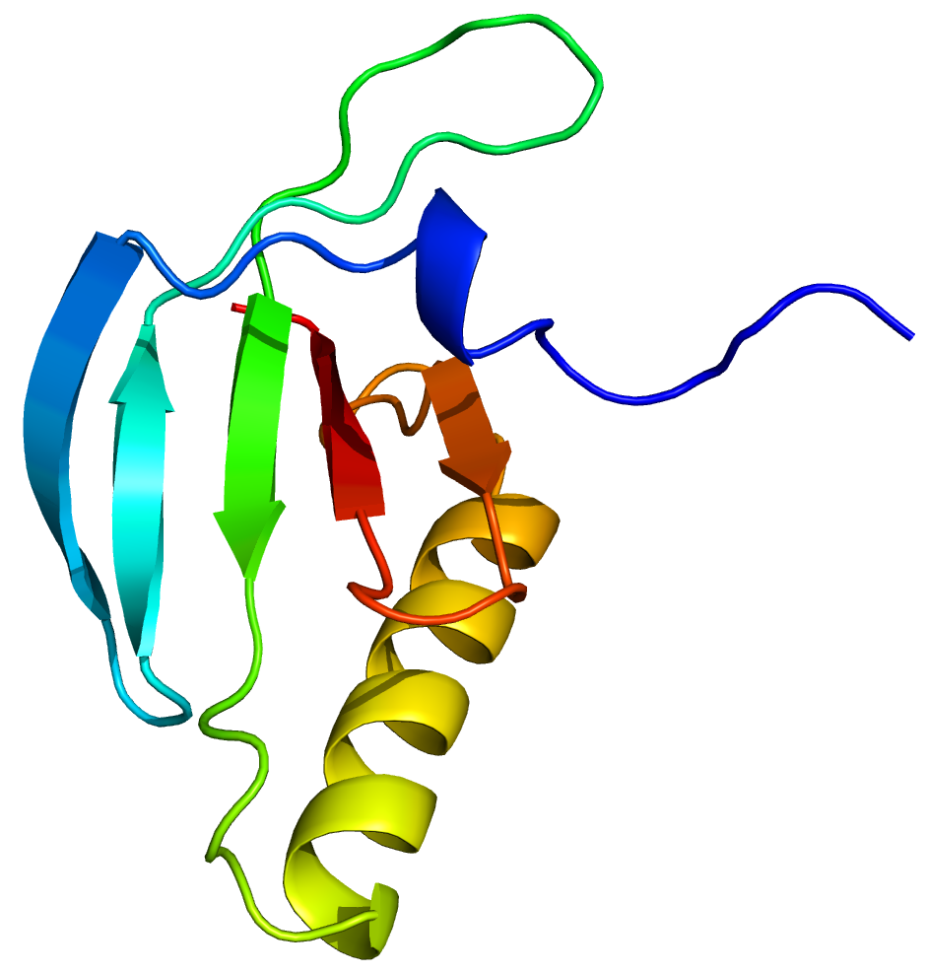
3.30.200.20 Phosphorylase kinase domain 1
1 sheet – with ±5 strands
3cc6A01

Slide 15
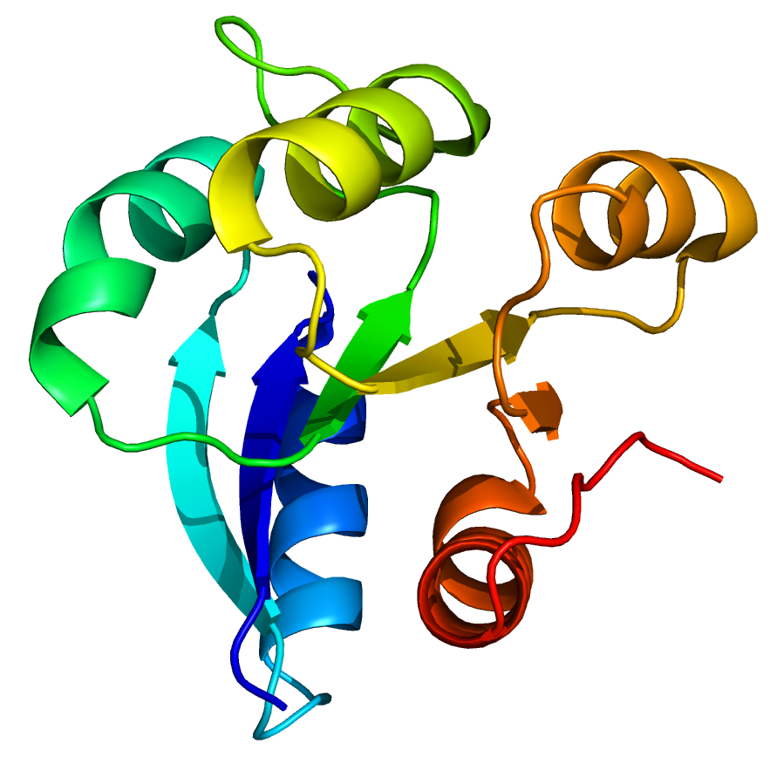
3.40.50.2300 Rossmann fold
1 sheet with ±5 strands with helices on both sides
5i4cA00

Slide 16
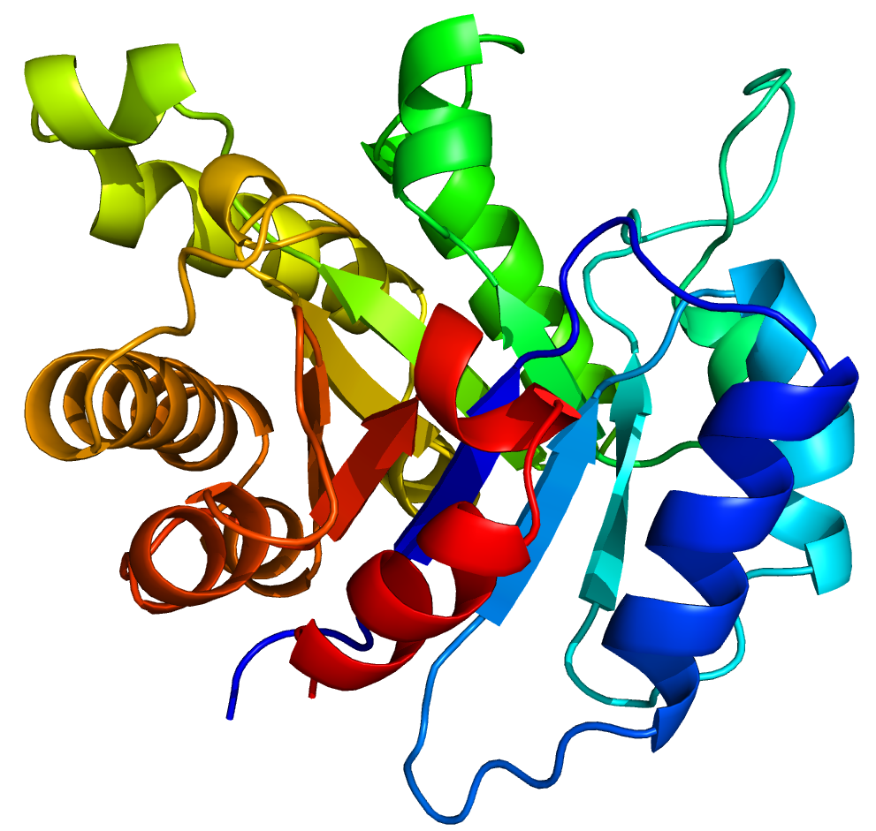
3.20.20.70 Aldolase class 1
TIM barrel – 8-strand barrel with 8 helices around
6timB00

