Slide 1
DBMS

Slide 2
What is Database
The database is a collection of inter-related data which is used to retrieve, insert and delete the data efficiently. It is also used to organize the data in the form of a table, schema, views, and reports, etc.
For example: The college Database organizes the data about the admin, staff, students and faculty etc.
Using the database, you can easily retrieve, insert, and delete the information.

Slide 3
Database Management System
Database management system is a software which is used to manage the database. For example: MySQL, Oracle, etc are a very popular commercial database which is used in different applications.
DBMS provides an interface to perform various operations like database creation, storing data in it, updating data, creating a table in the database and a lot more.
It provides protection and security to the database. In the case of multiple users, it also maintains data consistency.

Slide 4
DBMS allows users the following tasks:
Data Definition: It is used for creation, modification, and removal of definition that defines the organization of data in the database.
Data Updation: It is used for the insertion, modification, and deletion of the actual data in the database.
Data Retrieval: It is used to retrieve the data from the database which can be used by applications for various purposes.
User Administration: It is used for registering and monitoring users, maintain data integrity, enforcing data security, dealing with concurrency control, monitoring performance and recovering information corrupted by unexpected failure.

Slide 5
Characteristics of DBMS
It uses a digital repository established on a server to store and manage the information.
It can provide a clear and logical view of the process that manipulates data.
DBMS contains automatic backup and recovery procedures.
It contains ACID properties which maintain data in a healthy state in case of failure.
It can reduce the complex relationship between data.
It is used to support manipulation and processing of data.
It is used to provide security of data.
It can view the database from different viewpoints according to the requirements of the user.

Slide 6
Advantages of DBMS
Controls database redundancy: It can control data redundancy because it stores all the data in one single database file and that recorded data is placed in the database.
Data sharing: In DBMS, the authorized users of an organization can share the data among multiple users.
Easily Maintenance: It can be easily maintainable due to the centralized nature of the database system.
Reduce time: It reduces development time and maintenance need.
Backup: It provides backup and recovery subsystems which create automatic backup of data from hardware and software failures and restores the data if required.
multiple user interface: It provides different types of user interfaces like graphical user interfaces, application program interfaces

Slide 7
Disadvantages of DBMS
Cost of Hardware and Software: It requires a high speed of data processor and large memory size to run DBMS software.
Size: It occupies a large space of disks and large memory to run them efficiently.
Complexity: Database system creates additional complexity and requirements.
Higher impact of failure: Failure is highly impacted the database because in most of the organization, all the data stored in a single database and if the database is damaged due to electric failure or database corruption then the data may be lost forever.

Slide 8
Database Management System or DBMS in short refers to the technology of storing and retrieving usersí data with utmost efficiency along with appropriate security measures.
The basics of DBMS such as its architecture, data models, data schemas, data independence, E-R model, relation model, relational database design, and storage and file structure and much more are explain here.

Slide 9
Drawbacks of File processing system:
•Data redundancy and inconsistency
Multiple file formats, duplication of information in different files
Difficulty in accessing data
Need to write a new program to carry out each new task
Data isolation – since data scattered in various files & files in various format, it is difficult to write new application program to retrieve appropriate data.
Integrity problems
Data value stored in database must satisfy certain types of consistency constraints
 Integrity constraints (e.g. account balance > 0) become “buried” in program code .
Hard to add new constraints or change existing ones

Slide 10
Atomicity of updates
Failures may leave database in an inconsistent state with partial updates carried out.
Example: Transfer of funds from one account to another should either complete or not happen at all.
•Concurrent access by multiple users
Concurrent accessed needed for performance
 Uncontrolled concurrent accesses can lead to inconsistencies
–Example: Two people reading a balance and updating it at the same time
•Security problems
Hard to provide user access to some, but not all, data

Slide 11
DBMS vs. File System
DBMS | File System
DBMS is a collection of data. In DBMS, the user is not required to write the procedures. | File system is a collection of data. In this system, the user has to write the procedures for managing the database.
DBMS gives an abstract view of data that hides the details. | File system provides the detail of the data representation and storage of data.
DBMS provides a crash recovery mechanism, i.e., DBMS protects the user from the system failure. | File system doesn't have a crash mechanism, i.e., if the system crashes while entering some data, then the content of the file will lost.
DBMS provides a good protection mechanism. | It is very difficult to protect a file under the file system.
DBMS contains a wide variety of sophisticated techniques to store and retrieve the data. | File system can't efficiently store and retrieve the data.
DBMS takes care of Concurrent access of data using some form of locking. | In the File system, concurrent access has many problems like redirecting the file while other deleting some information or updating some information.

Slide 12
DBMS Architecture
The DBMS design depends upon its architecture. The basic client/server architecture is used to deal with a large number of PCs, web servers, database servers and other components that are connected with networks.
The client/server architecture consists of many PCs and a workstation which are connected via the network.
DBMS architecture depends upon how users are connected to the database to get their request done.

Slide 13
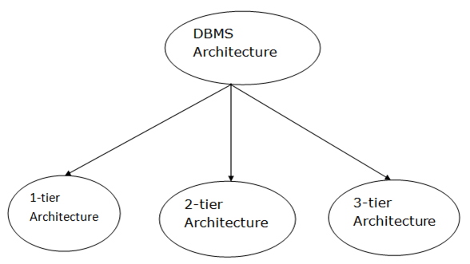
Types of DBMS Architecture

Slide 14
1-Tier Architecture
In this architecture, the database is directly available to the user. It means the user can directly sit on the DBMS and uses it.
Any changes done here will directly be done on the database itself. It doesn't provide a handy tool for end users.
The 1-Tier architecture is used for development of the local application, where programmers can directly communicate with the database for the quick response.

Slide 15
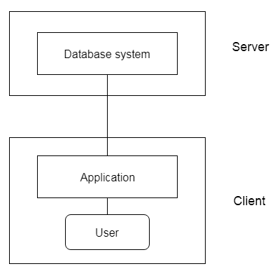
2-Tier Architecture
The 2-Tier architecture is same as basic client-server. In the two-tier architecture, applications on the client end can directly communicate with the database at the server side. For this interaction, API's like: ODBC, JDBC are used.
The user interfaces and application programs are run on the client-side.
The server side is responsible to provide the functionalities like: query processing and transaction management.
To communicate with the DBMS, client-side application establishes a connection with the server side.

Slide 16
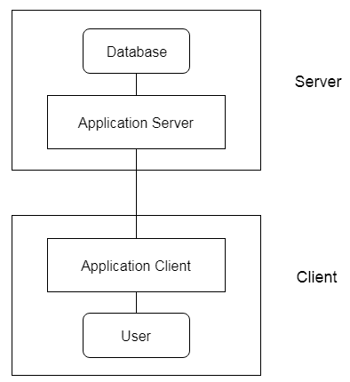
3-Tier Architecture
The 3-Tier architecture contains another layer between the client and server. In this architecture, client can't directly communicate with the server.
The application on the client-end interacts with an application server which further communicates with the database system.
End user has no idea about the existence of the database beyond the application server. The database also has no idea about any other user beyond the application.
The 3-Tier architecture is used in case of large web application.

Slide 17
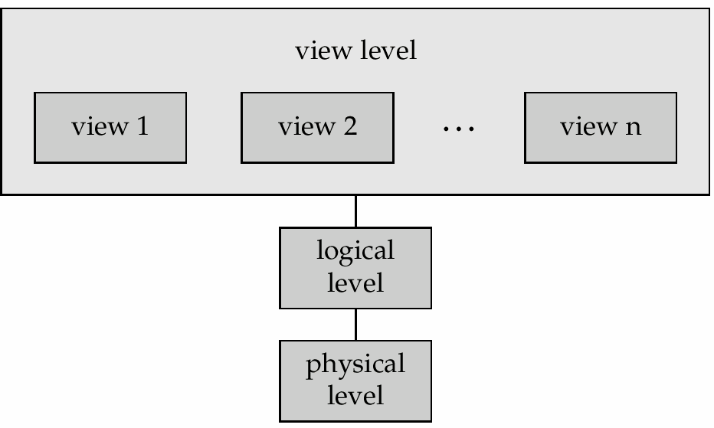
Data Abstraction
Purpose-Hides the certain details of how data stored & maintained, provide only abstract view.
There are 3 levels of abstraction
view level
logical level physical level

Slide 18
view level:- describe only part of entire database
v1: select ssn from student
v2: select ssn, c-id from takes
logical level:- it describes what data actually stored & relationship between them.
eg., tables
Student(ssn, name)
TAKES (ssn, c-id, grade)
physical level:
how are these tables stored, how many bytes / attribute etc

Slide 19
Three schema Architecture
The three schema architecture is also called ANSI/SPARC architecture or three-level architecture.
This framework is used to describe the structure of a specific database system.
The three schema architecture is also used to separate the user applications and physical database.
The three schema architecture contains three-levels. It breaks the database down into three different categories.

Slide 20
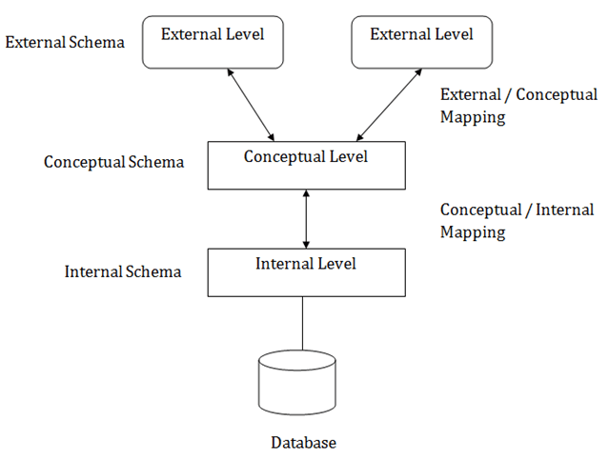
The three-schema architecture is as follows:

Slide 21
In the above diagram:
It shows the DBMS architecture.
Mapping is used to transform the request and response between various database levels of architecture.
Mapping is not good for small DBMS because it takes more time.
In External / Conceptual mapping, it is necessary to transform the request from external level to conceptual schema.
In Conceptual / Internal mapping, DBMS transform the request from the conceptual to internal level.

Slide 22
1. Internal Level
The internal level has an internal schema which describes the physical storage structure of the database.
The internal schema is also known as a physical schema.
It uses the physical data model. It is used to define that how the data will be stored in a block.
The physical level is used to describe complex low-level data structures in detail.

Slide 23
2. Conceptual Level
The conceptual schema describes the design of a database at the conceptual level. Conceptual level is also known as logical level.
The conceptual schema describes the structure of the whole database.
The conceptual level describes what data are to be stored in the database and also describes what relationship exists among those data.
In the conceptual level, internal details such as an implementation of the data structure are hidden.
Programmers and database administrators work at this level.

Slide 24
3. External Level
At the external level, a database contains several schemas that sometimes called as subschema. The subschema is used to describe the different view of the database.
An external schema is also known as view schema.
Each view schema describes the database part that a particular user group is interested and hides the remaining database from that user group.
The view schema describes the end user interaction with database systems.

Slide 25
Data Independence
The ability to modify a schema definition in one level without affecting a schema definition in the next higher level is called data independence.
Two levels of independence:
Logical data independence
Physical data independence
Physical data independence—
The ability to modify physical level schema without affecting the logical or view level schema.
Logical data independence---
The ability to change the logical level scheme without affecting the view level schemes or application programs

Slide 26
Instances and Schemas
Similar to types and variables in programming languages
Schema – The logical structure of the database
The overall design of a database ( i.e., the description of the database ) is called the database schema
  e.g., the database consists of information about a set of customers and accounts and the relationship between them
Instance – the actual content of the database at a particular point in time
The collection of information stored in the database at a particular moment is called an instance of database.
Analogous to the value of a variable

Slide 27
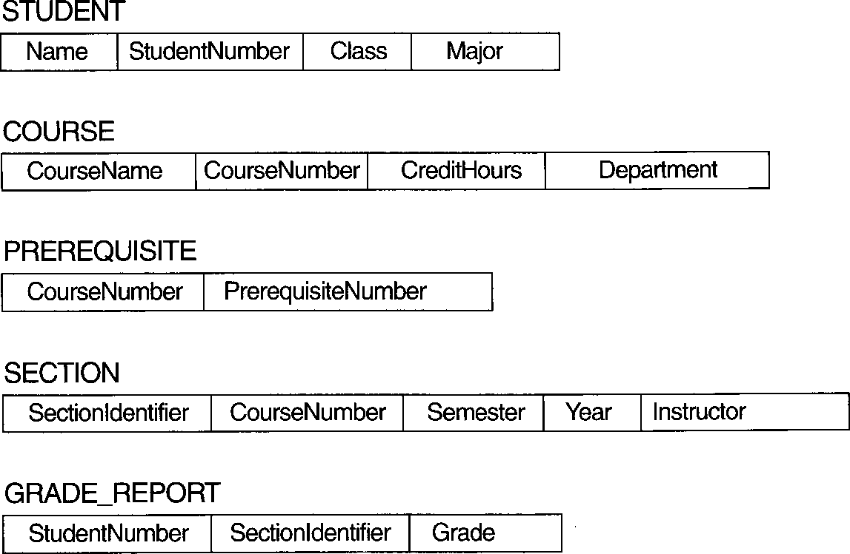
Schema diagram for UNIVERSITY database
schema construct

Slide 28
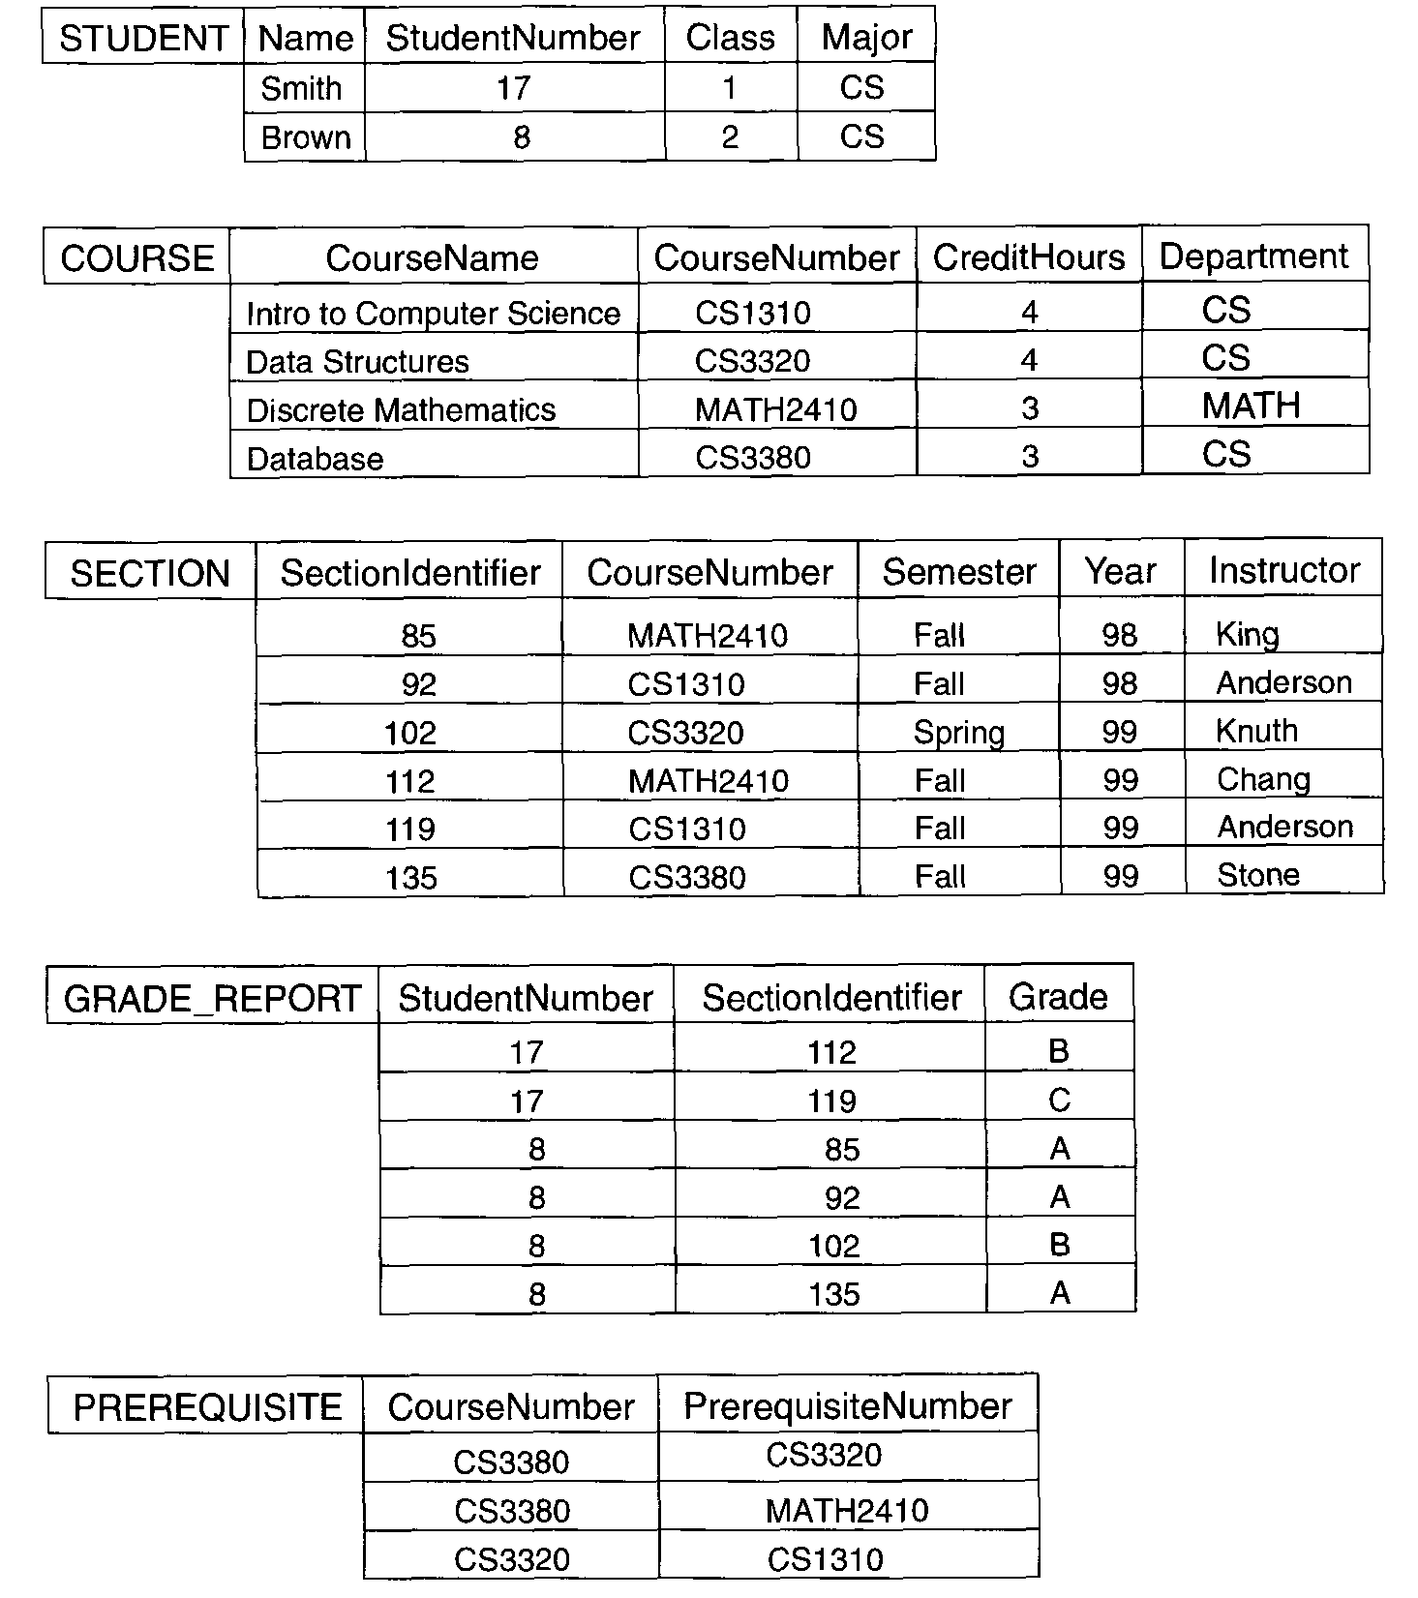
Figure 1.2 UNIVERSITY Database

Slide 29
Database Users
A typical DBMS has users with different rights and permissions who use it for different purposes. Some users retrieve data and some back it up. The users of a DBMS can be broadly categorized as follows −
Administrators − Administrators maintain the DBMS and are responsible for administrating the database. They are responsible to look after its usage and by whom it should be used. They create access profiles for users and apply limitations to maintain isolation and force security. Administrators also look after DBMS resources like system license, required tools, and other software and hardware related maintenance.
Designers − Designers are the group of people who actually work on the designing part of the database. They keep a close watch on what data should be kept and in what format. They identify and design the whole set of entities, relations, constraints, and views.
End Users − End users are those who actually reap the benefits of having a DBMS. End users can range from simple viewers who pay attention to the logs or market rates to sophisticated users such as business analysts.

Slide 30
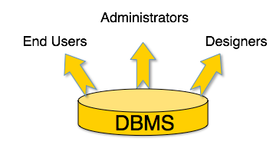

Slide 31
Data model Schema and Instance
The data which is stored in the database at a particular moment of time is called an instance of the database.
The overall design of a database is called schema.
A database schema is the skeleton structure of the database. It represents the logical view of the entire database.
A schema contains schema objects like table, foreign key, primary key, views, columns, data types, stored procedure, etc.
A database schema can be represented by using the visual diagram. That diagram shows the database objects and relationship with each other.
A database schema is designed by the database designers to help programmers whose software will interact with the database. The process of database creation is called data modeling.

Slide 32
A schema diagram can display only some aspects of a schema like the name of record type, data type, and constraints. Other aspects can't be specified through the schema diagram. For example, the given figure neither show the data type of each data item nor the relationship among various files.
In the database, actual data changes quite frequently. For example, in the given figure, the database changes whenever we add a new grade or add a student. The data at a particular moment of time is called the instance of the database.

Slide 33
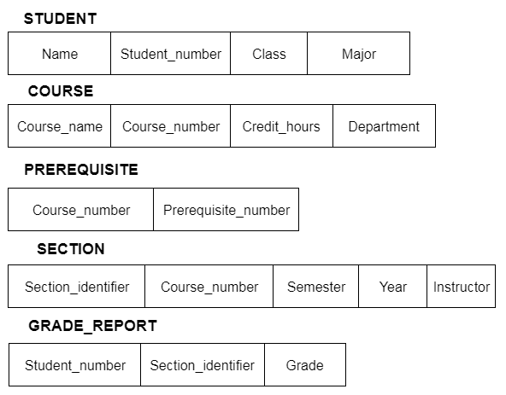

Slide 34
Data Independence
Data independence can be explained using the three-schema architecture.
Data independence refers characteristic of being able to modify the schema at one level of the database system without altering the schema at the next higher level.
There are two types of data independence:

Slide 35
1. Logical Data Independence
Logical data independence refers characteristic of being able to change the conceptual schema without having to change the external schema.
Logical data independence is used to separate the external level from the conceptual view.
If we do any changes in the conceptual view of the data, then the user view of the data would not be affected.
Logical data independence occurs at the user interface level.

Slide 36
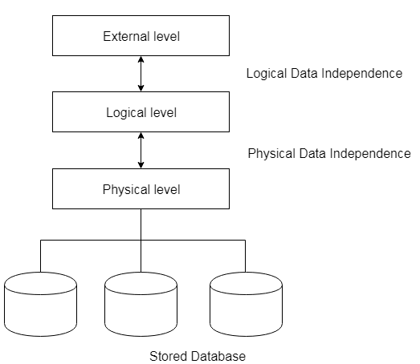
2. Physical Data Independence
Physical data independence can be defined as the capacity to change the internal schema without having to change the conceptual schema.
If we do any changes in the storage size of the database system server, then the Conceptual structure of the database will not be affected.
Physical data independence is used to separate conceptual levels from the internal levels.
Physical data independence occurs at the logical interface level.

Slide 37
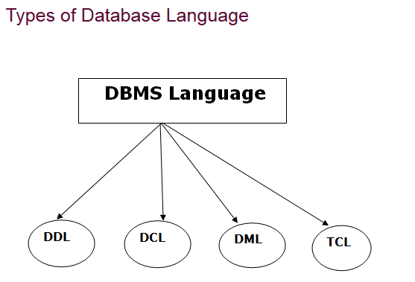
Database Language
A DBMS has appropriate languages and interfaces to express database queries and updates.
Database languages can be used to read, store and update the data in the database.

Slide 38
1. Data Definition Language
DDL stands for Data Definition Language. It is used to define database structure or pattern.
It is used to create schema, tables, indexes, constraints, etc. in the database.
Using the DDL statements, you can create the skeleton of the database.
Data definition language is used to store the information of metadata like the number of tables and schemas, their names, indexes, columns in each table, constraints, etc.

Slide 39
Here are some tasks that come under DDL:
Create: It is used to create objects in the database.
Alter: It is used to alter the structure of the database.
Drop: It is used to delete objects from the database.
Truncate: It is used to remove all records from a table.
Rename: It is used to rename an object.
Comment: It is used to comment on the data dictionary.
These commands are used to update the database schema that's why they come under Data definition language.

Slide 40
2. Data Manipulation Language
DML stands for Data Manipulation Language. It is used for accessing and manipulating data in a database. It handles user requests.
Here are some tasks that come under DML:
Select: It is used to retrieve data from a database.
Insert: It is used to insert data into a table.
Update: It is used to update existing data within a table.
Delete: It is used to delete all records from a table.
Merge: It performs UPSERT operation, i.e., insert or update operations.
Call: It is used to call a structured query language or a Java subprogram.
Explain Plan: It has the parameter of explaining data.
Lock Table: It controls concurrency.

Slide 41
3. Data Control Language
DCL stands for Data Control Language. It is used to retrieve the stored or saved data.
The DCL execution is transactional. It also has rollback parameters.
(But in Oracle database, the execution of data control language does not have the feature of rolling back.)
Here are some tasks that come under DCL:
Grant: It is used to give user access privileges to a database.
Revoke: It is used to take back permissions from the user.
There are the following operations which have the authorization of Revoke:
CONNECT, INSERT, USAGE, EXECUTE, DELETE, UPDATE and SELECT.

Slide 42
4. Transaction Control Language
TCL is used to run the changes made by the DML statement. TCL can be grouped into a logical transaction.
Here are some tasks that come under TCL:
Commit: It is used to save the transaction on the database.
Rollback: It is used to restore the database to original since the last Commit.

Slide 43
Database Applications
DBMS contains information about a particular enterprise
DBMS provides an environment that is both convenient and efficient
to use.
Database Applications:
Banking: all transaction
Airlines: reservations, schedules
Universities: registration, grades
Sales: customers, products, purchases
Manufacturing: production, inventory, orders, supply chain
Human resources: employee records, salaries, tax deductions
Databases touch all aspects of our lives

Slide 44
Data Models
It is a collection of conceptual tools for describing data, data relationship, data
semantics & consistency constraints.
Different types of data models:
• Entity-Relationship model
• Relational model
• Hierarchical model
• Network model
• object-oriented model

Slide 45
Entity-Relationship model
It consist of
Entities (objects) : ex. customer ,bank account.
Relationships between entities: ex. John having account no. S15751
The set of all entities of same type & the set of all relationship of the same type are termed as an entity set & relationship set respectively .
E-R diagram consist of following components:
Rectangles: which represent entity set.
Ellipses: which represent attributes
Diamonds: which represent relationship among entity sets
Lines :which link attributes to entity sets and entity sets to relationships

Slide 46
Data Models
It is a collection of conceptual tools for describing data, data relationship, data semantics & consistency constraints.
Different types of data models:
Entity-Relationship model
Relational model
Hierarchical model
Network model
object-oriented model

Slide 47
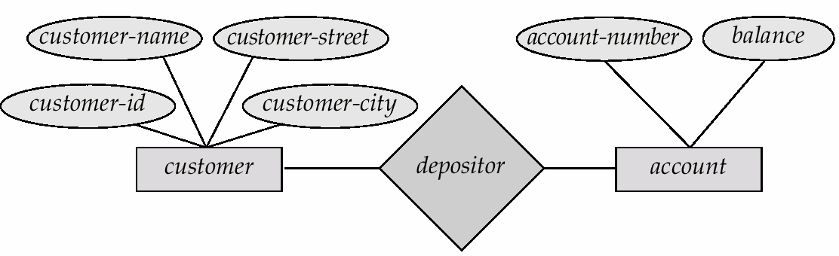
Entity-Relationship model:-
It consist of
Entities (objects) : ex. customer ,bank account.
Relationships between entities: ex. John having account no. S15751
The set of all entities of same type & the set of all relationship of the same type are termed as an entity set & relationship set respectively .
E-R diagram consist of following components: Rectangles: which represent entity set.
Ellipses: which represent attributes
Diamonds: which represent relationship among entity sets
Lines :which link attributes to entity sets and entity sets to relationships.
E-R diagram for banking system

Slide 48
Advantages:-
It is easy to develop relational model using E-R model It specify mapping cardinalities
It specifies key like primary key
We can specify generalization & specialization
Disadvantages:-
It is used for design not for implementation

Slide 49
Relational Model-
It represent data and relationships among those data by a collection of tables.
Each table has multiple columns and each column has a unique name.
Each table contains records of a particular type. Each record defines a fixed number of fields or attributes.
A relation having following rules---- Relation is a two-dimensional table.
A tuple is a row in the table.
Attribute is a column in the table.
Each column in the table has a unique name within the table. 5.Each column has a domain , the set of possible values that can
appear in that column.
6.The order of the rows and columns is not important. & duplicate row are not allowed

Slide 50
Example of tabular data in the relational model
Attributes
Customer- id | customer- name | customer- street | customer- city | account- number
tuple
192-83-7465 | Johnson | Alma | Palo Alto | A-101
019-28-3746 | Smith | North | Rye | A-215
192-83-7465 | Johnson | Alma | Palo Alto | A-201
321-12-3123 | Jones | Main | Harrison | A-217
019-28-3746 | Smith | North | Rye | A-201
domain

Slide 51
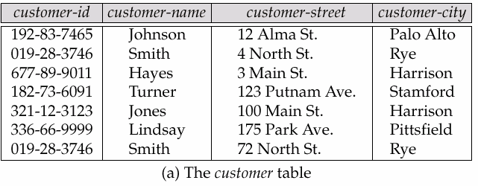
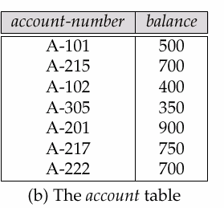
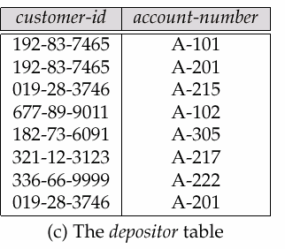
A Sample Relational Database

Slide 52
Advantages:
Structural independence: when it is possible to make change to the database structure without affecting the DBMS ‘s capability to access data, we can say that structural independence In relational database changes in database do not affect the data access
Conceptual simplicity: Relational database model is simpler at conceptual level. since the relational model frees the designer from the physical data storage details, the designer can concentrate on logical view of data base
Design implementation, maintenance & usage ease: relational model achieves both data independence & structural independence making the database design , maintenance, administration ?& usage much easier than other models
Disadvantages:
•Significant hardware & software overheads
•Not as good for transaction process modeling as hierarchical & network models May have slower processing times than hierarchical & network model

Slide 53
Hierarchical Model-
It is a kind of data management system that links the records in tree data structure such that each record type has only one owner
.
course
id
title
subject
id
title
teacher
id
name
A sample Hierarchical Model

Slide 54
Advantages:
•High speed of access to large datasets
•Ease of updates
•Simplicity: design is simple
•Data security: It is the first model which provide data security
•Efficiency:- It is very efficient when database contain large number of 1:n relationships & when user require large number of transaction, using data whose relationships are fixed
Disadvantages:-
Implementation complexity:- although the hierarchical model is conceptually simple & easy to design it is quite complex to implement; Database management problems: If you make any changes in the database structure of hierarchical database ,then you need to make the necessary changes in all application programs that access the database Lack of structural independence:-Hierarchical database system use physical storage path to navigate to different data segments. so if physical structure is changed the application will also have to be modified. thus in a hierarchical database the benefits of independence is limited by structural dependence

Slide 55
Advantages:
Conceptual simplicity: just like the hierarchical model, the network model is also conceptually simple & easy o design.
Capability to handle more relationship types: The network model can handle the one to many (1:n) & many to many (m:n) relationships.
Data independence:- the changes in data characteristics do not require changes to application programs.
Disadvantages:
•Detailed structural knowledge is required .
•Lack of structural independence.

Slide 56
The Object Oriented Model-
The Object Oriented model is based on a collection of objects.
An Object contains values stored in the instance variables within the object.
An Object contains bodies of code that operate on the object These objects are called methods.
Objects that contains same type of values and same methods grouped into classes.
A class may be viewed as a type definition for objects.
The only way in which one object can access the data of another object is invoking method of that object

Slide 57
Advantages:
•Application require less code
•Application use more natural data model
•Code is easier to maintain
•Data access is easy
•Object oriented features improve productivity

