Slide 1

Breaking Barriers:
Simplifying Accessible Video Production with the Open Source Solution MELVIN
Presented by
Benedikt Reuter, Korbinian Kuhn, Niklas Egger
For
ICCHP 2024, Linz

Slide 2

SHUFFLE
Accessibility in higher education research project
Four partner universities across Germany
University Bielefeld
Heidelberg University of Education
Media University Stuttgart
Freiburg University of Education
Several sub-projects, one of them is MELVIN
Map of Germany by mapsvg.com

Slide 3
The problem Melvin wants to address
Creating accessible videos is quite laborious
Video production involves multiple steps, often divided by different tools and services
Commercial software is sometimes not available due to economic constraints
These tools often require a certain amount of technical expertise
General Data Protection Regulation (GDPR) compliance is required by law

Slide 4
Our approach
Seamless workflow, all in one web application
Record
Captioning with ASR
Editing
Sharing
Upload
Open source
Self hosted (GDPR compliant)

Slide 5
The workflow in detail
Creating a new project through the record route

Slide 6
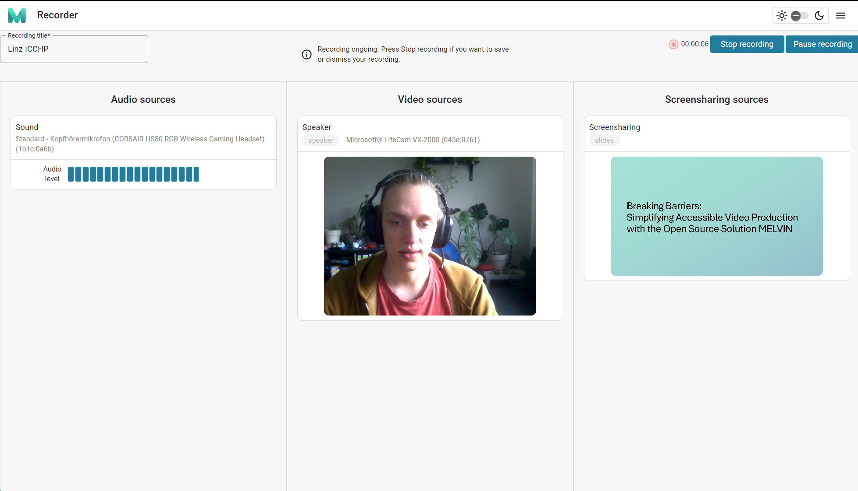
Recorder - Add input sources

Slide 7


Behind the scenes - Automatic speech recognition
Processing
Using OpenAI’s Whisper for the transcription of the recording
Whisper is part of the self hosting, no data transfer to external parties

Slide 8
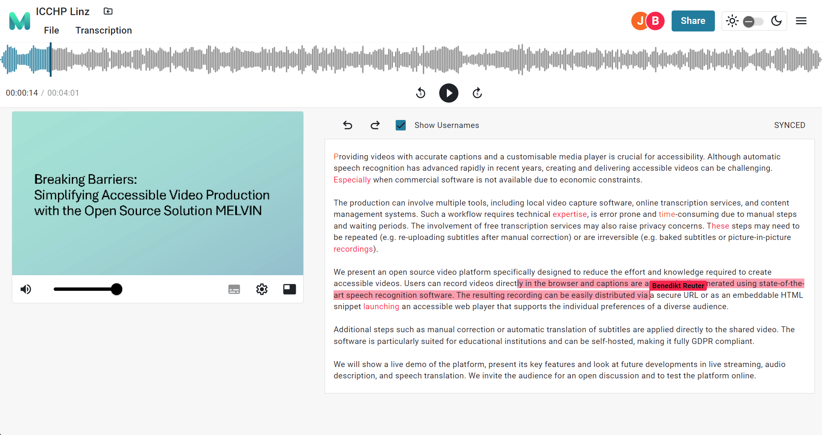
Editor - Manual correction

Slide 9
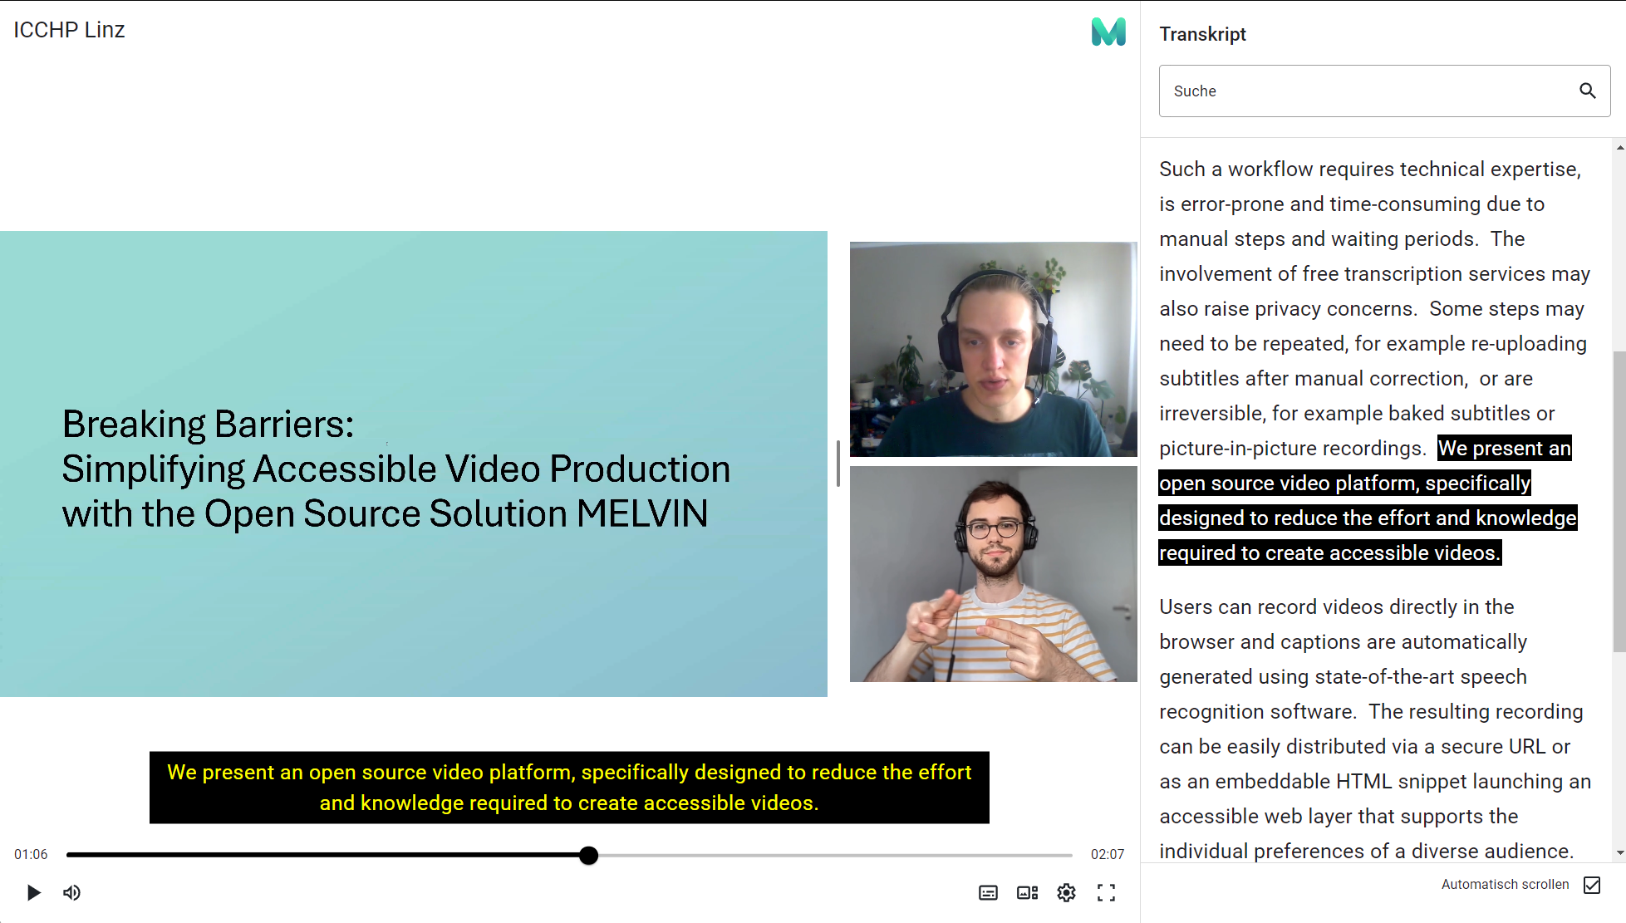
Player - Share a link or embed the player

Slide 10
Future
Making everything accessible and ready to use
Refining the full text editor
Add support for livestreams
Add support for audio descriptions
Adding state of the art speech translation functionality
End of project
December 2025

Slide 11
Questions and live test
Please note:
Work in progress
Not fully accessible yet
Not all features live
Try MELVIN yourself? English version available: Go to melvin.shuffle-projekt.de
Thanks for your time!
More infos about MELVIN and SHUFFLE (in german) at shuffle-projekt.de

