Slide 1
Predictive modeling of kidney conditions of patients using medical data and scans
F20DL UG-GRP-14
Abdul Samad Adam James Siddhant Pandey Shivadarshan Puttraraju Shoubhit Binoy

Slide 2
Project Overview
Objective:
Predict kidney conditions by analyzing CT scans
Predict chronic kidney conditions
Target Variable:
For Nominal Dataset Class: 0 – No Chronic Kidney Disease , 1- Presence of Chronic Kidney Disease
For Image Dataset – to classify the images between healthy and unhealthy kidney
Why we chose this topic:
Global Health Priority: Kidney diseases are a significant global health issue, affecting over 800 million people worldwide. Early detection and treatment are essential to prevent progression to kidney failure.
Advancing Medical Diagnostics: Applying machine learning to medical data can enhance diagnostic accuracy, improving patient outcomes and saving lives.
Notes:
Hi

Slide 3
Work Plan & Project Requirement
R1: Project Topic and Direction | Classify kidney conditions using CT images Predict chronic kidney conditions
R2: Data Analysis and Exploration | Perform EDA on both datasets Feature selection and dimensionality reduction
R3: Clustering | Apply clustering algorithms to identify patterns in patient data Interpret clusters to gain medical insights
R4: Baseline Training and Evaluation Experiments | Algorithms: Decision Trees Random Forests (Random Trees) Gradient Boosting Logistic Regression Tasks: Classification of kidney conditions Regression analysis for readmission prediction Evaluation Metrics: Accuracy, Precision, Recall, F1-Score, RMSE
R5: Neural Networks | Implement image classification using CNN based clustering Compare neural networks with baseline models Fine-tune models for optimal performance

Slide 4
Data Sources & ML Community Usage
Chronic Kidney Disease Dataset:
Link: https://www.kaggle.com/datasets/abhia1999/chronic-kidney-disease
ML Usage: Utilized for predictive modeling of Chronic Kidney Diseases.
CT Kidney Dataset:
Link: CT Kidney Dataset
ML Usage: Used for image classification tasks to detect kidney anomalies.
Contribution to ML Community:
Advances healthcare analytics
Provides benchmarks for algorithm performance
Supports research in medical image processing and patient outcome prediction

Slide 5
Preprocessing the data
Null and Duplicate Value | Identified and addressed missing and duplicate entries in the dataset, replacing them with the column median to maintain data integrity.
Biological Plausibility Check | Applied medically plausible thresholds to key attributes, flagging outliers as implausible and treating them as missing values
Median Imputation | Replaced all missing or implausible values with the median of their respective columns to ensure robust and realistic data for analysis.

Slide 6
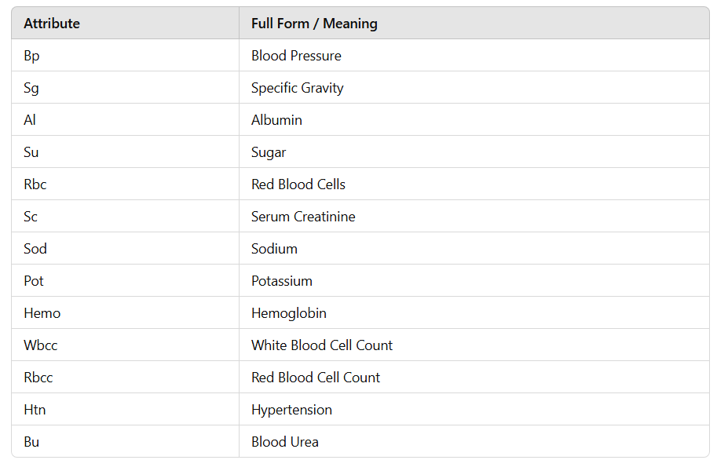

Slide 7
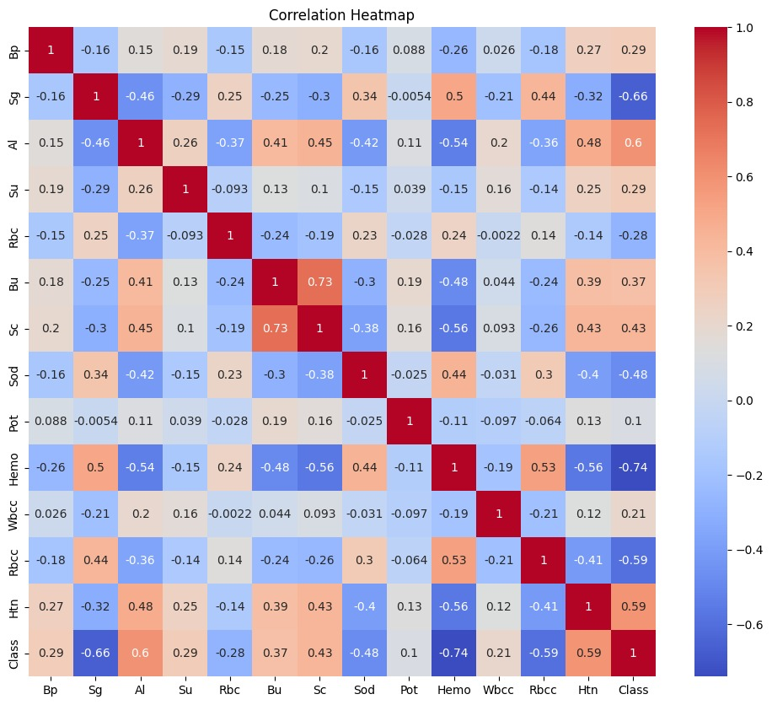
Correlation Heatmap
Primary Predictors: Sc, Hemo, Bu, Al, and Rbcc are key features with strong correlations to the Class variable, making them powerful predictors for CKD.
Secondary Predictors: Features like Bp, Sod, Pot, and Htn show moderate correlations and also contribute meaningfully to the prediction but are less dominant than the primary predictors.
Feature Relationships: Some features are highly correlated with each other (e.g., Sc and Bu), indicating possible multicollinearity that should be addressed in modeling (e.g., by using regularization techniques).

Slide 8
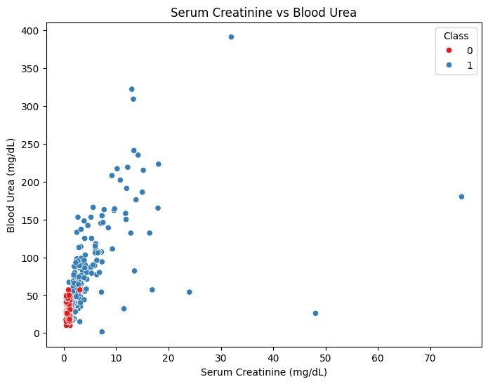
Scatter Plot Sc VS Blood Urea
A strong positive trend confirms that Sc and Bu are closely related measures of kidney function.
For patients in Class 1 (CKD), we expect higher values of both Sc and Bu.Modeling Implication: If both features are highly correlated, it might lead to multicollinearity. Regularization techniques (like Ridge or Lasso regression) or feature selection methods might be required to address this in modeling.

Slide 9
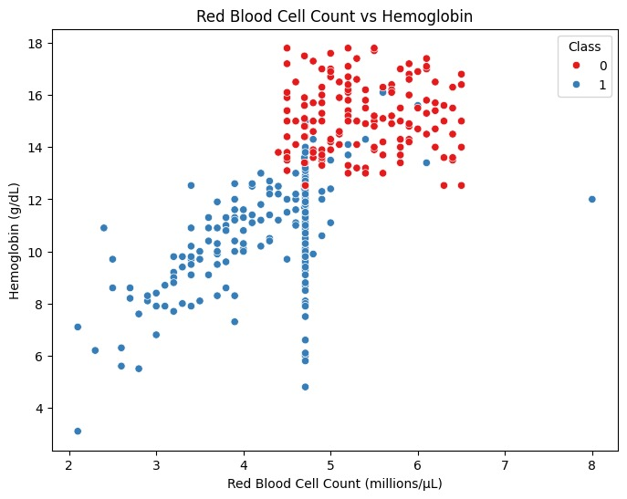
Scatter Plot RBC vs Hemoglobin
A clear positive trend between Rbcc and Hemo is expected for both classes. Lower values of both are associated with Class 1 (CKD), indicating anemia common in CKD patients.
Modeling Implication: The strong correlation might suggest that one of these features could be redundant, or both could be combined into a single composite feature.

Slide 10
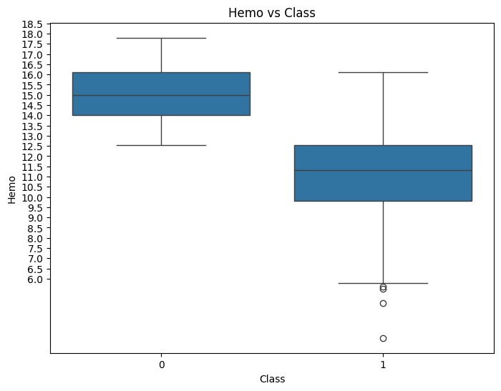
Box Plot: Hemo VS Class
Class 0 (No CKD): Haemoglobin values likely range between 14.5 and 16.5. Median: ~15.5.
Class 1 (CKD Present): Haemoglobin values range between 8.5 and 10.5. Median: ~9.0
Interpretation: If haemoglobin values fall below the Class 1 range (below 8.5), the likelihood of having CKD increases

Slide 11
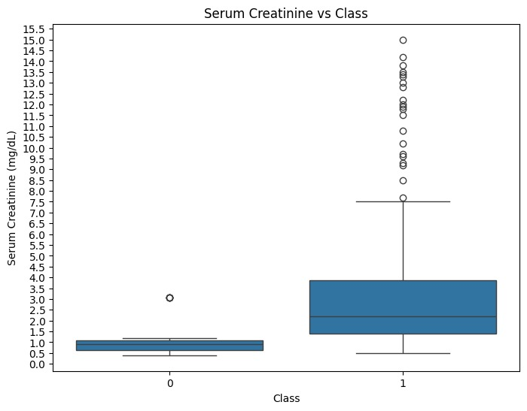
Box Plot: Serum Creatinine VS Class
Interpretation: If hemoglobin values fall below the Class 1 range (below 8.5), the likelihood of having CKD increases
Class 1 (CKD Present): Values range widely between 2.0 and 7.0 mg/dL, with outliers extending to 14 mg/dL. Median: ~4.0 mg/dL.
Interpretation: If serum creatinine levels exceed the Class 1 range (above 7.0 mg/dL), the likelihood of having CKD increases.

Slide 12
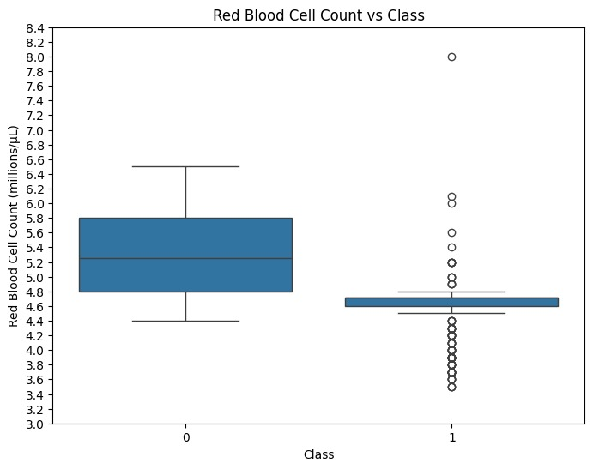
Box Plot: Rbcc VS Class
Class 0 (No CKD): Rbcc values typically range from 4.8 to 5.5 million cells/µL. Median: ~5.2 million cells/µL.
Class 1 (CKD Present): Rbcc values are between 3.5 and 4.5 million cells/µL. Median: ~4.1 million cells/µL.
Interpretation: If red blood cell count drops below the Class 1 range (below 3.5 million cells/µL), the likelihood of having CKD increases.

Slide 13
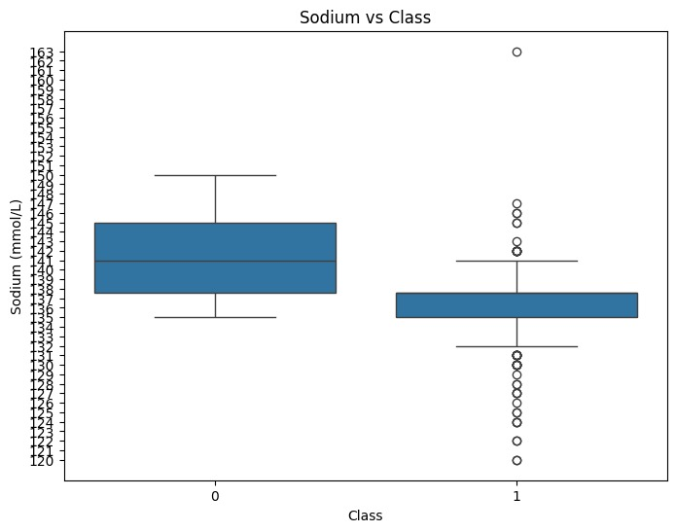
Box Plot: Sodium VS Class
Class 0 (No CKD): Sodium levels likely range between 137 and 143 mmol/L. Median: ~140 mmol/L.
Class 1 (CKD Present): Sodium levels range between 130 and 137 mmol/L, with possible drops to 120 mmol/L. Median: ~133 mmol/L.
Interpretation: If sodium levels fall below the Class 1 range (below 120 mmol/L), the likelihood of having CKD increases.

Slide 14
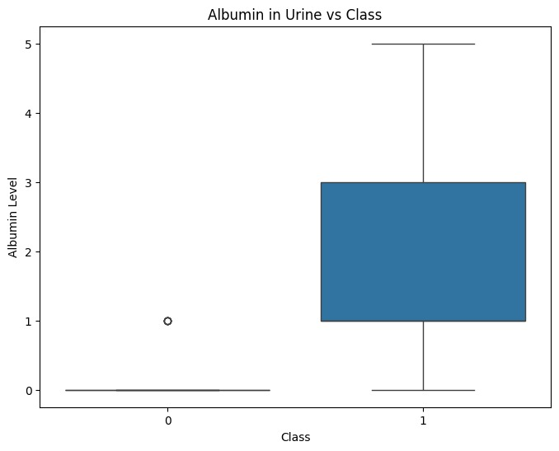
Box Plot: Albumin in Urine VS Class
Class 0 (No CKD): Median albumin level is around 1, with values typically between 0 and 2.
Class 1 (CKD Present): Albumin levels are typically between 3 and 5. Median: ~4.
Interpretation: If albumin levels exceed the Class 1 range (above 5), the likelihood of having CKD increases.

Slide 15
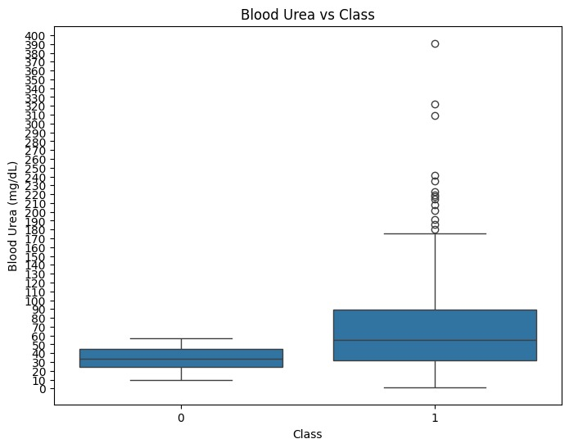
Box Plot: Blood Urea VS Class
Class 0 (No CKD): Blood urea values are typically between 20 and 45 mg/dL. Median: ~33.5 mg/dL.
Class 1 (CKD Present): Values range between 40 and 80 mg/dL, with outliers extending up to 120 mg/dL. Median: ~55 mg/dL.
Interpretation: If blood urea levels exceed the Class 1 range (above 80 mg/dL), the likelihood of having CKD increases.

Slide 16
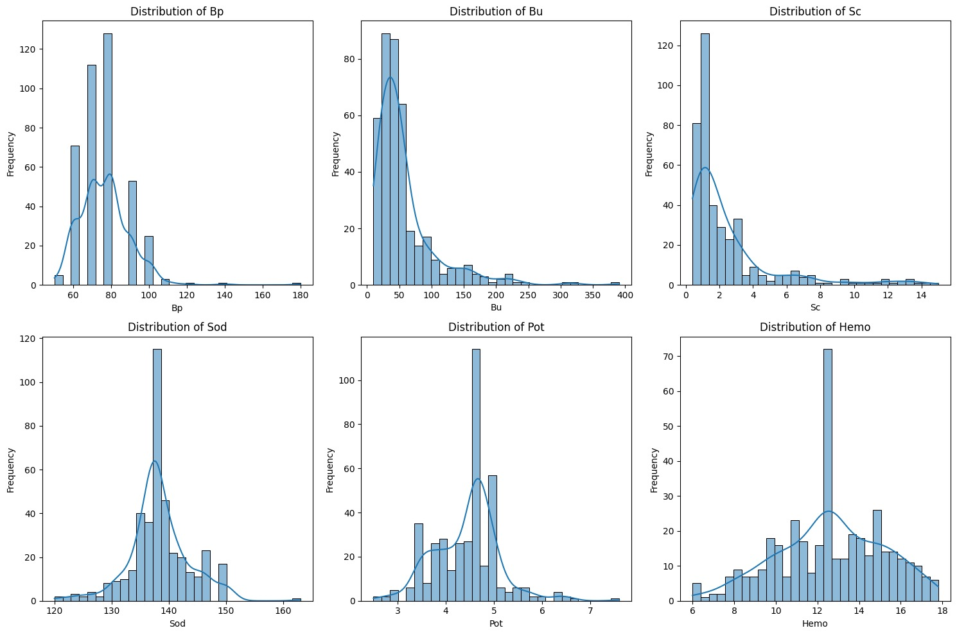
Histogram Analysis
From the histograms, Bu, Sc, and Hemo stand out as strong differentiators between CKD and non-CKD classes, with higher blood urea and creatinine and lower hemoglobin being strongly associated with CKD. Other features, such as Bp, Sod, and Pot, show more overlap between the two classes, making them less reliable predictors on their own.

Slide 17
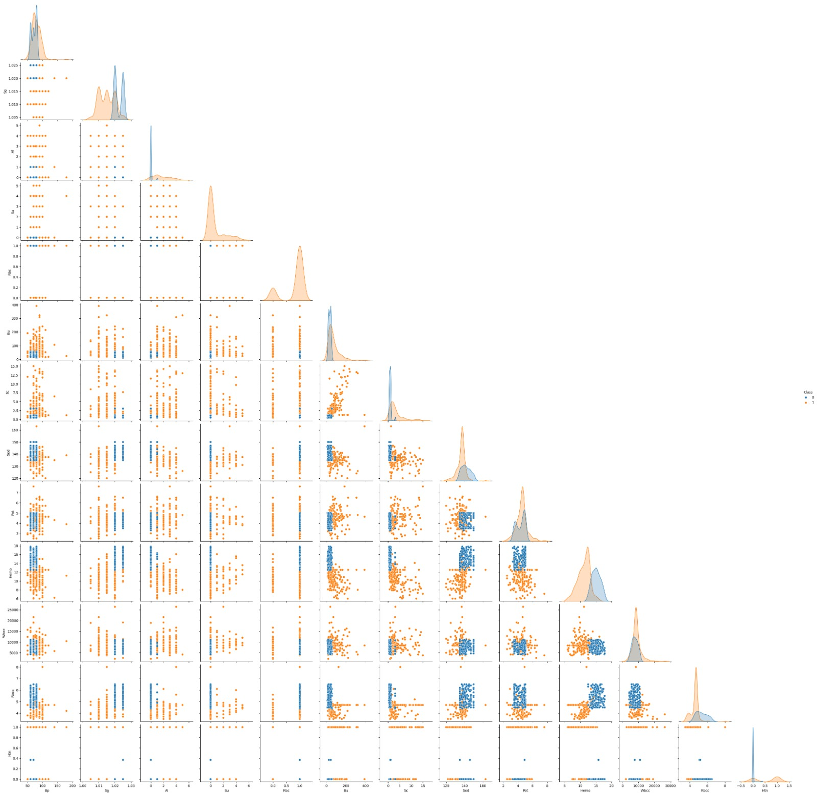
Pair-Plot
The pairplot shows that features like Sc, Bu, and Hemo exhibit strong separations between the classes and could be crucial for classification. However, some other features, like Sod and Pot, show overlapping distributions between the classes, meaning they may not be as effective on their own.

Slide 18
Why we want to try these algorithms
Decision Trees:
Interpretability: The tree structure makes it easy to visualize and understand the factors leading to readmissions.
Feature Exploration: Helps identify the most significant variables affecting patient outcomes.
Non-linear Relationships: Captures complex interactions between patient characteristics and readmission risk.
Random Forests:
Enhanced Accuracy: Aggregating multiple trees reduces overfitting and improves prediction accuracy.
Robustness to Noise: Performs well even when the dataset contains outliers or missing values.
Feature Importance: Offers insights into which features are most influential across all trees.
Gradient Boosting:
High Predictive Power: Focuses on correcting errors from previous models, leading to strong performance.
Handling Complex Patterns: Effective at modeling intricate relationships in the data.
Flexibility: Can be fine-tuned with various hyperparameters to optimize results for the specific dataset.
Logistic Regression:
Simplicity: Easy to implement and interpret, making it a good starting point.
Probabilistic Output: Provides probabilities, which are valuable for assessing patient risk levels.
Scalability: Efficient with large datasets, important if the readmission data is extensive.

Slide 19
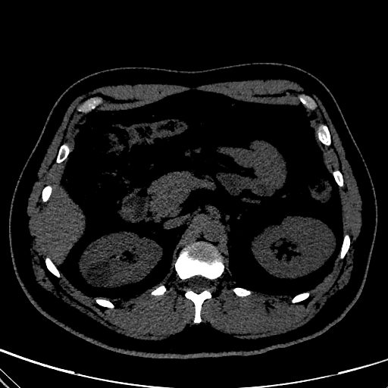
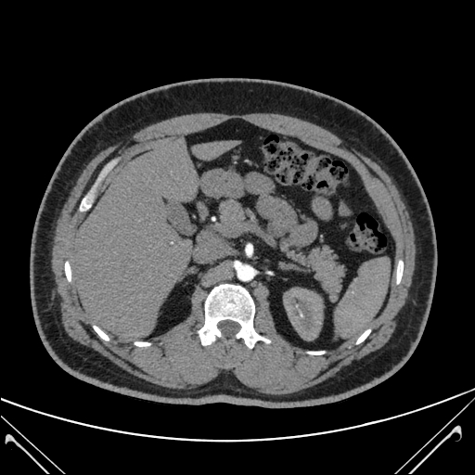
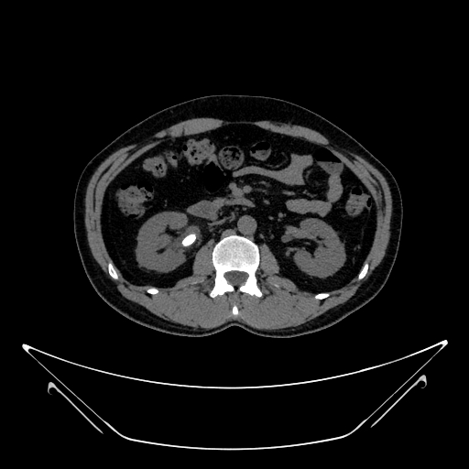
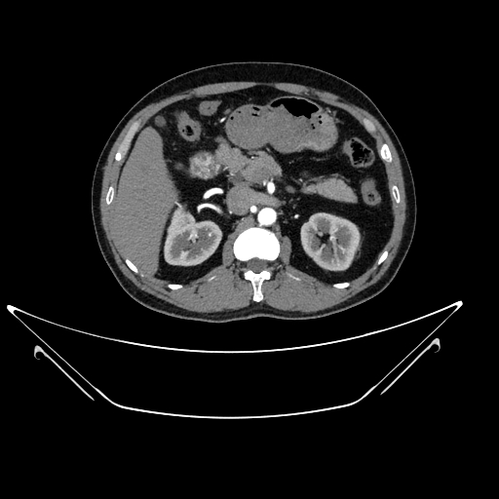
Dataset-2 CT Kidney Images
There are four directories in the folder
Cyst: Contains 3709 files
Normal: Contains 5077 files
Stone: Contains 1377 files
Tumor: Contains 2283 files
As part of the initial image preprocessing, a size check was conducted for all images to ensure consistency. The images were then resized using the most common size in the dataset as the reference point to maintain uniformity across the dataset

Slide 20
CNN-Based Clustering on CT Kidney Image Dataset
Goal: Group CT kidney images (normal, cyst, tumor, stone) using unsupervised clustering.
The K-Means Clustering algorithm was chosen. Its easy to use, effective, and suitable for medical scans. The images can be predefined to the number of clusters (k=4) so that they correspond to the four categories in the dataset.
Feature extraction: To extract picture features, use a CNN that has already been trained (such as ResNet).Using K-Means, cluster comparable photos according to how similar their features are.
Evaluation: Use measures such as the Silhouette Score to validate the quality of the clusters, then use PCA/t-SNE to show the findings.
What makes K-Means different? Ideal for discrete visual patterns (such as tumor versus normal).Scalable and quick for large file collections and easy to understand and modify for pre-established groups.
Other Approaches: DBSCAN (noise treatment) or Agglomerative Clustering (hierarchical clustering) may be used.

