Slide 1

Predictive modeling of chronic kidney diseases of patients using medical data and CT scans
F20DL UG-GRP-14
Abdul Samad Adam James Siddhant Pandey Shivadarshan Puttaraju Shoubhit Binoy

Slide 2
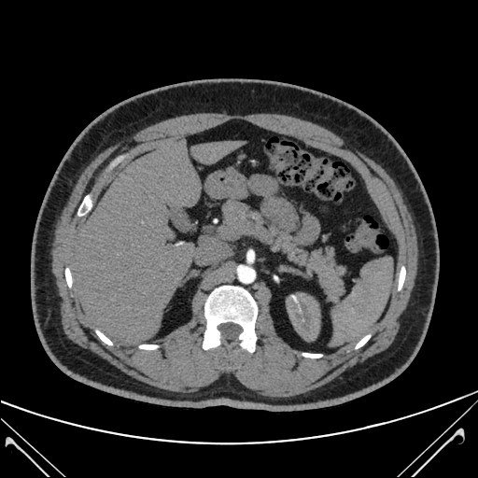
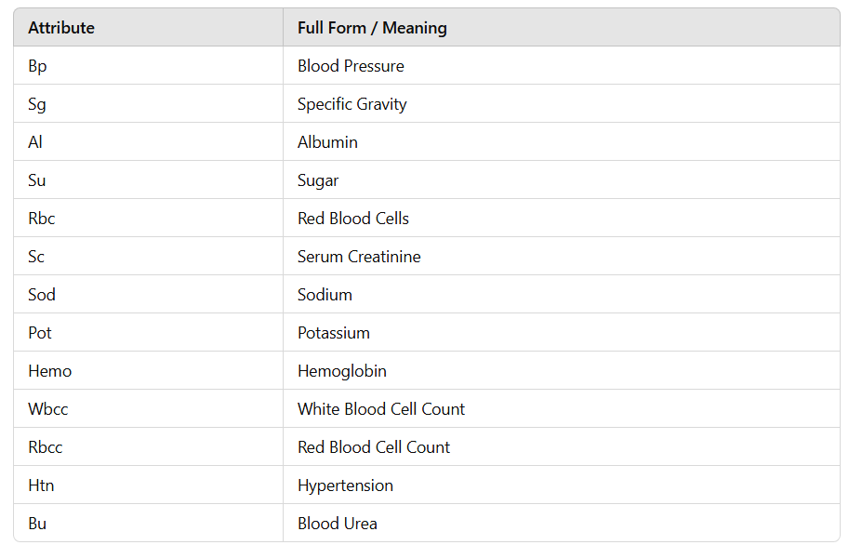
Dataset Overview
Objective:
Predict chronic kidney conditions
Predict kidney conditions by analyzing CT scans
Target Variable:
For Nominal Dataset Class: 0 – No Chronic Kidney Disease, 1- Presence of Chronic Kidney Disease
For Image Dataset – to classify the images between healthy and unhealthy kidney
Dataset Description
Nominal Dataset has 13 features
Image Dataset has 4 class: Normal, Cyst, Stone and Tumor
Why we chose this topic:
Global Health Priority: Kidney diseases are a significant global health issue, affecting over 800 million people worldwide. Early detection and treatment are essential to prevent progression to kidney failure.
Advancing Medical Diagnostics: Applying machine learning to medical data can enhance diagnostic accuracy, improving patient outcomes and saving lives.
Notes:
Data preprocessing: - Null & duplicate value
- Biological plausibility check
- Median Imputation
- Sequential Images
- Image Grey scaling and Data Augmentation [generalization]

Slide 3
Nominal Dataset Algorithms
Naïve Bayes
Overall Accuracy: 0.9375; Cross-validation (5-fold): Mean 94%, Std Dev 2.67%.
Class 0 (Precision: 0.90, Recall: 0.93, F1: 0.91); Class 1 (Precision: 0.96, Recall: 0.94, F1: 0.95).
ROC AUC: 0.99; Learning curve shows excellent generalization with training and validation scores converging.
Decision Tree
Train Accuracy: 0.9750; Test Accuracy: 0.9583 (Reduced overfitting with an optimal depth of 5).
Class 0 (Precision: 0.94, Recall: 1.00, F1: 0.97); Class 1 (Precision: 1.00, Recall: 0.96, F1: 0.98).
Feature Importance: Hemo (68.74%), Sg (22.86%), Al (4.93%); GridSearchCV accuracy: 0.9571.
Logistic Regression
RFE selected 5 features for the final model; l2 regularization outperformed l1.
Class 0 (Precision: 0.93, Recall: 0.96, F1: 0.95); Class 1 (Precision: 0.98, Recall: 0.96, F1: 0.97).
Wald’s Test showed slightly higher precision (+2%) but had a higher variance in cross-validation.
Gradient Boosting
Achieved 99% training accuracy and 99% test accuracy.
Feature Importance: Hemo and Sg were identified as the most critical contributors to predictions.
Robustness validated through 5-fold cross-validation, confirming the reliability of the model.
Notes:
naive bayes is a probablistic machine learning algorithm its best for the classificationof the task espically when the dataset is heavy, it works using probablity for each classbased on input features. in the results an accuracy of 93.75 percent was achieved withcross validation of 94 percent. a High AUC score was also achieved of 0.99 this shows that it responds well to unseen data. and a learning curve was also generated indicating no signsof overfitting.decision tree is a tree like structure, each node shows feature, the branch shows a decisionand leaf shows outcome. how this works is at each step the algorithm finds best feature it stops splitting when the nodes become pure. the train accuracy achived is 97.5 percentwith test accuracy= 95.83 percent and reduced overfitting by using optimal tree depth of 5. top features hemo,sg and Al. easy to inrept and visualise, handles numerical datawell. application is what im using in my fyp which is spam detection, medical diagnosis and alsoregression tasks like price prediction.

Slide 4
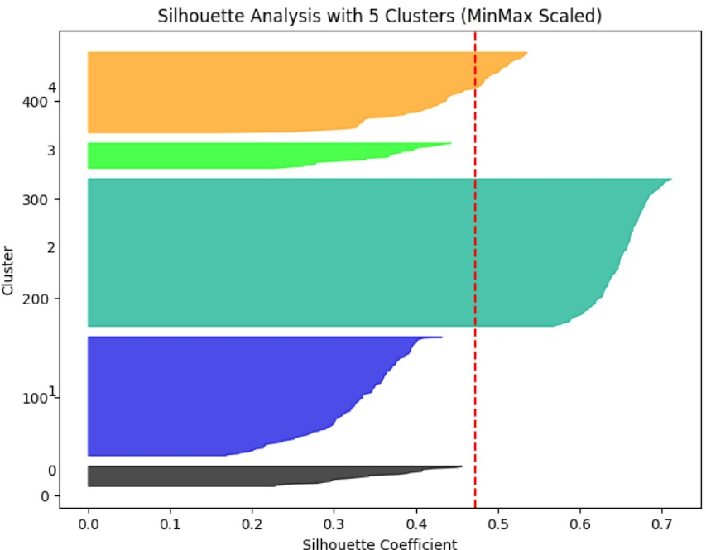
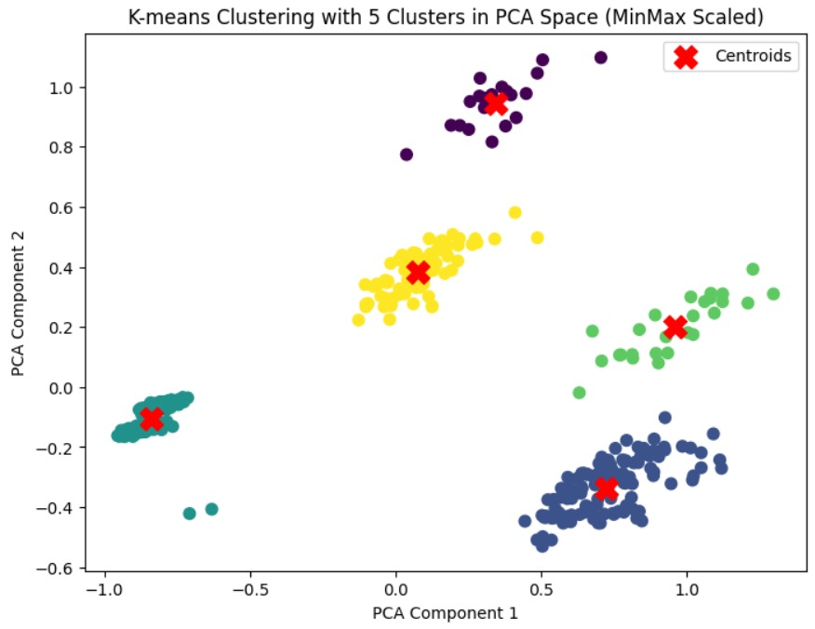
Clustering Algorithms
For our clustering analysis, we evaluated four methods: K-Means, DBSCAN, Gaussian Mixture Model (GMM), and Hierarchical Clustering, using different scaling techniques(Standard & MinMax) to compare their performance. Among these, K-Means with MinMax Scaling performed the best, achieving the highest silhouette score of 0.471 with 5 clusters. In contrast, DBSCAN had the poorest performance due to high noise, while GMM and Hierarchical Clustering also showed decent results with silhouette scores of 0.455. The use of PCA and t-SNE plots further confirmed that MinMax Scaling enhanced cluster separation, making K-Means the most effective approach for this dataset.

Slide 5
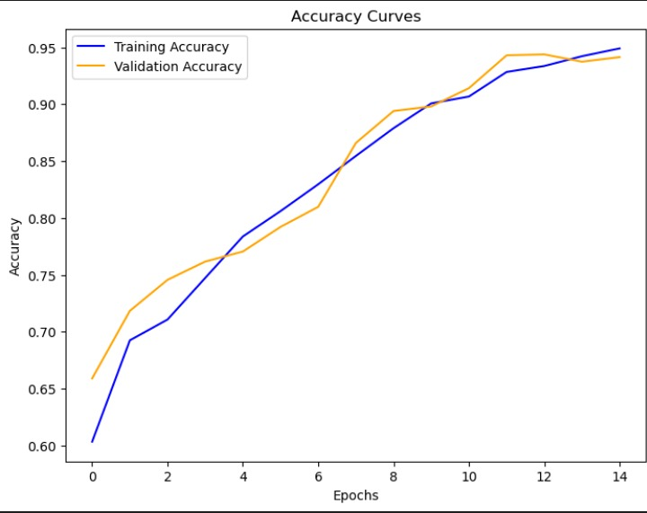
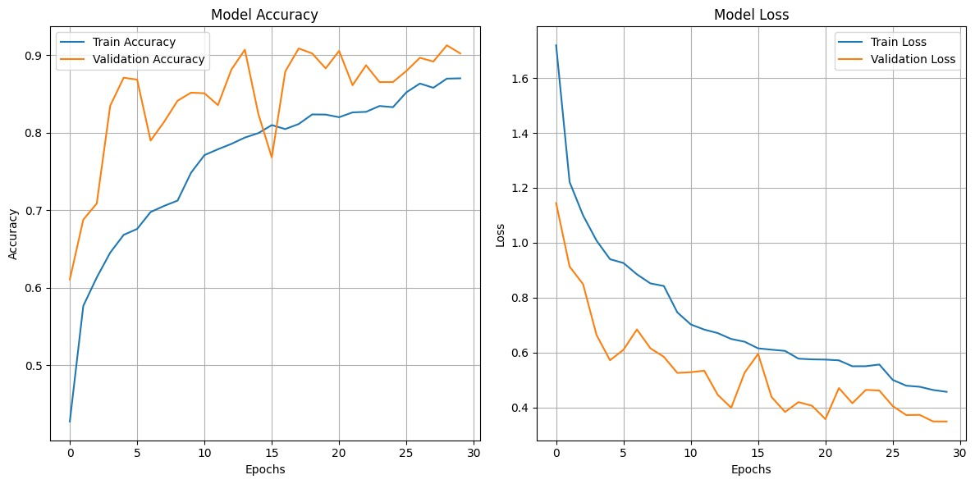
Image Processing Algorithms
For CNN
2D CNN only 12.2% of total params trainable as compared to 3D CNN all params being trainable.2D-CNN overall had many missed classifications with very poor f-1 and recall scores whereas
3D-CNN equals the performance of all classes with a drastic increase in accuracy. The 3D CNN was implemented with hyperparameters found using a random search for different no of filters, different dropout rates, and batch sizes. The 3D CNN model was trained with 3 different learning rates. Fine-tuning of class weights with emphasis on Stone class(1.2 times).
Overall the final 3D CNN model achieved train, validation, and test accuracies of 0.9491,0.9414, 0.9422 respectively. Concluding that 3D CNN is the best approach to classify our dataset.
For MLP
Augmention of the images, turned them into grayscale, added dropout layers, class weights, and L2 regularization. It achieved 91 test accuracy with 34% test loss but did not handle sequential data very well which is why 3D CNN was better.CNN:
For SVM
RBF kernel and class weights were used. A test accuracy, test accuracy and validation accuracy was achieved and it demonstrates superior power with less complexity and its not a linear data set.

