Slide 1
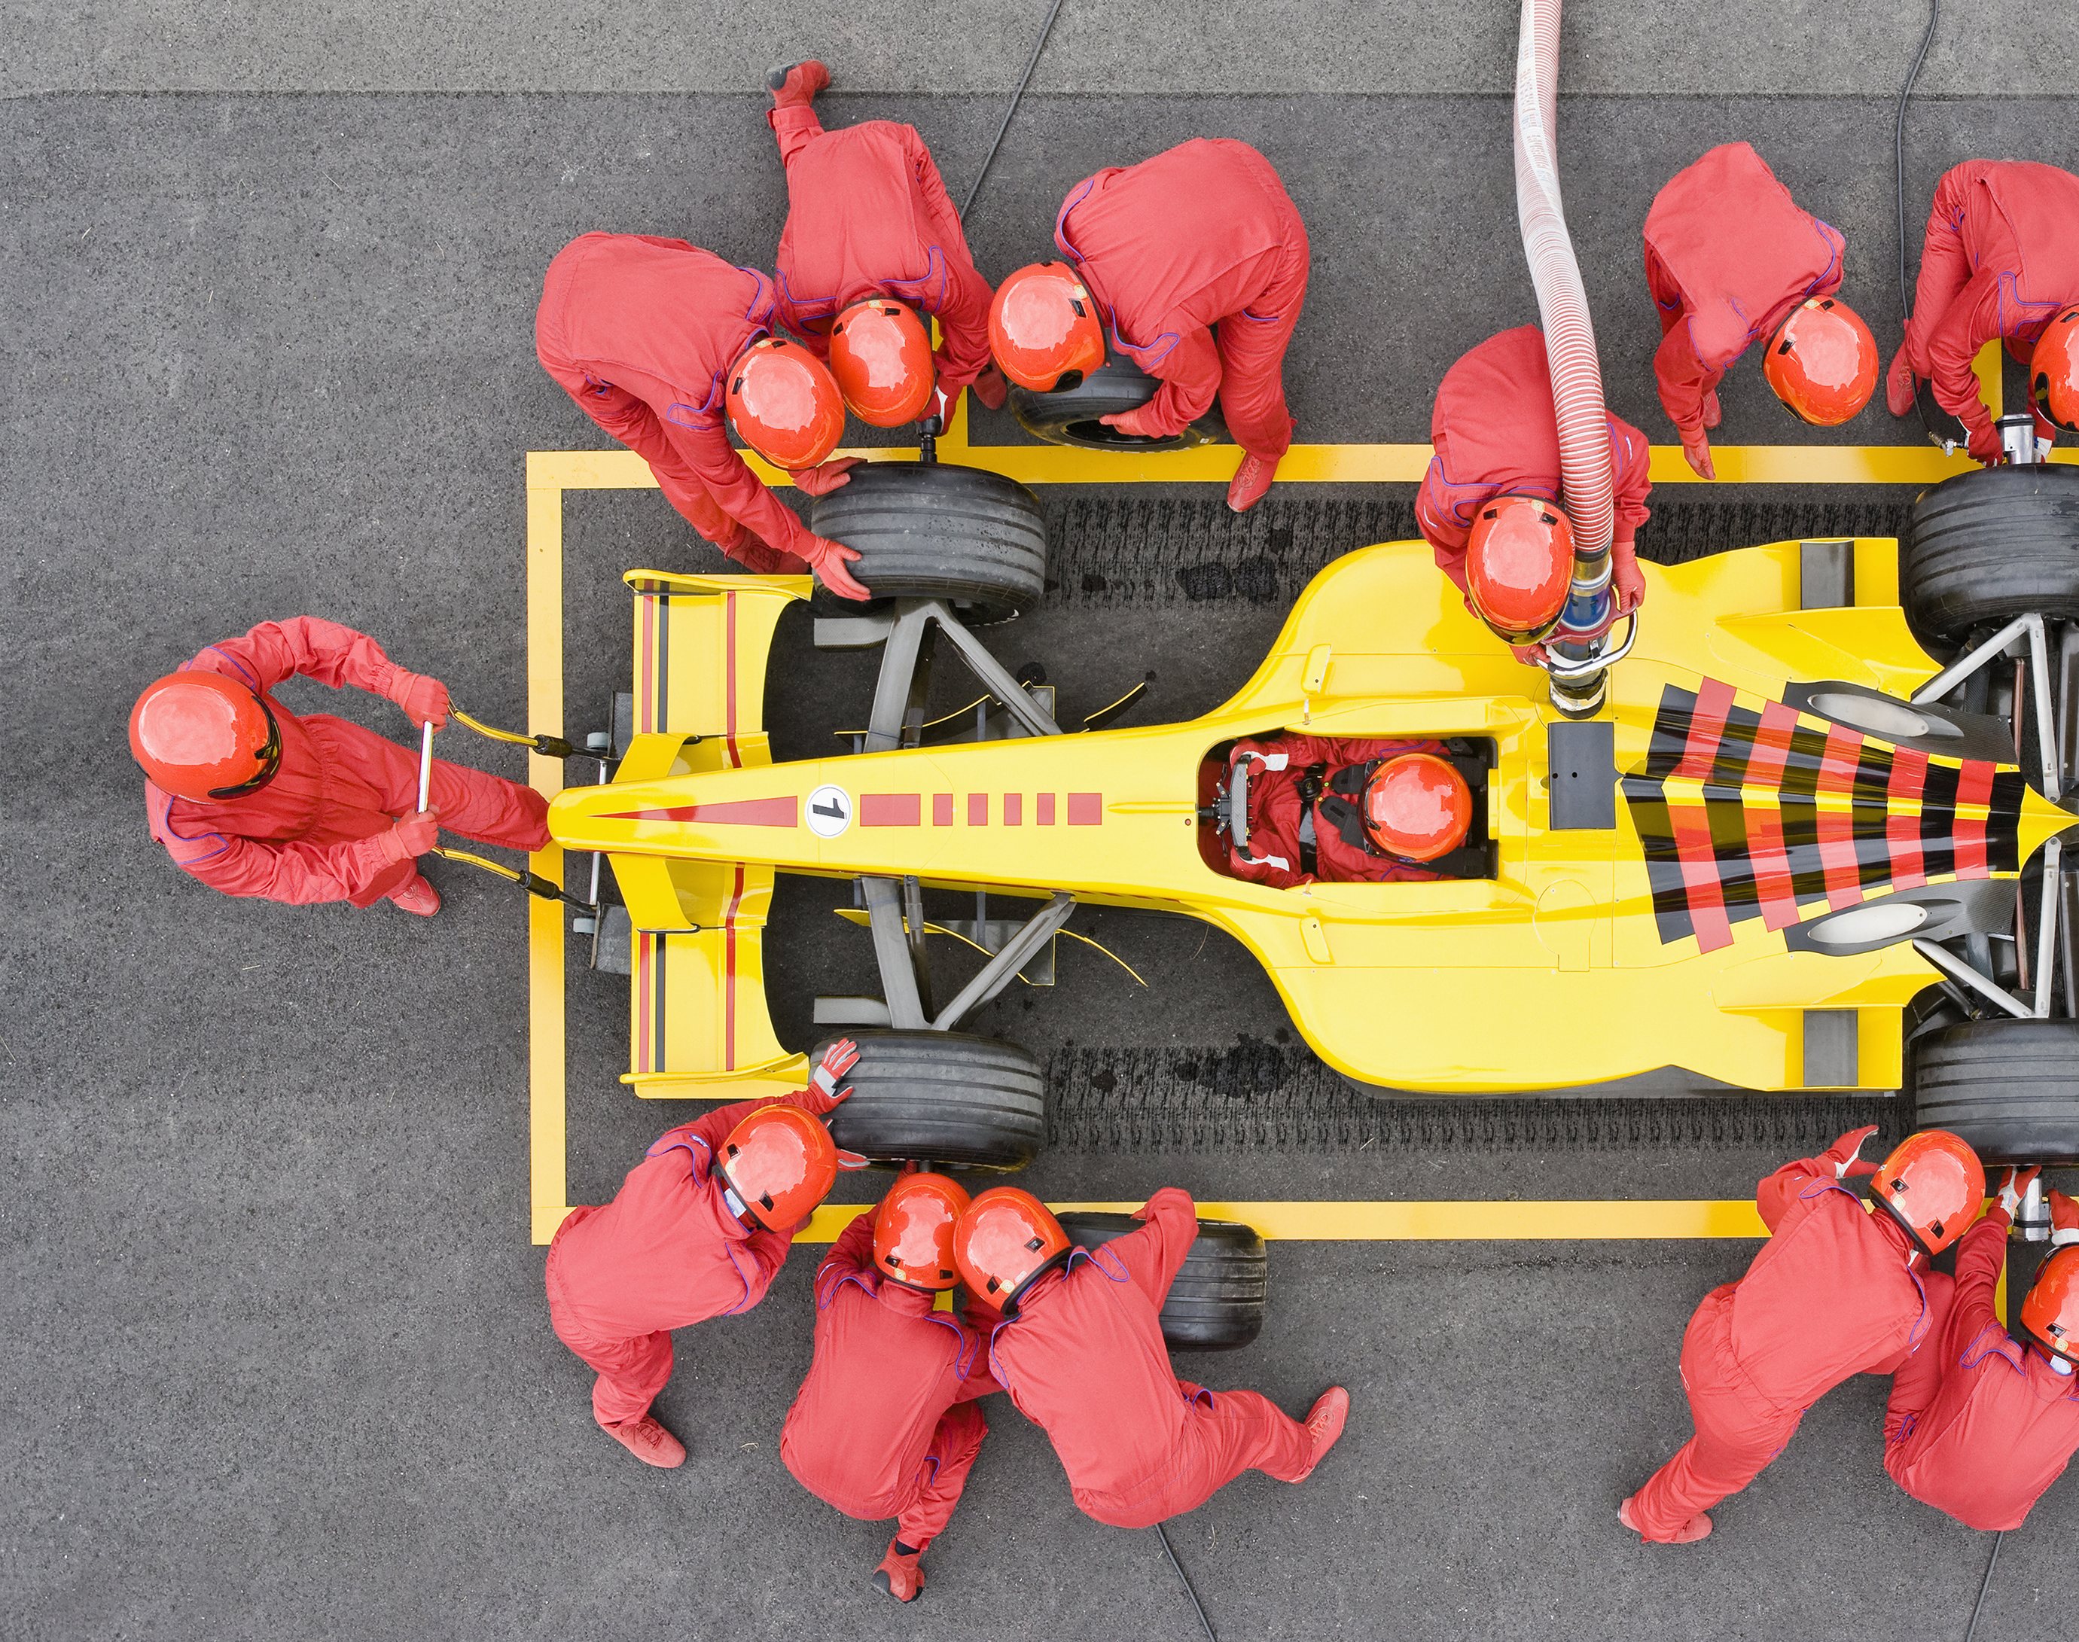
OptiGrid
Constrained Optimization and Visual Risk Profiling for F1 Fantasy
Project in Visualization - 4DT911
Jesper
Emil
Samuel

Slide 2
PROBLEM
Picking a team under a cost cap
Choose 5 drivers + 2 constructors within the budget to maximize points, when every race outcome is uncertain.
Constrained
Uncertain
Two objectives
Hard cost cap, fixed roster shape and limited transfers per week.
Crashes, safety cars and weather make averages misleading.
Score points this week and the following weeks
For: F1 Fantasy managers · sports bettors · motorsport analysts and fans

Slide 3
DATA
Three datasets
HISTORY
MARKET
CONTEXT
Ergast (Kaggle)
F1 Fantasy
OpenF1 API
6.5M
33 assets
2.3M
data points in 14 linked tables: results, qualifying, lap times, pit stops, standings.
22 drivers and 11 constructors: weekly price, points and ownership since 2022.
data points of session weather, sector splits, speed traps and pit flags.
Scope: 2022 onward (Ergast)
Joined on: race_id · driver_id · constructor_id

Slide 4
GOALS
Five Goals
GOAL 1
GOAL 2
GOAL 3
Integrated Architecture
Interactive Discovery
Constrained Optimization
Unified data pipeline
Interactive charts and comparisons
Algorithmic lineup optimizer
GOAL 4
GOAL 5
Risk Profiling
Dynamic Asset Comparison
Floor (p₁₀)
Median (p₅₀)
Ceiling (p₉₀)
Side-by-side comparison

Slide 5
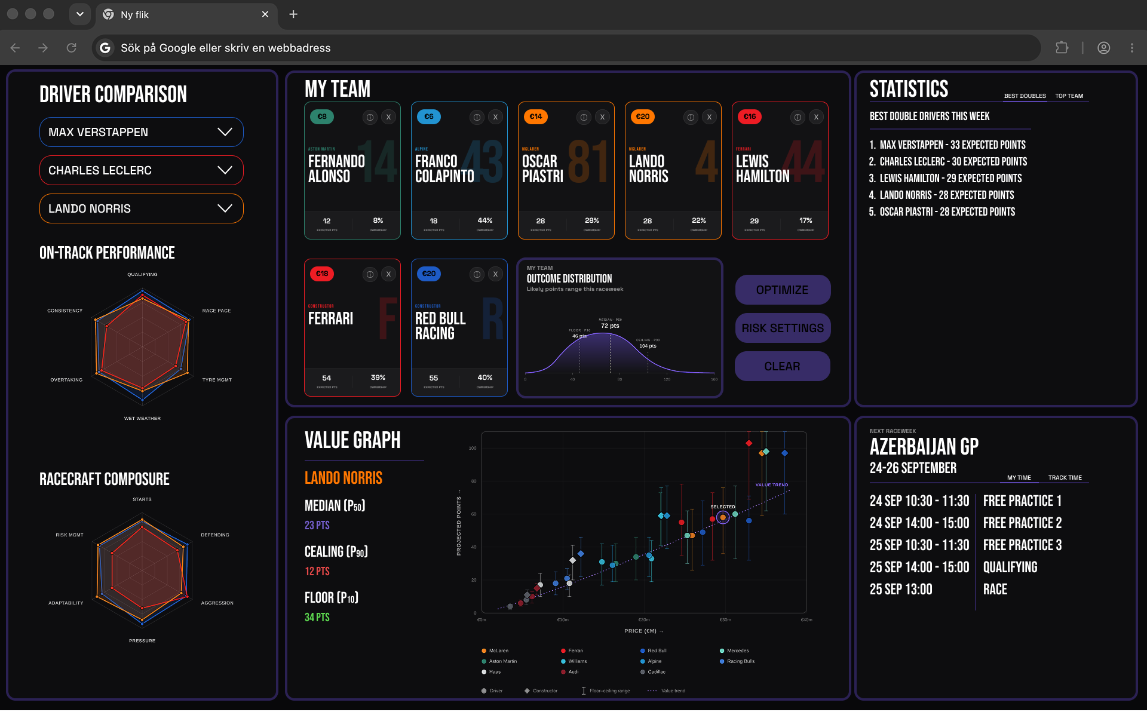
DESIGN
Bubble Chart
PPM comparisons and expected points distribution
Lineup Optimizer
Optimize your lineup from budget and risk slider
Driver Comparison
Comparing of three drivers on different performance metrics
Driver Info
Click on a specific driver to get more information and statistics
Other data
Different statistics and times for upcoming weekend

Slide 6
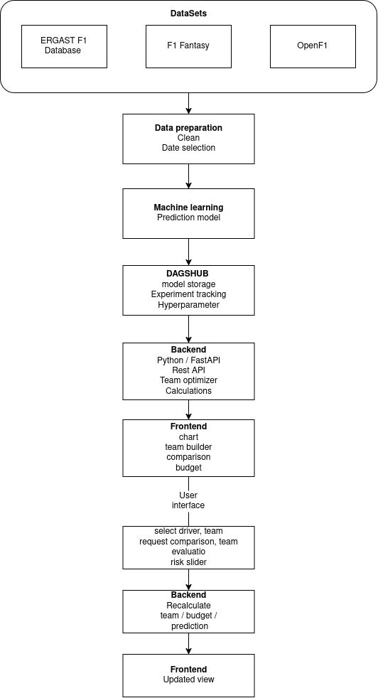
DATA PIPELINE

Slide 7
RESPONSIBILITIES
Samuel Berg
Emil Ulvagården
Jesper Wingren
DevOps, Backend
Fullstack
Machine Learning, Frontend

