Slide 1
Project in Visualization and Data Analysis

Slide 2
Dataset 1
Formula 1 Race Data (Kaggle) From Ergast Database
  circuits.csv
  constructor_results.csv
  constructor_standings.csv
  constructors.csv
  driver_standings.csv
  drivers.csv
  lap_times.csv
  pit_stops.csv
  qualifying.csv
  races.csv
  results.csv
  seasons.csv
  sprint_results.csv
  status.csv
Drivers/constructors/races are linked by ID
Has Data from 1950 – Now
121 Features - 14 files

Slide 3
Dataset 2 & 3
Formula 1 Fantasy data (2022 – Now)
  Driver Prices
  Constructor Prices
  Points
Fastf1
  Weather information

Slide 4
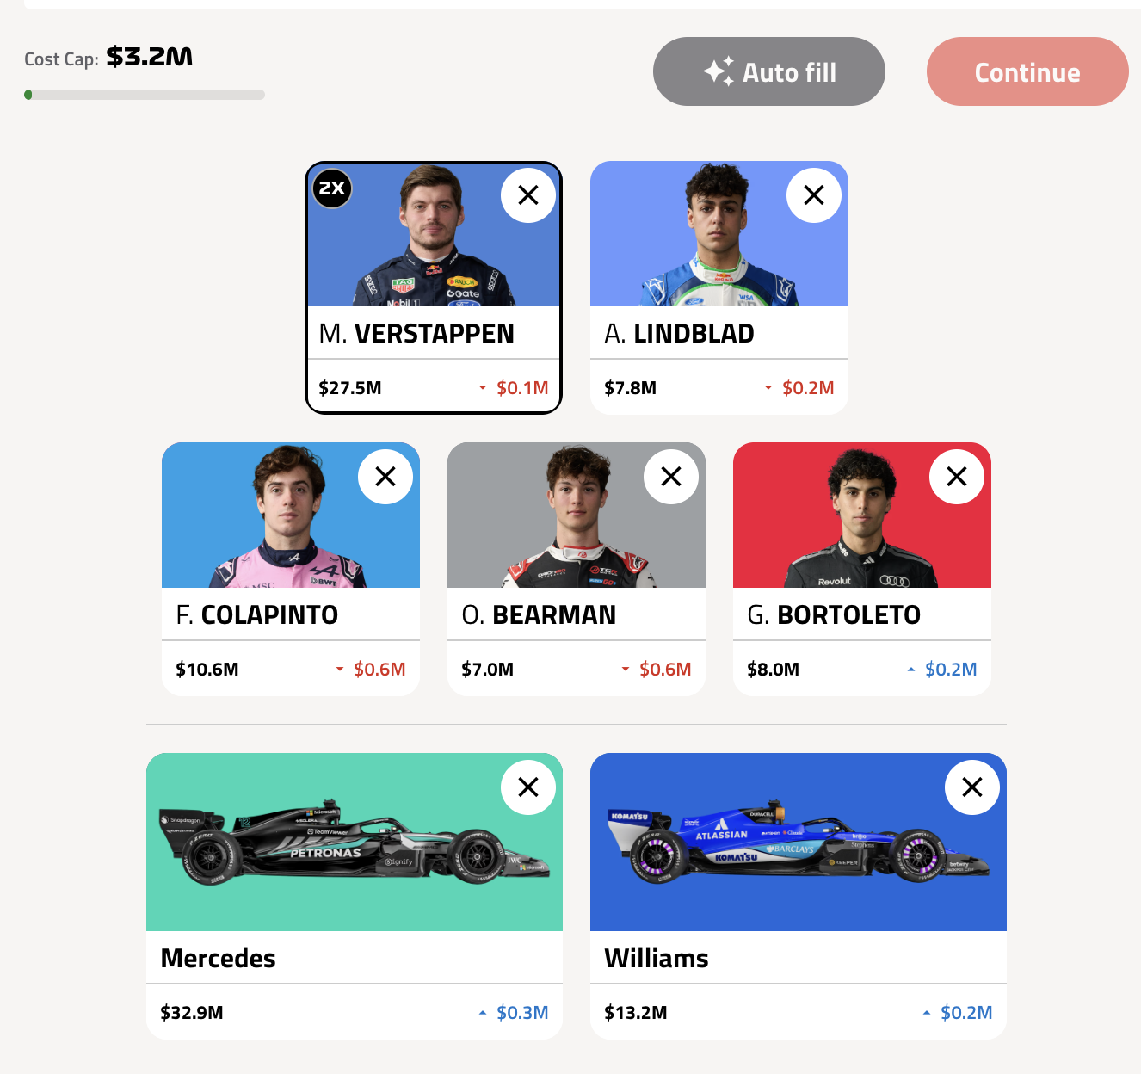
Intro to Formula 1 Fantasy
Budget
Points
Transfers
2 Teams
5 Drivers

Slide 5
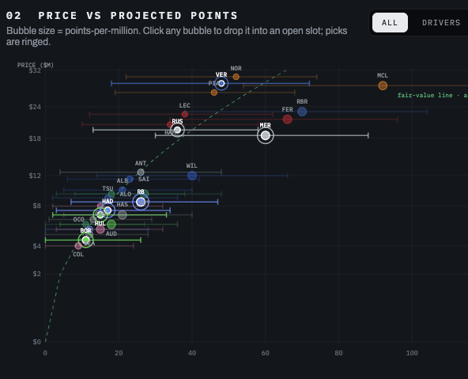
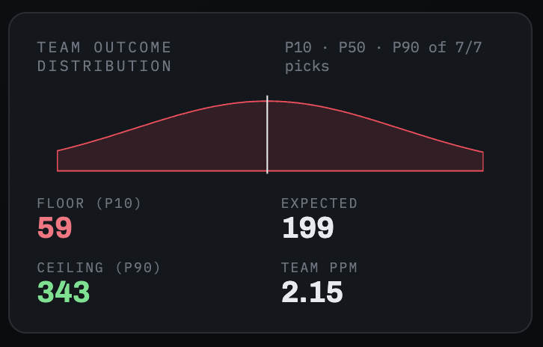
Project Idea
Formula 1 fantasy predictor
  For Fantasy players
  Applicable to Sports Gambling
Features:
Predicted Points
Predicted Result
Team optimizer
Comparison tools
Images generated by AI

