Slide 1
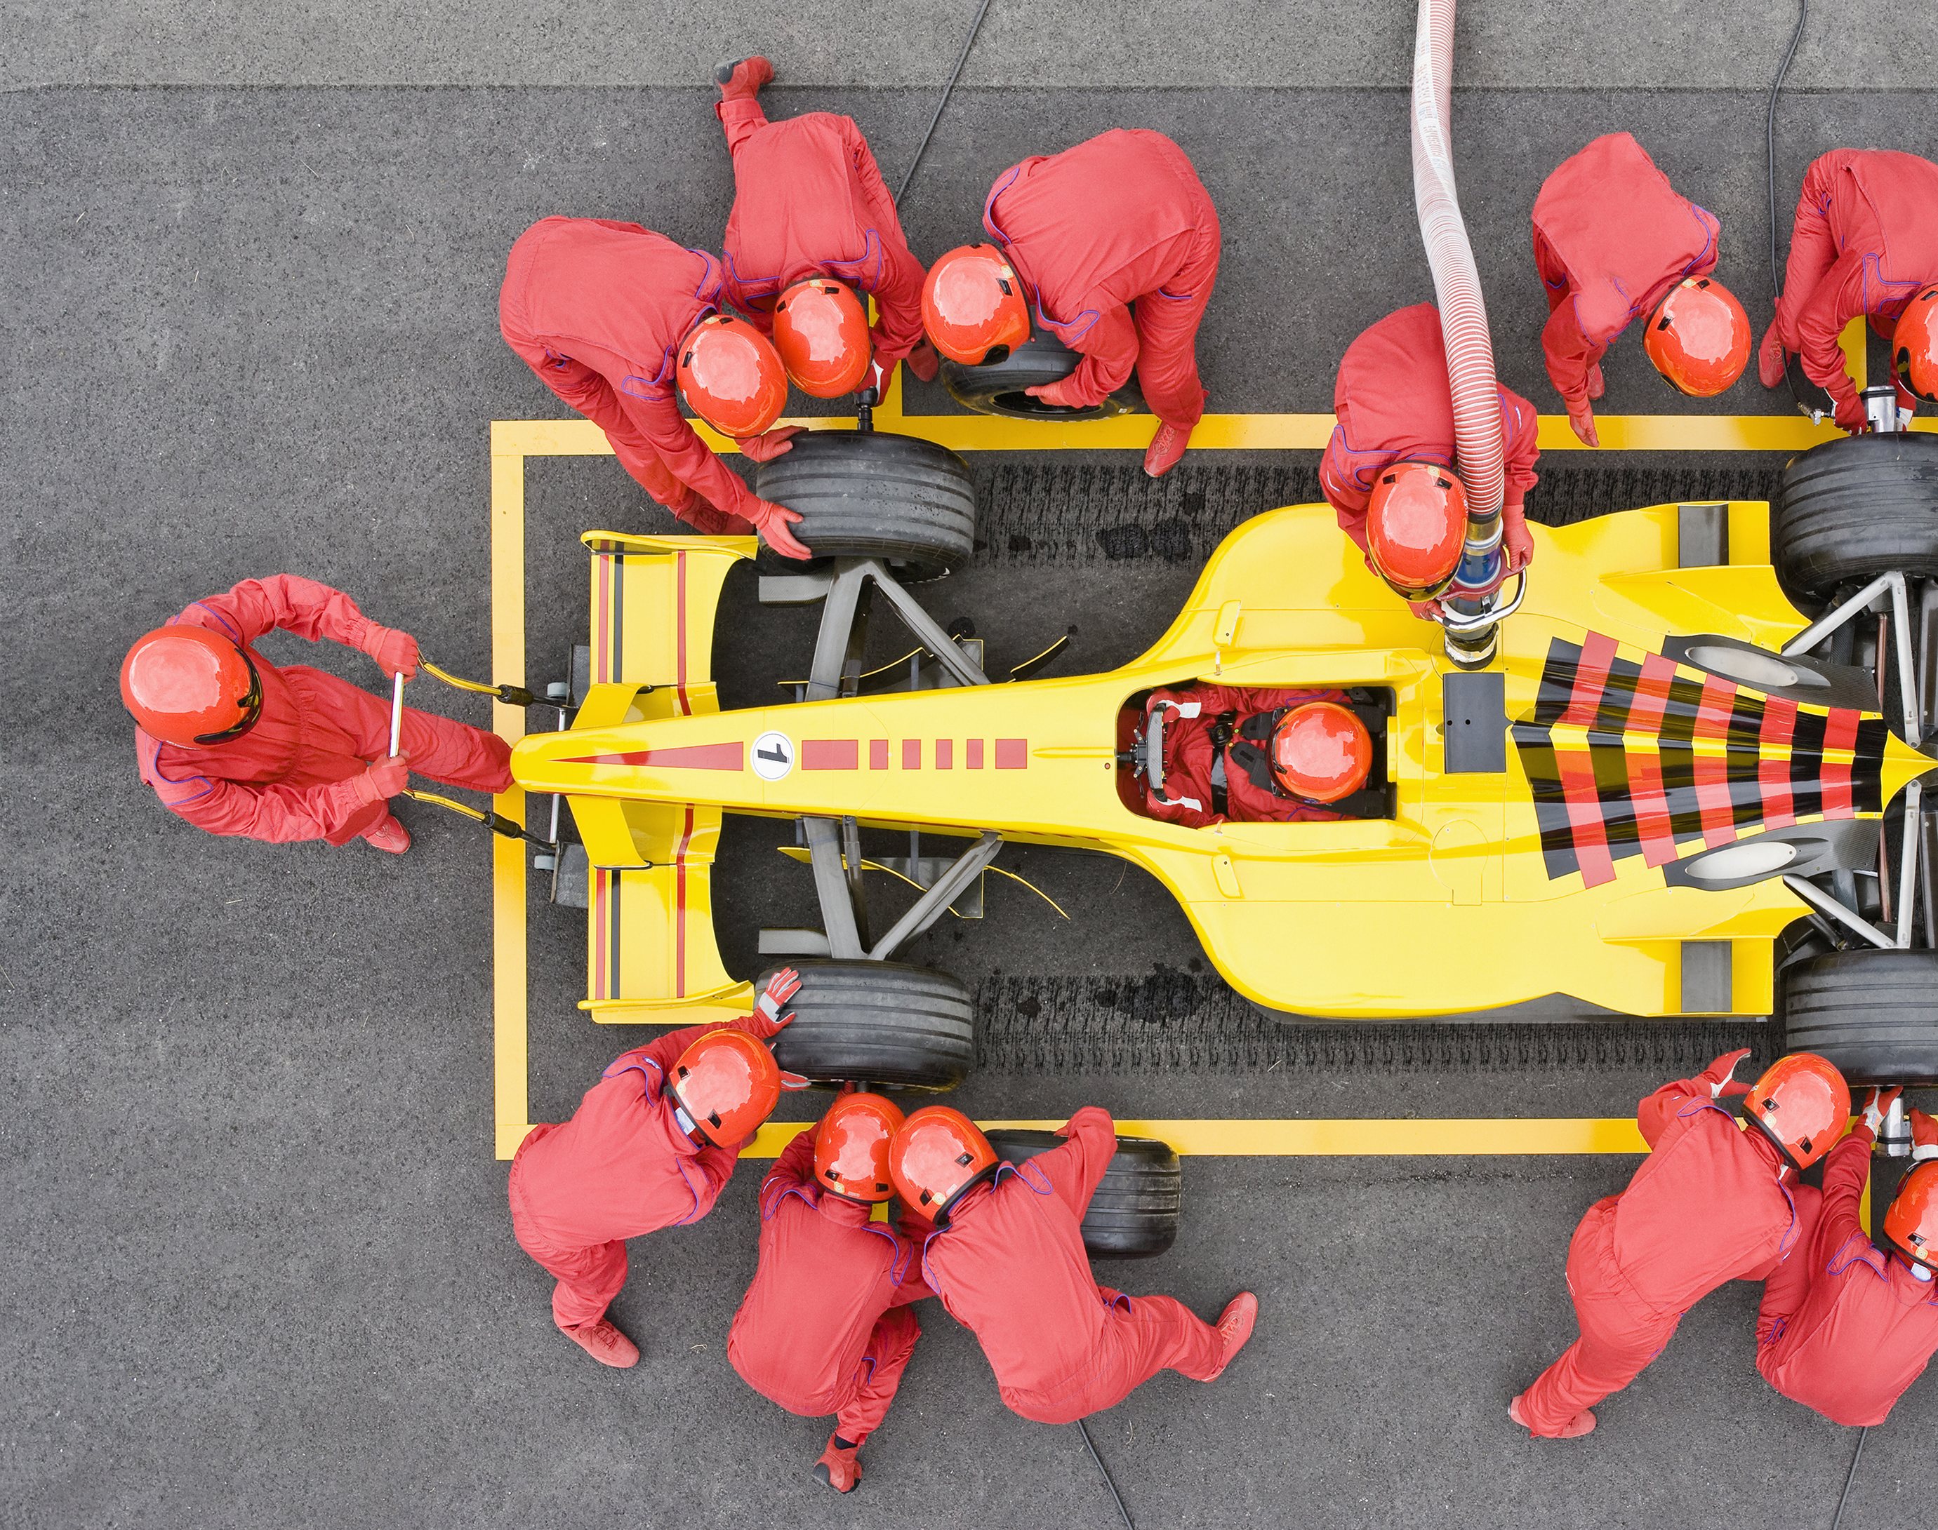
OptiGrid
Constrained Optimization and Visual Risk Profiling for F1 Fantasy
Project in Visualization - 4DT911
Jesper
Emil
Samuel

Slide 2






The Challenge
Balancing immediate point production against volatile market dynamics under a hard cost cap.
Fantasy managers dilemma
The analytical challenge
Strict Roster Constraints
The Average Trap
Dual-Objective Trade-off
Multi-Modal Variables
Transfer Friction
Risk vs Reward

Slide 3
Data Architecture & Integration
Unifying historical data with dynamic fantasy market economics.
CORE RELATIONAL DATA
MARKET & SCORING LAYER
SESSION CONTEXT
Ergast F1 Historical Archive
F1 Fantasy Game Data
OpenF1 API
1950–Present
Dynamic Weekly Data
Telemetry Data
● Driver, constructor, and race-level historical records.
● Weekly pricing, ownership, and scoring dynamics.
● Live weather, tire, and track-evolution telemetry.

Slide 4






Target Audience & Generalizability
From fantasy managers to probabilistic modeling across sports and finance.
PRIMARY USERS
POSSIBLE EXTENSIONS
Target Audience
Generalizability & Cross-Domain Impact
F1 Fantasy Managers
Daily Fantasy Sports
Casual and competitive players seeking data-driven transfers, budget maximization, and automated lineup optimization to climb league standings.
The constrained combinatorial optimizer could translate to Premier League Fantasy and NFL Fantasy leagues.
Sports Wagering & Oddsmaking
Sports Bettors & Wagering Analysts
Outcome distribution modeling (P10, P50, P90) can compute true fair-value odds, identify mispriced markets, and calculate risk margins.
Bettors looking for probabilistic finish projections, head-to-head match-up edges, and objective value lines against public odds.
Financial Portfolio Allocation
Motorsport Fans & Data Enthusiasts
Balancing volatile, high-return assets with stable budget-enablers under a fixed ceiling mirrors classic portfolio construction.
Track followers wanting interactive visual comparisons of car pace vs. driver skill and cost-efficiency benchmarks (PPM).

Slide 5
Dataset 1: Historical Racing Archive (Ergast)
Covers F1 history (1950–Present)
6,500,563 Data Points
14 Relational Tables
121 Features
Schema & Entity Architecture
Analysis
● Core Relational Backbone: 14 relational tables linked by raceId, driverId, and constructorId.
● High-Volume Tables: lap_times (882k rows / 5.3M points), results (27.5k rows), driver_standings (35.7k rows), and pit_stops (22.7k rows).
● Dimensional Types: Quantitative coordinates (lat, lng, alt), ordinal finishing ranks (position), and categorical status codes (Engine, Accident, Finished).
● 1,707 duplicate rows found in lap_times.csv, which is to be expected
● No missing values.

Slide 6
Dataset 2: Dynamic Game Economics (F1 Fantasy)
Valuation metrics spanning 2022 to the present.
2022–Present
Weekly Temporal Step
Dynamic Valuations
187 Data Points
Schema & Entity Architecture
Analysis
● Asset Universe: Weekly valuations for 22 active drivers and 11 constructors.
● Core Dimensions: Quantitative continuous pricing (price_m), total fantasy points, and ownership percentages (selected_by_pct).
● Strict distribution in pricing: premium anchor assets ($25M–$35M) vs. budget enablers ($5M–$10M).
● High volatility in ownership percentage driven by recent race form and track matchups.
● Clean dataset with zero missing cells across active records.
● Standardized driver acronyms/codes (VER, HAM, NOR) to align with Ergast's historical driverRef schema.

Slide 7
Dataset 3: Real-Time Session Telemetry (OpenF1)
Micro-temporal and track-level telemetry capturing active racing conditions.
Sub-Second Latency
16 Telemetry Dimensions
Micro-Spatial GPS
2,341,250 Data Points
Schema & Entity Architecture
Analysis
● Contextual Variables: Track temperature, air temperature, humidity, rainfall indicators, and wind vectors.
● Session Granularity: Sector-by-sector time splits (segments_sector_1/2/3), speed trap readings, and pit-lane state flags (is_pit_out_lap).
● Micro-temporal: sub-second telemetry synchronized against official session elapsed clocks.
● Micro-spatial: track coordinate mapping along physical race circuit sectors.
● Null cells resulting from pit exit out-laps prior to official timing line activation.

