Slide 1
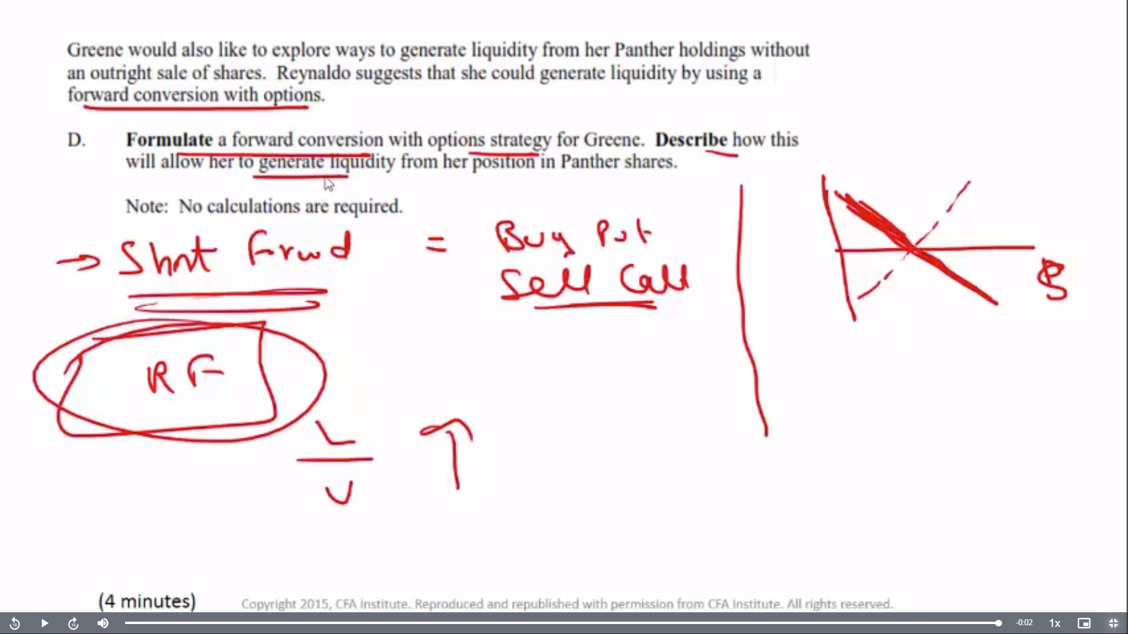
Risk free, loan to value high!

Slide 2
