Slide 1
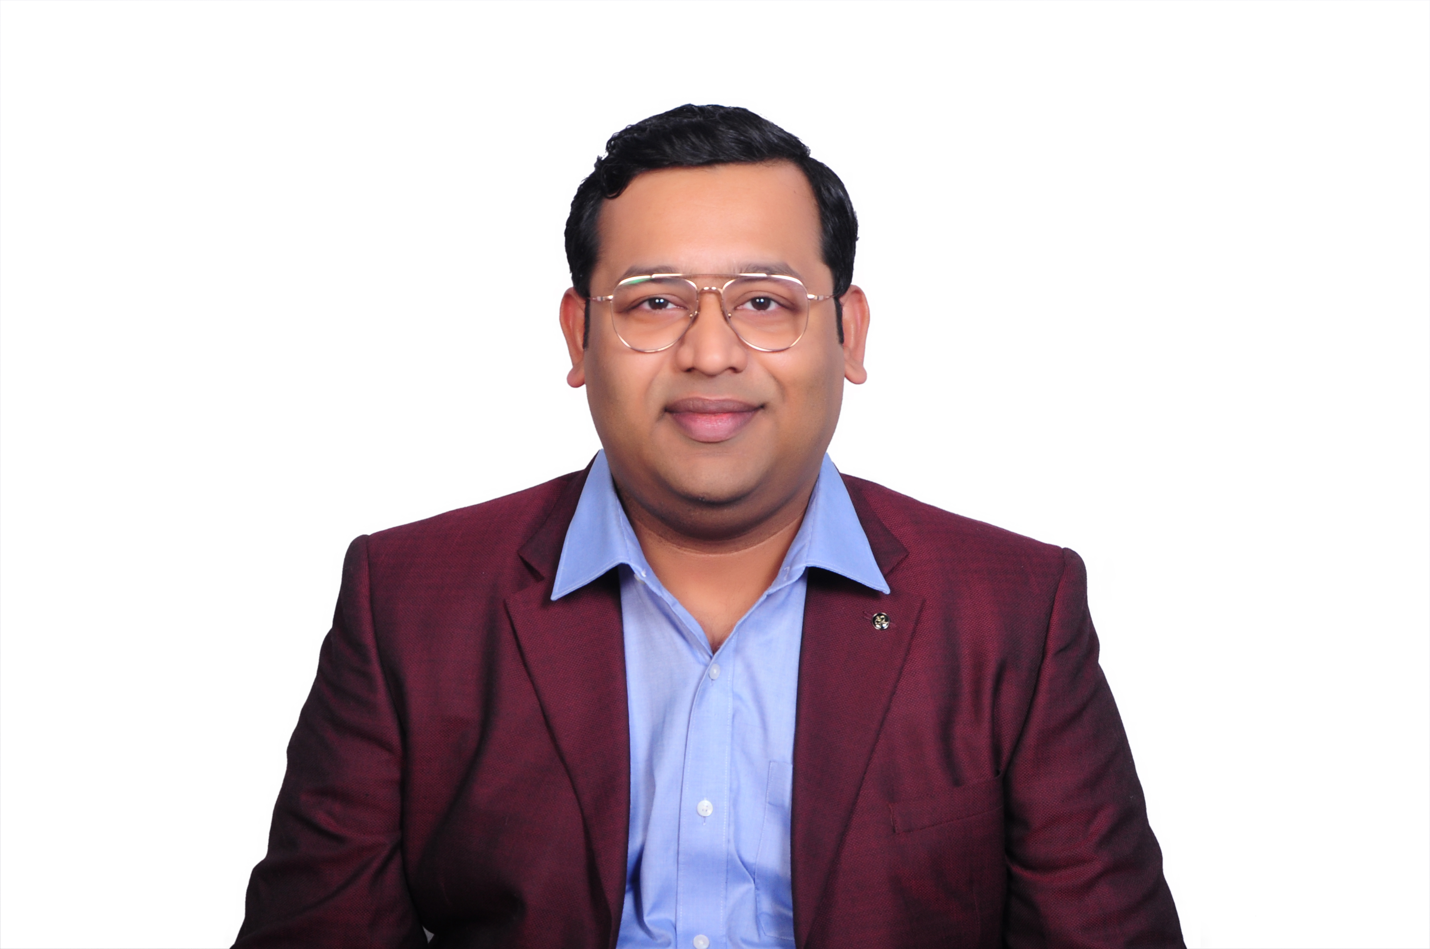
SANJIB BISWAS
SENIOR MANAGER
sanjib.biswas@pwc.com
EXPERIENCE SUMMARY
Senior Manager at PwC with 13+ years in Gen AI, Agentic Automation & LLMs. Previously successfully led AI Center of Excellence as Technical Architect, managing 12+ team for AI solution design and deployment across Insurance, Pharma, Retail, Banking & Supply Chain.
[Photo]
Agentic Knowledge Management Solution | PwC Client
Built multi-division KM system: M365 Teams Bot → Kong API Gateway → AWS Lambda with Strands Agent orchestration on Bedrock.
3-tool agent architecture: Intent Classification, Query Enhancement, Halucination detection & SharePoint Document Search via Microsoft Graph OBO auth.
End-to-end: MemoryDB for session persistence, CloudWatch/Splunk logging, adaptive feedback cards; Terraform-managed infra.
Automated Medical Record Summarization | PwC Client
Fine-tuned GPT-4.1 on claim-related medical records for automated fact extraction via Azure AI Foundry.
HNSW-based vector indexing with text-embedding-3-large on Azure AI Search; OCR + summarization pipeline.
Production: Azure OpenAI + Document Intelligence + Semantic Ranker, RAG-powered Q&A via Streamlit UI.
Skills
LLMs & AI
LLM Guardrails & Security – Internal Chatbot
GPT-4/4.1
ColPali
WildGuard
Claude Sonnet
RAG Pipeline
NER
Fine-tuned WildGuard on 120K dataset for Medicare/Medicaid fraud & PHI violation detection via AWS SageMaker.
LoRA/QLoRA training on AWS EC2 P4d A100; jailbreak detection, prompt injection prevention via Step Functions.
Production: ONNX Runtime + TensorRT on Kubernetes (EKS) / NVIDIA Triton, <45ms latency.
Agents
LoRA/QLoRA
Fine-tuning
Prompt Engg
HNSW Indexing
FAISS
Embeddings
OCR
Semantic Search
Agentic Chat with SQL Assistant | Natural-Language to SQL
LangGraph
NetworkX
LSTM
Bayesian
LLM-powered agents for SQL generation with query planning, validation & self-correction using Claude Sonnet.
GPT-4 metadata extraction, 1536-dim FAISS embeddings, RAG for top-5 table selection, NetworkX join paths.
Deployed as on-prem API via Dockerized FastAPI + Nginx + Redis; LangGraph multi-agent orchestration.
Frameworks
LangChain
Airflow
MLflow
ONNX
PyTorch
TensorFlow
Azure AI Foundry
Cloud & DevOps
Automated Forecast Engine | Leni
AWS SageMaker
Azure AI
Containers
ARIMA, SARIMA, auto-regressive models with GLM-based forecasting + LSTM neural networks for temporal dependencies.
Shapiro test, rolling/sliding window validation, MLflow model versioning; improved forecasting accuracy by 19%.
Centralized platform with dashboard for all business units; reduced model lifecycle time.
AWS EKS
Terraform
GitHub Actions
Docker
CI/CD
Git
Inference
Marketing Mix Model (MMM) | Budget Optimization
TensorRT
CUDA
FP16/INT8
GGUF
Bayesian & LASSO regression for media effectiveness with adstock transformations (Geometric, Log, Hill, Beta).
Linear Programming (LPP) to optimize spend across channels, maximizing ROI; reduced wasted spend by 33%.
Cross-validation & hyperparameter tuning with MAPE, R-Squared & BIC metrics for model reliability.
.
Data & Lang
SQL Server
Redis
Vector DB
SQL
Python
NumPy
FastAPI

