Slide 1
Nyx-Net 2.0 Beta
Songyuan Bo
Miftahul Huq

Slide 2
What is Nyx-Net?
Nyx-Net is a novel snapshot-based fuzzing approach designed for efficient testing of complex, stateful network services.
Key Features:
Uses incremental snapshots for efficiency.
Supports fuzzing a wide range of targets including servers, clients, games, and IPC interfaces.
Builds on the capabilities of Nyx, enhancing it for network fuzzing.
Achievements:
Improved test throughput by up to 300x and coverage by up to 70% compared to state-of-the-art methods.
Discovered previously unknown bugs in major software like Lighttpd and Firefox.

Slide 3
Core Design of Nyx-Net
Key Components:
Hypervisor-Based Snapshot Fuzzing: Ensures noise-free testing and quick resets.
Selective Emulation of Network Traffic: Avoids the heavy cost of handling real network traffic.
Incremental Snapshots:
Reduce repeated processing of identical prefixes in test cases.
Improve test throughput by 10x to 30x in complex scenarios.
Flexibility: Compatible with POSIX-compliant systems and supports both network and IPC fuzzing.

Slide 4
Advantage and Impacts
Performance:
Handles complex, stateful message-based systems with ease.
Outperforms AFLnet and other tools in most benchmarks, including ProFuzzBench.
Found bugs in:
Servers: Lighttpd.
Clients: MySQL client.
Games: Super Mario (10x–30x faster level-solving).
IPC Interfaces: Firefox sandbox processes.

Slide 5
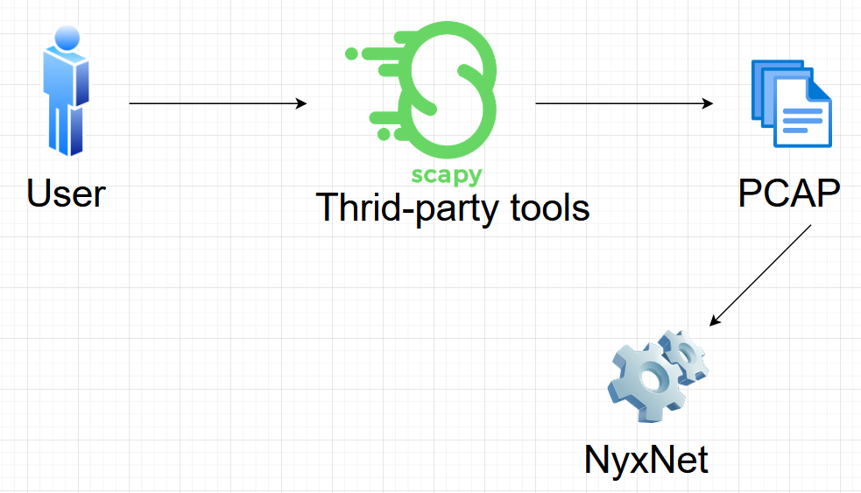
What it was

Slide 6
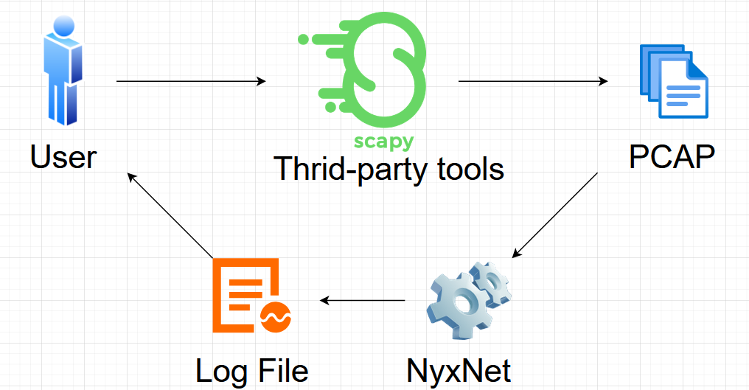
What it was

Slide 7
Grammar based fuzzing
Dynamic packets generation
Automation
Improves efficiency and accuracy of fuzzing
Improves potential chance of finding vulnerability and instability of the PUT

Slide 8
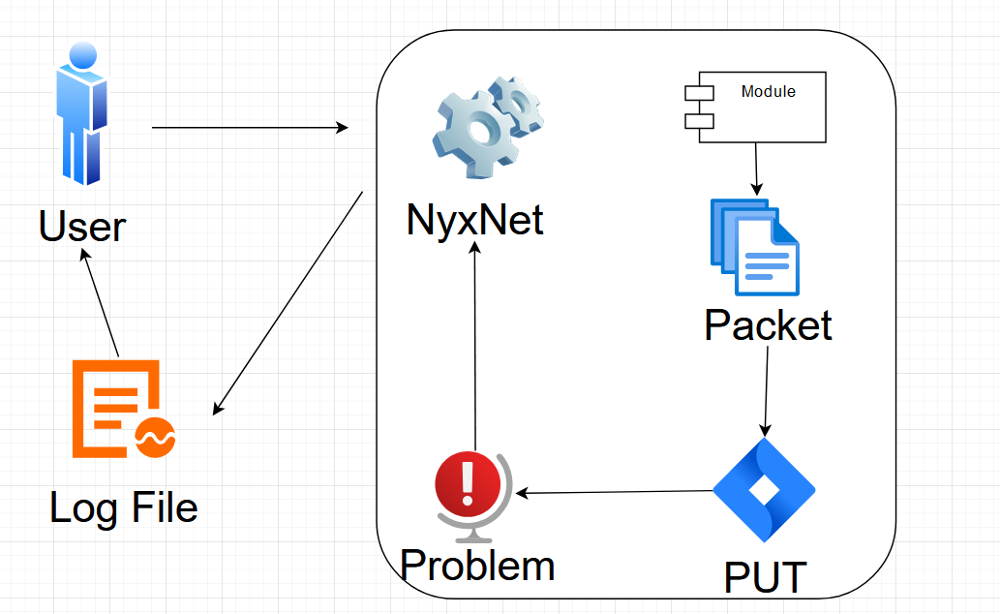
Our improvement

Slide 9

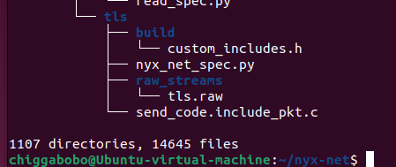
Problem
The source code of NyxNet 1.0 would not compile
Insufficient time given to exam all source code (586MP)

Slide 10
Project plan (Altered)
Create a standalone Grammar-based fuzzing module/program
Mimic NyxNet
Intergrate the module into NyxNet after we have it working

Slide 11
Live Demo!

Slide 12
Resources
Schumilo, S., Aschermann, C., Jemmett, A., Abbasi, A., & Holz, T. (2022). Nyx-Net: Network Fuzzing with Incremental Snapshots. In Seventeenth European Conference on Computer Systems (EuroSys '22), April 5–8, 2022, Rennes, France. ACM. https://doi.org/10.1145/3492321.3519591
Van-Thuan Pham, Marcel Böhme, and Abhik Roychoudhury. AFLNET: A Greybox Fuzzer for Network Protocols. In IEEE International Conference on Software Testing, 2020.
Dokyung Song, Felicitas Hetzelt, Jonghwan Kim, Brent Byunghoon Kang, Jean-Pierre Seifert, and Michael Franz. Agamotto: Accelerating kernel driver fuzzing with lightweight virtual machine checkpoints. In USENIX Security Symposium, 2020.
“Welcome to Scapy’s Documentation!.” Welcome to Scapy’s Documentation! - Scapy 2.6.0 Documentation, scapy.readthedocs.io/en/latest/. Accessed 21 Nov. 2024.

Slide 13
Questions?

