Slide 1
Local Interpretable Model-agnostic Explanations
Stephan Berke
University of Freiburg
December 6, 2023

Slide 2
Agenda
1. INTRODUCTION
2. EXPLANATIONS
3. OVERVIEW
4. MATHEMATICAL REPRESENTATION
5. TRADE-OFF
6. ALGORITHM
7. KERNEL WIDTH
8. RECENT APPLICATIONS
9. DISCUSSION
10. Q&A

Slide 3
L
I M E
OCAL
NTERPRETABLE
ODEL-AGNOSTIC
XPLANATIONS
Notes:
Local: Global function locally approximated
Interpretable: Understandable for humans, a qualitative and quantitative help
Model-agnostic: Works on any black box model

Slide 4




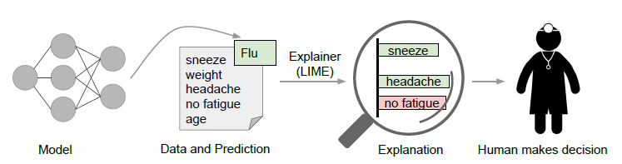
INTRODUCTION
BLACK-BOX MODEL
OUTPUT
EXPLANATION
LIME
HUMAN MAKES DECISION
INPUT
Source: Ribeiro et al. (2016)

Slide 5
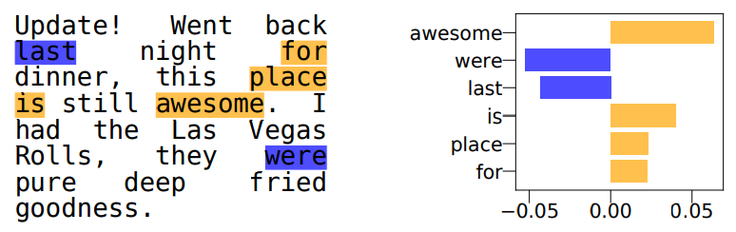
EXPLANATIONS
IMAGES
TEXT
Original image
Explanation
Source: Garreau et al.(2021)
Source: Mardaoui et al.(2020)
Source: Ribeiro et al.(2016)
Notes:
Picture can be classified as turtle or strawberry. LIME provides suitable explanations.
Husky classified as wolf: use lime for debugging.
Text: Explains predictions of classifier of yelp review.
Positive and negtive contributions highlighted.

Slide 6

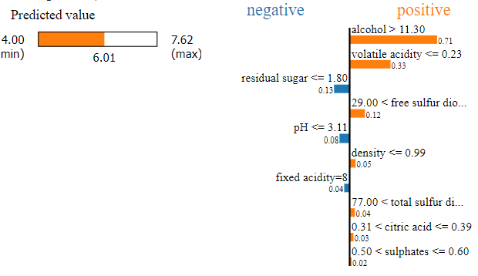
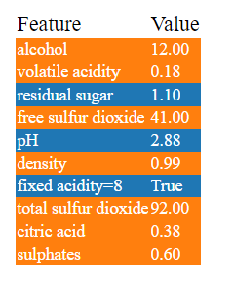
WINE EXAMPLE
DATA
Access lime package
Predict wine quality based on analysis values
(pip install lime)
from lime import lime_tabular
Train the explainer
explainer = lime_tabular.LimeTabularExplainer(training_data = np.array(X_train),
mode = "regression",
feature_names = X_train.columns,
categorical_features = [0])
Explain certain instance
exp = explainer.explain_instance(data_row = X_test.iloc[823],
predict_fn = model.predict)
exp.show_in_notebook(show_table = True)
Source: Own graph
Notes:
Prediction by ML model.
Dataset on wine consists of quality as variable to be xplained and chemical properties as explanatory variables.
Predctions quite good, LIME shows contributions of most important features on prediction to quality. Table shows actual values of each feature.
Code: Explainer is linear regression.
Highest coefficients indicate most imortant variables

Slide 7


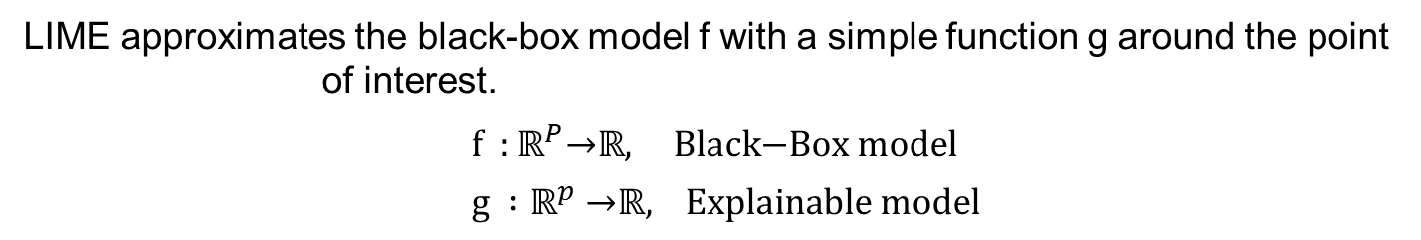
OVERVIEW
Introduced by Ribeiro et al.(2016) in
“Why Should I Trust You?” - Explaining the Predictions of Any Classifier
LIME approximates the black-box model f with a simple function g around the point of interest.
$\text{f}\text{ : }ℝ^{P}\text{→}ℝ\text{, } \text{Black}\text{−}\text{B}\text{ox} \text{model}$ $\text{g} :ℝ^{p} \text{→}ℝ\text{, } \text{Explainable} \text{model}$
f
g
Only in its neighborhood the explainable model’s predictions are guaranteed to be very close to the black-box ones.
Notes:
Black box model as complex ML functio

Slide 8
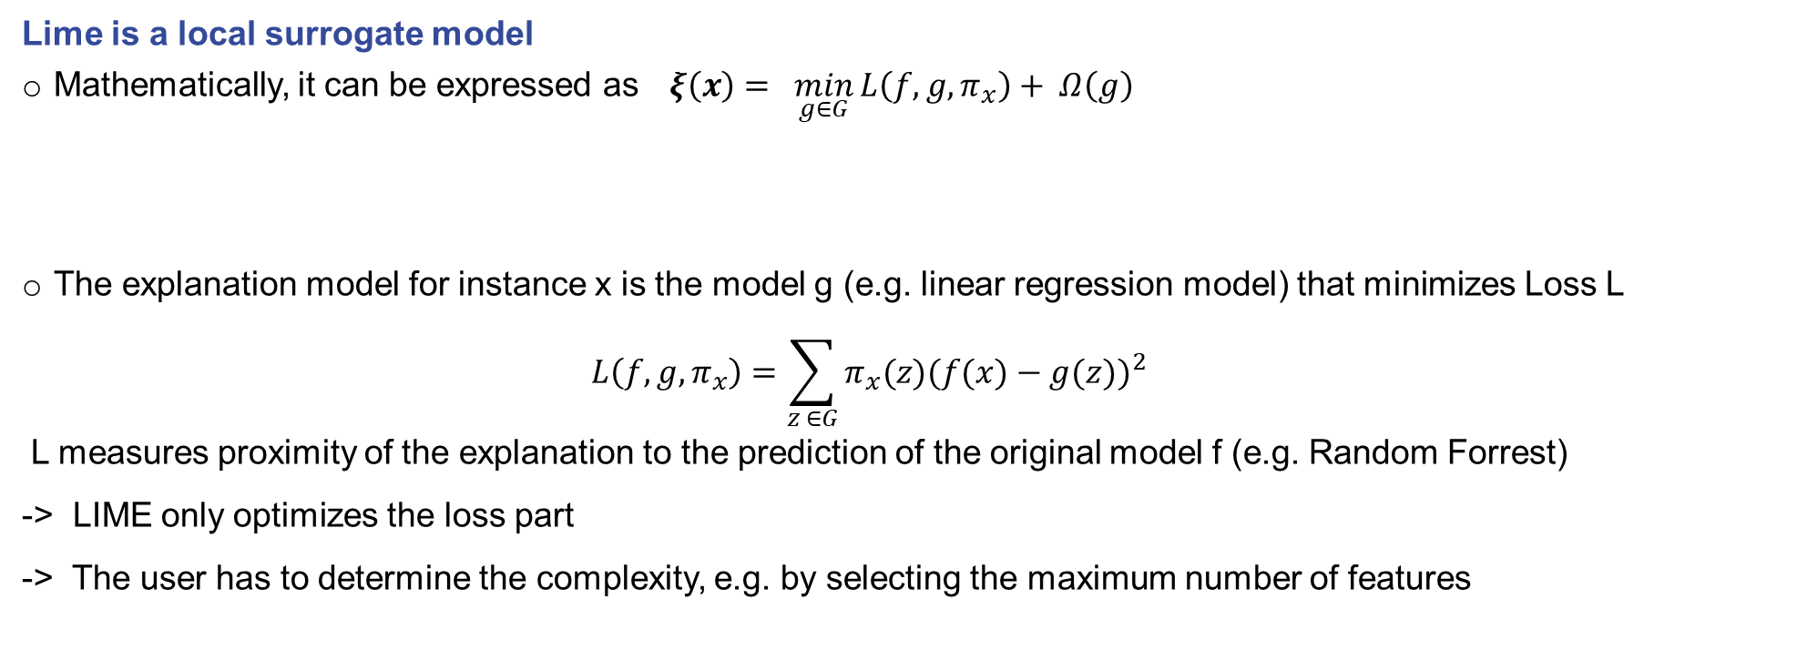

MATHEMATICAL REPRESENTATION
Lime is a local surrogate model
Mathematically, it can be expressed as $ξ\left(x\right)= \min_{g∈G}{L\left(f,g,π_{x}\right)+ Ω\left(g\right)}$
The explanation model for instance x is the model g (e.g. linear regression model) that minimizes Loss L
$$L\left(f,g,π_{x}\right)=\sum_{z ∈G}{π_{x}(z{)(f(x)−g(z))}^{2}}$$
L measures proximity of the explanation to the prediction of the original model f (e.g. Random Forrest)
-> LIME only optimizes the loss part
-> The user has to determine the complexity, e.g. by selecting the maximum number of features
x : instance of interest
L : loss function
G : class of linear models g(z) = $w_{g}∗z^{′}$
${ π}_{x}$: proximity measure
Ω(g) : model complexity
z : sample in neighborhood of x
Source: Molnar(2020)

Slide 9
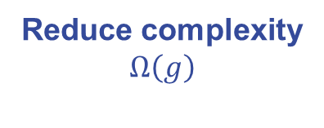
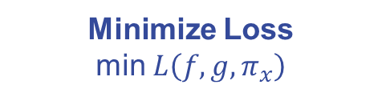
TRADE-OFF
Fidelity
Trade-off
Interpretability
Minimize Loss
min $L\left(f,g,π_{x}\right)$
Reduce complexity
$Ω\left(g\right)$
Polynomial Regression
Ridge
Linear Regression
Choose complexity of surrogate model
Notes:
Ridge: using a penalty term

Slide 10
LIME ALGORITHM

Slide 11
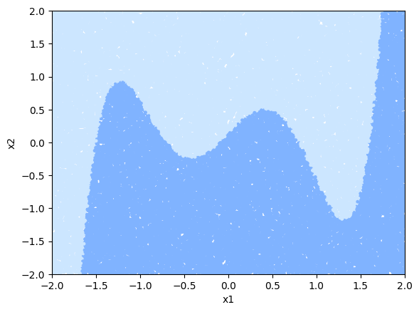
TWO-DIMENSIONAL DATASET
Create a random dataset
num_points = 50000
x1 = np.random.uniform(-2, 2, num_points)
x2 = np.random.uniform(-2, 2, num_points)
Integrate binary classification by split line
def split_line(x1, x2):
return (x1+1.5)*(x1+0.7)*(x1+0.1)* (x1-0.8)*(x1-1.6)
y = np.where(x2 < split_line(x1, x2), 0, 1)
Source: Own graph
Notes:
Wine example with to features x1 and x2, maybe level of alcohol and residal sugar, binary classified as good or bad. Classification boundary of complex model calssifies certain combinations or values either as good or bad wine.

Slide 12
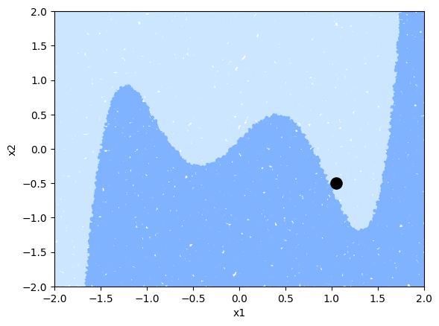
TWO-DIMENSIONAL DATASET
Instance of interest
Xi = np.array([1.05,-0.5])
Source: Own graph
Notes:
Instance of interest could be a specific wine which has to be classified. The wine has certain porperties x1 and x2.
Instance lies very close to classification boundary. Interesting because we want to know why my instance has been classified to certain group.
Then switch from global perspective with cmplex structure to local perspective with linear strucutre.

Slide 13
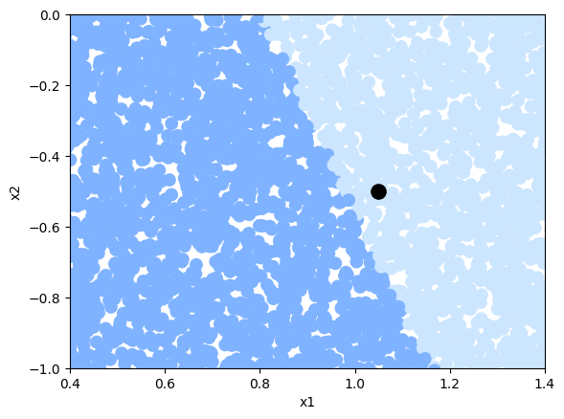
LOCAL PERSPECTIVE
Local perspective displays linear classification boundary
Source: Own graph
Notes:
A zoom shows that our complex curvy model transformed into a linear function.

Slide 14

RANOM FORREST PREDICTIONS (BLACK BOX MODEL)
Learn Black Box model on sample dataset using Random Forrest
from sklearn.ensemble import RandomForestClassifier
classifier = RandomForestClassifier(n_estimat=100)
classifier.fit(X, y)
Create a new dataset using meshgrid
def make_meshgrid(x1, x2….
return np.vstack((xx1.ravel(), xx2.ravel())).T
XX = make_meshgrid(X[:,0],X[:,1],h=.02)
Predict the new dataset with the learned model
yy = classifier.predict(XX)
Source: Own graph

Slide 15
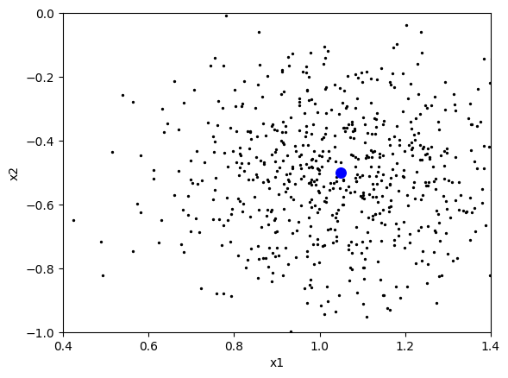
GENERATION STEP
Pertubate random gaussian distributed points around instance
X_pertub = np.random.normal(0,0.2,size=(500,X.shape[1]))
X_lime = X_pertub + np.random.normal(0, 0.001, size=X_pertub.shape)
X_lime += Xi
Source: Own graph
Notes:
LIME approach: Pertubate random gaussian distributed points around instance of interest

Slide 16
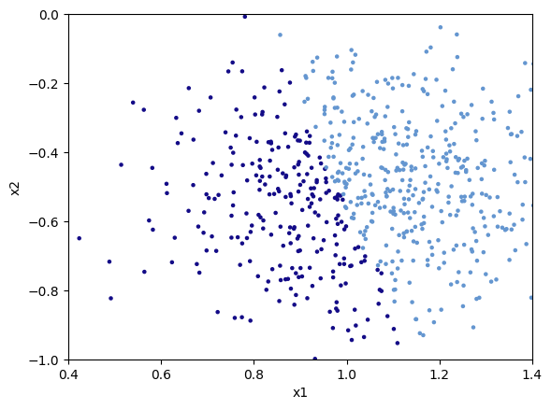
ML PREDICTIONS
1
Use trained classifier to predict classification of new data
y_lime = classifier.predict(X_lime)
Source: Own graph
Notes:
Apply trained classifier to predict classification of new data

Slide 17
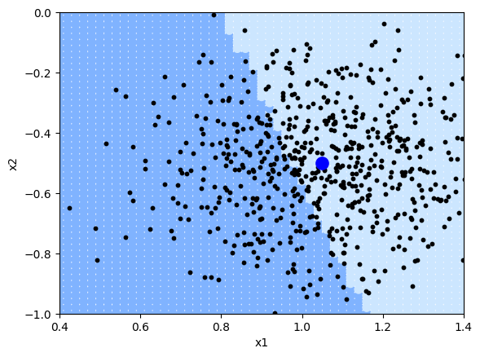
RANDOM SAMPLES AROUND INSTANCE
Instance of interest (big dot) and data sampled from a normal distribution (small dots)
Source: Own graph
Notes:
Instance of interest, sampled data and classification boundary

Slide 18
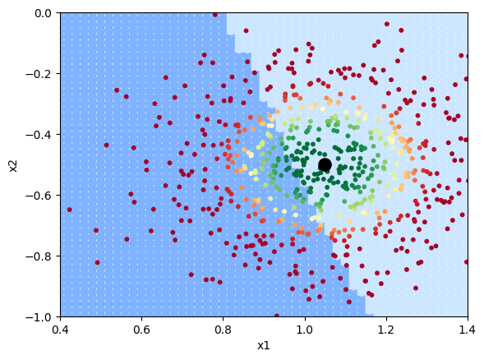
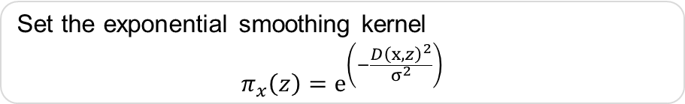
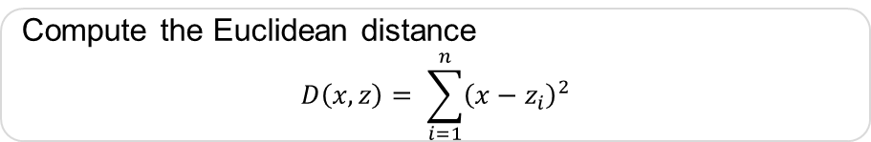
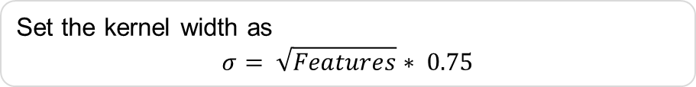
WEIGHTING
Weight pertubated data according to its distance
Set the kernel width as
$$σ= \sqrt{Features}∗ 0.75$$
kernel_width = np.sqrt(X_lime.shape[1])* 0.75
Compute the Euclidean distance
$$D\left(x,z\right)= \sum_{i=1}^{n}{{\left(x−z_{i}\right)}^{2}}$$
Distance = np.sum((Xi - X_lime)**2,axis=1)
Set the exponential smoothing kernel
$$π_{x}\left(z\right)=ⅇ^{\left(−\frac{D{\left(x,z\right)}^{2}}{σ^{2}}\right)}$$
weights = np.sqrt(np.exp(-(Distance**2)/(kernel_width**2)))
Source: Own graph
Notes:
What we have: Weighted data which has been classified: Enough information to apply regression

Slide 19
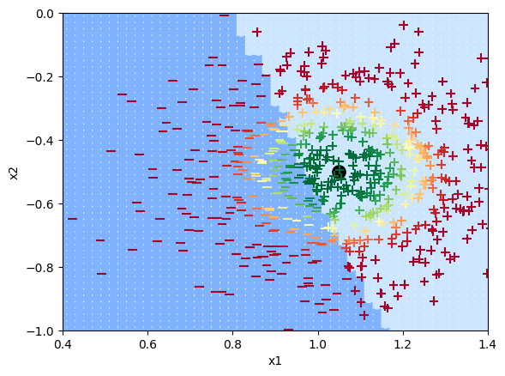
CLASSIFICATIONS OF LOCALLY TRAINED MODEL
Fit regression using weighted least squares around instance of interest
from sklearn.linear_model import LinearRegression
simpler_model = LinearRegression()
simpler_model.fit(X_lime, y_lime, sample_weight=weights)
Predict classification on locally trained model
y_linmodel = simpler_model.predict(X_lime)
Create a binary decision variable for the locally trained model
y_linmodel_binary = (y_linmodel < 0.5).astype(int)
Source: Own graph
Notes:
Application of weighted linear regression on classification

Slide 20

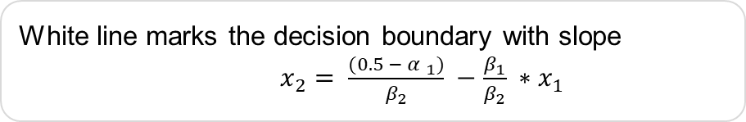
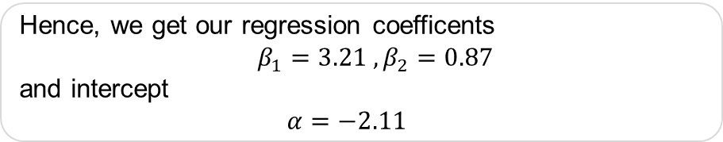
DECISION BOUNDARY
Hence, we get our regression coefficents $β_{1}=3.21 , β_{2}=0.87$
and intercept
$α=−2.11$
White line marks the decision boundary with slope
$x_{2}= \frac{{(0.5 − α }_{1})}{β_{2}} −\frac{β_{1}}{β_{2}} ∗x_{1}$
Signs of the grid show classifications of the locally learned model from the weighted samples
Notes:
Linear regression as tangent of ML model.
Local model fairly precise.
The coefficients of this estimated linear model can be used to understand how changes in the explanatoriy variables affect the classification output for the instance being explained.
The estimated coefficients suggest that increasing the values of x1 and x2 will cause the prediction to lean towards the prediction of the negative class.
Coefficients: If there is an effect on dependend var (y) a unit change in var changes the classification by (high) coefficient. -> identify the features that contributed the most to the decision. In this case x1

Slide 21
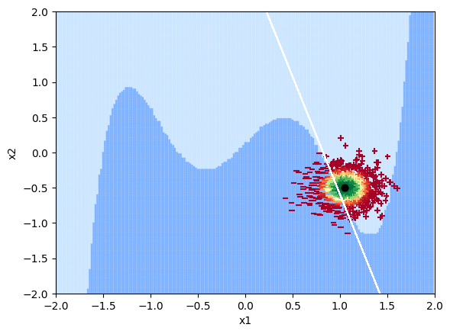
GLOBAL PERSPECTIVE
Visualization of locality
Source: Own graph
Notes:
New linear decision boundary is not globally faithful, only a proper discrimintor in the locality of the instance being explained

Slide 22
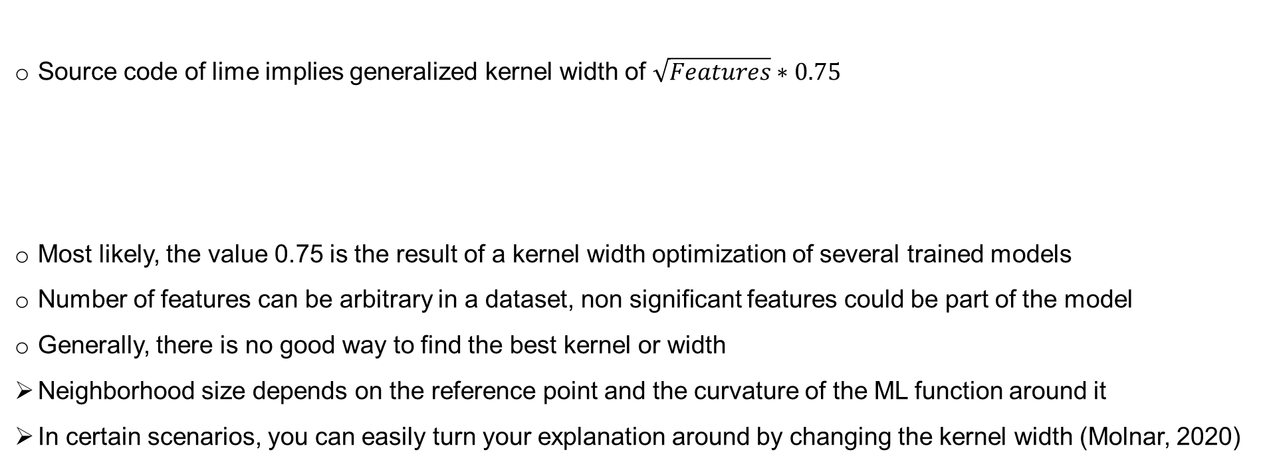
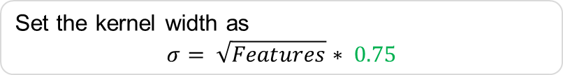
KERNEL WIDTH PROBLEM
Source code of lime implies generalized kernel width of $\sqrt{Features}∗0.75$
Most likely, the value 0.75 is the result of a kernel width optimization of several trained models
Number of features can be arbitrary in a dataset, non significant features could be part of the model
Generally, there is no good way to find the best kernel or width
Neighborhood size depends on the reference point and the curvature of the ML function around it
In certain scenarios, you can easily turn your explanation around by changing the kernel width (Molnar, 2020)
Set the kernel width as
$$σ= \sqrt{Features}∗ 0.75$$
Notes:
Highest accuracy with 0.75

Slide 23
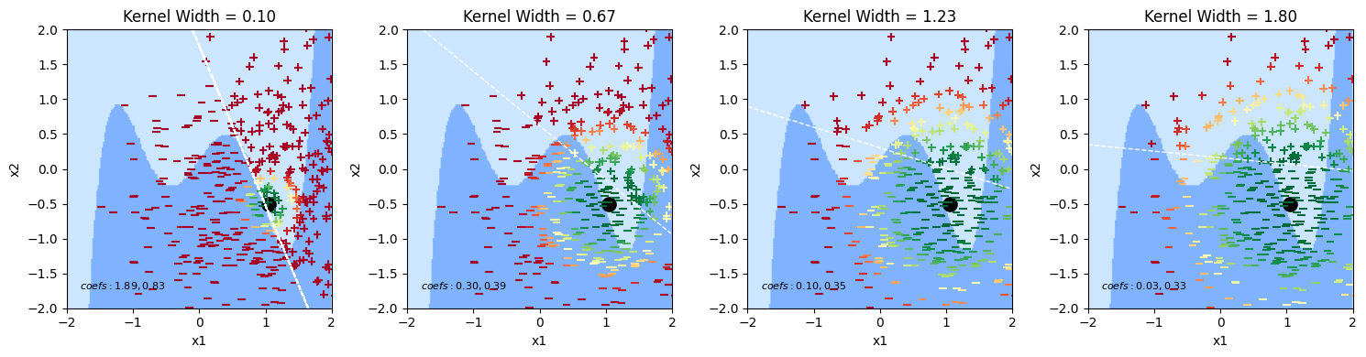
KERNEL WIDTH PROBLEM
Source: Own graph
Notes:
Increase of kernel width decreases explanatory value.
Slope from very steep to almost flat with no explanatory power.

Slide 24
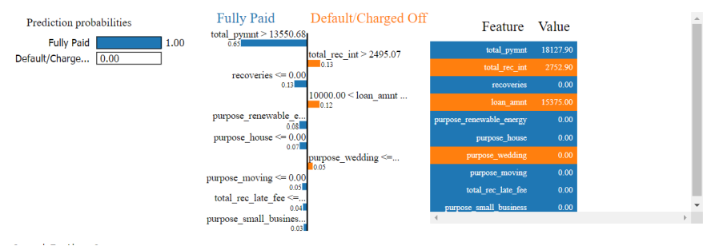
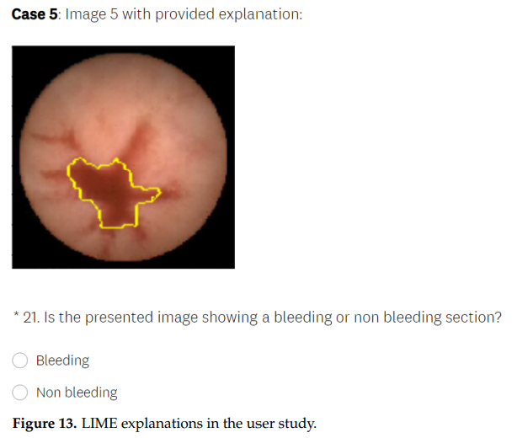
RECENT APPLICATIONS
CREDIT RISK MANAGEMENT (Misheva, 2021)
MEDICAL DIAGNOSIS (Knapič, 2021)
AI moves borrowers who would have been classified as subprime by traditional criteria to “better” loan grades
Lime provides consistent explanations that are in line with financial logic
20 most important features remained stable even in view of changing test sizes
LIME explanation support shows that participants performed slightly better in the test phase with the explanations provided
Users answered more questions correctly with explanation support by LIME (difference not stat. significant (p = 0.738))
Notes:
Credit:
No default: ML predicts credit will be fully paid back.
E.g. Total payment of 18127 larger than decision boundary of 13550 and so on.
Diagnosis:
Participants get pictures with and without explanations and have to classify the wound as bleeding and non bleeding.

Slide 25

DISCUSSION
Disadvantages
Determination problem of neighborhood width is still unsolved
User has to experiment with different kernel settings
Random distribution of samples generates a new data set each run
Different executions may lead to different explanations
Confidence issues with explanations
Advantages
Easy to operate
LIME explanations are brief and potentially contrastive (Molnar, 2020)
Human-friendly interpretability
Useful for time-sensitive real-world applications
Only method that works for tabular, text and image data
Especially LIME for images gained special interest
Conclusion: Powerful tool, room for continuous research

Slide 26
REFERENCES
Knapič, S., Malhi, A., Saluja, R., & Främling, K. (2021). Explainable artificial intelligence for human decision support system in the medical domain. Machine Learning and Knowledge Extraction, 3(3), 740-770.
Garreau, D., & Luxburg, U. (2020, June). Explaining the explainer: A first theoretical analysis of LIME. In International conference on artificial intelligence and statistics (pp. 1287-1296). PMLR.
Molnar, C. (2020). Interpretable machine learning. Lulu. com.
Misheva, B. H., Osterrieder, J., Hirsa, A., Kulkarni, O., & Lin, S. F. (2021). Explainable AI in credit risk management. arXiv preprint arXiv:2103.00949.
Nieto Juscafresa, A. (2022). An introduction to explainable artificial intelligence with LIME and SHAP.
Ribeiro, M. T., Singh, S., & Guestrin, C. (2016, August). " Why should i trust you?" Explaining the predictions of any classifier. In Proceedings of the 22nd ACM SIGKDD international conference on knowledge discovery and data mining (pp. 1135-1144).
Visani, G., Bagli, E., & Chesani, F. (2020). OptiLIME: Optimized LIME explanations for diagnostic computer algorithms
Visani, G., Bagli, E., Chesani, F., Poluzzi, A., & Capuzzo, D. (2022). Statistical stability indices for LIME: Obtaining reliable explanations for machine learning models. Journal of the Operational Research Society, 73(1), 91-101.

Slide 27


REPLICATE RESULTS
Wine Dataset Notebook
LIME Algorithm Notebook

Slide 28
Q&A

