Slide 1
Gaming Behaviour Analysis and Prediction
Are machine learning models able to predict player engagement?
Zabala Ormazabal, Jokin - 28/07/2024

Slide 2
Introduction
Overview of the project
Importance of predicting gaming behavior
Objective: To predict player engagement levels using machine learning

Slide 3
Business Description
Overview of the gaming industry
Significance of understanding player engagement
Impact on game design, marketing, and player retention

Slide 4
Hypothesis and Goal
Hypothesis: Can Machine learning models,accurately predict player engagement levels
General goal: Develop models to classify engagement as 'Low', 'Medium', or 'High'
Success criteria: Model accuracy and reliability

Slide 5
Dataset Description
Source: Kaggle
Key features: PlayerID, Age, Gender, Location, GameGenre, PlayTimeHours and Engagement Level.
Dataset size: 40,034 records, 13 features

Slide 6
Technologies Used
Programming language: Python
Libraries: Pandas, Seaborn, Matplotlib, Scikit-Learn
Tools: Jupyter Notebook, GridSearchCV for hyperparameter tuning

Slide 7
Data Preparation
Data cleaning: Handling missing values and incorrect formats
Encoding categorical features using LabelEncoder
Standardizing numerical features using StandardScaler
Visualization of feature distributions

Slide 8
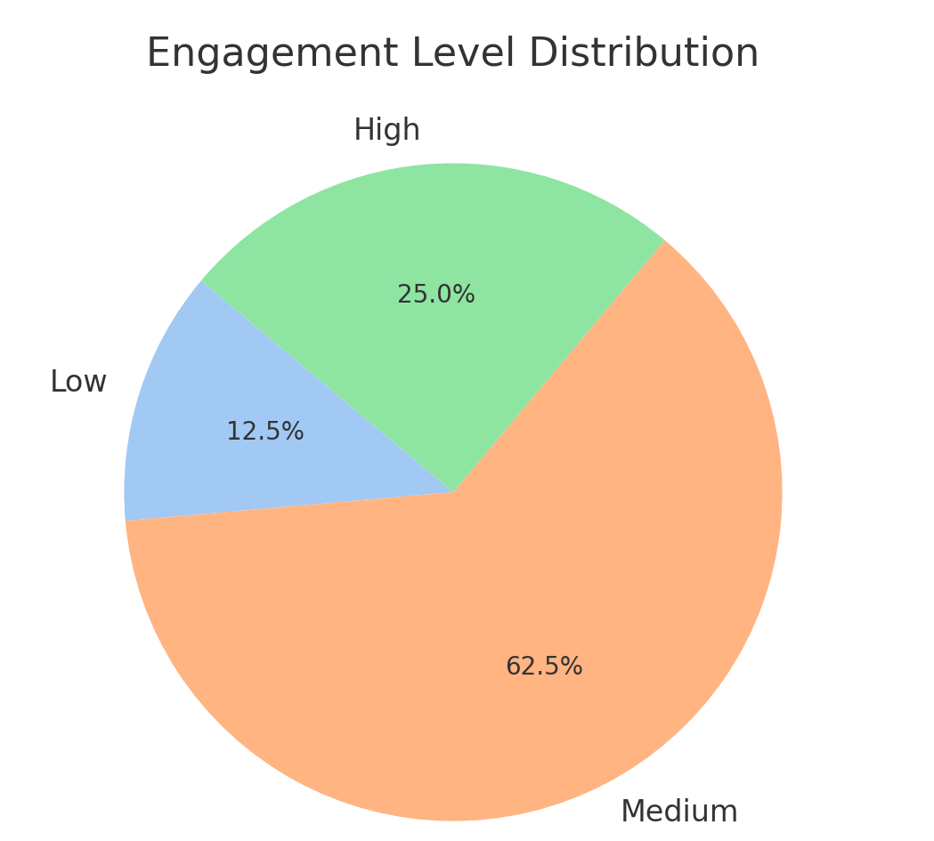
Engagement Level Distribution

Slide 9
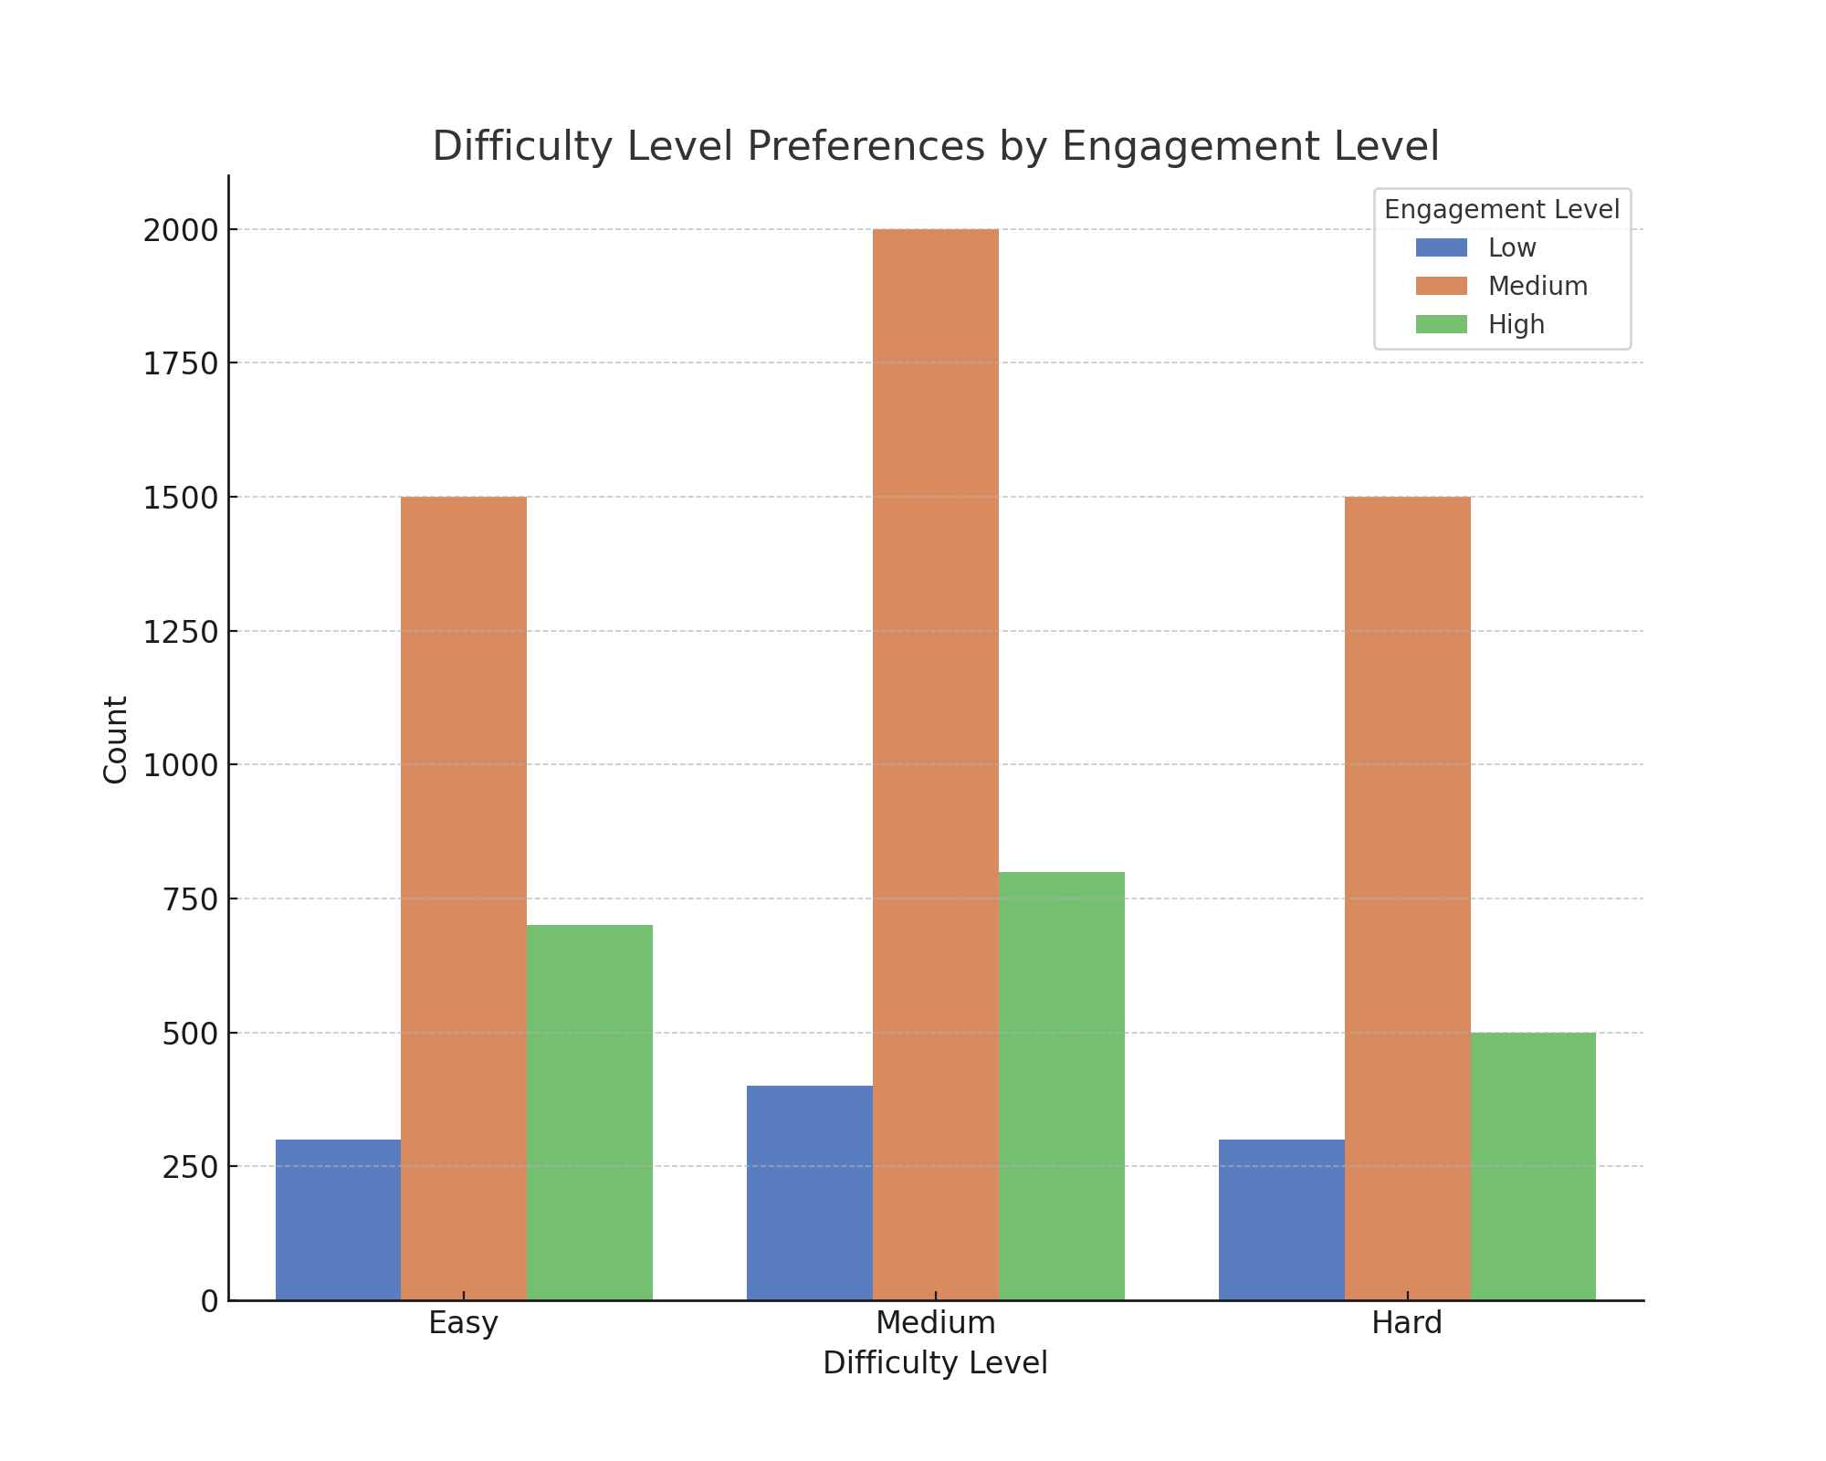
Difficulty Level Preferences by Engagement Level

Slide 10
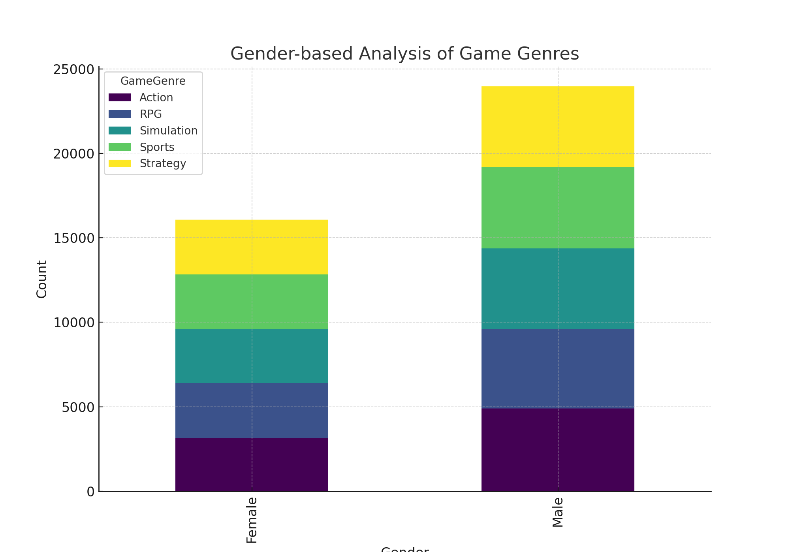
Gender-based Analysis of Game Genres

Slide 11
Machine Learning Models
Logistic Regression
Random Forest
Support Vector Machine (SVM)

Slide 12
Model Training and Evaluation
Training process: Splitting data into training and testing sets
Cross-validation and hyperparameter tuning
Evaluation metrics: Precision, recall, F1-score

Slide 13
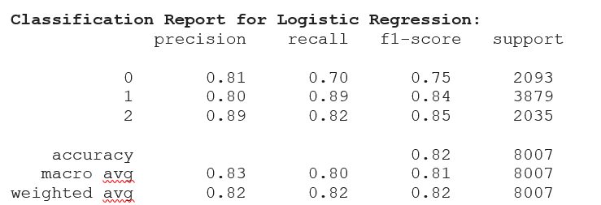
Results - Logistic Regression

Slide 14
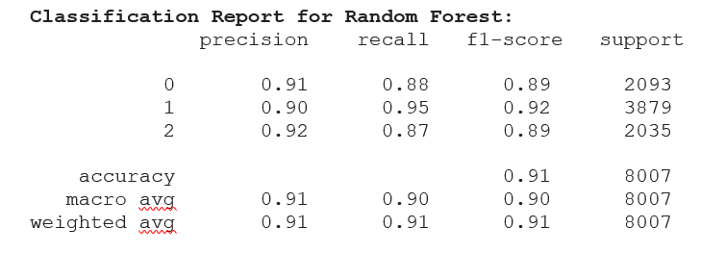
Results - Random Forest

Slide 15
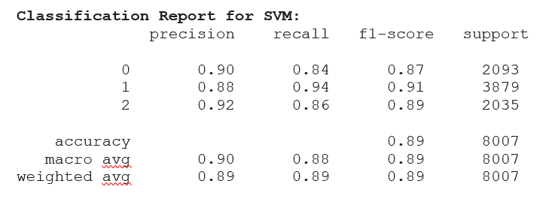
Results - SVM

Slide 16
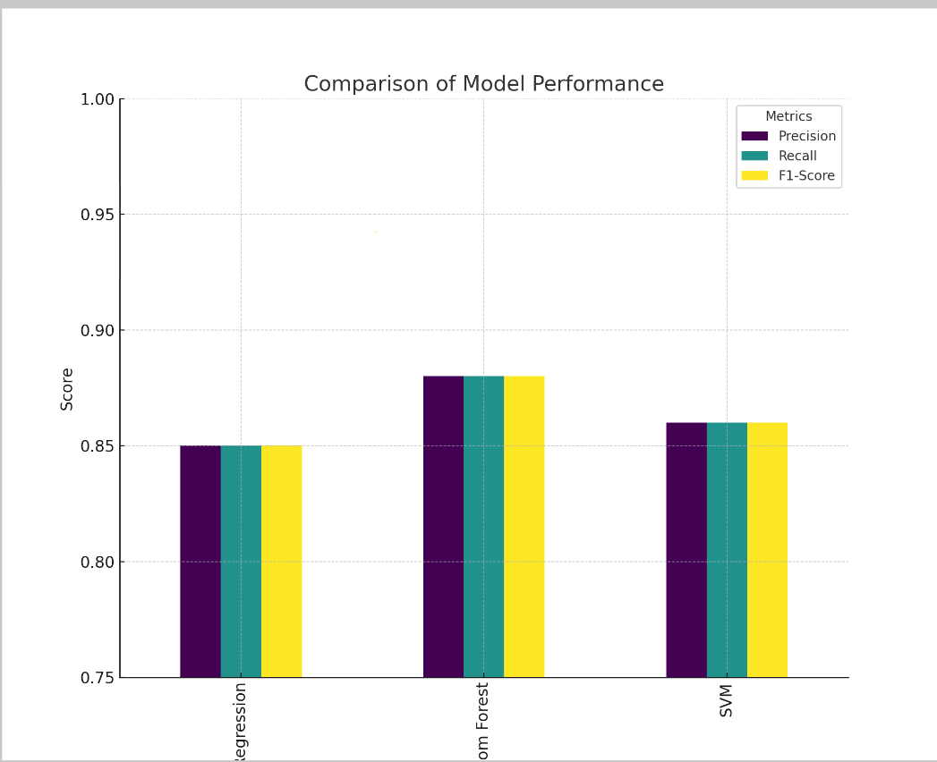
Comparison of Model Performance

Slide 17
Challenges Encountered
Data cleaning and preprocessing
Encoding categorical data
Hyperparameter tuning
Ensuring models generalize well to new data

Slide 18
Strategies to Overcome Challenges
Techniques use for data cleaning
Use of LabelEncoder and StandardScaler
GridSearchCV for hyperparameter tuning
Cross-validation for better generalization

Slide 19
Conclusion
Summary of key findings
Random Forest outperformed Logistic Regression and SVM
Implications for game developers and marketers
Future work: Improving model accuracy and exploring more features

