Slide 1

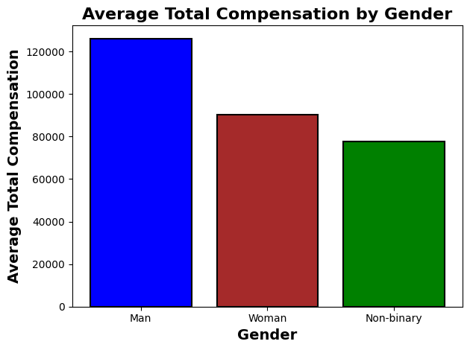
Data Exploration & Preparation
L7_CA_1_Salary_Survey
Sean Whelan
L7 Dip. in Data Analytics - Sept 2025 cohort Stage 1 Sem 1
Introduction
Results
Conclusions
This continuous assessment examines a salary survey dataset with 28,178 responses and 23 variables related to employee compensation and demographics. The objective is to identify and carry out an exploratory analysis and preparation for Machine Learning of a Salary Dataset. This task includes identifying and removing outliers, handling missing data, addressing duplicate records and selecting relevant features. This analysis reveals significant relationships between compensation and factors such as gender, education, and professional experience.
Compensation Analysis by Demographics: Exploratory analysis revealed significant compensation disparities across demographic groups. Gender analysis showed men earning an average total compensation of $125,903 compared to women's $90,251, representing a 28% pay gap ($35,652 difference). Non-binary respondents averaged $77,705.
Education and Experience Impact: Higher levels of Education strongly correlated with compensation, with professional degree holders (MD, JD) earning $147,041 compared to $86,504 for high school education. Experience analysis demonstrated clear career progression, with compensation nearly doubling from entry-level ($68,817) to 21-30 years experience ($114,227)
This project successfully cleaned and prepared a salary survey dataset for machine learning analysis. The original dataset contained 28,178 responses with significant data quality issues including missing values, outliers, and formatting inconsistencies. Through exploratory data analysis, these issues were addressed.
The final cleaned dataset contains approximately 26,700 records across 13 features, providing a solid foundation for building machine learning prediction models. The features retained all showed meaningful relationships with compensation and are appropriate for use in salary prediction. This prepared dataset is now ready for the next phase of machine learning model development and testing.
A substantial gender pay gap was identified, with men earning an average of $125,903 compared to women's $90,251.
Education level showed a strong correlation with compensation, with professional degree holders earning roughly $60,000 more than those with only high school education ($147,041 compared to $86,504).
Experience also demonstrated a clear impact, with total compensation nearly doubling from entry-level positions ($68,773) to those with 20+ years of experience ($114,024).
Methods
Initial exploration using df.info() and df.describe() revealed that numeric variables (salary, age, experience) were incorrectly stored as object types. Salary values contained comma formatting (e.g., "55,000") requiring string manipulation and type conversion using str.replace() and pd.to numeric(). Age and experience variables were intentionally categorical ranges (e.g., "25-34", "11-20 years"), appropriate for the survey format. The duplicated() method identified 92 rows that were completely empty across all fields. Investigation confirmed these were identical blank submissions rather than legitimate responses. These were removed using drop duplicates(). Salary distribution analysis using pd.cut() with defined bins revealed extreme outliers such as minimum $0 and maximum $6 billion. Binned distribution showed 95% of responses fell between $20,000-$200,000. Salaries outside the $20,000-$500,000 range were filtered as data errors, resulting in the removal of 533 records. Missing values in key demographic variables (industry: 69, education: 200, gender: 166) represented less than 2% of data. Rows with missing values in these essential features were removed using dropna(subset=['industry', 'education', 'gender']) as these variables are critical for compensation analysis.
Figure 1: Average total compensation by gender reveals a significant pay gap, with men earning $125,903 compared to women's $90,251 (28% difference).
References
Weiss, N.A. (2017) ‘Introduction to Statistics’, in Introductory Statistics. 10th edn. British Library Cataloguing-in-Publication Data.
Pandas development team (2024) pandas documentation. Available at: https://pandas.pydata.org/docs/ (Accessed: 10 November 2024).
Data Science With Python | Python for Data Science | Python Data Science Tutorial Data Science With Python | Python for Data Science | Python Data Science Tutorial | Simplilearn
Our Dedication.Your Journey.
www.cct.ie

