Slide 1
Agenda
Traditional Automation
Test Driven Development
Behavior Driven Development
Gherkin fundamentals
Gherkin Keywords
Feature File
Step Definition
BDD Execution Report
Key benefits of BDD

Slide 2
Traditional Automation
Project
Requirement
QA
DEV
Test Case
CODE
Support Code
Automation Library
System

Slide 3
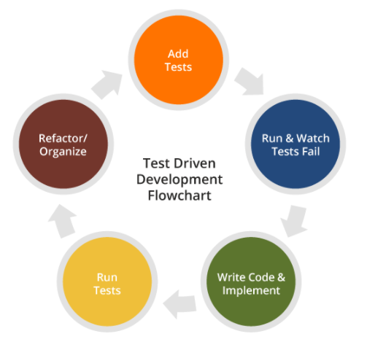
Test Driven Development (TDD)

Slide 4
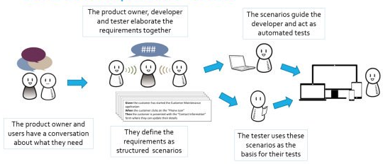
Behavior Driven Development (BDD)

Slide 5



Roles Before and After BDD
QA / SDET
DEV
BA
SDET
1
2
5
6
Before
Write Stories in Rally
Test Cases in ALM
Write Test Automation
Write App code
3
Write Test Data in XML, JSON format or DB
7
Trigger Test Cases
8
Can review Test Results in a report
1
2
5
Write Stories in Rally
Feature files in ALM GitHub
After
Define Steps in Feature file (Automation)
Follow “Given” “When” “Then” format
Follow “Given” “When” “Then” format
Post Deployment
Pre Deployment
6
Write App code in line with flow in feature file
3
Write Test Data in XML, JSON format or DB GitHub
Embedded in Feature files
Run Feature files
7
Post Deployment
Pre Deployment
4
Everyone (including Developers & BA) can review Feature Files
8
Everyone (including Developers & BA) can review Test Results in a report

Slide 6
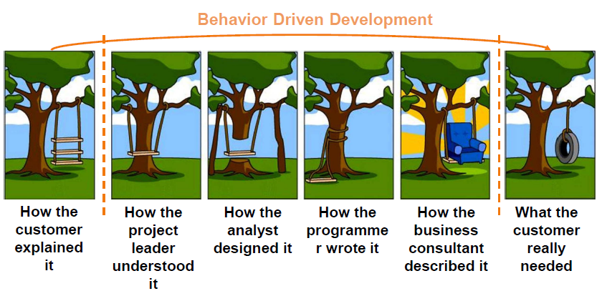
Behavior Driven Development (BDD)

Slide 7
Behavior Driven Development (BDD)
B-Behavior, the desired behavior of the software to be developed.
D–Driven, the project is oriented around and aligned with the desired behavior
D–Development, software is mapped directly to the declaration of behavior, supported by automated tooling.
In short, BDD is an approach for building a shared understanding regarding what software should be built by working through specific examples.

Slide 8
Principles
Business Traceability - All development work can be traced back directly to business objectives.
Needs Focused - Software development meets user needs and ultimately supports current and future business objectives.
Efficient Prioritization - Business critical features are delivered first.
Shared Understanding - All parties (business and technical) have a shared understanding of the project and thorough visibility into the project’s progression.

Slide 9
BDD Structure
Title: The story should have a clear, explicit title.
Narrative: A short, introductory section that specifies three things…
•what business value the stakeholder will derive from this effect
•who(which business or project role) is the driver or primary stakeholder of the story (the actor who derives business benefit from the story)
•what effect the stakeholder wants the story to have
Acceptance criteria or scenarios: a description of each specific case of the narrative. Such a scenario has the following structure…
•specify the initial condition that is assumed to be true at the beginning of the scenario. This may consist of a single clause, or several
•state which event trigger initiates the scenario
•state the expected outcome, in one or more clauses

Slide 10
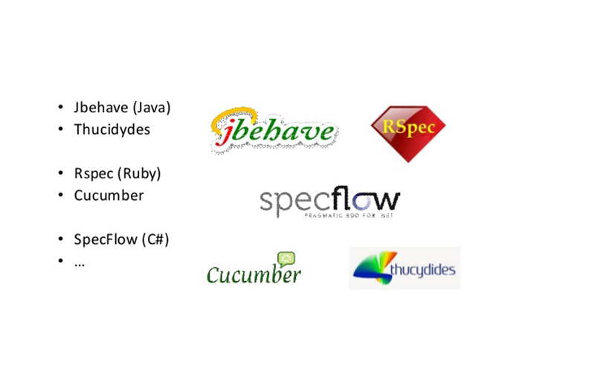
BDD Tools

Slide 11

Cucumber and Gherkin fundamentals
Cucumber is a testing tool that supports BDD framework.
It defines application behavior using simple English text, defined by a language called Gherkin.
Gherkin Language is easily readable and understood by Clients, Product Owners, Business analysts, Developers, Testers and Everyone in the team.

Slide 12
Feature File
@EndToEnd
Feature: Login to the system
As a user I want to login into the system with my username and password.
#Positive Scenario
@SmokeTest @Regression
Scenario: Verify that user can login to the system
Given I Launch "https://www.abcd.co.in/login" page
When I fill in the username with "abcd19789@abcd.com"
And I fill in the password with "abcd19789@123"
And I click on signin button
Then I am on the Home page
#Negative Scenario
@Regression
Scenario: Verify that user can not login to the system with invalid credentials
Given I Launch "https://www.abcd.co.in/login" page
When I fill in the username with "abcd19789@abcd.com"
And I fill in the invalid password with "invalid@123"
And I click on signin button
But I should not be allowed to login

Slide 13
Gherkin Keywords
Keywords in Gherkin Language
Feature:
Background:
Scenario:
Given:
When:
Then:
And:
But:
Scenario Outline:
Examples:

Slide 14
Gherkin Keywords
Keywords in Gherkin Language
Feature: Describes the overall feature or user story.
Background:
Scenario:
Given:
When:
Then:
And:
But:
Scenario Outline:
Examples:

Slide 15
Gherkin Keywords
Keywords in Gherkin Language
Feature: Describes the overall feature or user story.
Background: Runs before each scenario. Has the prerequisite steps. (Optional)
Scenario:
Given:
When:
Then:
And:
But:
Scenario Outline:
Examples:

Slide 16
Gherkin Keywords
Keywords in Gherkin Language
Feature: Describes the overall feature or user story.
Background: Runs before each scenario. Has the prerequisite steps. (Optional)
Scenario: Describes the specific scenario of the feature or user story.
Given:
When:
Then:
And:
But:
Scenario Outline:
Examples:

Slide 17
Gherkin Keywords
Keywords in Gherkin Language
Feature: Describes the overall feature or user story.
Background: Runs before each scenario. Has the prerequisite steps. (Optional)
Scenario: Describes the specific scenario of the feature or user story.
Given: Starting point of the test step.
When:
Then:
And:
But:
Scenario Outline:
Examples:

Slide 18
Gherkin Keywords
Keywords in Gherkin Language
Feature: Describes the overall feature or user story.
Background: Runs before each scenario. Has the prerequisite steps. (Optional)
Scenario: Describes the specific scenario of the feature or user story.
Given: Starting point of the test step.
When: Specific condition or action that determines the scenario.
Then:
And:
But:
Scenario Outline:
Examples:

Slide 19
Gherkin Keywords
Keywords in Gherkin Language
Feature: Describes the overall feature or user story.
Background: Runs before each scenario. Has the prerequisite steps. (Optional)
Scenario: Describes the specific scenario of the feature or user story.
Given: Starting point of the test step.
When: Specific condition or action that determines the scenario.
Then: Expected outcome of the scenario (Assertions).
And:
But:
Scenario Outline:
Examples:

Slide 20
Gherkin Keywords
Keywords in Gherkin Language
Feature: Describes the overall feature or user story.
Background: Runs before each scenario. Has the prerequisite steps. (Optional)
Scenario: Describes the specific scenario of the feature or user story.
Given: Starting point of the test step.
When: Specific condition or action that determines the scenario.
Then: Expected outcome of the scenario (Assertions).
And: Should be used in contrast to When or Then.
But:
Scenario Outline:
Examples:

Slide 21
Gherkin Keywords
Keywords in Gherkin Language
Feature: Describes the overall feature or user story.
Background: Runs before each scenario. Has the prerequisite steps. (Optional)
Scenario: Describes the specific scenario of the feature or user story.
Given: Starting point of the test step.
When: Specific condition or action that determines the scenario.
Then: Expected outcome of the scenario (Assertions).
And: Should be used in contrast to When or Then.
But: Should be used to define negative conditions.
Scenario Outline:
Examples:

Slide 22
Gherkin Keywords
Keywords in Gherkin Language
Feature: Describes the overall feature or user story.
Background: Runs before each scenario. Has the prerequisite steps. (Optional)
Scenario: Describes the specific scenario of the feature or user story.
Given: Starting point of the test step.
When: Specific condition or action that determines the scenario.
Then: Expected outcome of the scenario (Assertions).
And: Should be used in contrast to When or Then.
But: Should be used to define negative conditions.
Scenario Outline: Describes the specific scenario of the feature or user story and Iterated with multiple data.
Examples:

Slide 23
Gherkin Keywords
Keywords in Gherkin Language
Feature: Describes the overall feature or user story.
Background: Runs before each scenario. Has the prerequisite steps. (Optional)
Scenario: Describes the specific scenario of the feature or user story.
Given: Starting point of the test step.
When: Specific condition or action that determines the scenario.
Then: Expected outcome of the scenario (Assertions).
And: Should be used in contrast to When or Then.
But: Should be used to define negative conditions.
Scenario Outline: Describes the specific scenario of the feature or user story and Iterated with multiple data.
Examples: List of data provided to the Scenario Outline. (Helps in Data Driven)

Slide 24
Gherkin Keywords
Keywords in Gherkin Language
Feature: Describes the overall feature or user story.
Background: Runs before each scenario. Has the prerequisite steps. (Optional)
Scenario: Describes the specific scenario of the feature or user story.
Given: Starting point of the test step.
When: Specific condition or action that determines the scenario.
Then: Expected outcome of the scenario (Assertions).
And: Should be used in contrast to When or Then.
But: Should be used to define negative conditions.
Scenario Outline: Describes the specific scenario of the feature or user story and Iterated with multiple data.
Examples: List of data provided to the Scenario Outline. (Helps in Data Driven)
* Specical Keyword with no specific reason.

Slide 25
Feature File
Feature: Login to the system
As a user I want to login into the system with my username and password.

Slide 26
Feature File
Feature: Login to the system
As a user I want to login into the system with my username and password.
Scenario: Verify that user can login to the system
Given I Launch "https://www.abcd.co.in/login" page
When I fill in the username with "abcd19789@abcd.com"
And I fill in the password with "abcd19789@123"
And I click on signin button
Then I am on the Home page

Slide 27
Feature File
Feature: Login to the system
As a user I want to login into the system with my username and password.
Scenario: Verify that user can login to the system
Given I Launch "https://www.abcd.co.in/login" page
When I fill in the username with "abcd19789@abcd.com"
And I fill in the password with "abcd19789@123"
And I click on signin button
Then I am on the Home page
Scenario: Verify that user can not login to the system with invalid credentials
Given I Launch "https://www.abcd.co.in/login" page
When I fill in the username with "abcd19789@abcd.com"
And I fill in the invalid password with "invalid@123"
And I click on signin button
But I should not be allowed to login

Slide 28
Feature File
Feature: Login to the system
As a user I want to login into the system with my username and password.
#Positive Scenario
Scenario: Verify that user can login to the system
Given I Launch "https://www.abcd.co.in/login" page
When I fill in the username with "abcd19789@abcd.com"
And I fill in the password with "abcd19789@123"
And I click on signin button
Then I am on the Home page
#Negative Scenario
Scenario: Verify that user can not login to the system with invalid credentials
Given I Launch "https://www.abcd.co.in/login" page
When I fill in the username with "abcd19789@abcd.com"
And I fill in the invalid password with "invalid@123"
And I click on signin button
But I should not be allowed to login

Slide 29
Feature File - Background
Feature: Login to the system
As a user I want to login into the system with my username and password.
Background:
Given I am on login "https://www.abcd.co.in/login" page
#Positive Scenario
Scenario: Verify that user can login to the system
When I fill in the username with "abcd19789@abcd.com"
And I fill in the password with "abcd19789@123"
And I click on signin button
Then I am on the Home page
#Negative Scenario
Scenario: Verify that user can not login to the system with invalid credentials
When I fill in the username with "abcd19789@abcd.com"
And I fill in the invalid password with "invalid@123"
And I click on signin button
But I should not be allowed to login

Slide 30
Data Driven in BDD
Feature: Login to the system
As a user I want to login into the system when I provide my username and password.
#Positive Scenario
Scenario Outline: Verify that user can login to the system
Given I Launch "https://www.abcd.co.in/login" page
When I fill in the username with “< username >”
And I fill in the “<password >” with password
And I click on Signin button
Then I am on the Home page with “<role>” access privileges
Examples:
|username |password |role |
|amin_abcd@abcd.com |admin@abcd123 |admin |
|user_abcd@abcd.com |user@abcd123 |user |

Slide 31
Test Data in BDD
Feature: Login to the system
As a user I want to login into the system with my username and password.
#Positive Scenario
Scenario: Verify that user can login to the system
Given I Launch "https://www.abcd.co.in/login" page
When I fill in the username with "abcd19789@abcd.com"
And I fill in the password with "abcd19789@123"
And I click on signin button
Then I am on the Home page

Slide 32
Test Data in BDD
Feature: Login to the system
As a user I want to login into the system with my username and password.
#Positive Scenario
Scenario: Verify that user can login to the system
Given I Launch page
|URL| "https://www.abcd.co.in/login" |
When I fill in the username with valid Username
|Username| abcd19789@abcd.com|
And I fill in the password with valid password
|Password|"abcd19789@123“|
And I click on signin button
Then I am on the Home page

Slide 33
Test Data in BDD – Three ways
Feature: Login to the system
As a user I want to login into the system with my username and password.
#Positive Scenario
Scenario: Verify that user can login to the system
Given I Launch "https://www.abcd.co.in/login" page --------- As a value
When I fill in the username with valid Username --------- As DataTable
|Username| abcd19789@abcd.com|
And I fill in the password with valid <password> ---------- As Example Variables
And I click on signin button
Then I am on the Home page
Examples:
|password |
|admin@abcd123 |
|user@abcd123 |

Slide 34
Feature File Clarity
Feature: Creating a new policy Quote as an Agent with …… …… ……..
Background:
Given I have login to the policy center as a valid agent Or I am an Agent and I have successfully logged in to the Policy Center
And …………….
And ……………..
Scenario: Verify that user can login to the system
When I create a new customer in the new customer creation page
|William |Smith| 25 Cross St |64457 | California| Htjvlo23 |
And I select the Auto Policy in the Business classification page
And I provide the class code
|23423|
.
.

Slide 35
Test Data in BDD - Incorrect
Feature: Login to the system
As a user I want to login into the system when I provide my username and password.
#Positive Scenario
Scenario Outline: Verify that user can login to the system
Given I Launch "https://www.abcd.co.in/login" page
When I fill in the username with “< username >”
And I fill in the “<password >” with password
And I click on Signin button
Then I am on the Home page with “<role>” access privileges
And My profile name <ProfileName> is displayed
And My gender <gender> is displayed
Examples:
|username |password |role | ProfileName| gender|
|amin_abcd@abcd.com |admin@abcd123 |admin | MyAmAdmin| Male|

Slide 36
Test Data in BDD - correct
Feature: Login to the system
As a user I want to login into the system when I provide my username and password.
#Positive Scenario
Scenario: Verify that user can login to the system
Given I Launch "https://www.abcd.co.in/login" page
When I fill in the username with valid username
|username | amin_abcd@abcd.com |
And I fill in the with valid password
|password | admin@abcd123 |
And I click on Signin button
Then I am on the Home page with the access privileges
|role | admin |
And My profile name is displayed
| ProfileName| MyAmAdmin|
And My gender is displayed
| gender| Male|

Slide 37
Feature File
@EndToEnd
Feature: Login to the system
As a user I want to login into the system with my username and password.
#Positive Scenario
@SmokeTest @Regression
Scenario: Verify that user can login to the system
Given I Launch "https://www.abcd.co.in/login" page
When I fill in the username with "abcd19789@abcd.com"
And I fill in the password with "abcd19789@123"
And I click on signin button
Then I am on the Home page
#Negative Scenario
@Regression
Scenario: Verify that user can not login to the system with invalid credentials
Given I Launch "https://www.abcd.co.in/login" page
When I fill in the username with "abcd19789@abcd.com"
And I fill in the invalid password with "invalid@123"
And I click on signin button
But I should not be allowed to login

Slide 38
Feature File
@EndToEnd
Feature: Login to the system
As a user I want to login into the system with my username and password.
#Positive Scenario
@SmokeTest @Regression
Scenario: Verify that user can login to the system
Given I Launch "https://www.abcd.co.in/login" page
When I fill in the username with "abcd19789@abcd.com"
And I fill in the password with "abcd19789@123"
And I click on signin button
Then I am on the Home page
#Negative Scenario
@Regression
Scenario: Verify that user can not login to the system with invalid credentials
Given I Launch "https://www.abcd.co.in/login" page
When I fill in the username with "abcd19789@abcd.com"
And I fill in the invalid password with "invalid@123"
And I click on signin button
But I should not be allowed to login

Slide 39
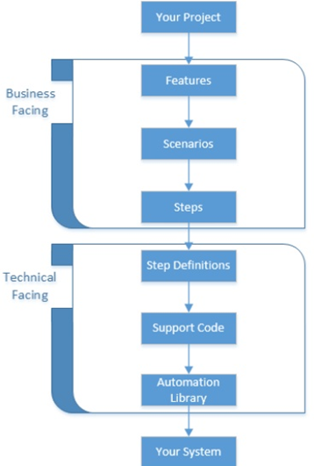
Behavior Driven Development Flow

Slide 40
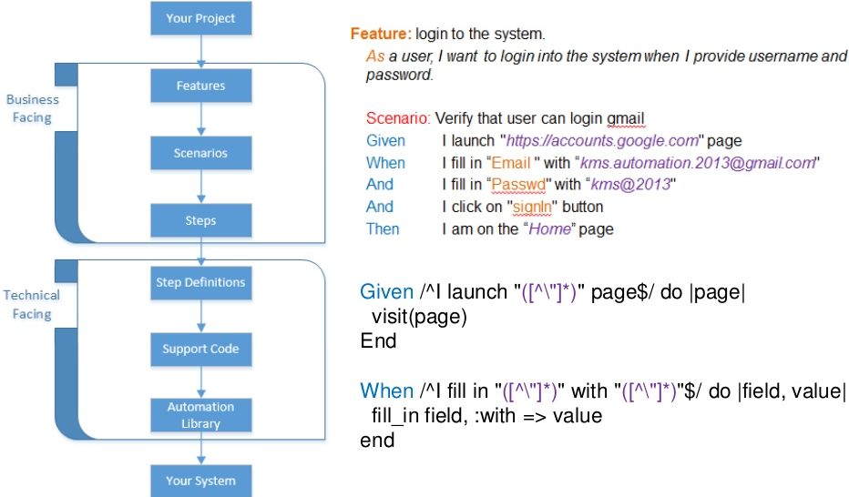
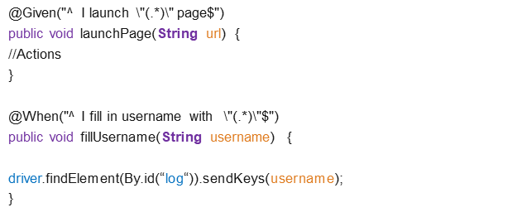

Behavior Driven Development Flow
Feature: Login to the system As a user I want to login into the system with my username and password.
#Positive Scenario
Scenario: Verify that user can login to the system
Given I Launch "https://www.abcd.co.in/login" page
When I fill in the username with "abcd19789@abcd.com"
And I fill in the password with "abcd19789@123"
And I click on signin button
Then I am on the Home page
@Given("^ I Launch \"(.*)\" page$")
public void launchPage(String url) {
//Actions
}
@When("^ I fill in username with \"(.*)\"$")
public void fillUsername(String username) {
driver.findElement(By.id(“log“)).sendKeys(username);
}

Slide 41
Step Definition in BDD
Feature Files
Step Definitions
Glue Code / Runner
Hooks

Slide 42
Feature File
@EndToEnd
Feature: Login to the system
As a user I want to login into the system with my username and password.
#Positive Scenario
@SmokeTest @Regression
Scenario: Verify that user can login to the system
Given I Launch "https://www.abcd.co.in/login" page ------------------- Method()
When I fill in the username with abcd19789@abcd.com ------------------- Method()
And I fill in the password with "abcd19789@123“ ------------------- Method()
And I click on signin button ------------------- Method()
Then I am on the Home page ------------------- Method()
#Negative Scenario
@Regression
Scenario: Verify that user can not login to the system with invalid credentials
Given I Launch "https://www.abcd.co.in/login" page ------------------- Method()
When I fill in the username with abcd19789@abcd.com ------------------- Method()
And I fill in the invalid password with "invalid@123“ ------------------- Method()
And I click on signin button ------------------- Method()
But I should not be allowed to login ------------------- Method()

Slide 43
Feature File
@EndToEnd
Feature: Login to the system
As a user I want to login into the system with my username and password.
#Positive Scenario
@SmokeTest @Regression
Scenario: Verify that user can login to the system
Given I Launch "https://www.abcd.co.in/login" page ------------------- launch()
When I fill in the username with abcd19789@abcd.com ------------------- username()
And I fill in the password with "abcd19789@123“ ------------------- password()
And I click on signin button ------------------- signin()
Then I am on the Home page ------------------- homepage()
#Negative Scenario
@Regression
Scenario: Verify that user can not login to the system with invalid credentials
Given I Launch "https://www.abcd.co.in/login" page ------------------- launch()
When I fill in the username with abcd19789@abcd.com ------------------- usernam()
And I fill in the invalid password with "invalid@123“ ------------------- inValidpassword()
And I click on signin button ------------------- signin()
But I should not be allowed to login ------------------- validationError()

Slide 44
Step Definition in BDD
import cucumber.api.java.en.*;
public class LoginStepDefinitions {
@Given("^ I launch \"(.*)\" , \"(.*)\" , \"(.*)\" page$")
public void launchPage(String url, String url2,String url3) {
//Actions
}
@When("^ I fill in username with \"(.*)\"$")
public void fillUsername(String username) {
driver.findElement(By.id(“log“)).sendKeys(username);
}
@And("^ I fill in password with \"(.*)\"$")
public void fillPassword(String password) {
driver.findElement(By.id(“pwd“)).sendKeys(password);
}
….

Slide 45
Step Definition in BDD
import cucumber.api.java.en.*;
public class LoginStepDefinitions {
@Given("^ I launch \"(.*)\" , \"(.*)\" , \"(.*)\" page$")
public void launchPage(String url, String url2,String url3) {
//Actions
}
@When("^ I fill in username with \"(.*)\"$")
public void fillUsername(String username) {
driver.findElement(By.id(“log“)).sendKeys(username);
}
@And("^ I fill in password with \"(.*)\"$")
public void fillPassword(String password) {
driver.findElement(By.id(“pwd“)).sendKeys(password);
}
….

Slide 46
Step Definition in BDD – Common Methods
Feature: create customer
Scenario: Verify that an agent can successfully access create customer page
Given I am an agent login to the abcd application
|agent1|agent@123|
When ………………..
And ………………..
And ………………..
Then ………………..
And ………………..
Scenario: Verify that an user can successfully access create customer page
Given I am an user login to the abcd application
|user1|user@123|
When ………………..
And ………………..
And ………………..
Then ………………..
And ………………..
import cucumber.api.java.en.*;
public class LoginStepDefinitions {
@Given("^ I am an agent login to the abcd application$")
public void loginAgent(DataTable tdata) {
List<List<String>> datalist = data.asLists();
username.sendKeys(tdata.get(0).get(0));
password.sendKeys(tdata.get(0).get(0));
Loginbutton.click();
}
@Given("^ I am an user login to the abcd application$")
public void loginUser(DataTable tdata) {
List<List<String>> datalist = data.asLists();
username.sendKeys(tdata.get(0).get(0));
password.sendKeys(tdata.get(0).get(0));
Loginbutton.click();
}

Slide 47
Step Definition in BDD – Common Methods
Feature: Login to the system
Scenario: Verify that an agent can successfully access create customer page
Given I am an agent login to the abcd application
|agent1|agent@123|
When ………………..
And ………………..
And ………………..
Then ………………..
And ………………..
Scenario: Verify that an user can successfully access create customer page
Given I am an user login to the abcd application
|user1|user@123|
When ………………..
And ………………..
And ………………..
Then ………………..
And ………………..
import cucumber.api.java.en.*;
public class LoginStepDefinitions {
@Given("^ I am an (agent|user) login to the abcd application$")
public void loginAgent(DataTable tdata) {
List<List<String>> datalist = data.asLists();
username.sendKeys(tdata.get(0).get(0));
password.sendKeys(tdata.get(0).get(0));
Loginbutton.click();
}

Slide 48
Hooks in BDD
import cucumber.api.java.After;
import cucumber.api.java.Before;
public class Hooks {
@Before
public void beforeEveryyScenario() {
//Bunch of Code gets executed before every scenario
}
@After
public void afterEveryyScenario() {
//Bunch of Code gets executed After every scenario
}
….

Slide 49
Hooks in BDD
public class Hooks {
Feature 1
@Before
Background
Scenario 1
Background
Scenario 2
@After
Feature 2
Scenario 3
}
Scenario 4

Slide 50
Hooks in BDD
public class Hooks {
Feature 1
@Before
Background
Scenario 1
Background
Scenario 2
@After
Feature 2
Scenario 3
}
Scenario 4

Slide 51
Hooks in BDD
public class Hooks {
Feature 1
@Before
Background
Scenario 1
Background
Scenario 2
@After
Feature 2
Scenario 3
}
Scenario 4

Slide 52
Hooks in BDD
public class Hooks {
Feature 1
@Before
Background
Scenario 1
Background
Scenario 2
@After
Feature 2
Scenario 3
}
Scenario 4

Slide 53
Hooks in BDD
public class Hooks {
Feature 1
@Before
Background
Scenario 1
Background
Scenario 2
@After
Feature 2
Scenario 3
}
Scenario 4

Slide 54
GLUE CODE
import cucumber.api.CucumberOptions;
import cucumber.api.testng.TestNGCucumberRunner;
@CucumberOptions(
features = "test/resources/features",
glue = {“com.hartford.stepdefs"},
tags = {“@SmoteTest“, “~@IgnoreCase"},
format = {
"pretty",
"html:target/cucumber-reports/cucumber-pretty",
"json:target/cucumber-reports/CucumberTestReport.json",
})
public class TestRunner extends AbstractTestNGCucumberTests{
}

Slide 55
GLUE CODE
import cucumber.api.CucumberOptions;
import cucumber.api.testng.TestNGCucumberRunner;
@CucumberOptions(
features = "test/resources/features",
glue = {“com.hartford.stepdefs"},
tags = {“@SmoteTest"},
format = {
"pretty",
"html:target/cucumber-reports/cucumber-pretty",
"json:target/cucumber-reports/CucumberTestReport.json",
})
public class TestRunner extends AbstractTestNGCucumberTests{
}

Slide 56
GLUE CODE
import cucumber.api.CucumberOptions;
import cucumber.api.testng.TestNGCucumberRunner;
@CucumberOptions(
features = "test/resources/features",
glue = {“com.hartford.stepdefs"},
tags = {“@SmoteTest"},
format = {
"pretty",
"html:target/cucumber-reports/cucumber-pretty",
"json:target/cucumber-reports/CucumberTestReport.json",
})
public class TestRunner extends AbstractTestNGCucumberTests{
}

Slide 57
GLUE CODE
import cucumber.api.CucumberOptions;
import cucumber.api.testng.TestNGCucumberRunner;
@CucumberOptions(
features = "test/resources/features",
glue = {“com.hartford.stepdefs"},
tags = {“@SmoteTest"},
format = {
"pretty",
"html:target/cucumber-reports/cucumber-pretty",
"json:target/cucumber-reports/CucumberTestReport.json",
})
public class TestRunner extends AbstractTestNGCucumberTests{
}

Slide 58
GLUE CODE
import cucumber.api.CucumberOptions;
import cucumber.api.testng.TestNGCucumberRunner;
@CucumberOptions(
features = "test/resources/features",
glue = {“com.hartford.stepdefs"},
tags = {“@SmoteTest"},
format = {
"pretty",
"html:target/cucumber-reports/cucumber-pretty",
"json:target/cucumber-reports/CucumberTestReport.json",
})
public class TestRunner extends AbstractTestNGCucumberTests{
}

Slide 59
GLUE CODE
import cucumber.api.CucumberOptions;
import cucumber.api.testng.TestNGCucumberRunner;
@CucumberOptions(
features = "test/resources/features",
glue = {“com.hartford.stepdefs"},
tags = {“@SmoteTest"},
format = {
"pretty",
"html:target/cucumber-reports/cucumber-pretty",
"json:target/cucumber-reports/CucumberTestReport.json",
})
public class TestRunner extends AbstractTestNGCucumberTests{
}

Slide 60
GLUE CODE
import cucumber.api.CucumberOptions;
import cucumber.api.testng.TestNGCucumberRunner;
@CucumberOptions(
features = "test/resources/features",
glue = {“com.hartford.stepdefs"},
tags = {“@SmoteTest"},
format = {
"pretty",
"html:target/cucumber-reports/cucumber-pretty",
"json:target/cucumber-reports/CucumberTestReport.json",
})
public class TestRunner extends AbstractTestNGCucumberTests{
@BeforeClass
public void setUpClass() {
//A set of code that gets executed before the suite execution (current class)
}
@AfterClass
public void tearDownClass() {
//A set of code that gets executed After the suite (current class)
}
}

Slide 61
BDD Elements (vanilla)
Feature File – (filename.feature)
Step Definition – (Java Class)
Hook – (Java Class)
Glue Code / Runner – (Java Class)

Slide 62
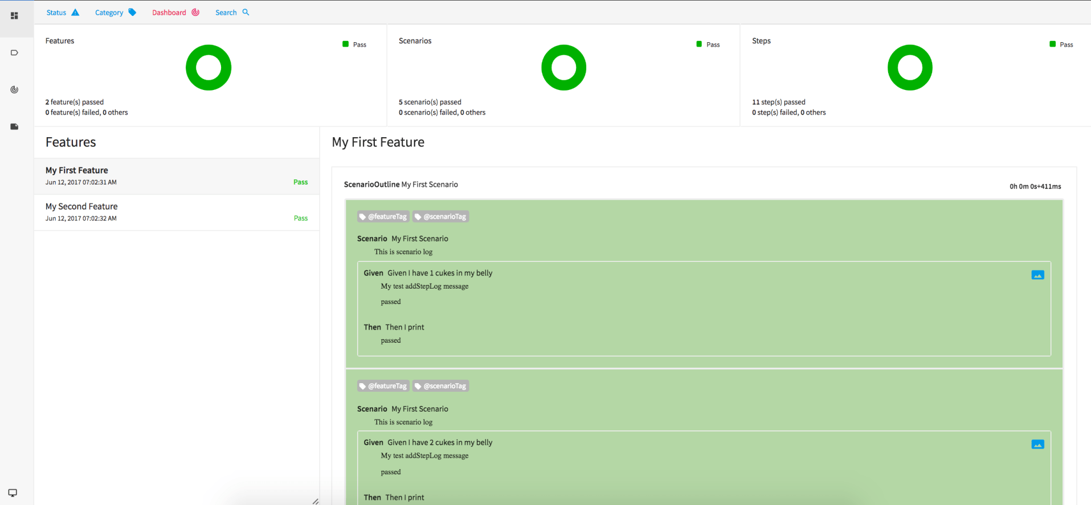
Example BDD Execution Report

Slide 63
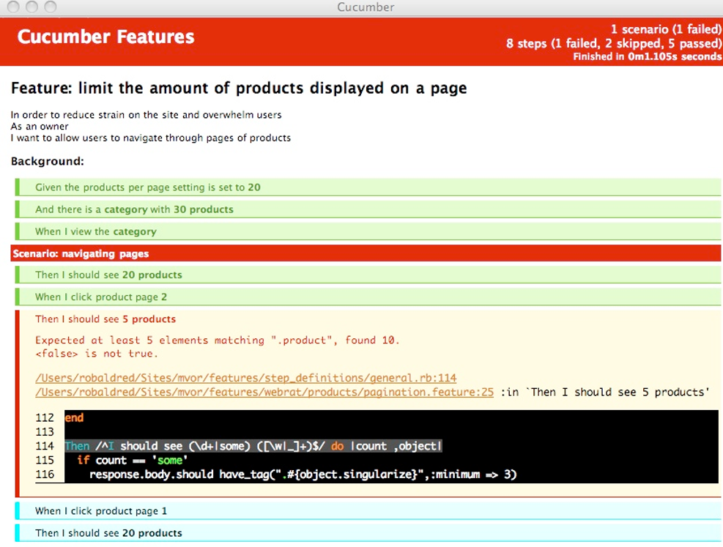
Example BDD Execution Report

