Slide 1
RTOS REVIEW REPORT
“TRAFFIC RULES VIOLATIONS TRACKING SYSTEM”

Slide 2
Team No: -07
NAME | USN | ROLL NO
Suraj Baddi | 01FE19BEC268 | 525
Sandeep S P | 01FE19BEC269 | 526
Daneshwari S Hurali | 01FE19BEC270 | 527
G B Madhuritha | 01FE19BEC271 | 528

Slide 3
Problem statement:
Currently, traffic police and cameras are only deployed at traffic signals. This limits them to report violations only if they happen within the vicinity leaving room for many blind spots. Another constraint is the capacity of this personnel to quickly capture as many violations photographs as possible towards proof before the vehicle rushes away. Vehicles automatically identify and report traffic violations on the road around them as they move around, thus acting as crowd sourced law enforcement.
Solution Ask- Leverage front-mounted mobile phone/dedicated cameras on car windshield to identify, photograph, and report traffic violations anywhere on the road, thus reducing dependency on static cameras and human personnel.

Slide 4
Introduction:
Traffic rule violation leads to various road accidents. Statistics show that traffic violations are the most important cause of the accidents. Street mischance is most undesirable thing to happen to a street client, however they happen frequently. The most deplorable thing is that we don't gain from our errors on street. The majority of the street clients are very much aware of the general tenets and security measures while utilizing streets however it is just the laxity on part of street clients, which cause mishaps and accidents. These days’ movement police confronting numerous challenges to identify the vehicles that violets activity rules. More than one officer is required for activity checking. Still large portions of the culprits are effortlessly gotten away from the police.

Slide 5
Literature Survey on Road Accidents:
Road safety continues to be a major developmental issue, a public health concern and a leading cause of death and injury across the world, killing more than 1.35 million globally as reported in the Global Status report on Road Safety 2018 with 90% of these casualties taking place in the developing countries and 11% alone being accounted for by India.
As per the Report on Road accidents in India 2019, the accident-related deaths in India in 2019 were 1,51,113 in number. It is indeed a matter of great concern that despite the continuing efforts of the Government in this regard and our commitments for halving fatalities we have not been able to register significant progress on this front.

Slide 6
.
Road accidents, Number of persons killed and injured in the last five years 2015- 2019
It will be noted that in 2019 a total of 4,49,002 road accidents were reported by States and Union Territories (UTs) killing 1,51,113 people and causing injury to 4,51,361 persons. The number of 4,49,002 accidents and 1,51,113 deaths in 2019 translates into an average of 1,230 accidents and 414 deaths every day and nearly 51 accidents and 17 deaths every hour.
Year | Total Number of Road Accidents (in numbers) | % Change | Total Number of Persons Killed (in numbers) | % Change | Total Number of Persons Injured (in numbers) | % Change
2015 | 5,01,423 |  | 1,46,133 |  | 5,00,279
2016 | 4,80,652 | -4.14 | 1,50,785 | 3.18 | 4,94,624 | -1.13
2017 | 4,64,910 | -3.28 | 1,47,913 | -1.90 | 4,70,975 | -4.78
2018 | 4,67,044 | 0.46 | 1,51,417 | 2.37 | 4,69,418 | -0.33
2019 | 4,49,002 | -3.86 | 1,51,113 | -0.20 | 4,51,361 | -3.85

Slide 7
Multiple Solutions:
In accordance with the Problem Statement below listed are some solutions:
Leverage dedicated cameras on car windshield to identify photographs and report traffic violations anywhere on the road.
Citizen’s involvement in enforcement road safety regulations by reporting about the traffic rules violations through their phones.

Slide 8
.
Objectives | Multiple Solutions
Detection of violation | Camera Sensors Manually (through bare eyes)
Notification of detected violation | LED’s Buzzer
Information gathering | Camera(photo’s) Manually (UART/keypad)
Taking required actions | Message to police and owner by a call(LCD/UART) Message to police and owner by a text(LCD/UART)

Slide 9
Best suited solution:
Leveraging dedicated cameras on car windshield to identify photographs and report traffic violations anywhere on the road thus reducing dependency on static cameras and human personnel.
As traffic rule violations largely go unchecked because of manpower and resources constraints while vehicles hitting the roads continue to increase exponentially.
So, the use of cameras on car windshield helps to:
Deter Crime
Monitor Scenarios and Activities
Gather Evidence
Maintain Records
Arrive at the right decisions

Slide 10
0
Objectives | Chosen Solution
Detection of violation | Manually(pictures are taken using camera manually i.e camera is not self controlled.)
Notification of detected violation | LED’s
Information gathering | seeing from the pics taken(UART)
Taking required actions | Message to police and owner by a text (LCD/ UART)

Slide 11
Functions involved in the selected solution:
Firstly, we use the camera to detect the violations.
As soon as the violations occur in front the camera the photographs are taken.
Now we manually send the text message along with the photographs as proof to the police.
The police receive the proof and carries out the action.

Slide 12
Use of the ARM components:
We use a sensor/camera to detect the violations.
As soon as the violation is detected the LED’s blink.
Now we send the text message through UART.
As the message is sent to/received by police we get the indication on LCD.

Slide 13
.
Constraints:
Sensors.
Camera.
Peripherals Used:
LED’s
LCD
UART

Slide 14
Optimization Techniques:
Code minimization
If-else
While and for
Data types
Local and Global declaration
Functions or modular approach
Using header files
Conditional execution
Pass by value
Pass by reference

Slide 15
Block Diagram:
Notifies the detection of violation
Message sent to police and the owner
Camera [captures the violation]
Violation reported

Slide 16
Algorithm:
Step 1: Start
Step 2: Take the input from the user using UART.
Step 3: Turn on the Buzzer to notify that the violation is detected.
Step 4: Display “Violation detected” on LCD.
Step 5: Take the input using UART.
Step 6: Select the type of violation made.
Step 7: Display the type of violation on LCD.
Step 8: After all the functions, Display “Report Sent” on UART.
Step 9: Display “Report received by Police” on LCD.

Slide 17
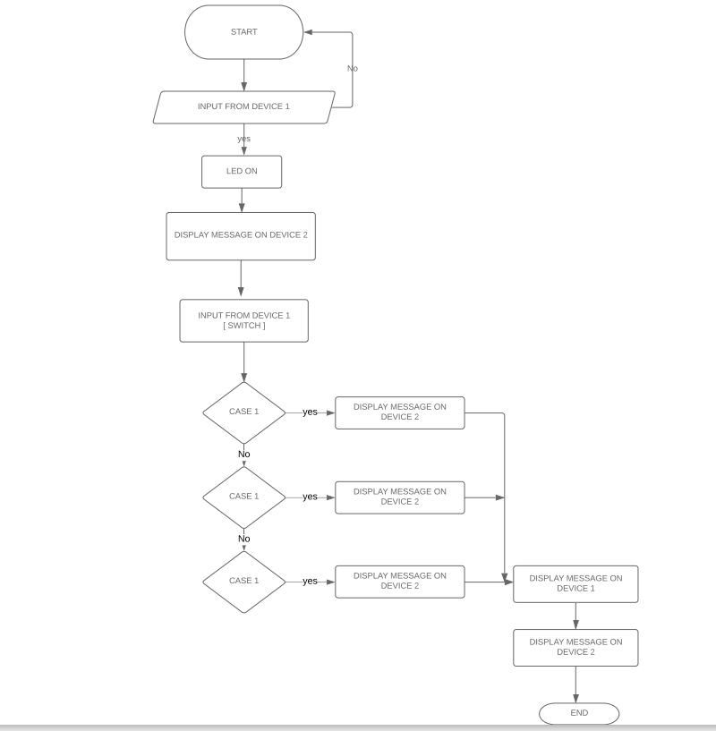
Flowchart:

Slide 18
LPC2148 Code:
#include <lpc214x.h>
#include <stdint.h>
#include <stdlib.h>
#include <stdio.h>
void serial()
{
PINSEL0 = 5;
U0LCR = 0x83;
U0DLM = 0x00;
U0DLL = 0x61;
U0LCR = 0x03;
}
unsigned char receive()
{
while(!(U0LSR & 0x01));
return (U0RBR);
}

Slide 19
.
.
void display(char *msg)
{
uint8_t i=0;
for(i=0;msg[i]!=0;i++)
{
U0THR = msg[i];
while(!(U0LSR & 0x20));
}
}
int main(void)
{
while(1){
unsigned int i;
unsigned char mg;
serial();
display("PRESS 1 TO REPORT A VOILATION\n");
mg = receive();
//m = mg;
if(mg == '1'){
//first line

Slide 20
.
serial();
display("OUTPUT :: VOILATION FOUND\n");
serial();
display("ENTER 1-OVER SPEED 2-DRINK AND DRIVE 3-NO HELMET AND SEND PHOTO PROOF\n");
mg = receive();
if(mg == '1'){
//second line
display("OUTPUT :: OVER SPEED\n");
}
else if(mg == '2')
{
display("OUTPUT :: DRINK AND DRIVE\n");
}
else if(mg == '3')
{
display("OUTPUT :: NO HELMET\n");
}
else{}

Slide 21
.
serial();
display("REPORT SENT\n");
display("OUTPUT :: PHOTOS RECEIVED\n");
display("BY POLICE\n");
display("OUTPUT :: OWNER FOUND\n");
display("OUTPUT :: MESSAGE SENT\n");
}}
}

Slide 22
Proteus Code:
#include <lpc214x.h>
#include <stdint.h>
#include <stdlib.h>
#include <stdio.h>
void delay_ms(uint16_t j) /* Function for delay in milliseconds */
{
uint16_t x,i;
for(i=0;i<j;i++)
{
for(x=0; x<6000; x++); /* loop to generate 1 millisecond delay with Cclk = 60MHz */
}
}
void LCD_CMD(char command)
{
IO0PIN = ( (IO0PIN & 0xFFFF00FF) | (command<<8) );
IO0SET = 0x00080000; /* EN = 1 */
IO0CLR = 0x00060000; /* RS = 0, RW = 0 */
delay_ms(2);
IO0CLR = 0x00080000; /* EN = 0, RS and RW unchanged(i.e. RS = RW = 0) */

Slide 23
.
delay_ms(5);
}
void LCD_INIT(void)
{
IO0DIR = 0x000FFF00; /* P0.8 to P0.15 LCD Data. P0.4,5,6 as RS RW and EN */
delay_ms(20);
LCD_CMD(0x38); /* Initialize lcd */
LCD_CMD(0x0C); /* Display on cursor off */
LCD_CMD(0x06); /* Auto increment cursor */
LCD_CMD(0x01); /* Display clear */
LCD_CMD(0x80); /* First line first position */
}
void LCD_STRING (char* msg)
{
uint8_t i=0;
while(msg[i]!=0)
{
IO0PIN = ( (IO0PIN & 0xFFFF00FF) | (msg[i]<<8) );
IO0SET = 0x000A0000; /* RS = 1, , EN = 1 */
IO0CLR = 0x00040000; /* RW = 0 */
delay_ms(2);
IO0CLR = 0x00080000; /* EN = 0, RS and RW unchanged(i.e. RS = 1, RW = 0) */

Slide 24
.
delay_ms(5);
i++;
}
}
void serial()
{
PINSEL0 = 5;
U0LCR = 0x83;
U0DLM = 0x00;
U0DLL = 0x61;
U0LCR = 0x03;
}
unsigned char receive()
{
serial();
while(!(U0LSR & 0x01));
return (U0RBR);
}
void display(char *msg)
{
uint8_t i=0;
for(i=0;msg[i]!=0;i++)
{
U0THR = msg[i];
while(!(U0LSR & 0x20));
} }

Slide 25
.
int main(void)
{
while(1){
unsigned int i;
unsigned char mg;
serial();
display("PRESS 1 TO REPORT A VOILATION //// \n");
mg = receive();
//m = mg;
if(mg == '1'){
LCD_INIT();
LCD_STRING("voilation found");//first line
//serial();
display("ENTER 1-OVER SPEED 2-DRINK AND DRIVE 3-NO HELMET AND SEND PHOTO PROOF //// \n");
mg = receive();
LCD_INIT();
if(mg == '1'){
LCD_STRING("OVER SPEED");//second line
}
else if(mg == '2')
{LCD_STRING("DRINK AND DRIVE");
}
else if(mg == '3')
{LCD_STRING("NO HELMET");
}

Slide 26
.
else{}
serial();
display("REPORT SENT //// \n");
LCD_INIT();
LCD_STRING("PHOTOS RECEIVED");
LCD_CMD(0xC0);
LCD_STRING("BY POLICE");
mg = receive();
LCD_INIT();
LCD_STRING("OWNER FOUND");
mg = receive();
LCD_CMD(0xC0);
LCD_STRING("MESSAGE SENT");
}}
}

Slide 27
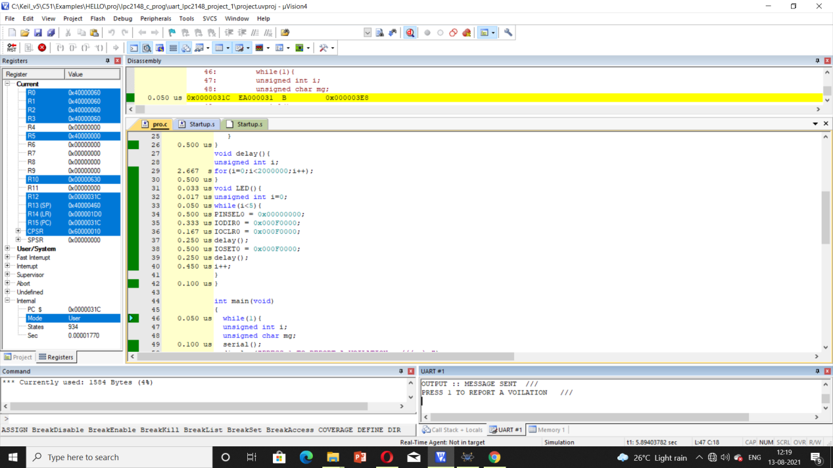
Execution Profiling:

Slide 28
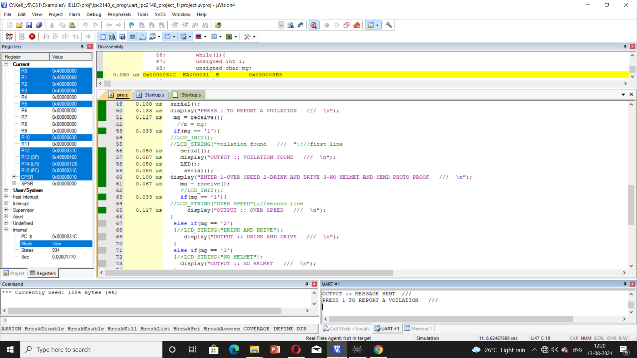
.

Slide 29
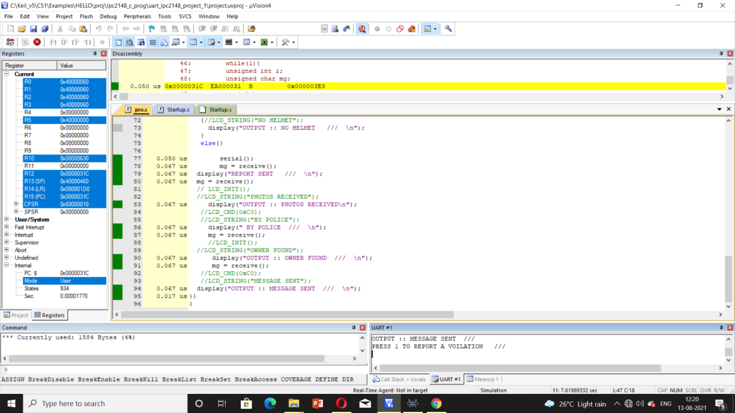
.

Slide 30
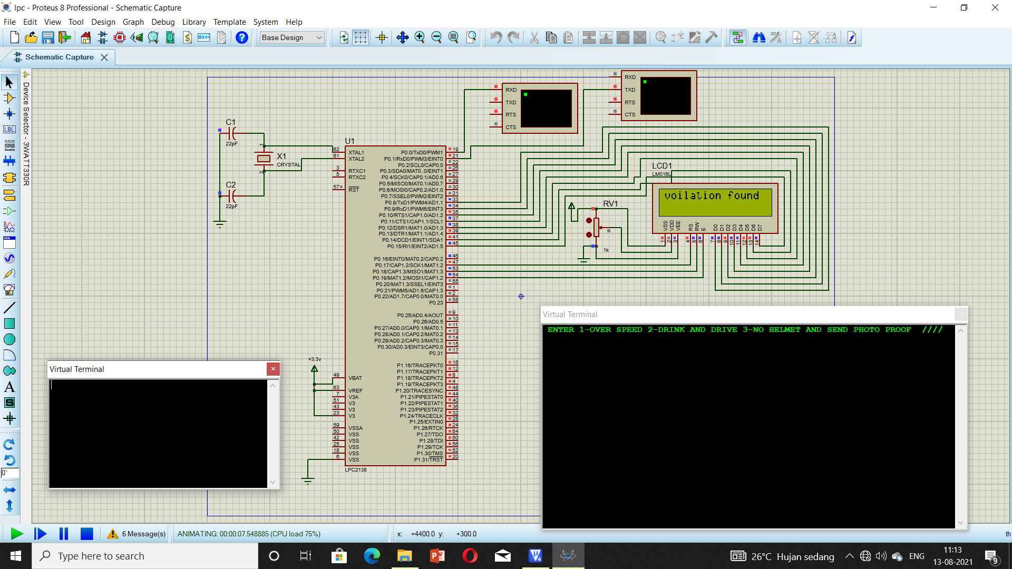
Simulation Results:

Slide 31

.

Slide 32
References:
www.nevonprojects.com
www.8051projects.com
www.youtube.com
www.github.com
https://morth.nic.in/road-accident-in-india
Books:
Steve Furber
William Hohl

