Slide 1
Universal Windows Platform: New Features in Creators Update and beyond
Sergii Baidachnyi
Principal Technical Evangelist
Microsoft Canada
sbaydach@microsoft.com

Slide 2
Creators Update Features
https://docs.microsoft.com/en-us/windows/uwp/whats-new/windows-10-version-1703

Slide 3
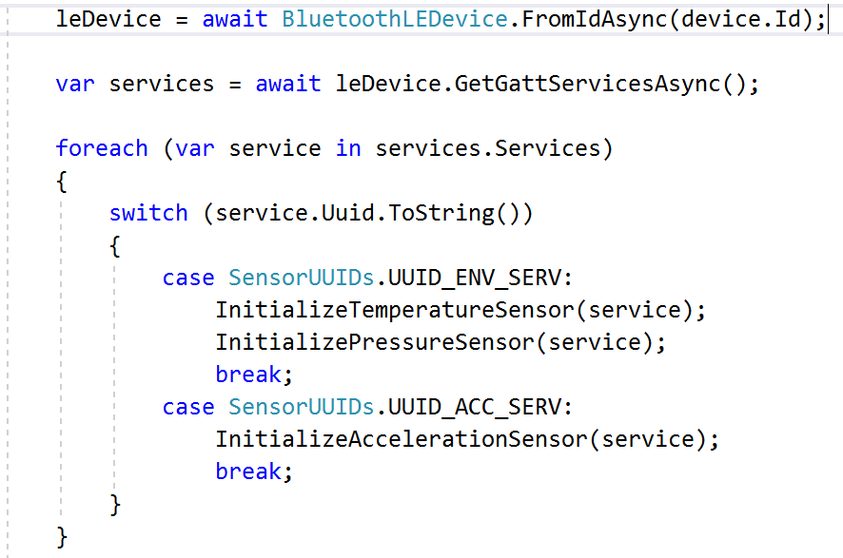
Bluetooth LE
Pairing is not a requirement anymore
Your application can use peripheral role (if your radio supports it)
Background and foreground scenarios are supported
Find more details in my posts: http://en.baydachnyy.com

Slide 4
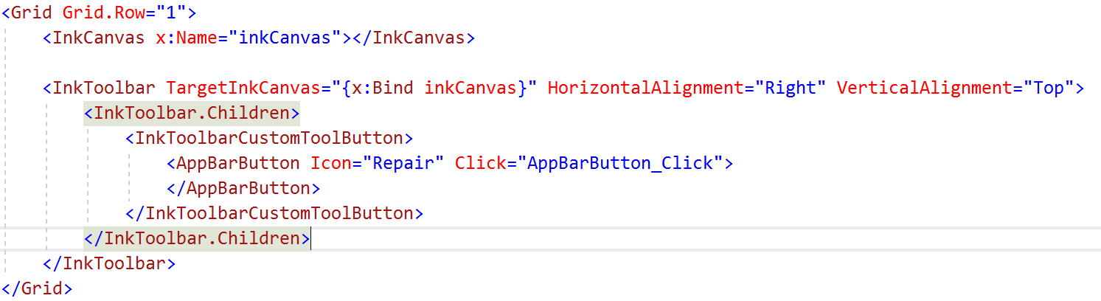
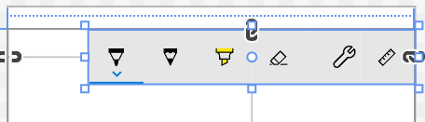
Ink
Enable Ink using InkToolbar and InkCanvas
You can add custom buttons and switches if you want
Collect new strokes using InkPresenter
Analyze input using InkAnalyzer
Support Surface Dial

Slide 5

SVG Support
New images source: SvgImageSource

Slide 6
Maps
MapBillboard class - to add images
FindMapElementAtOffset method - to find all elements in the area
StartContinuousPan method - to pan the map
Use style sheets to customize the look and feel
Manage offline maps using the OfflineMaps class
Add and manage waypoints using the EnhancedWayPoint class
Get traffic level and estimate travel times without traffic (see the MapRoute class)
Get information about potential issues along a route

Slide 7
Surface Dial
Surface Dial has own API (but it’s a BLE device)
Users may use Wheel window to setup the device
Default menu can be suppressed or modified
RadialController provides access to the device

Slide 8
Next Release Features
https://docs.microsoft.com/en-us/windows/uwp/whats-new/windows-10-build-16190

Slide 9
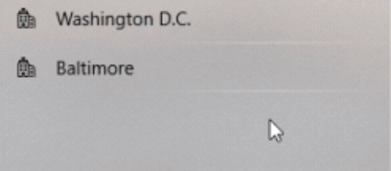
Fluent Design Features
Acrylic material
Acrylic is a type of Brush that creates a partially transparent texture
AcrylicBrush class
Reveal
Reveal is a lighting effect that helps bring depth and focus to your app's interactive elements
RevealBrush, RevealBackgroundBrush and RevealBorderBrush classes
Parallax
Parallax is a visual effect where items closer to the viewer move faster than items in the background
ParallaxView class

Slide 10
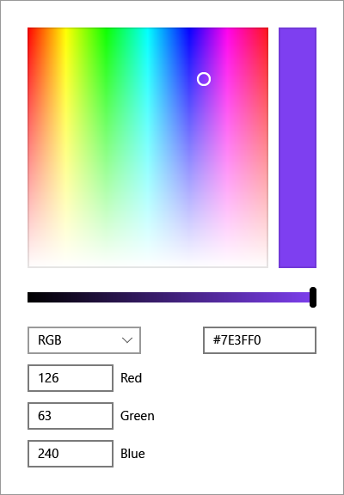


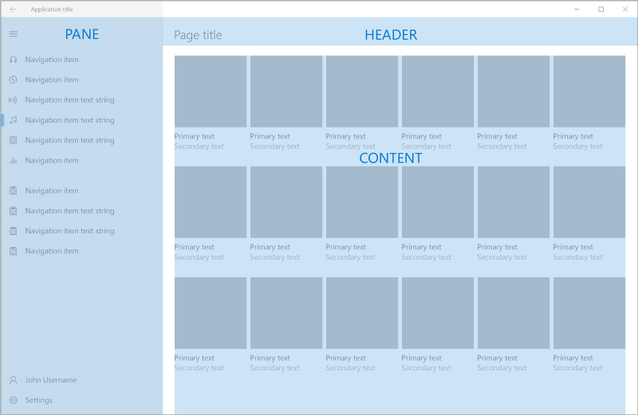
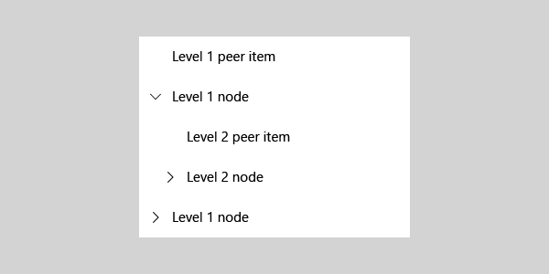
New User Controls
Color Picker Control
Navigation View Control
Person Picture Control
Rating Control
Tree View Control

Slide 11
XAML Standard 1.0 and .NET Standard 2.0
UWP
Android
iOS
. . . . .
.NET Standard 2.0
+
XAML Standard 1.0

Slide 12
Demos
https://github.com/sbaidachni/BuildVancouver_Demo

Slide 13
Questions?
sbaydach@microsoft.com

