Slide 1
NYC_Citibike_Challenge
File created on: 12/19/2020 1:39:42 PM

Slide 2
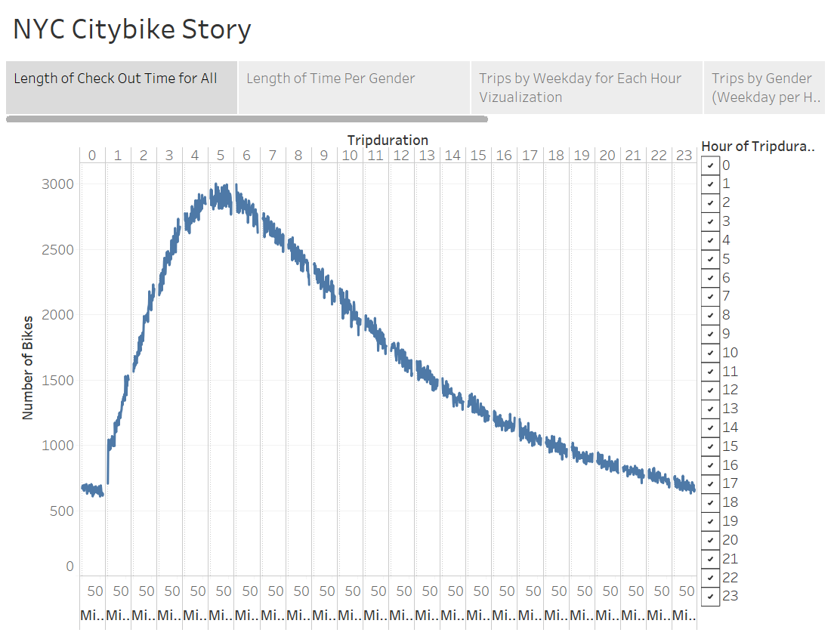

Slide 3
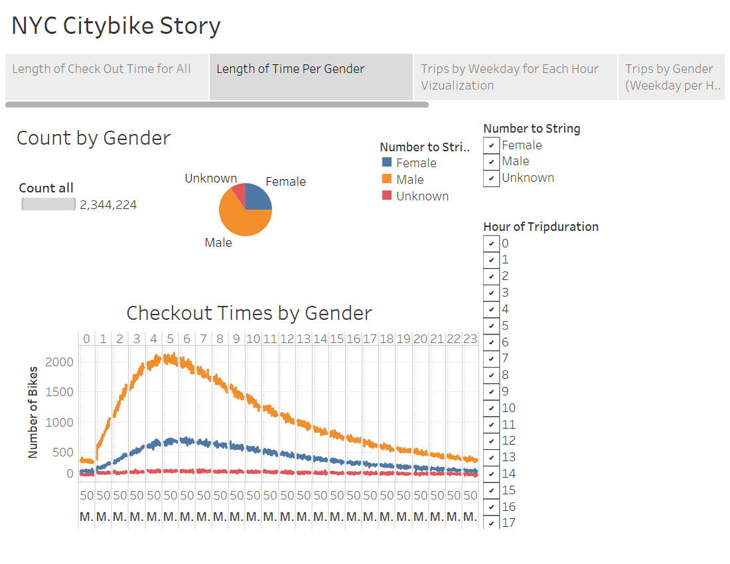

Slide 4
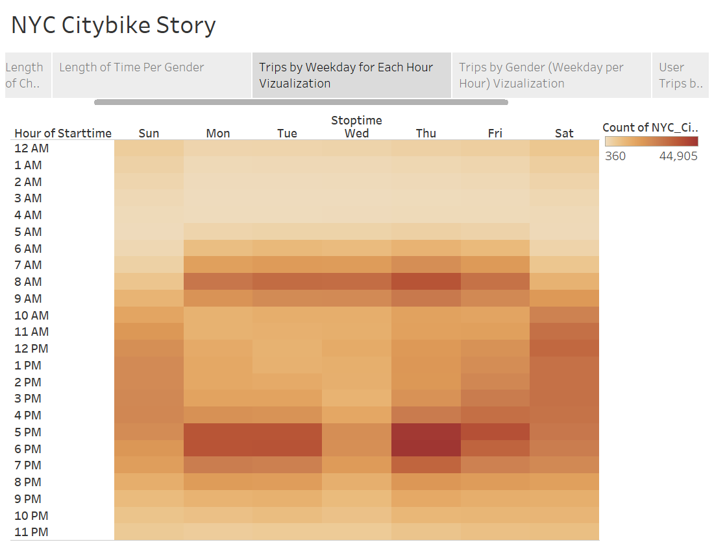

Slide 5
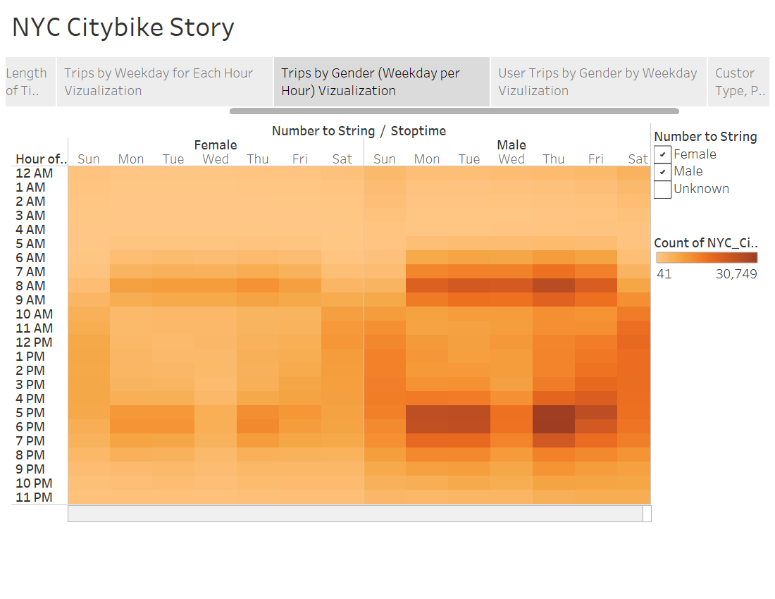

Slide 6
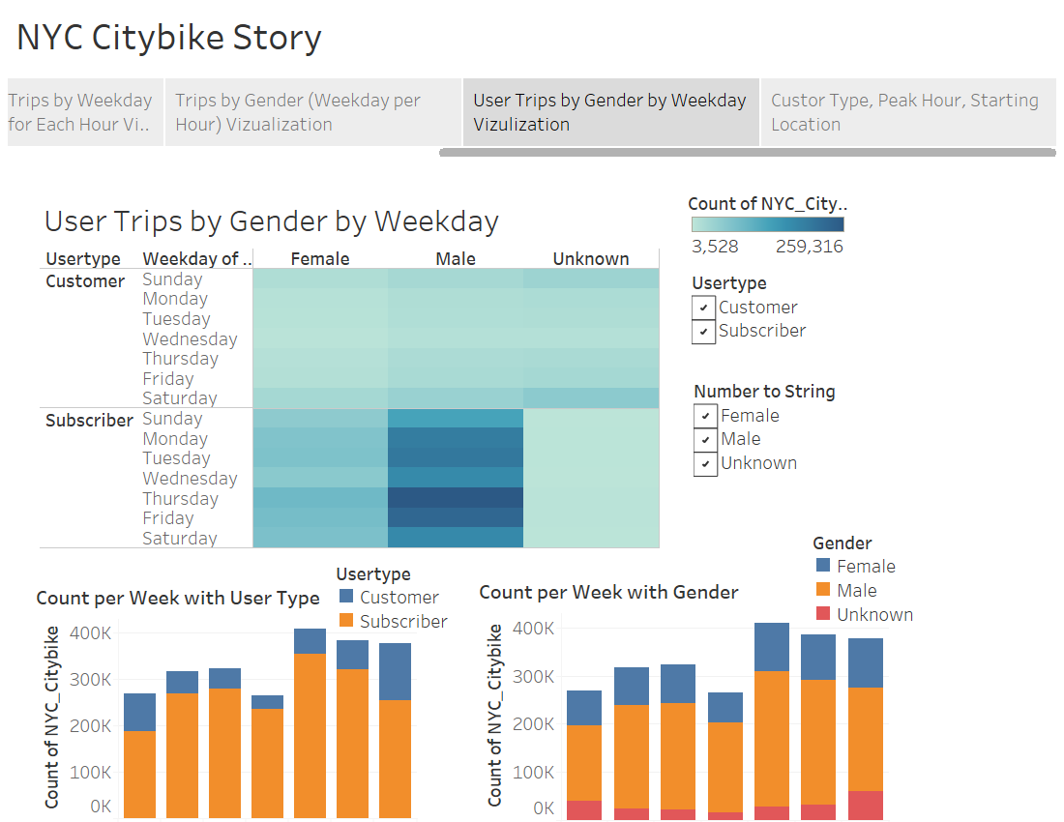

Slide 7
