Slide 1

Online Examination Management System “Using Fisher-Yates and Tokenization algorithm”
Prepared by:
Bishworaj Ghimire
Nischal Ghimire
Shyam Bakhrel
Sudip Maharjan

Slide 2
Contents
Introduction
Problem statement
Objectives of study
Requirement analysis
System design
Algorithm implementation
Conclusion

Slide 3
Introduction
Online Examination Management System (OEMS) is a web based application, that allows students to participate in practice exams online.
This platform provides students to register to the system and choose the subjects of exam and submit the answers, and lastly view the results.
This application uses Fisher-Yates shuffling algorithm and tokenization algorithm.

Slide 4
Problem statement
Our current market(industry) lacks the platform where students can learn through online medium.
Students as well as many learners can’t practice for exams such as MBBS entrance exams, Engineering entrance exams, BSc CSIT entrance exams and so on.
The intention of this project is to solve the above problems.

Slide 5
Objectives of study
Maintaining the online exam system efficiently.
Allow students to participate in online practice exams.
Enable user to view the results of their exams.
Make the job of evaluating student’s answers easy.
Save time of manual examination and generate accurate exam results.

Slide 6
Requirement analysis
Functional requirements
Administrator aspect
System aspect
Student aspect
Non-functional requirements
Performance
Usability
Portability
Availability

Slide 7
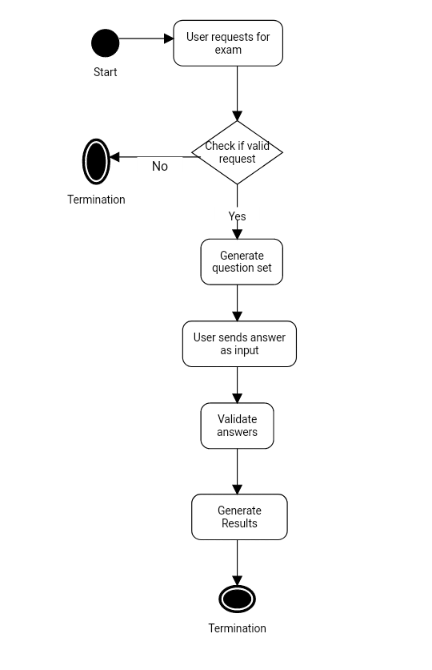
System design
Figure: Activity diagram of the system

Slide 8
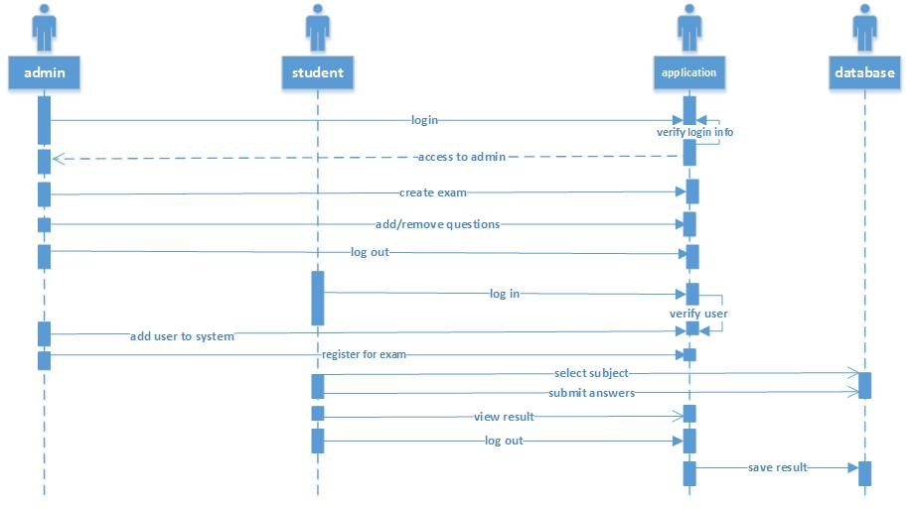
UML designs
Figure: Sequence diagram of the system

Slide 9
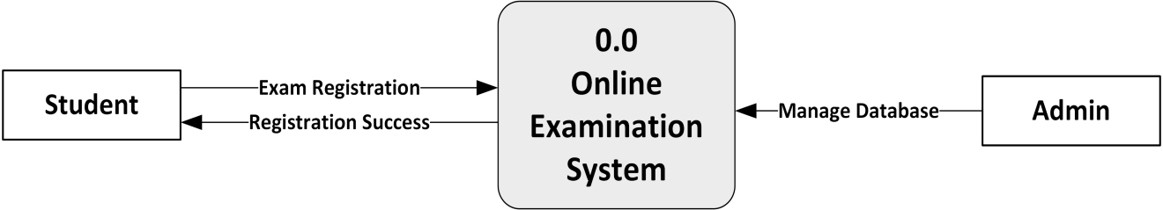
UML design continue…
Fig: Level 0 Data Flow Diagram of the System

Slide 10
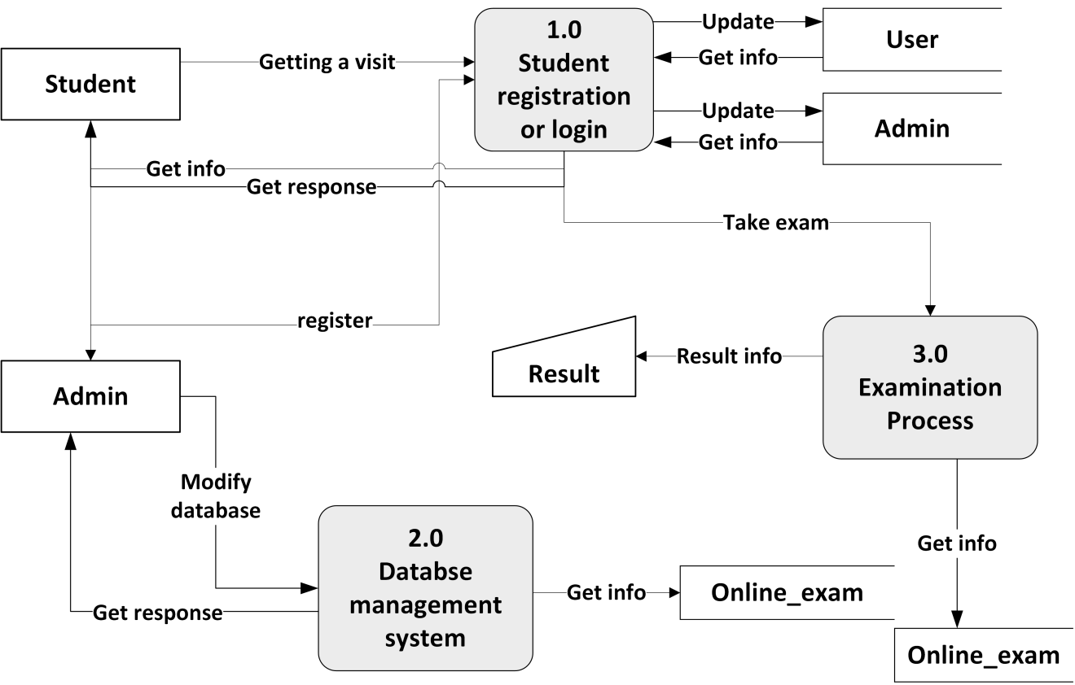
UML design continue…
Fig: Level 1 Data Flow Diagram of the System

Slide 11
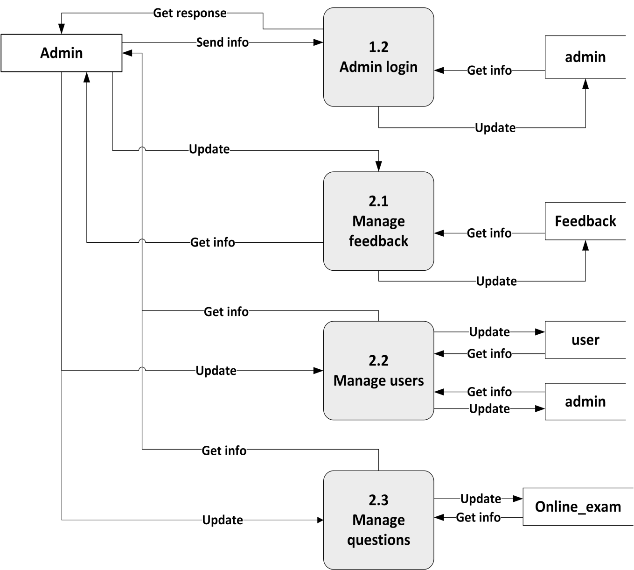
UML design continue…
Fig: Level 2 Data Flow Diagram of Admin

Slide 12
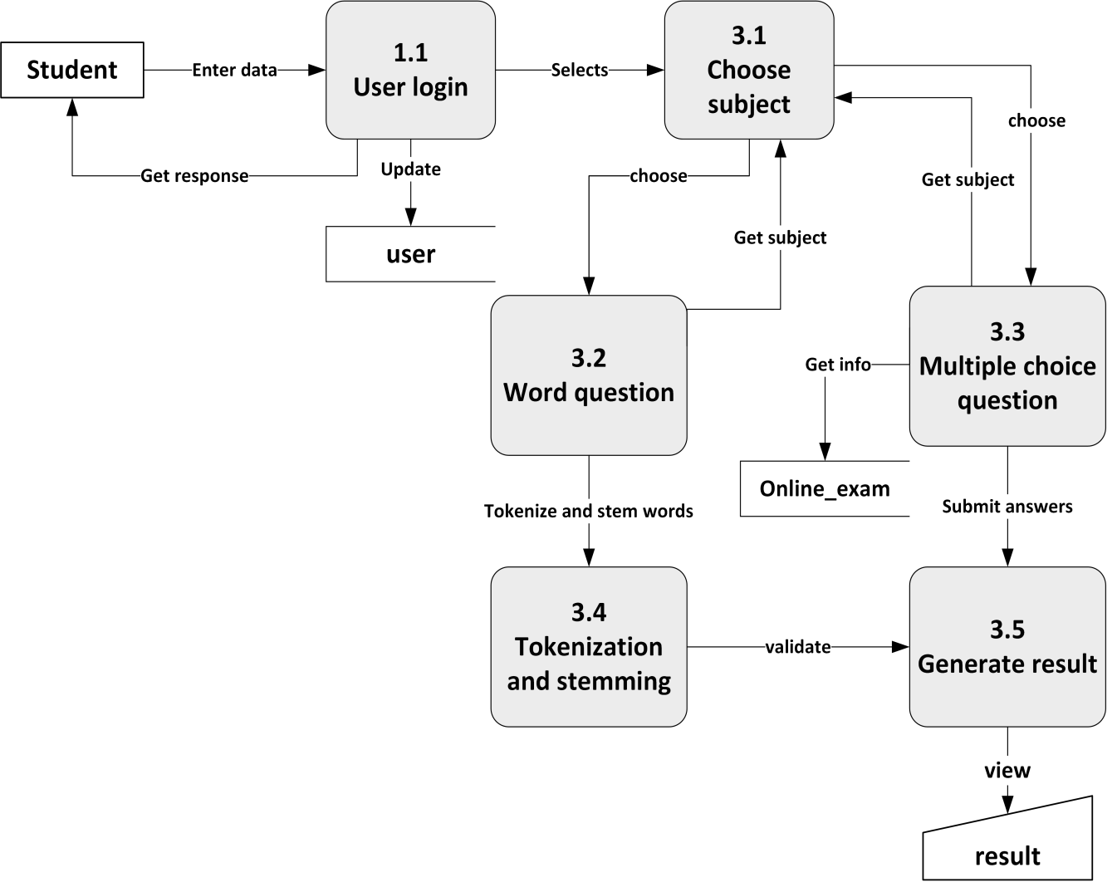
UML design continue…
Fig: Level 2 Data Flow Diagram of User

Slide 13
Algorithm Implementation
Fisher Yates Algorithm
Write down the numbers from 1 through N.
Pick a random number k between one and the number of unstruck numbers remaining (inclusive). The random number k is selected as, k=rand(1 to N)
Counting from the low end, strike out the k^{th} number not yet struck out, and write it down at the end of a separate list. (For Modern-Shuffling algorithm to reduce complexities, we place already stroked numbers at the end of the list by swapping them with the last unstruck number at each iteration)
From i=0 to j
Select and swap j^{th} element a[j] to temporary variable as well as a[n] and a[n] is placed at a[j] and N is set to N-1.
Repeat from step 2 until all the numbers have been struck out.
The sequence of numbers written down in step 3 is now a random permutation of the original numbers.

Slide 14
Tokenization Process
Get Input answer in Phrase and store in string
Remove special characters like comma, full stops etc.
Get all the uppercase letters to lower case.
Create token of words by detecting white space
Remove stop words like preposition, adverbs, pronouns etc.
Select a word for stemming
Use Stemming method for removing suffixes.
Repeat step 6. until all words are stemmed.
Compare tokenized words with answer stored in database
Generate result

Slide 15
Porter’s Stemmer process
For stemming, this system follows porter stemmer which is used to erase suffixes from words.
A consonant will be denoted by c, a vowel by v. A list ccc... of length greater than 0 will be denoted by C, and a list vvv... of length greater than 0 will be denoted by V. Any word, or part of a word, therefore has one of the four forms:
CVCV ... C
CVCV ... V
VCVC ... C
VCVC ... V
These may all be represented by the single form
[C]VCVC ... [V]
where the square brackets denote arbitrary presence of their contents. Using (VC)m to denote VC repeated m times, this may again be written as
[C](VC)m[V].
m will be called the measure of any word or word part when represented in this form. The case m = 0 covers the null word. Here are some examples:
m=0 TR, EE, TREE, Y, BY.
m=1 TROUBLE, OATS, TREES, IVY.
m=2 TROUBLES, PRIVATE, OATEN, ORRERY.
The rules for removing a suffix will be given in the form
(condition) S1 -> S2
This means that if a word ends with the suffix S1, and the stem before S1 satisfies the given condition, S1 is replaced by S2.

Slide 16
Conclusion
The use of Fisher-Yates algorithm for generating random question has helped in shuffling of questions without repetition. Users can login through the system and easily participate for examinations.
Use of Tokenization has helped our system to generate tokens. The Porter Stemmer algorithm worked fine to remove suffixes for answers which helped system to validate answers.

Slide 17
References
[1] P, Martin (Jan 2006). The Porter Stemming Algorithm. Retrieved at August 15, 2017, from https://tartarus.org/martin/PorterStemmer
[2] The original paper: Porter, M.F., 1980, An algorithm for suffix stripping, Program, 14(3) P: 130-137.
[3] Donald Knuth, “Art of Computer Programming”, Algorithm P, Ed-Addison-Wesley, 1962, Volume I.
[4] W3schools.com. (2017). Bootstrap 3 Tutorial. [online] Retrieved at July 11, 2017,from https://www.w3schools.com/bootstrap
[5] QuizUp. (2017). QuizUp. [online] Retrieved at July 11, 2017, from https://www.quizup.com/ [Accessed 14 Sep. 2017].
[6] Yaksha (Sept 2003). Php Quiz Random Questions. Retrieved at July 15, 2017, from http://board.phpbuilder.com/showthread.php?10255818-PHP-Quiz-Random-Questions.
[7] Kennyledet (Jan 2, 2014). Algorithm Implementations Fisher Yates. Retrieved at August 08, 2017, from https://github.com/kennyledet/Algorithm-Implementations/tree/master/Fisher-Yates/PHP/mitogh.

