Slide 1
What is pfsense?
Pfsense is open source network firewall software distribution.
The software is used to make dedicated firewall/router for a network and it is considered for its reliability and offers many features.
Pfsense is firewall and the purpose of firewall is provide security.
Firewall rules control what traffic is allowed to enter an interface on the firewall.
PfSense is easy to install and maintain offering a very useful web based user interface.

Slide 2
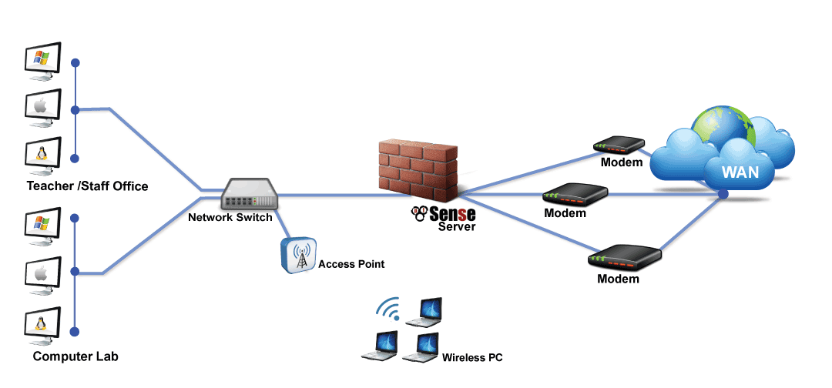
Pfsense Diagram

Slide 3
How it work?
Firewalls are setup at every connection to the Internet, therefore all the data flow to careful monitoring. Firewalls can also be turn on to follow "rules".
These Rules are simply security rules that can be set up by yourself. Based on your security policy those rules are changed.
Rules are constructed by the nwtwork peripherals like IP address, Domain name, protocols, and ports, etc..
Rules are like who want to connect the network, what kind of connection to survey the our network.which or what kind of data transmitted over the network.basically all the flow of data transmission is controlled.

Slide 4
Use of Pfsense
LAN / WAN Routing
Firewall Rules
DHCP / DNS Server
Transparent Squid Proxy Server
DNS Blacklist
Port Forwarding / NAT
Squid proxy filter
URL Blacklist

Slide 5


