Slide 1
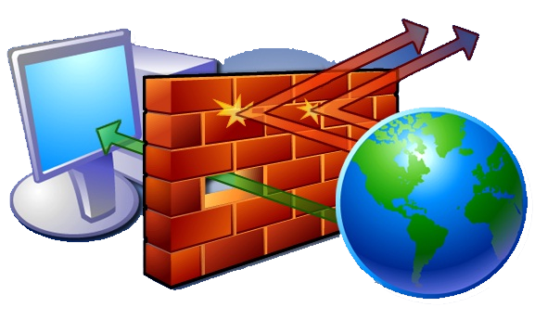
WHY FIREWALL
Firewall can block unauthorized access to private networks.
Firewall act the safeguarding them from hackers, viruses and worms.
Firewall block and allow messages entering and leaving the intranet and restricting.
Firewall acts as the first line of defense against these threats.

Slide 2
WHAT IS FIREWALL?
A firewall is a software program or piece of hardware.
Firewall is a system that is designed to prevent unauthorized access to from a private network.
It is used to allow and block the un wanted data packets and content filter.
Firewalls protect you from offensive software that may come to reside on your systems or network.
Firewall having a

Slide 3
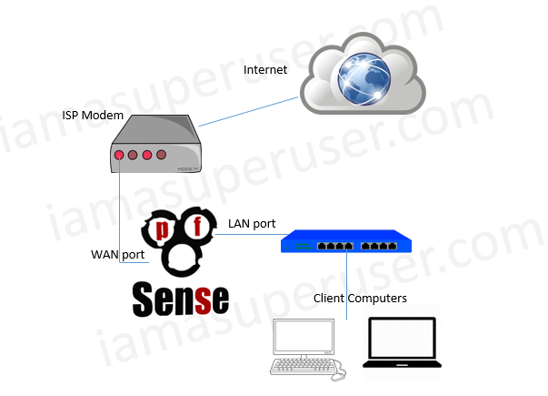
FIREWALL TYPES
Firewall having a two types one is software firewall another one is hardware firewall.
Software firewall
A Software Firewall is a piece of software that is installed on your computer in order to protect it from unauthorized access
Example : pfSense, ZoneAlarm, Outpost Firewall Pro, PeerBlock, Ipcorp,.. etc.

Slide 4
FIREWALL TYPES
Hardware firewall
A Hardware Firewall is a device to which you connect your computers or network in order to protect them from unauthorized access.
Example : PC, Fortinet, Cisco SA, McAfree Next Generation,NetGear,..etc.
A firewall is a hardware or software system that prevents unauthorized access to or from a network. It can be implemented in both hardware and software, or a combination of both.

Slide 5
HOW TO WORK ?
Firewalls are setup at every connection to the Internet, therefore all the data flow to careful monitoring. Firewalls can also be turn on to follow "rules".
These Rules are simply security rules that can be set up by yourself. Based on your security policy those rules are changed.
Rules are constructed by the nwtwork peripherals like IP address, Domain name, protocols, and ports, etc..
Rules are like who want to connect the network, what kind of connection to survey the our network.which or what kind of data transmitted over the network.basically all the flow of data transmission is controlled.

Slide 6
FEATURES
To Helps screen out hackers, viruses, and worms that try to reach your computer over the Internet.=
To Deny the untrusted website or social media (e.g www.facebookcom, twitter, google talk, gmail, youtube, whatsapp, etc )
Block the unwanted or restricted of a domain name’s (e.g- oneindia.com).
If want to block the particular Ip address( 192.168.2.*) or a particular networks (e.g-192.168.2.*/24).
Data is exchanged between your computer and servers, and the firewall monitoring the data to check wheather is safe or not

