Slide 1
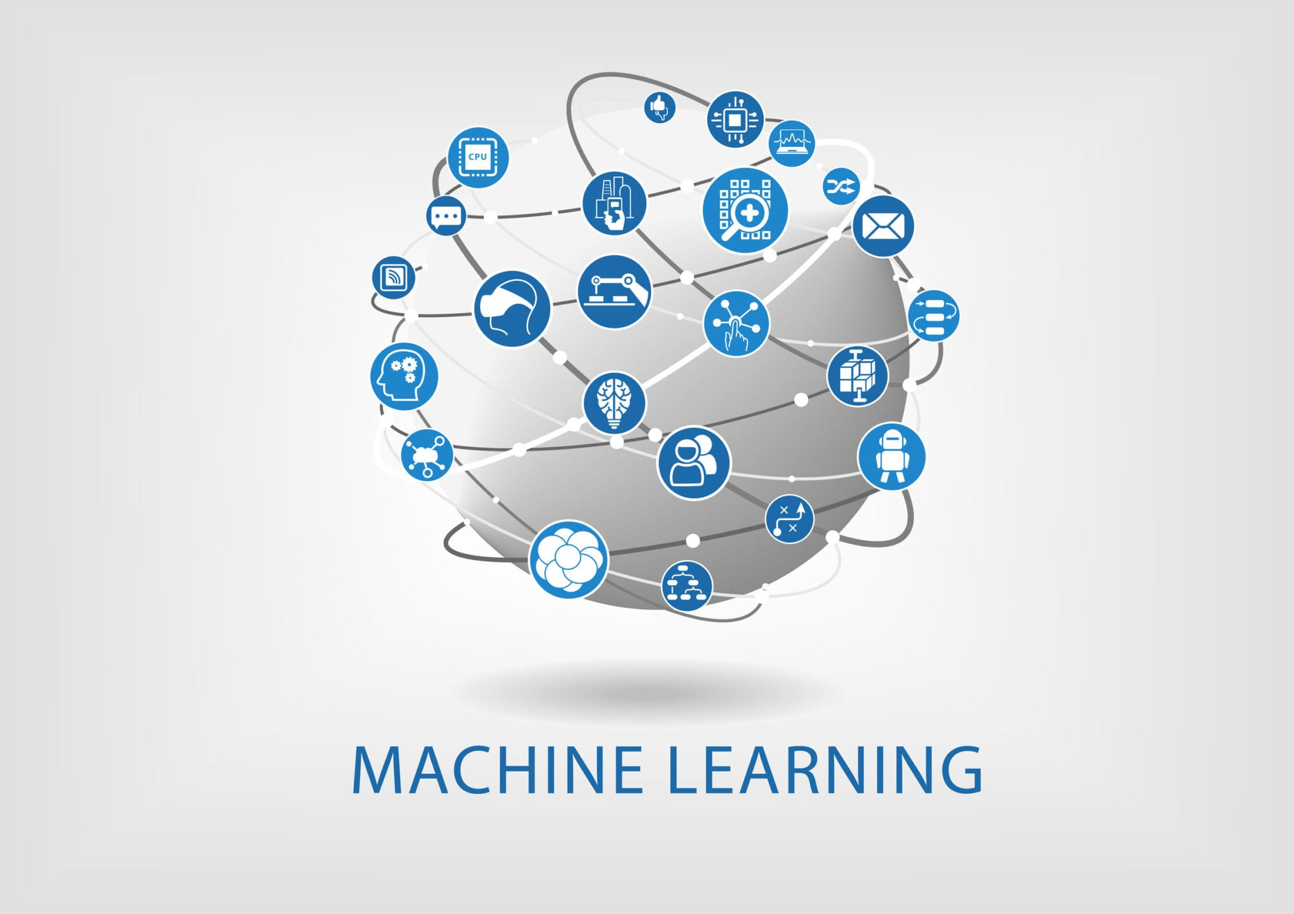
Introduction to Machine Learning Algorithms
Srinivasan Balan
ISE 437
Data Analytics for Industrial Engineering
Course instructor: Dr. Natalia Summerville

Slide 2
Agenda
Introduction
Motivation
Different ML algorithms
Mathematical background
Model applications
Implementation using Scikit Learn packages
Summary

Slide 3
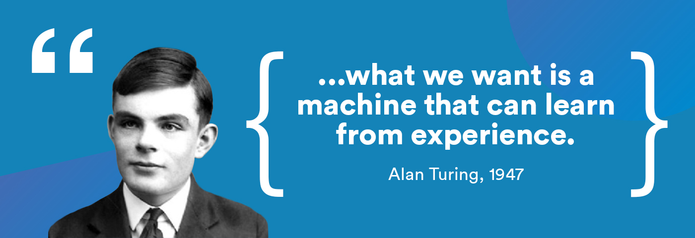

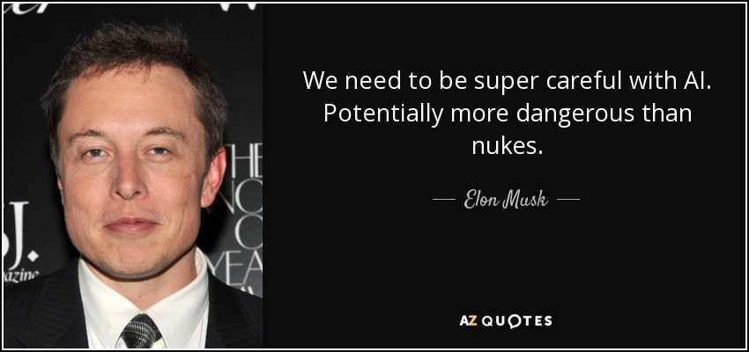
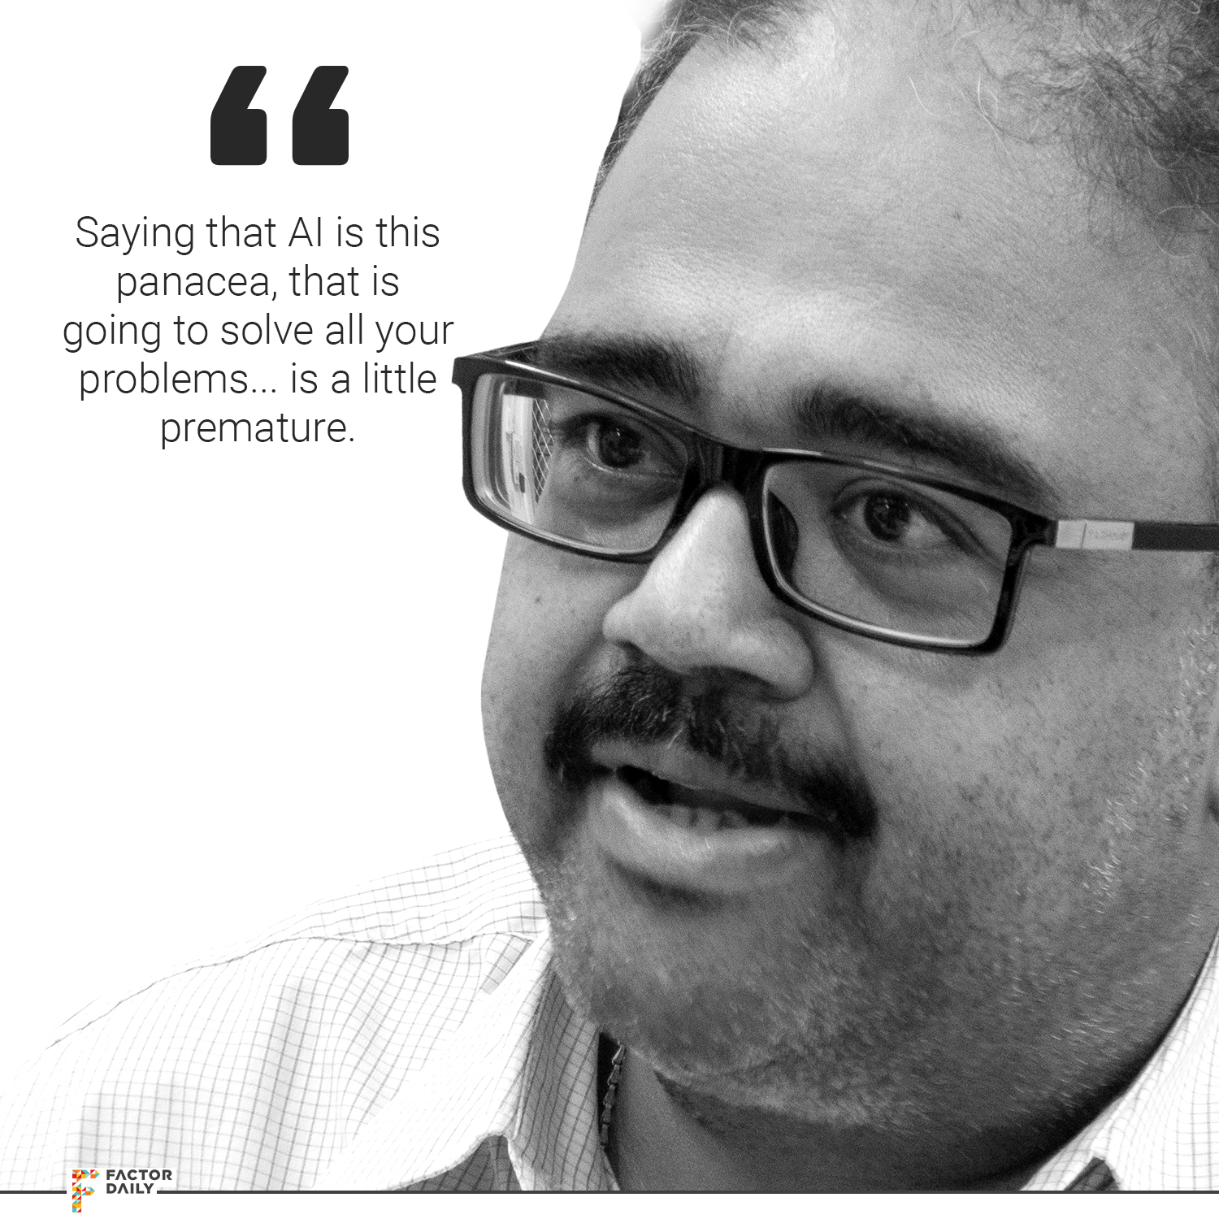
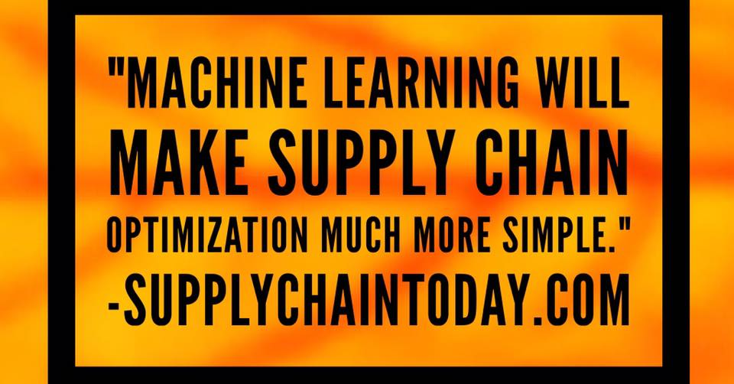
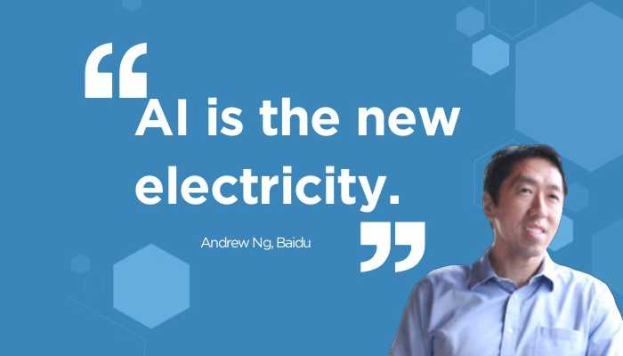

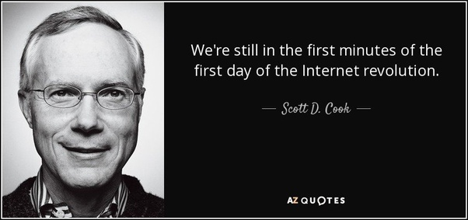
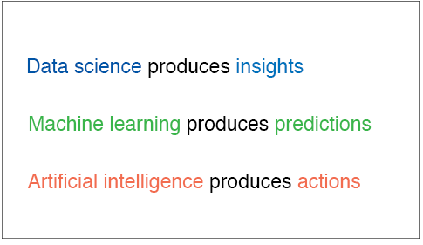
Introduction

Slide 4
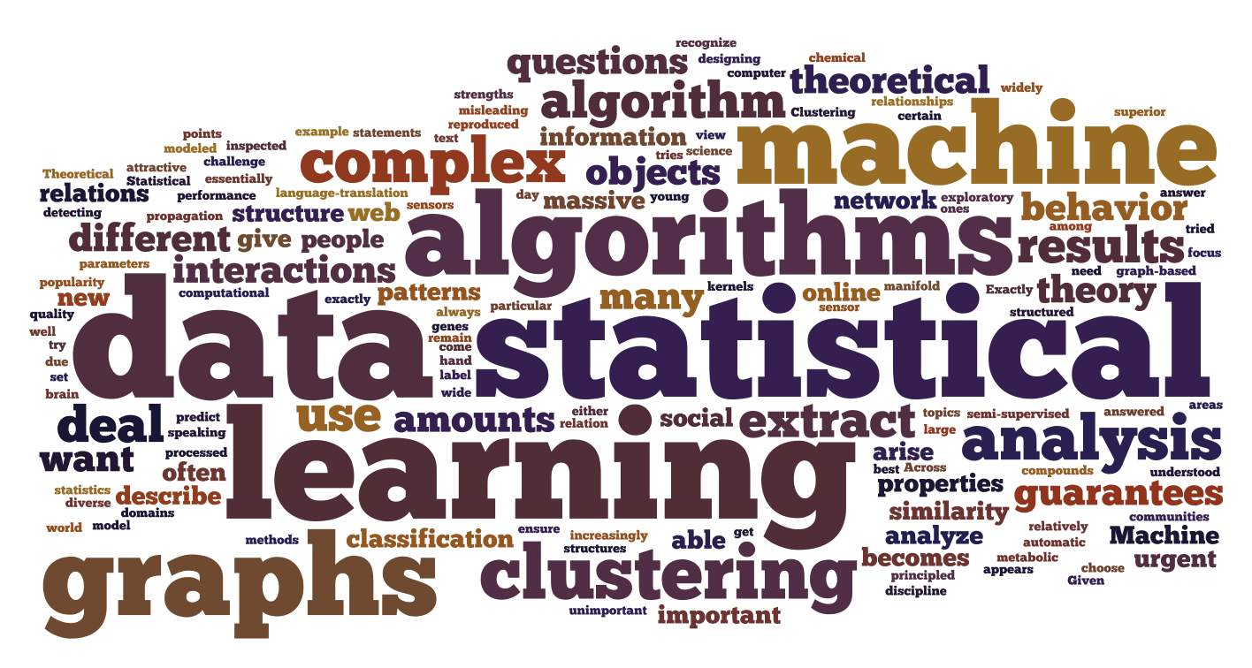
Motivation
Supervised Learning
Classification
Regression
Unsupervised Learning
Clustering
Dimension Reduction
Association
Reinforcement Learning
Algorithm learns to react to an environment

Slide 5
Machine Learning Algorithms
Unsupervised Learning
Clustering
K-means clustering
Hierarchical clustering
Dimensionality Reduction
Association
Apriori algorithm
Hash Tree table
Frequent Itemset generation
Supervised Learning
Classification
Decision Tree
Random Forest
Logistic Regression
SVM
Neural Networks
Naïve Bayes
Regression
Linear Regression
Lasso
Ridge
Reinforcement Learning
Q-Learning
Temporal Difference Learning
SARSA

Slide 6
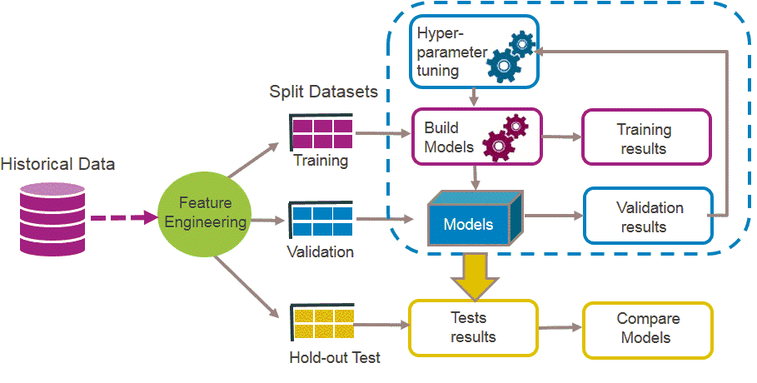
How it works

Slide 7
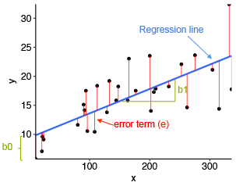
Linear Regression
Predicts the relationship between independent and dependent variables.
Y = β0 + β1x
Examples:
Rainfall and Crop yield
R&D expenses and Profit on new products
Works on minimizing the sum of squares of errors
Uses gradient descent to minimize the errors (SSE)
Modeled as both simple and multiple linear regression
Variants such as Lasso, Ridge, Splines are special types

Slide 8

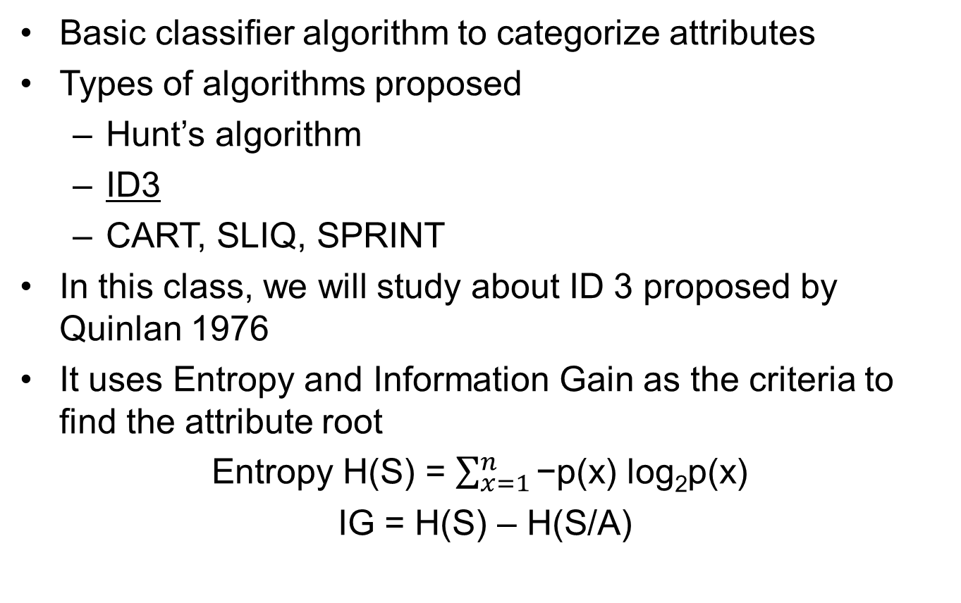
Decision Tree
Basic classifier algorithm to categorize attributes
Types of algorithms proposed
Hunt’s algorithm
ID3
CART, SLIQ, SPRINT
In this class, we will study about ID 3 proposed by Quinlan 1976
It uses Entropy and Information Gain as the criteria to find the attribute root
Entropy H(S) = $\sum_{x=1}^{n}{\text{−}\text{p}\text{(}\text{x}\text{) }\text{log}\text{2}\text{p}\text{(}\text{x}\text{) }}$
IG = H(S) – H(S/A)

Slide 9
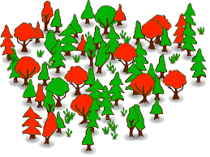
Random Forest
Made up of many decision trees
Two key concepts
Random sampling of training data points when building trees
Random subsets of features considered when splitting nodes
Samples are drawn with replacement known as bootstrapping (bagging)
Subset of all features are considered for splitting the data

Slide 10
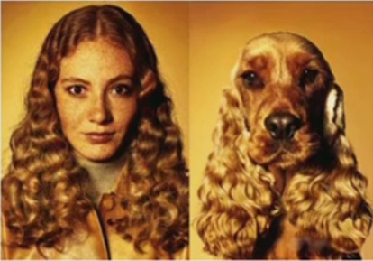
K-means Clustering
Organizing data into clusters provide information about the internal structure of the data
Dimensionality reduction
Data reduction
Similarity is a philosophical question
Use distance to measure the closeness
Euclidean, Manhattan, Hamming distance
Correlation coefficient ( r )
Should follow triangle inequality
Works on minimizing the sum of squared errors (SSE)

Slide 11

Model applications
We will go through all the four models with examples
System requirements
We use Anaconda IDE for Python scripting
Jupyter notebook to code all the algorithms
Use of Spyder is also encouraged
Use packages as NumPy, Matplotlib, Pandas for data preparation
We use Scikit Learn toolbox for all ML techniques

Slide 12
Summary
Practice and get acquainted
Python is handy and easy to implement
More models to come in future classes
More online videos, lectures and other applications
Other frameworks like Azure, TensorFlow and Keras will be helpful in Deep Learning, RL and other advanced algorithms

Slide 13

Q&A
Please fill up the class evaluation for this session
Queries can be posted to sbalan@ncsu.edu

