Slide 1


Stanislav Baláž
March 12, 2026

Slide 2

Outline
Executive Summary
Introduction
Methodology
Results
Conclusions
Appendix
SpaceX-Landing-Prediction-Technical-Enhancements

Slide 3
Executive Summary
Objective: Build a model to predict SpaceX Falcon 9 first-stage landing success to support competitive bidding
Methodologies:
Data was collected from SpaceX API and Wikipedia using Python Requests
Data wrangling, preprocessing and analysis performed with Pandas, SQL, Folium, Plotly Dash and Scikit-Learn => 83 features used to visualize patterns and predict landing success
Results:
Increasing trend in success rate from 2013 to 2020
High success rates uncovered in SSO, VLEO orbits, payload range 3000 – 4000 kg and booster version FT
Logistic Regression outperformed other evaluated models with Accuracy and Generalization Capacity (Train/Test gap)
Final Model Evaluation Metrics
Accuracy 83.3%
Recall 100%
Precision 80%
Specificity 50%
Action
Tune the model to improve prediction of landing failures

Slide 4
Introduction
Background and Context
SpaceX is a private American aerospace company established with a vision of decreasing the costs of space launches
Most of savings is linked to possibility of reusing the first stage, which makes SpaceX highly competitive
Objectives
Predicting whether the first stage will land successfully or not, helps calculate estimated launch costs => competitive offers to potential customers
The objective of this project is to build a prediction model which allows us to answer the key question: Will the first stage land successfully or not?

Slide 5

Section 1

Slide 6
Methodology
Executive Summary
Data collection methodology: data was collected via SpaceX REST API and webscraping Wikipedia List of Falcon 9 and Falcon Heavy launches
Performed data wrangling: collected data was processed using Pandas to retain relevant records, handle missing values, and create labels for machine learning
Performed exploratory data analysis (EDA) using visualization and SQL
Performed interactive visual analytics using Folium and Plotly Dash
Performed predictive analysis using classification models: several classification models were built, tuned and evaluated. The best model has been identified.

Slide 7
Data Collection
Data was collected via two sources:
SpaceX REST API:
Original data source: URL = https://api.spacexdata.com/v4/launches/past
Data Source actually used for consistency reasons: URL = https://cf-courses-data.s3.us.cloud-object-storage.appdomain.cloud/IBM-DS0321EN-SkillsNetwork/datasets/API_call_spacex_api.json
Data was enriched from secondary API endpoints (rockets, launchpads, payloads, and cores), URL = https://api.spacexdata.com/v4/item
Wikipedia List of Falcon 9 and Falcon Heavy launches: URL = https://en.wikipedia.org/w/index.php?title=List_of_Falcon_9_and_Falcon_Heavy_launches&oldid=1027686922
Data retrieved via SpaceX REST API was used for further modelling

Slide 8
Data Collection – SpaceX API
Start
Data retrieval from SpaceX REST API using Python requests library
Data normalization and processing performed via Pandas DataFrames
Specific features extracted and utilized to enrich data using secondary SpaceX API endpoints (via auxiliary functions)
Records up to November 13, 2020 with one core and only related to Falcon 9 were retained
Data wrangling – missing PayloadMass values filled with mean
Data export to CSV file (dataset_part_1.csv)
API Endpoint
GET request
Request Successful
No
Yes
Normalize & Extract Features and Data
DataFrame: data
Enrich Data via Additional API Calls
Extract Falcon 9 Launches
Data Wrangling:
PayloadMass
DataFrame: data_falcon9
Export to CSV
CSV File
End
GitHub Link to API Notebook

Slide 9
Data Collection - Scraping
Start
Data scraped from Wiki page with List of Falcon 9 and Falcon Heavy launches using Python requests and Beautiful Soup libraries
Data extracted from Beautiful Soup object and preprocessed using auxiliary functions => dictionary launch_dict
Data loaded to DataFrame df
Data export to CSV file (spacex_web_scraped.csv)
Wiki Page
Falcon Launches
GET request
Request Successful
No
Yes
Create
Beautiful Soup Object
Extract Relevant Columns
Create Dictionary and Populate Data
Auxiliary
Functions
Dictionary:
launch_dict
Load to DataFrame
DataFrame:
df
Export to CSV
CSV File
GitHub Link to Scraping Notebook
End

Slide 10
Data Wrangling
Missing values for PayloadMass were filled in by mean value (API Notebook)
Class, binary target variable for machine learning was derived from categorical Outcome (Landing Outcome) variable (Data Wrangling Notebook)
Data export to CSV file (dataset_part_2.csv)
Start
DataFrame: data_falcon9
PayloadMass Missing:
Fill with Mean
Create Binary Target Variable:
Class
GitHub Link to API Notebook – see Task 3: Dealing with Missing Values
GitHub Link to Data Wrangling Notebook – see TASK 4: Create a landing outcome label from Outcome column
Export to CSV
CSV File
End

Slide 11
EDA with Data Visualization
EDA visualization contains the following charts:
Categorical scatter plots – utilized to visualize distribution and density of landing successes for multivariate relationships (Flight Number vs Payload Mass/ Launch Site/ Orbit, Payload Mass vs Launch Site/ Orbit)
Bar Chart of Success Rates by Orbit Type – used to identify the highest and lowest performing orbits in terms of landing success rate (along with the number of launches for statistical context)
Line Chart of Success Rate Evolution – visualizing the increasing trend in yearly success rates evolution (along with the number of launches for statistical context)
GitHub Link to EDA Visualization Notebook

Slide 12
EDA with SQL
SQL queries performed using SQL Cell Magic
Data table preparation – SPACEXTABLE created with data from DataFrame df
Launch Sites Summary:
List of analyzed Launch Sites created
Records for sites starting with CCA retrieved to provide brief overview
Customer Analytics – total Payload Mass carried for NASA (CRS) aggregated
GitHub Link to EDA with SQL

Slide 13
EDA with SQL
SQL queries performed using SQL Cell Magic
Booster Version Analytics:
Average Payload Mass carried by F9 v1.1 has been calculated
Overview of boosters carrying 4000 kg to 6000 kg Payload Mass with landing success in drone ship
Summary of boosters carrying maximum Payload Mass for the analyzed period of time
GitHub Link to EDA with SQL

Slide 14
EDA with SQL
SQL queries performed using SQL Cell Magic
Landing Outcome Evaluation:
Date of the first successful landing in ground pad identified
Boosters with failure in drone ship landing in 2015 identified
Aggregation of landing outcomes in the years 2010 to 2017
Mission Outcome Analysis – aggregated successes and failures of the analyzed missions
GitHub Link to EDA with SQL

Slide 15
Build an Interactive Map with Folium
Folium map was used to capture locations of SpaceX Launch Sites
Various map objects were utilized to highlight selected properties:
Circles – identify exact location of each launch site with 1 km radius
Markers – added to the map to visualize:
Names of Launch Sites
Individual launches and their landing outcome (green – success, red – failure)
Distance from the Launch Sites to closest points in their proximities (coastline, city, highway, railway)
Marker Cluster – utilized to simplify the map by dynamically grouping individual launch markers, since many of them share the same coordinates
Lines – utilized as a trace to closest points in the proximities of Launch Sites
GitHub Link to Interactive Map with Folium
Nbviewer Link to Interactive Map with Folium

Slide 16
Build a Dashboard with Plotly Dash
SpaceX Launch Records Dashboard contains:
Dropdown Box – provides option to select All Sites for the overview of all launches or a specific Launch Site for the analysis of a specific site
Range Slider – possibility to select a certain payload range to be analyzed
Pie Chart – visualizes success rates of all sites if All Sites are selected in a dropdown. If a specific site is picked in a dropdown, then success and failures portions of the site is presented
Scatter chart – utilized to analyze correlation between Success, Payload and Booster Version Category. Represent all sites or a specific site, depending on the Dropdown Box selection. Payload range selected in the Range Slider is rendered.
The components and their interactions provides flexible visual analytics on SpaceX Launch Success of selected site / all sites.
Dashboard also presents success of individual launches for a selectable Payload range, all this with indication of the respective Booster Version Category.
GitHub Link to Dashboard with Plotly Dash

Slide 17
Predictive Analysis (Classification)
Feature engineering – performed one-hot encoding of categorical variables (EDA with Data Visualization notebook) prior to predictive analysis
Used libraries: Pandas, NumPy, Matplotlib, Seaborn, Scikit-Learn
Features were loaded to variable X (83 columns), Target to variable Y
Features were standardized using StandardScaler()
Both X and Y were split to training and testing data via train_test_split() with stratification
Classification models using Logistic Regression, Support Vector Machine, Decision Tree, and k-Nearest Neighbors were built, improved, and evaluated
GitHub Link to Predictive Analysis

Slide 18
Predictive Analysis (Classification)
The same process was applied to each of the Classification models
Define Hyperparameter Space – build the parameters grid to be used for hyperparameters tuning (model improvement)
Define the Estimator – build the classification model to be used
Define GridSearchCV object – build the object for hyperparameter tuning with defined Estimator and Hyperparameter Space, using 10-fold cross validation and accuracy as the default classification scoring metric
Fit/Train GridSearchCV – improve the model using train data and find the best combination of hyperparameters
Evaluate the model using test data with .score( ) method and confusion matrix
GitHub Link to Predictive Analysis

Slide 19
Predictive Analysis (Classification)
The approach to identify the best classification performing model
Metric: Accuracy
Visual Analytics: Confusion Matrix
Models were sorted in descending order of their evaluation results (test data)
The highest accuracy of 83.3% was reached by Logistic Regression and Support Vector Machine models
Then the model with smaller gap between test and train accuracy, i.e. indicating better generalization was selected as the best performing model
Logistic Regression
GitHub Link to Predictive Analysis

Slide 20
Predictive Analysis (Classification)
Dataset
Load Target to NumPy Array
NumPy Array:
Y
Test Data:
X_Test, Y_Test
Start
Train/Test Split
Features Preprocessing:
StandardScaler
NumPy Array:
X
Train Data:
X_Train, Y_Train
Selection of Models
Definition of Model/Estimator
Definition of Hyperparameter Space
GridSearchCV Fit
(10-fold)
Tuned Model
(.best_params)
No
Are All Selected Models Evaluated
Final Model Ranking
Train Score
Test Score
Confusion Matrix Heatmap
Model Evaluation (Test Data)
Yes
The Best Model: Logistic Regression
End
GitHub Link to Predictive Analysis

Slide 21
Results
Exploratory data analysis results
Interactive analytics demo in screenshots
Predictive analysis results

Slide 22

Section 2

Slide 23
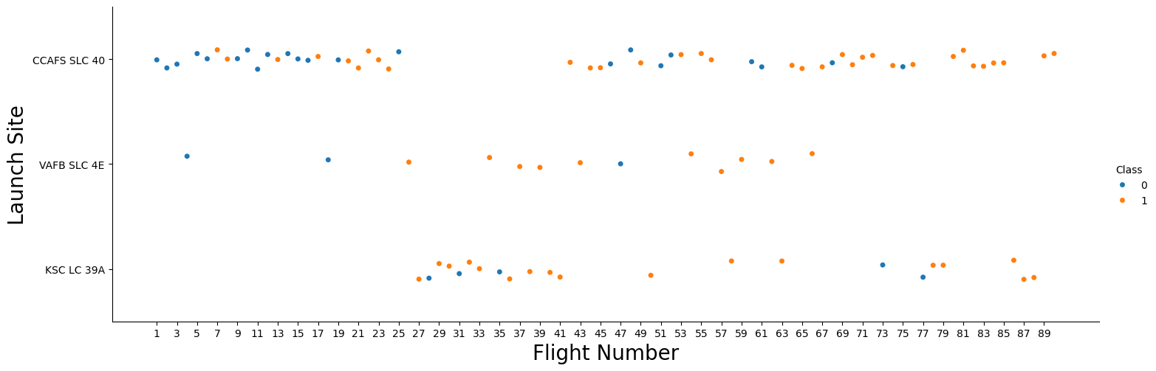
Flight Number vs. Launch Site

Slide 24
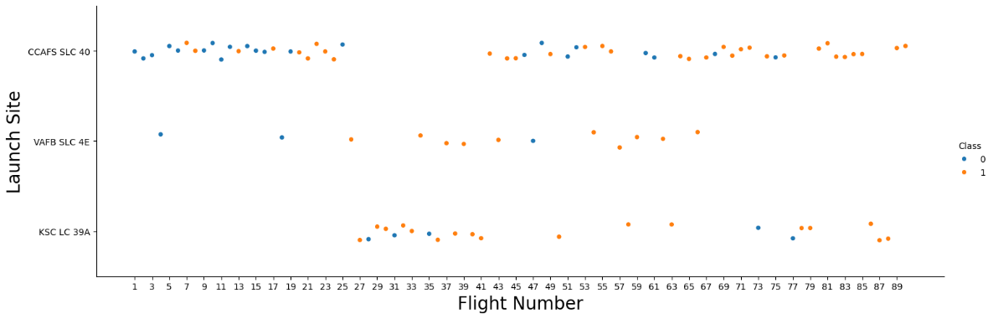
Flight Number vs. Launch Site
First set of flights (25) had a low rate of successful returns of stage 1. Most of them were launched from CCAFS SLC 40.
For later launches (starting from #26), overall portion of successful returns increased.
VAFB SLC 4E has the highest rate of successful returns in later flights
CCAFS SLC 40 and KSLC 39A shows similar successful returns ratio in later flights
CCAFS SLC 40 successful returns ratio improved during the last 20 flights

Slide 25
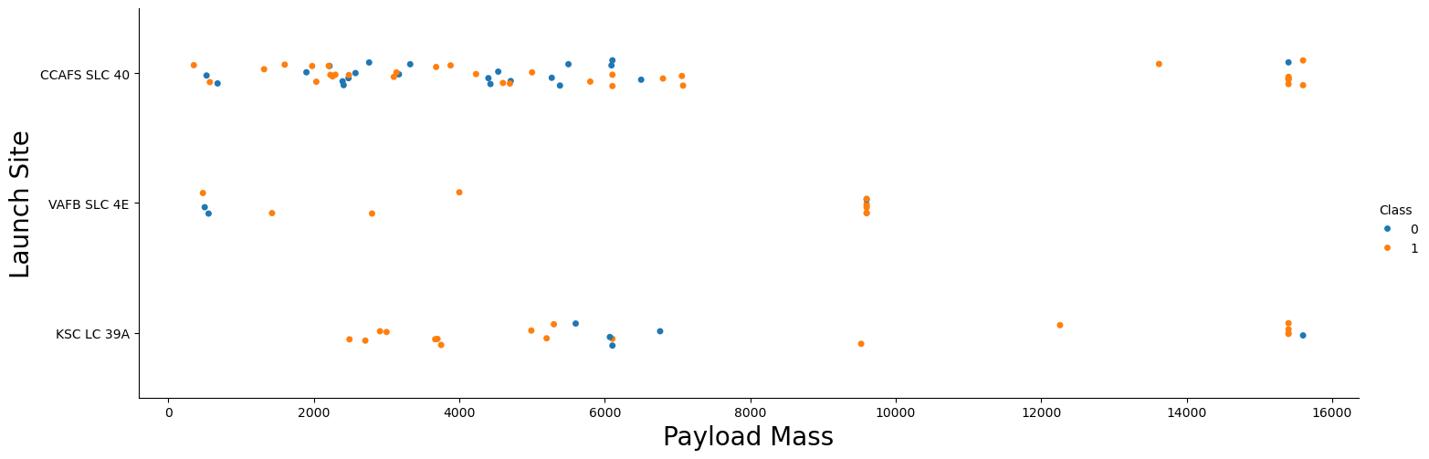
Payload vs. Launch Site

Slide 26
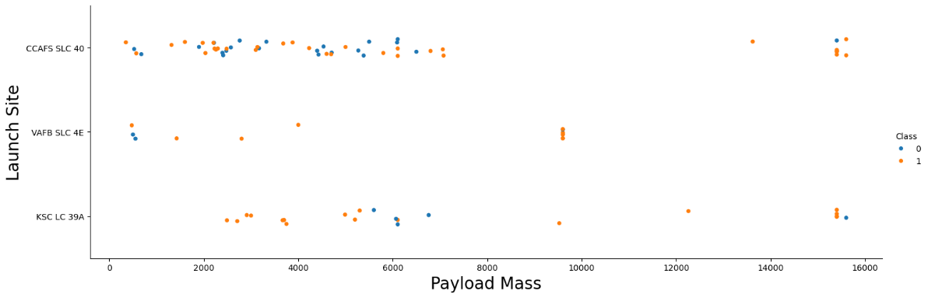
Payload vs. Launch Site
VAFB SLC 4E – maximum launched payload mass 10000 kg
Almost all Payloads 10000 kg (+/-10%) are launched from VAFB SLC 4E

Slide 27
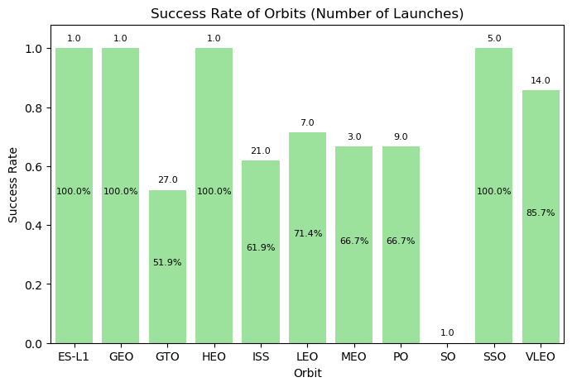
Success Rate vs. Orbit Type

Slide 28
Success Rate vs. Orbit Type
SSO orbit success rate = 100%, with 5 launches
VLEO shows good rate of 86% for 14 launches
Orbits ES-L1, GEO, HEO – 100% success rate. Only one launch is available for each => low statistical significance

Slide 29
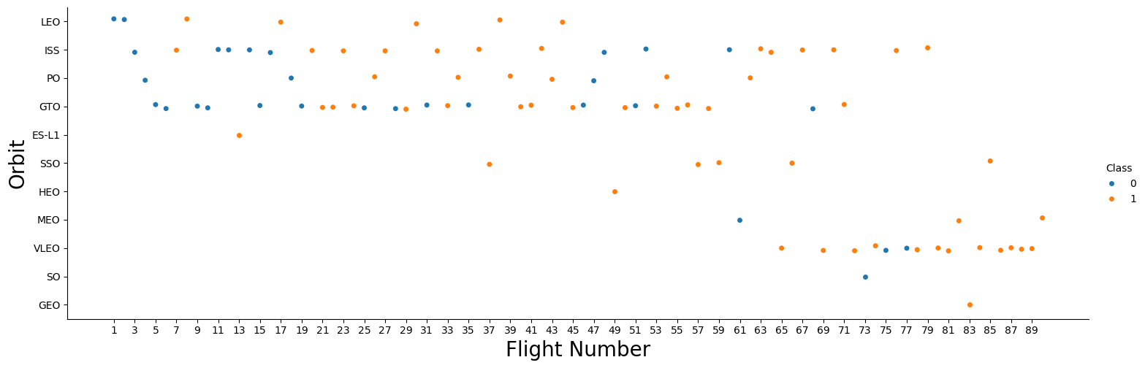
Flight Number vs. Orbit Type

Slide 30
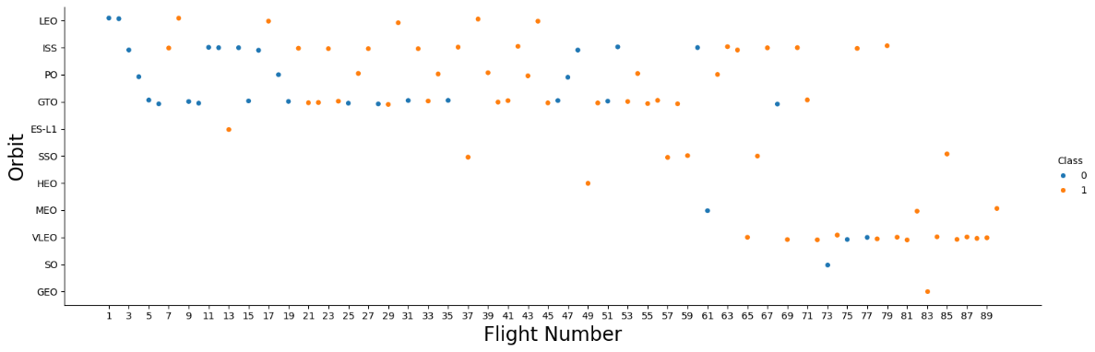
Payload vs. Orbit Type
LEO – success seems to be related to the number of flights
GTO – there appears to be no relationship between flight number and success
VLEO – high success rate, the first launch was #65 (June 2019) – start of Starlink era

Slide 31
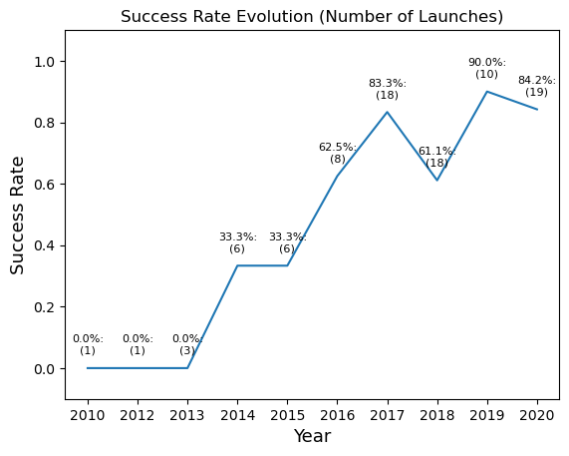
Launch Success Yearly Trend

Slide 32
Launch Success Yearly Trend
Success rate upward trend in the analyzed period since 2013 to 2020 with local dips
Local dips in 2018 and 2020

Slide 33
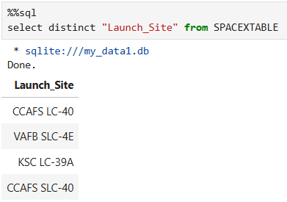
All Launch Site Names
A SELECT statement with DISTINCT clause was utilized to eliminate duplicities from the result
There are four Launch Sites in the analyzed data

Slide 34
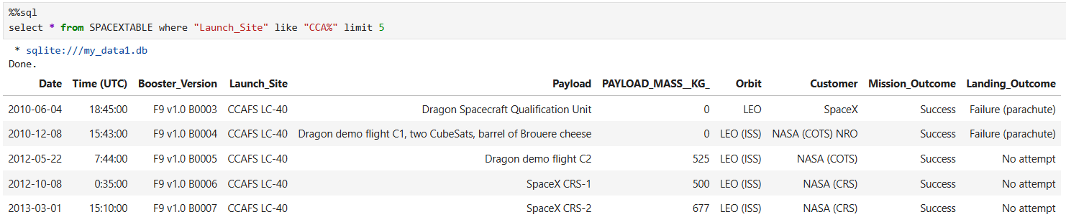
Launch Site Names Begin with 'CCA'
A SELECT statement with WHERE clause containing operator LIKE and using the pattern with wild character % was utilized to pull records with Launch_Site starting with “CCA”. Keyword LIMIT with literal 5 was utilized to restrict number of returned records to 5
The result shows exactly 5 records, all beginning with “CCA”

Slide 35
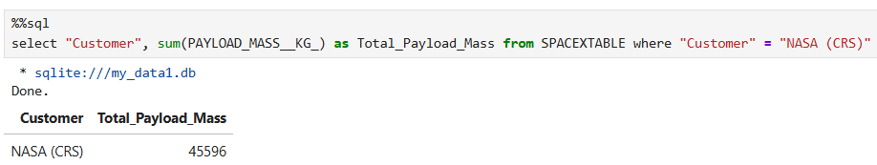
Total Payload Mass
A SELECT statement with SUM function and WHERE clause was utilized to pull records with Customer “NASA (CRS)” and summarize the Payload Mass.
The result shows that a cumulative Payload Mass of 45596 kg was carried for NASA (CRS)

Slide 36
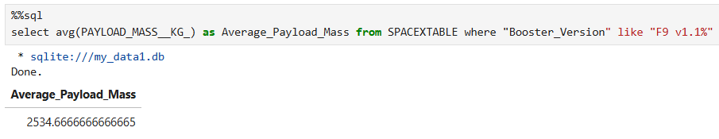
Average Payload Mass by F9 v1.1
A SELECT statement with AVG function and WHERE clause containing operator LIKE and using the pattern with wild character % was utilized to pull records with Booster_Version starting with “F9 v1.1”.
The result shows that an average Payload Mass carried by the Booster_Version F9 v1.1 amounted to 2535 kg

Slide 37
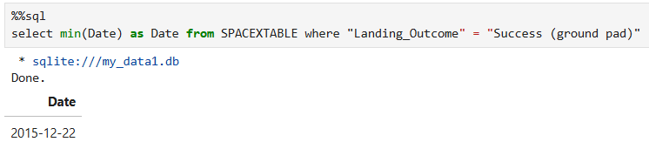
First Successful Ground Landing Date
A SELECT statement, with MIN function and WHERE clause was utilized to identify the date of the first successful ground landing
Using ISO 8601 date format allowed for direct application of the MIN function
The first successful ground landing was performed on December 22, 2015

Slide 38
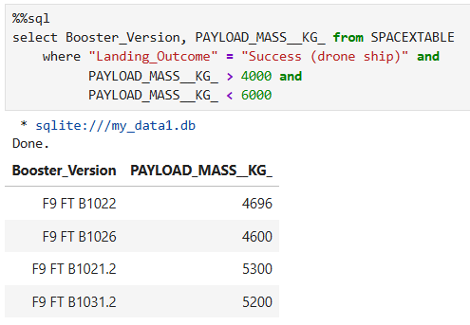
Successful Drone Ship Landing with Payload between 4000 and 6000
A SELECT statement with WHERE clause using operators AND was utilized to identify successful drone ship landings with Payloads between 4000 kg and 6000 kg
Four boosters were identified as meeting the specified criteria

Slide 39
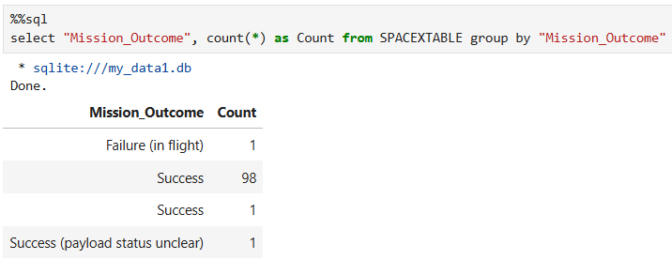
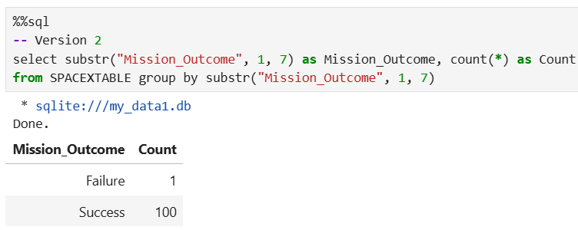
Total Number of Successful and Failure Mission Outcomes
Version 1
Two versions of a query were designed. Version 2 is considered the final version.
A SELECT statement using SUBSTR and COUNT functions with GROUP BY clause was utilized to aggregate successes and failures in Mission Outcome
One failure and one hundred success were identified in the analyzed records
Version 2

Slide 40
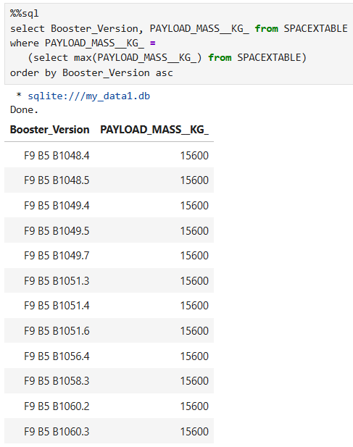
Boosters Carried Maximum Payload
A SELECT statement with WHERE clause using subquery with MAX function, and with ORDER BY clause was utilized to identify the Booster Versions which carried the maximum Payload Mass
Maximum Payload Mass of 15600 kg was carried by twelve Booster Versions
The result was sorted by Booster Version in ascending order

Slide 41
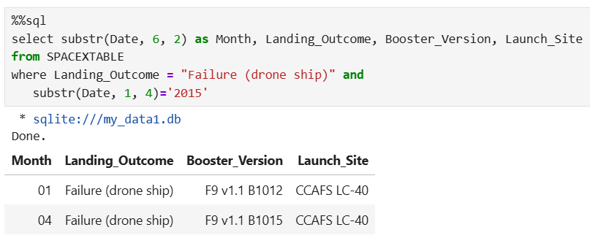
2015 Launch Records
A SELECT statement with SUBSTR functions and WHERE clause was utilized to identify records with failure Landing Outcome in drone ships in 2015
Two records have been selected as failure drone ship landings in 2015

Slide 42
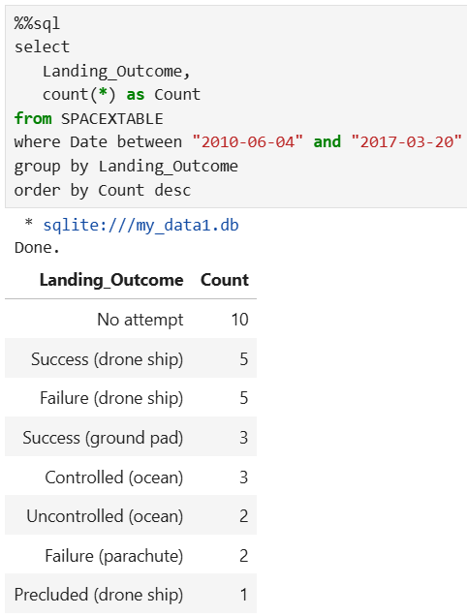
Rank Landing Outcomes Between 2010-06-04 and 2017-03-20
A SELECT statement with COUNT function, WHERE clause using BETWEEN…AND operator, GROUP BY and ORDER BY clauses was utilized to identify records between June 4, 2010 and March 20, 2017 and show aggregated Landing Outcomes
Landing Outcome categories were sorted by their respective counts in descending order

Slide 43

Section 3

Slide 44
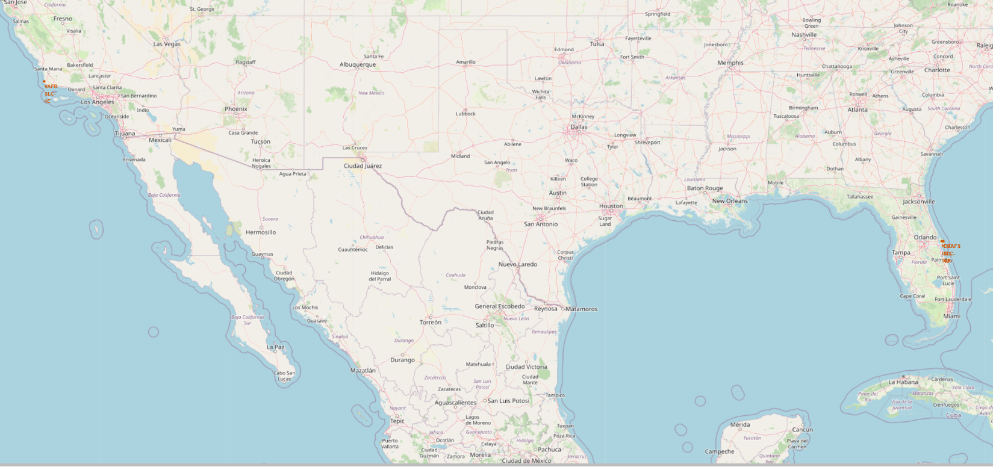

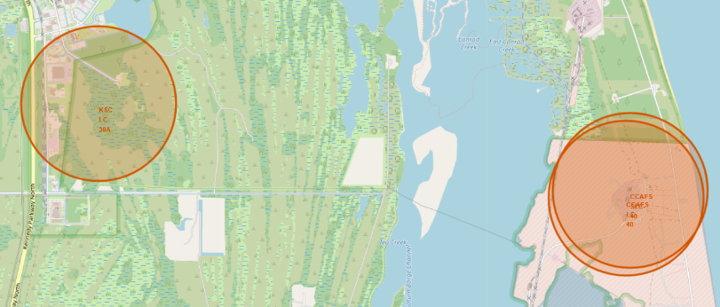
Launch Sites Locations

Slide 45
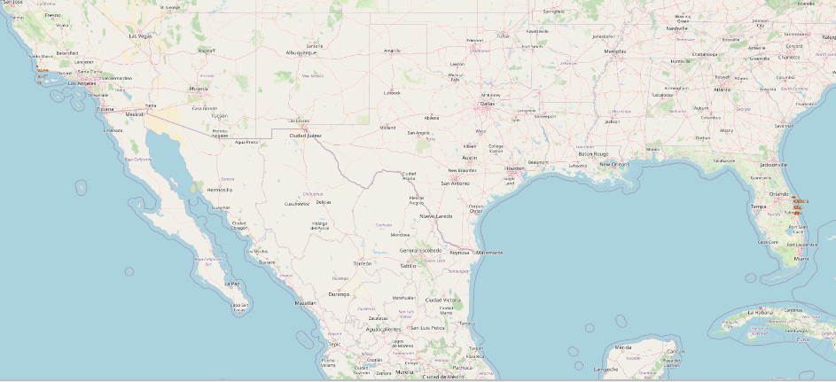
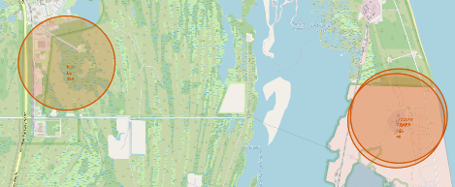
Launch Sites Locations
Launch Sites are highlighted with:
Red Circles (1km radius) with pop-up (site name)
Red Markers with the site names
Launch Sites are located close to the shore for safety reasons (rockets are launched towards the ocean to avoid inhabited areas)
CCAFS LC-40 and CCAFS SLC-40 refer to the same Launch Site
Most Launch sites (2/3) are located on the east coast to benefit the Eastward Boost (Earth’s rotation)
VAFB launch site is located on the west coast since it launches South to Polar Orbits

Slide 46
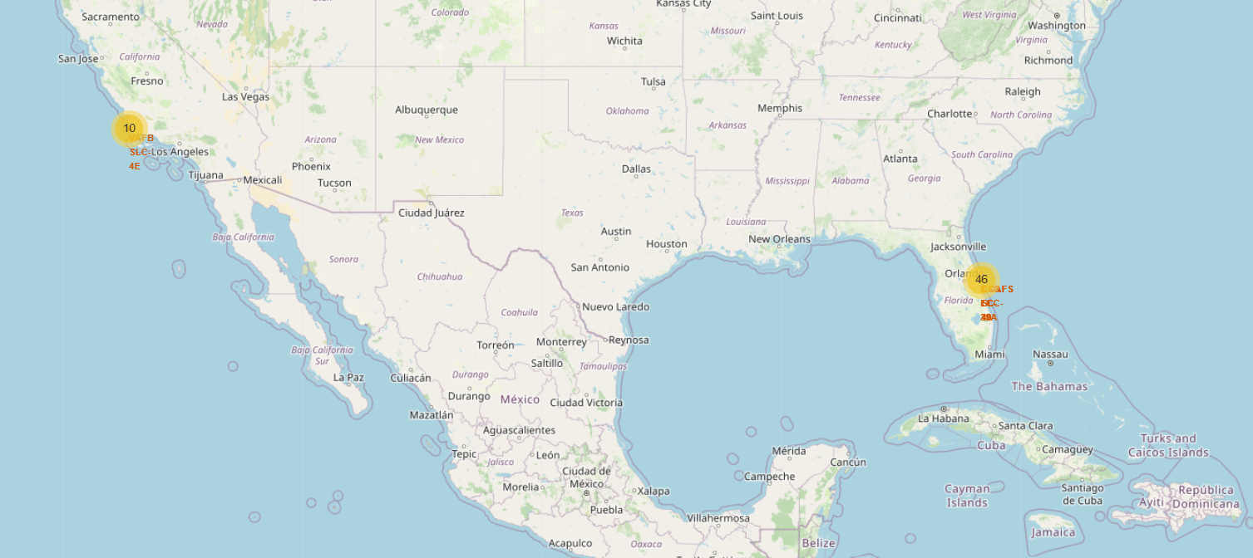
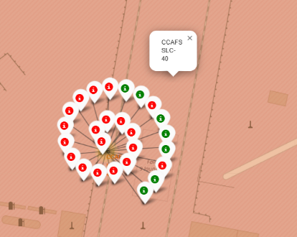
Launch Outcomes Success / Failure

Slide 47
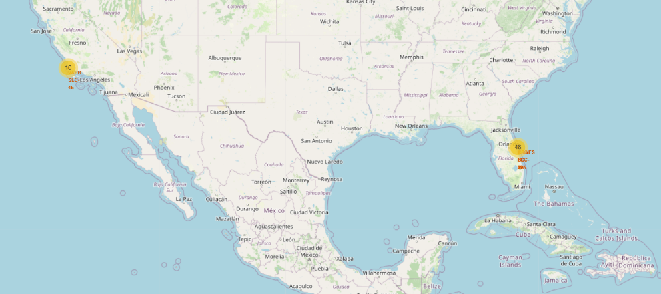
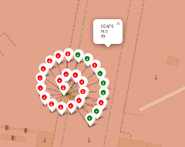
Launch Outcomes Success / Failure
For each launch, a marker was created (green – success, red - failure)
Many markers share the same location. To improve visibility, markers have been added/grouped to dynamic MarkerCluster object
Most launches are performed from the Launch Sites on the east coast
The most frequented launch site is CCAFS SLC-40 with 26 lunches and the lowest success ratio of landing success

Slide 48
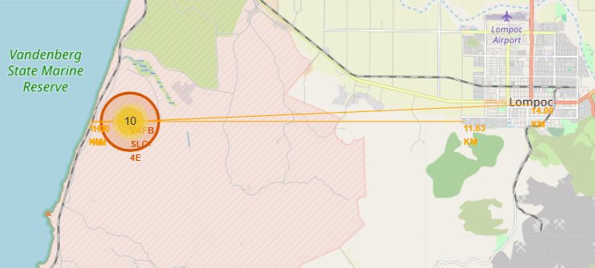
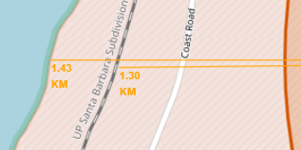
VAFB SLC-4E Launch Site Proximities

Slide 49
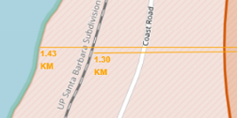
VAFB SLC-4E Launch Site Proximities
For each Launch Site, markers with distance to its proximities (city, railway, highway) were created
Lines (PolyLine) objects were drawn to highlight distances from a Launch Site to its proximities
Launch sites are located:
Close to coast, so that rockets can be launched to the area above the ocean (safety)
Close to the railway and/or highway, due to transport reasons
Farther from cities (safety, elimination of discomfort due to noise and vibrations)

Slide 50

Section 4

Slide 51
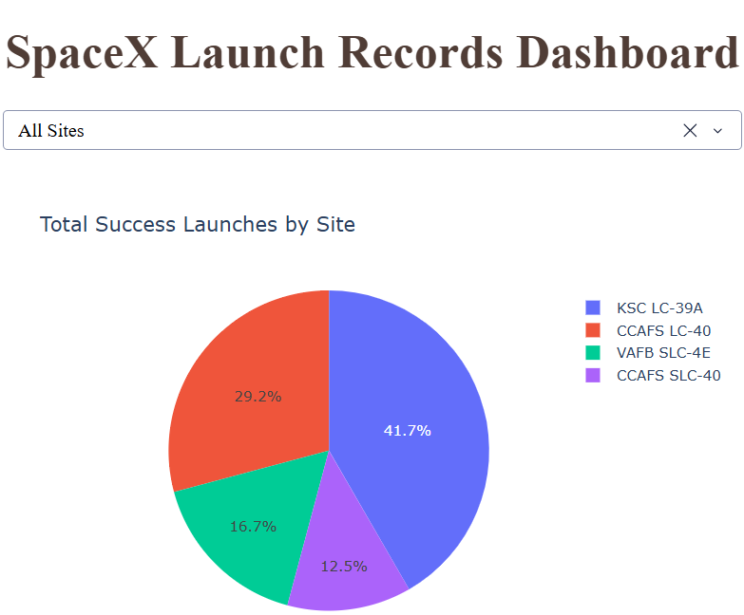
Total Success Launches by Site
Application contains a Dropdown box for Launch Site selection
If All Sites are selected, then the pie chart (via Plotly Express) shows a summary of successful launches for all sites
Out of the four launch sites, KSC LC-39A itself performed 41.7% of all successful launches
The least portion of 12.5% was performed by CCAFS SLC-40

Slide 52
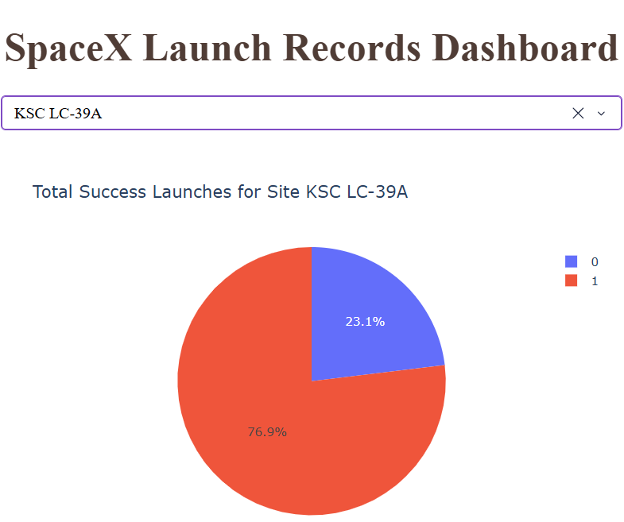
Site with The Highest Launch Success Ratio
KSC LC-39A
Application contains a Dropdown box for Launch Site selected and a Pie Chart linked to the selection
If an individual site is selected, then the Pie Chart (via Plotly Express) shows portions of success and failures for the launch site
KSC LC-39A is the site with the highest launch success ratio of 76.9%
As shown on the prior slide, this site has also the highest share of all successful launches

Slide 53
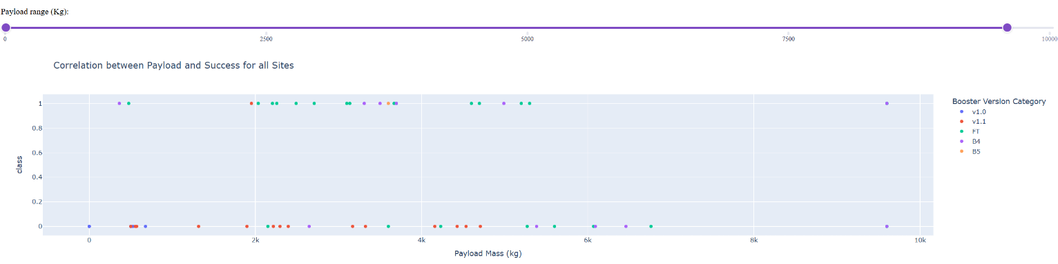
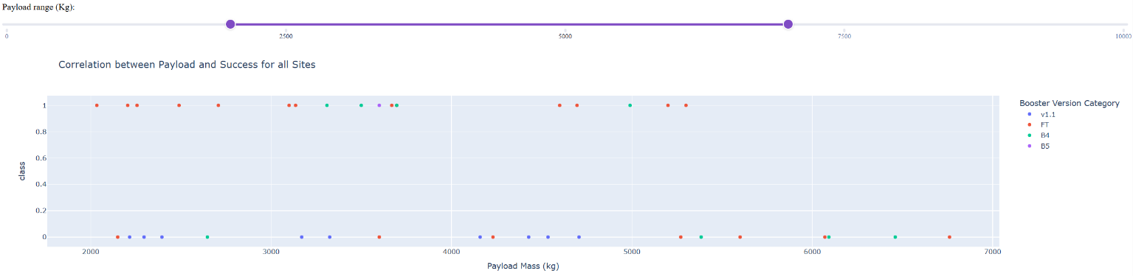
Payload vs. Launch Outcome vs. Booster Version

Slide 54

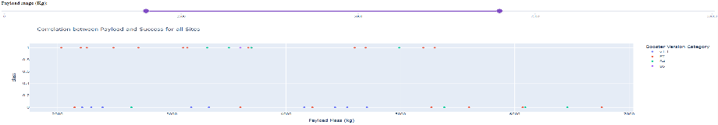
Payload vs. Launch Outcome vs. Booster Version
Application contains a RangeSlider which allows us to select a Payload range to be analyzed, and a Scatter Plot linked to the selected Payload range
The scatter plot shows individual launches for selected Payload range, split to success and failure, with color indicating a booster version
Payload range 3000 – 4000 kg shows the highest launch success rate
The lowest launch success rate is observed in payload range 6000 – 7000 kg
FT Booster Version shows the highest launch success rate

Slide 55

Section 5

Slide 56
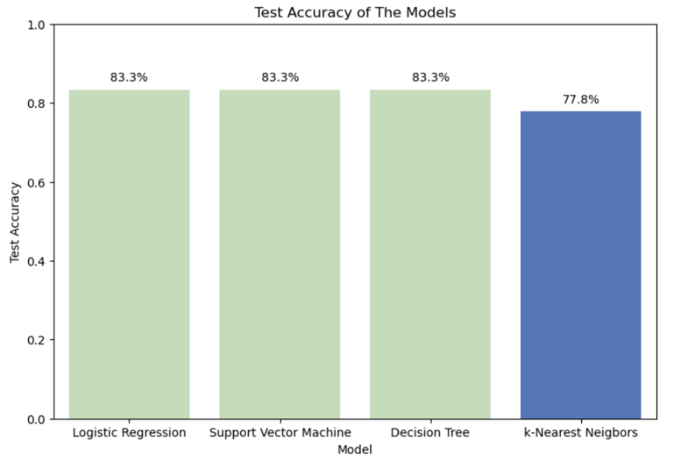
Classification Accuracy
Results: Logistic Regression, Support Vector Machine, Decision Tree models achieved the highest Test Accuracy score of 83.3%
Secondary criterion: Generalization Capacity was used to identify the best performing model
Generalization Capacity indicates the model captures underlying pattern in training data rather then noise (model is less prone to overfitting)

Slide 57
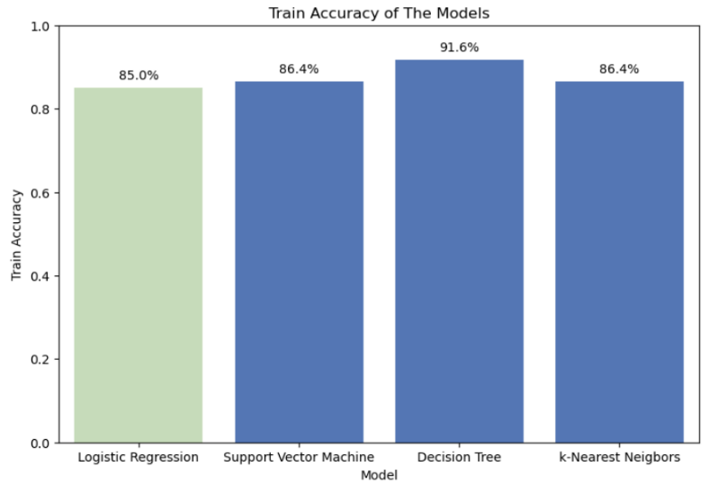
Classification Accuracy
Conclusion: Logistic Regression model is selected as the best model since it has the smallest delta between testing and training accuracy
The smallest gap indicates the best Generalization Capacity, i.e. model is less prone to overfitting
The best parameters: 'C': 0.1, 'penalty': 'l2', 'solver': 'lbfgs'

Slide 58
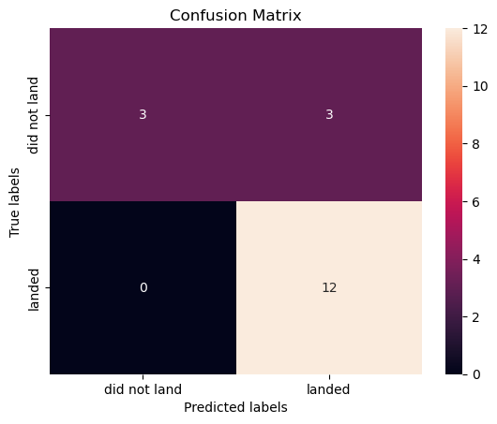
Confusion Matrix
Confusion matrix of the Logistic Regression model exhibits:
Impressive Recall of 100% (12 True Positives, and 0 False Negatives)
Accuracy 83.3% (15 predictions from 18 are correct)
Precision of 80% (12 True Positives, 15 Predicted Positives)
Specificity (1-FPR) of 50% is a key model limitation (3 False Positives and 3 True Negatives)

Slide 59
Conclusions
Launch Sites Locations (*)
Mainly on the east coast (2/3) – Eastward Boost
Farther from cities and close to the coast, railway and highway
General
Increasing trend in success rate from 2013 to 2020. Low success rate for the first 25 launches mainly performed at CCAFS SLC-40
Increasing portion of heavy payloads (+10000 kg), except for VAFB SLC-4E
Orbits
SSO, VLEO – orbits with the highest success rate (> 85%), having at least 5 launches
VLEO – started from flight 65 – Starlink era. Heavy payloads +15000 kg.
Payloads
The highest success rate payload range is 3000 – 4000 kg
The lowest success rate payload range is 6000 – 7000 kg
Boosters
FT Booster Version shows the highest launch success rate
* (CCAFS LC-40 and CCAFS SLC-40 refer to the same Launch Site)

Slide 60
Conclusions
Logistic Regression was identified as the best performing classification model (Accuracy, Generalization Capacity) to answer the question “Will stage one land successfully?”
Solid results achieved for accuracy (83.3%), recall (100%), and precision (80%)
Specificity of 50% – model is too optimistic in predicting success. Significant tendency to false positives is the main area for improvement.
Action – balance the model by improving Specificity – increase Decision Threshold to tune the model

Slide 61
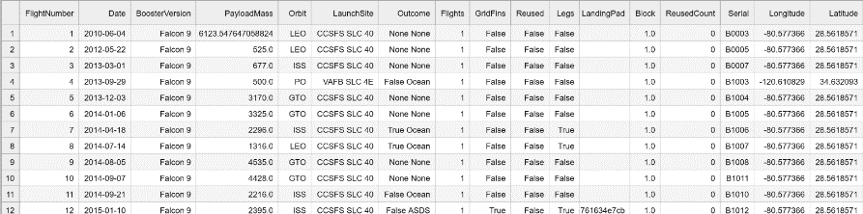
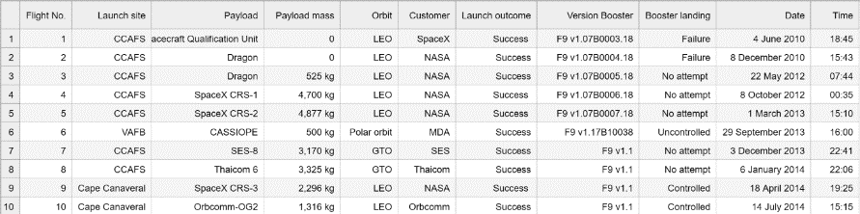
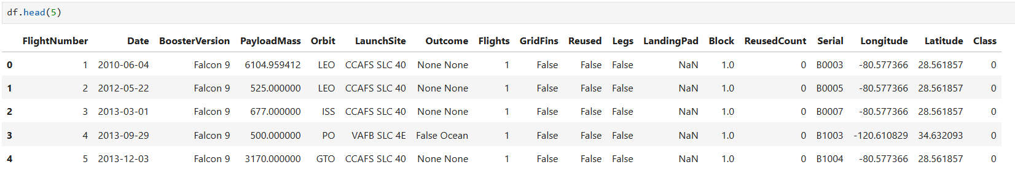
Appendix A – Data Collection and Wrangling
Collection SpaceX API
static_json_url='https://cf-courses-data.s3.us.cloud-object-storage.appdomain.cloud/IBM-DS0321EN-SkillsNetwork/datasets/API_call_spacex_api.json’
response = requests.get(static_json_url)
data = pd.json_normalize(response.json())
data_falcon9.to_csv('dataset_part_1.csv', index=False)
Collection Wikipedia
session.get("https://en.wikipedia.org/", headers=headers)response = session.get(static_url, headers=headers)response.status_code
html = response.text
soup = BeautifulSoup(html, "html.parser")
df.to_csv('spacex_web_scraped.csv', index=False)
Wrangling
PayLoadMass_mean = data_falcon9['PayloadMass'].mean()
data_falcon9['PayloadMass'] = data_falcon9['PayloadMass'].fillna(PayLoadMass_mean)
bad_outcomes=set(landing_outcomes.keys()[[1,3,5,6,7]])
landing_class = [int(Out not in bad_outcomes) for Out in df['Outcome’]]

Slide 62

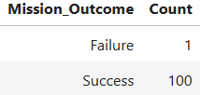
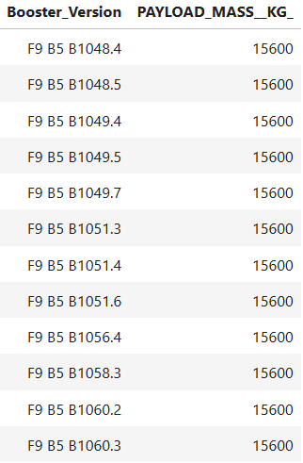
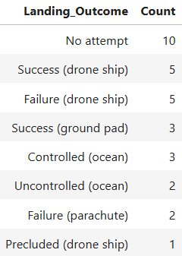
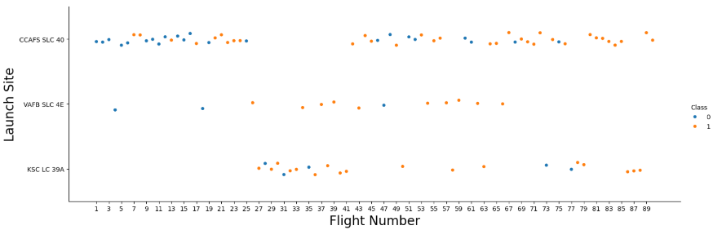
Appendix B – EDA SQL & Visualization
SQL
%sql create table SPACEXTABLE as select * from SPACEXTBL where Date is not null
select avg(PAYLOAD_MASS__KG_) as Average_Payload_Mass from SPACEXTABLE where "Booster_Version" like "F9 v1.1%“
select substr("Mission_Outcome", 1, 7) as Mission_Outcome, count(*) as Count from SPACEXTABLE group by substr("Mission_Outcome", 1, 7)
select Booster_Version, PAYLOAD_MASS__KG_ from SPACEXTABLE where PAYLOAD_MASS__KG_ = (select max(PAYLOAD_MASS__KG_) from SPACEXTABLE) order by Booster_Version asc
select Landing_Outcome, count(*) as Count from SPACEXTABLE where Date between "2010-06-04" and "2017-03-20"group by Landing_Outcome order by Count desc
Visualization
Flight Number and Launch Site
sns.catplot(y="LaunchSite", x="FlightNumber", hue="Class", data=df, aspect=3)
plt.xlabel("Flight Number",fontsize=20)
plt.ylabel("Launch Site",fontsize=20
plt.xticks(ticks=range(1, 91, 2))
plt.show()

Slide 63
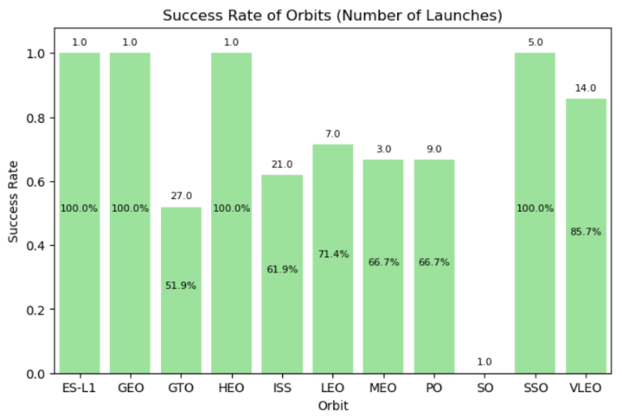
Appendix B – EDA SQL & Visualization
Visualization
Orbits Success Rate
orbit_success = df.groupby('Orbit')['Class'].agg(['mean', 'count’])
orbit_success.columns=['Success_Rate', 'Count’]
plt.figure(figsize=(8, 5))
ax = sns.barplot(x='Orbit’, y='Success_Rate', data=orbit_success, color='lightgreen’)
for i, row in orbit_success.iterrows():
ax.text(i, row['Success_Rate'] + 0.02, str(row['Count']), ha='center', va='bottom’,
fontsize=8)
if row['Success_Rate’]:
ax.text(i, row['Success_Rate'] * 0.5, f"{row['Success_Rate']:.1%}", ha='center’,
va='bottom’, fontsize=8)
plt.ylim(0, 1.08)
plt.xlabel('Orbit’)
plt.ylabel('Success Rate’)
plt.title('Success Rate of Orbits (Number of Launches)’)
plt.show()

Slide 64
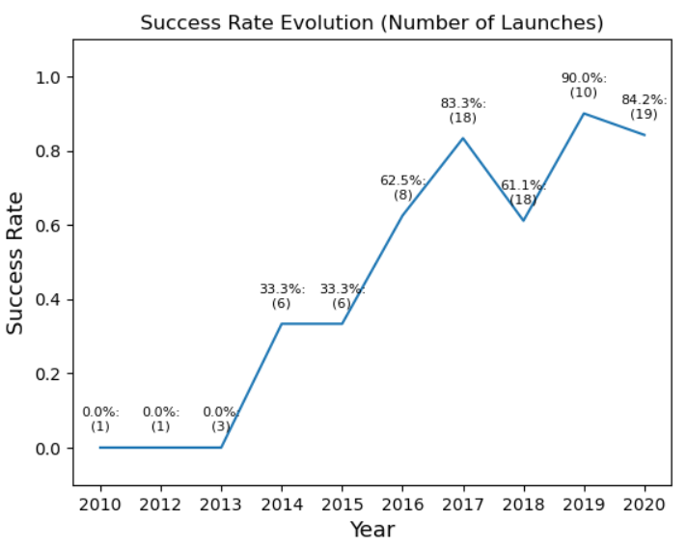
Appendix B – EDA SQL & Visualization
Visualization
Success Rate Evolution
year_success = df.groupby('Year')['Class'].agg(['mean', 'count’])
year_success.columns=['Success_Rate', 'Count’]
year_success.reset_index(inplace=True)
ax = sns.lineplot(x='Year', y='Success_Rate', data=year_success)
for i, row in year_success.iterrows(): ax.text(row['Year'], row['Success_Rate'] + 0.04,
f"{row['Success_Rate']:.1%}:\n({str(row['Count'])})",
ha='center', va='bottom', fontsize=8)
plt.ylim(-0.1, 1.1)
plt.xlabel("Year", fontsize=13)
plt.ylabel("Success Rate", fontsize=13)
plt.title("Success Rate Evolution (Number of Launches)")
plt.show()

Slide 65
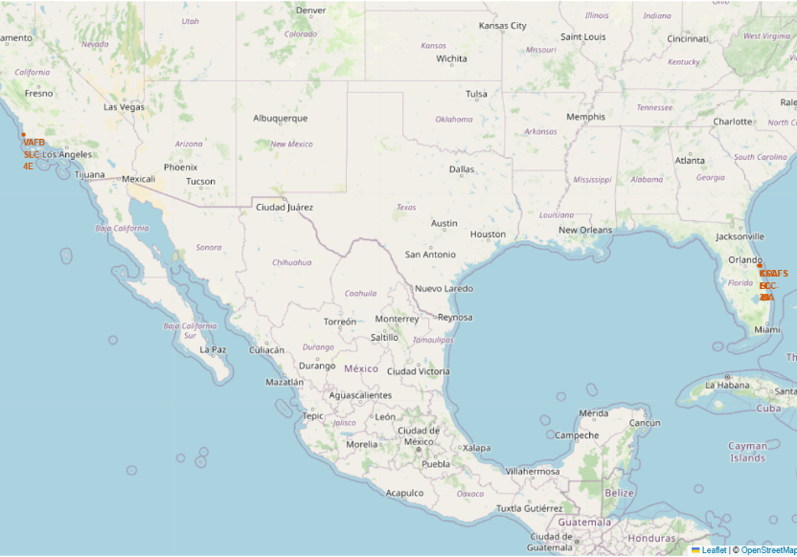
Appendix C – Interactive Visual Analytics
Folium – Geospatial Interactive Analytics
site_map = folium.Map(location=nasa_coordinate, zoom_start=5)
for i, site in launch_sites_df.iterrows():
site_name = site['Launch_Site’]
site_coordinate = [site['Lat'], site['Long’]]
circle_site = folium.Circle(site_coordinate, radius=1000,
color='#d35400', fill=True).add_child(folium.Popup(site_name))
marker_site = folium.map.Marker(site_coordinate,
icon=DivIcon(icon_size=(20,20), icon_anchor=(0,-3),
html='<div style="font-size: 12; color:#d35400;"><b>%s</b></div>’ %
site_name,
),
)
site_map.add_child(circle_site)
site_map.add_child(marker_site)site_map

Slide 66
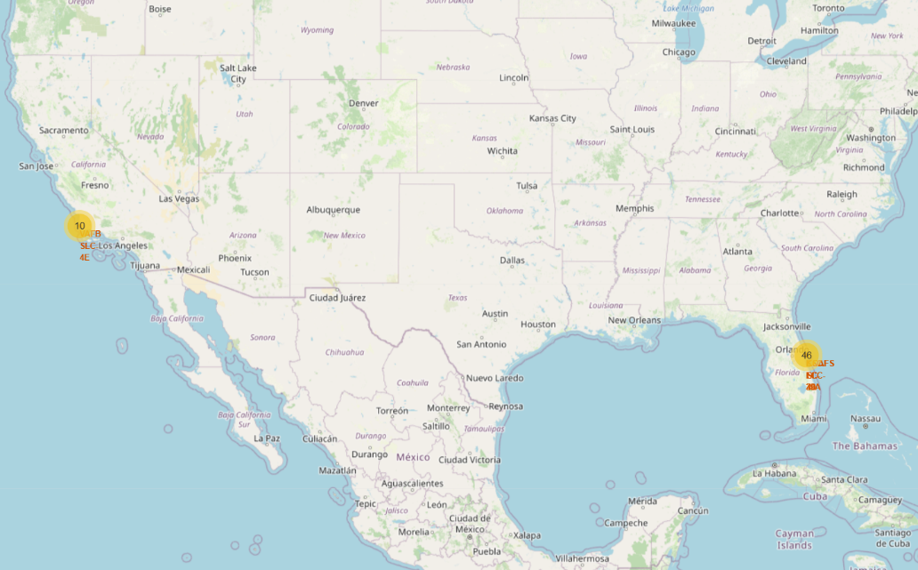
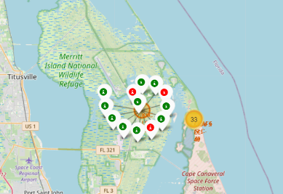
Appendix C – Interactive Visual Analytics
Folium – Geospatial Interactive Analytics
marker_cluster = MarkerCluster()
for index, row in spacex_df.iterrows():
marker = folium.Marker(
location=[row['Lat'], row['Long’]],
icon=folium.Icon(
color='white’,
icon_color=row['marker_color’]
)
)
marker_cluster.add_child(marker)
site_map

Slide 67


Appendix C – Interactive Visual Analytics
Plotly Dash – Interactive Launch Performance Dashboard
@app.callback(
Output(component_id='success-payload-scatter-chart', component_property='figure'),
[
Input(component_id='site-dropdown', component_property='value'),
Input(component_id="payload-slider", component_property="value")
]
)
def get_scatter_chart(entered_site, payload_range):
filtered_df = spacex_df[spacex_df['Payload Mass (kg)'].between(*payload_range,
inclusive='both')]
# All Launch Sites
if entered_site == 'ALL':
fig = px.scatter(
filtered_df,
x='Payload Mass (kg)',
y='class',
color='Booster Version Category',
title='Correlation between Payload and Success for all Sites'
)
return fig
# Selected Launch Site
else:
filtered_df=filtered_df[filtered_df['Launch Site']==entered_site]
fig = px.scatter(
filtered_df,
x='Payload Mass (kg)',
y='class',
color='Booster Version Category',
title='Correlation between Payload and Success for Site ' + entered_site
)
return fig

Slide 68

Appendix D – Machine Learning Details
Features Engineering – One-Hot Encoding
features = df[['FlightNumber', 'PayloadMass', 'Orbit', 'LaunchSite', 'Flights', 'GridFins', 'Reused', 'Legs', 'LandingPad', 'Block', 'ReusedCount', 'Serial']]
features_one_hot = pd.get_dummies(features, columns=['Orbit', 'LaunchSite', 'LandingPad', 'Serial’], drop_first=False)
features_one_hot = features_one_hot.astype('float64')

Slide 69


Appendix D – Machine Learning Details
fig, (ax1, ax2) = plt.subplots(1, 2, figsize=(20, 6))
green = '#C5E0B4’
blue = '#4472C4’
padding = 5
colors_test = [green if x==max_Test_Accuracy else blue for x in results['Test_Accuracy’]]
sns.barplot(x='Model', y='Test_Accuracy', data=results, hue='Model', palette=colors_test, ax=ax1)
ax1.set_ylim(0,1)
ax1.set_ylabel('Test Accuracy’)
ax1.set_title('Test Accuracy of The Models’)
for container in ax1.containers:
labels=[f'{value:.1%}' for value in container.datavalues]
ax1.bar_label(container, labels=labels, padding=padding)
colors_train = [green, blue, blue, blue]
sns.barplot(x='Model', y='Train_Accuracy', data=results, hue='Model’, palette=colors_train, ax=ax2)
ax2.set_ylim(0,1)
ax2.set_ylabel('Train Accuracy’)
ax2.set_title('Train Accuracy of The Models’)
for container in ax2.containers:
labels=[f'{value:.1%}' for value in container.datavalues]
ax2.bar_label(container, labels=labels, padding=padding)
plt.show()

Slide 70


Appendix D – Machine Learning Details
Logistic Regression – The Best Model
parameters = {"C":[0.01, 0.1, 1],'penalty':['l2'], 'solver':['lbfgs’]}
lr = LogisticRegression()
logreg_cv = GridSearchCV(estimator=lr, param_grid=parameters, cv=10, verbose=1)
logreg_cv.fit(X_train, Y_train)
logreg_cv.score(X_test, Y_test)
yhat=logreg_cv.predict(X_test)
plot_confusion_matrix(Y_test, yhat)

Slide 71


